Slide 1


CIP-API SIT Environment and API Test Workshop
04/06/2020

Slide 2
This meeting is being recorded for those that cannot attend.

Slide 3
Agenda
Background to CIP-API
SIT (BETA) environment
API testing
Postman
Demo
Feedback

Slide 4
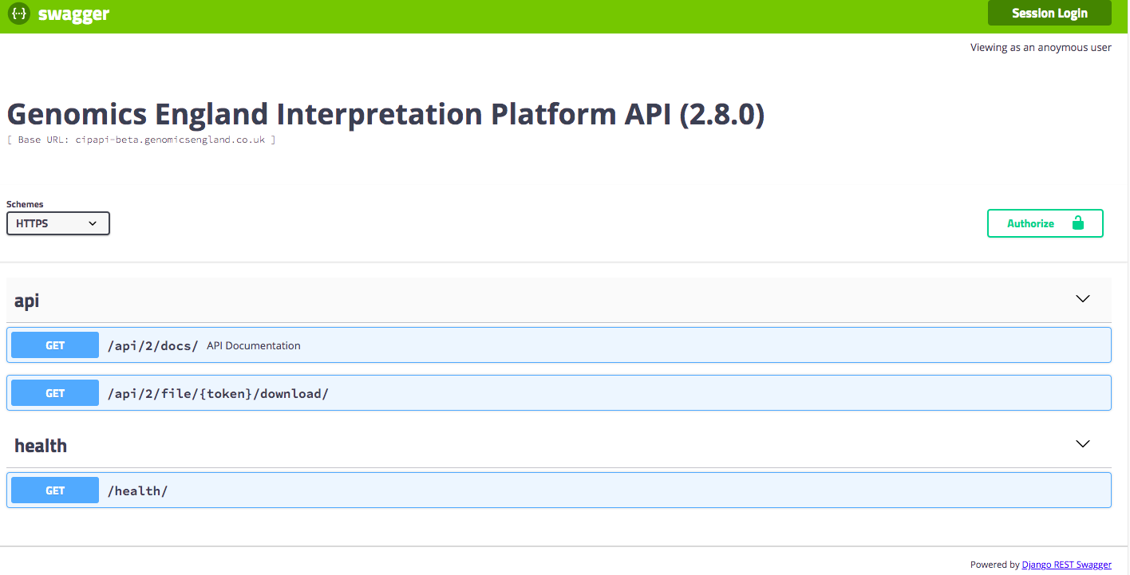
Interpretation-API (CIP-API)
The case manager for the Interpretation Platform; it handles different cases in the platform, the interpretation services applied to them, the status of their interpretation, the reporting and the final outcomes. Can be accessed programmatically through a REST API

Slide 5
SIT Environment

Slide 6
SIT Environment
SIT = System Integration Testing
Instance of CIP API on public internet containing dummy data pulled from 1000G
Beta – features will be deployed here before being rolled out to production
API:
https://cipapi-beta.genomicsengland.co.uk/api/2/docs/
Interpretation Portal:
https://cipapi-beta.genomicsengland.co.uk/interpretationportal/

Slide 7
SIT Environment
Available for GLHs to use for testing local systems that integrate with CIP-API
Test new features of tools that integrate with CIP-API
Test compatibility with new CIP-API features before release
Can test features that modify data (e.g. submitting exit questionnaires) without affecting live cases.
Requires separate client credentials – if you don’t have these ask service desk
Warning – data in CIP-API SIT shouldn’t be considered stable

Slide 8
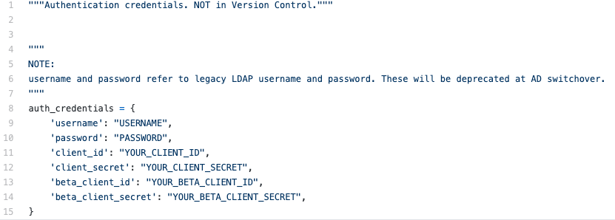
SIT Environment
If you use JellyPy, this already has support for CIP-API SIT

Slide 9
SIT Environment
If you use JellyPy, this already has support for CIP-API SIT

Slide 10
SIT Environment
If you use JellyPy, this already has support for CIP-API SIT

Slide 11
API Testing

Slide 12
API Tests
Automated tests to check API endpoints working as expected
Can be integrated into CI/CD workflows
Can monitor performance, trigger alerts etc.
Contract testing (PACT)
Contract between “consumer” (i.e. clients) and “provider” (i.e. API)
Ensures APIs and clients will work together

Slide 13
Postman
Postman is a platform for building, testing and monitoring APIs
API to allow integration with CI/CD pipelines
We used this to write quick set of tests to check all CIPAPI-SIT endpoints - used during recent migration to AWS

Slide 14
Demo

Slide 15
Demo
The Postman collection used in the demo is available to download at: https://github.com/genomicsengland/ACGS_GeL_API_workshop/blob/master/postman_workshop/CIPAPI%20SIT.postman_collection.json
To use it, you will need to:
Import the JSON file into Postman
Configure the collection variables (as described here https://learning.postman.com/docs/postman/variables-and-environments/variables/#defining-collection-variables)

Slide 16
Feedback

