Slide 1
Monitor Patient Enrollment with flexdashboard and shinydashboard Packages
Yujie Cui, MS
Data Analyst,
Terasaki Research Institute (TRI),
Los Angeles, CA
ycui@terasaki.org

Slide 2
Introduction
Based in Westwood.
We aim to solve the major problems limiting the access and success of kidney transplantation.
We use randomized controlled trials (RCT) to test the effectiveness of new educational programs in improving patient’s knowledge, readiness and attitude in pursuit of kidney transplant.
We need to enroll patients with chronic kidney disease (CKD).

Slide 3
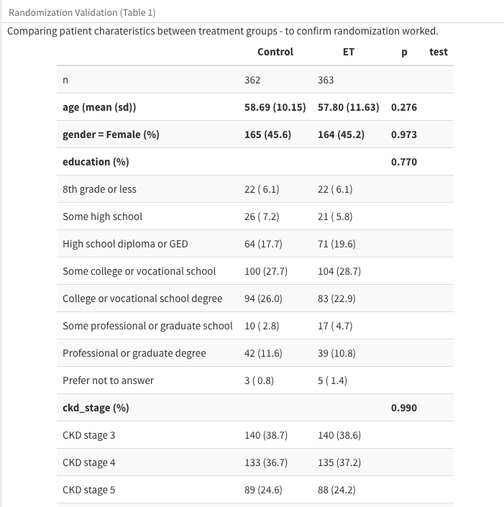
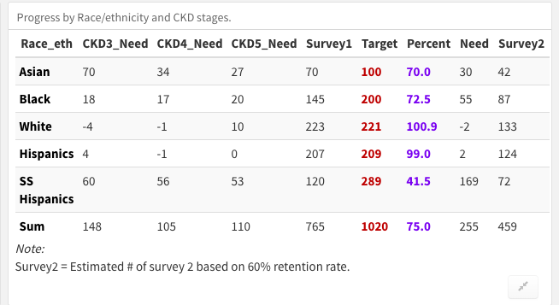
Why do WE need dashboards?
Monitoring patient enrollment is repetitive
To facilitate fast and informed decision making

Slide 4
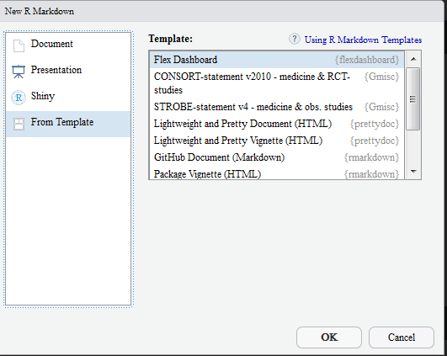
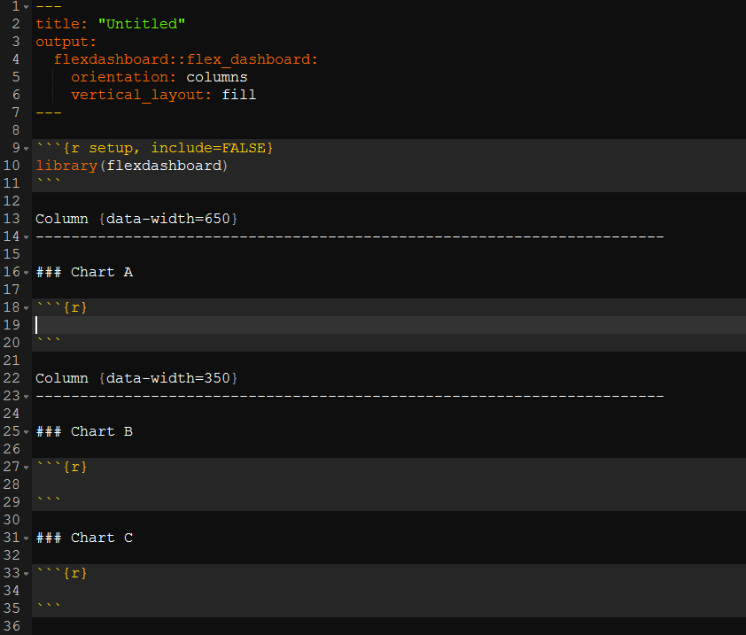
Getting started with the flexdashboard package
https://rmarkdown.rstudio.com/flexdashboard/

Slide 5
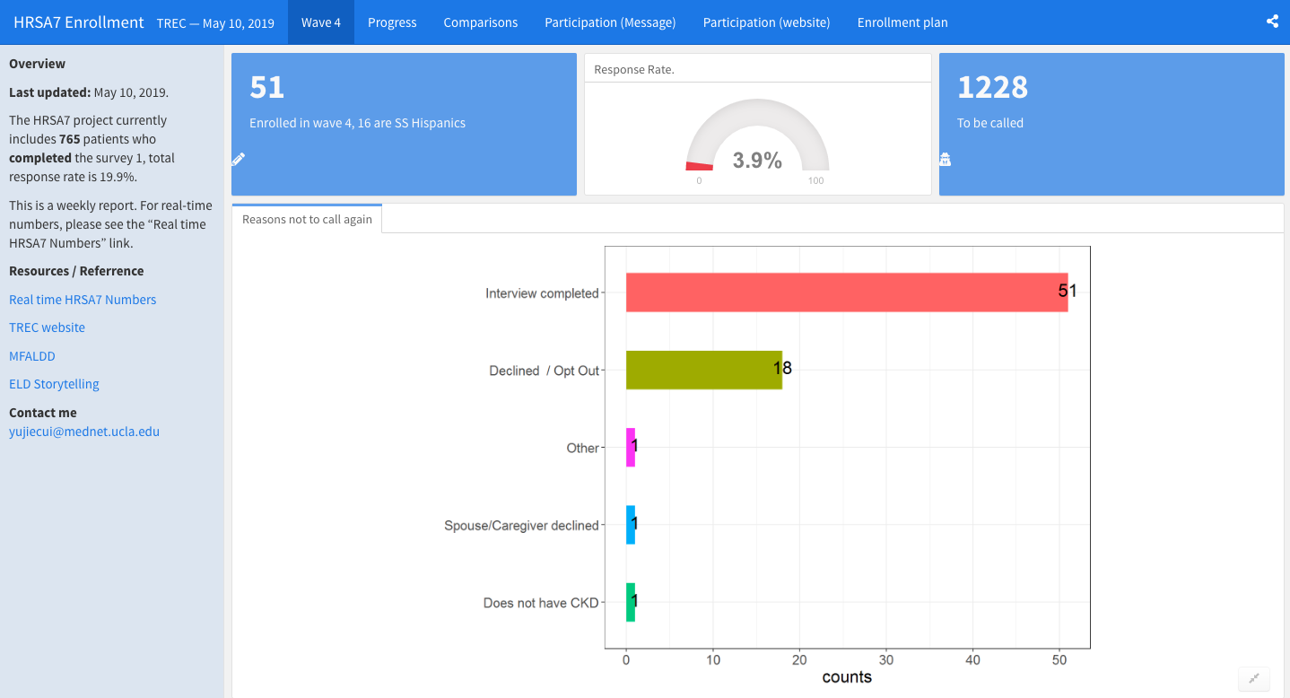
The flexdashboard
http://rpubs.com/yujiecui/hrsa7_ucla

Slide 6
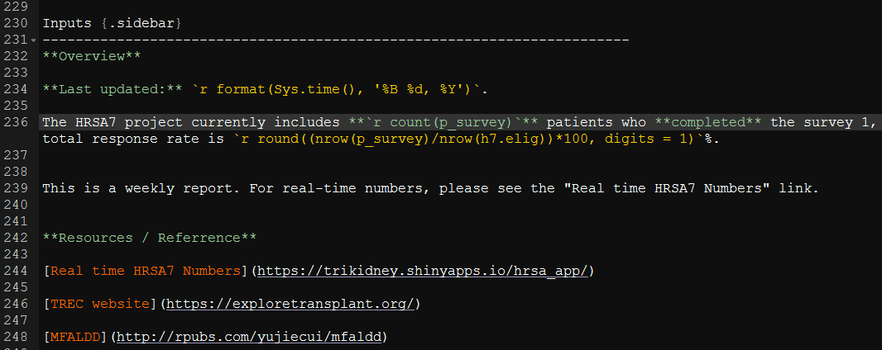
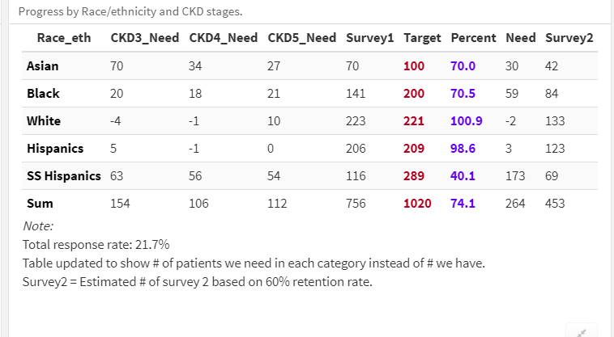
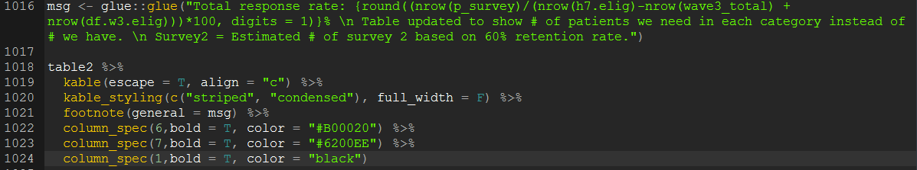
Placeholders and the glue package

Slide 7
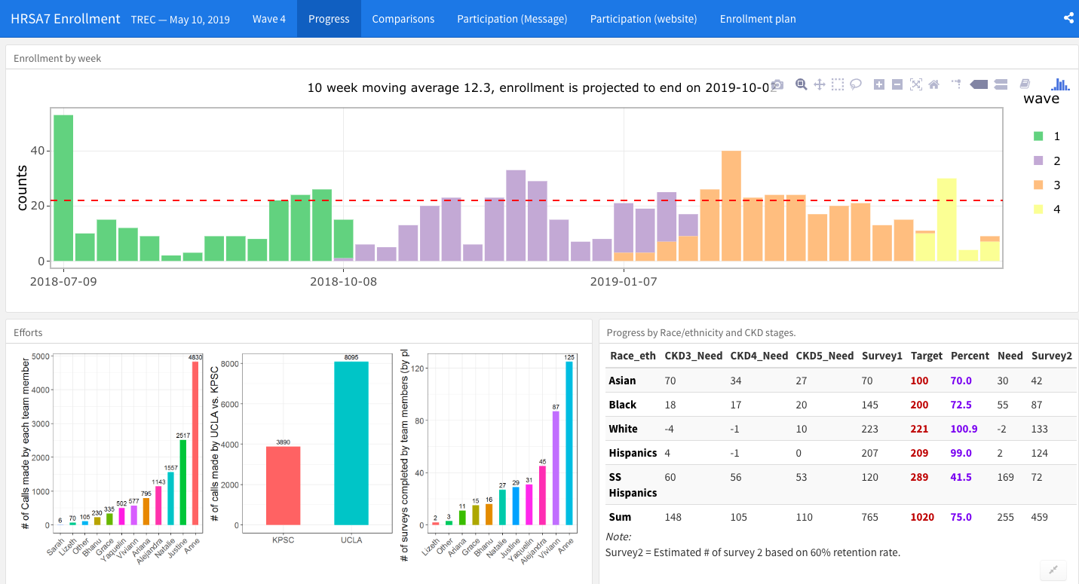
patchwork
(plot1|plot2|plot3)

Slide 8
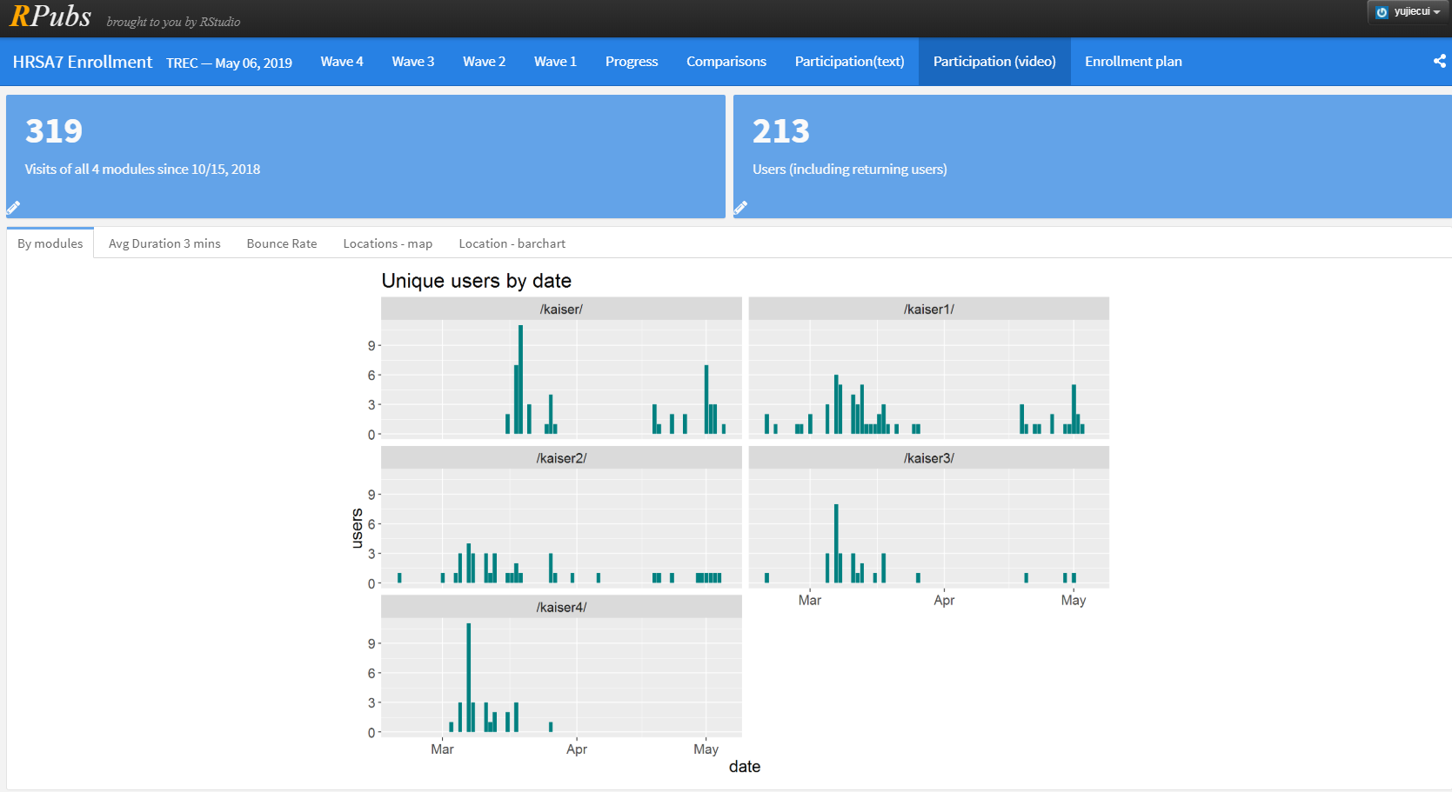
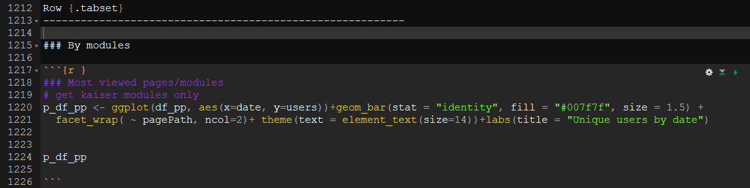
tabset

Slide 9
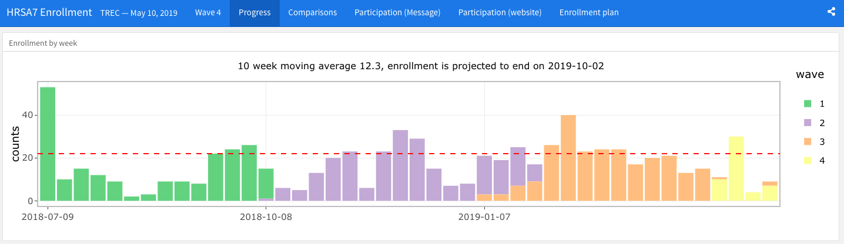
ggplotly
ggplotly(plot1)

Slide 10
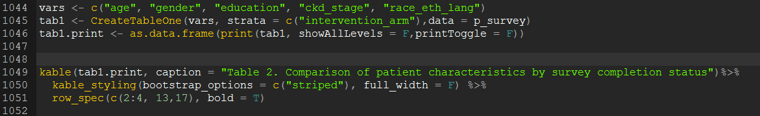
Tableone + kable

Slide 11
Example 1
http://rpubs.com/yujiecui/hrsa7_ucla

Slide 12
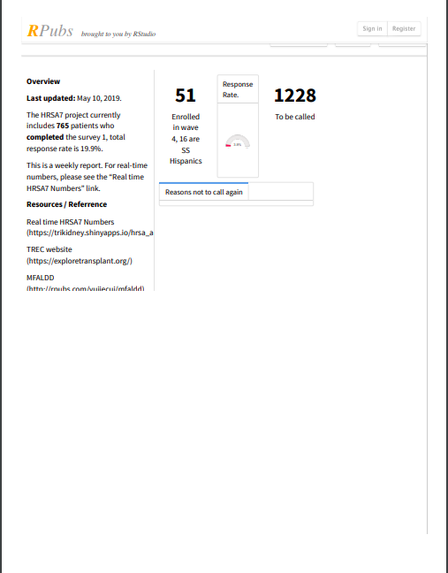
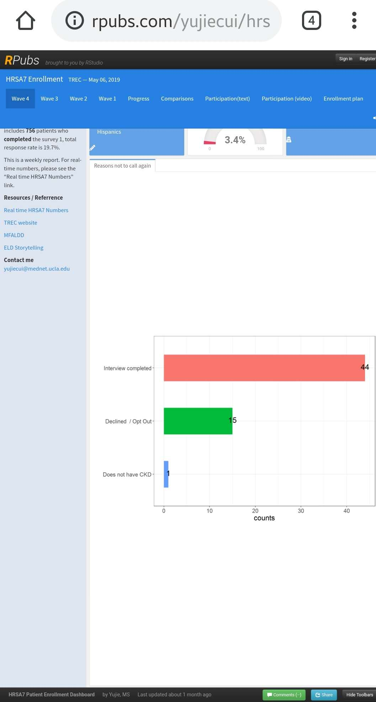
Limitations?
Not real-time!
Does not adapt to screen sizes properly
Not print-friendly!

Slide 13
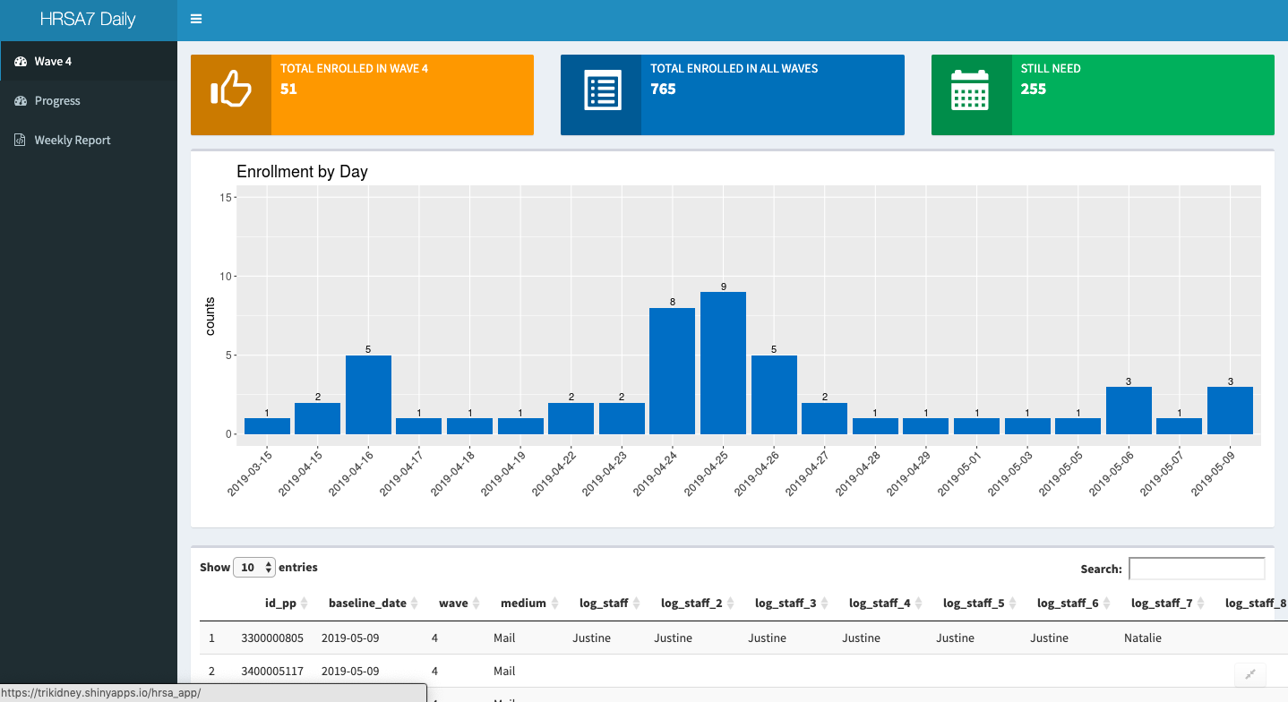
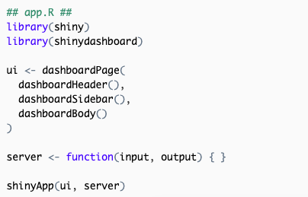
The shinydashboard
https://rstudio.github.io/shinydashboard/get_started.html

Slide 14
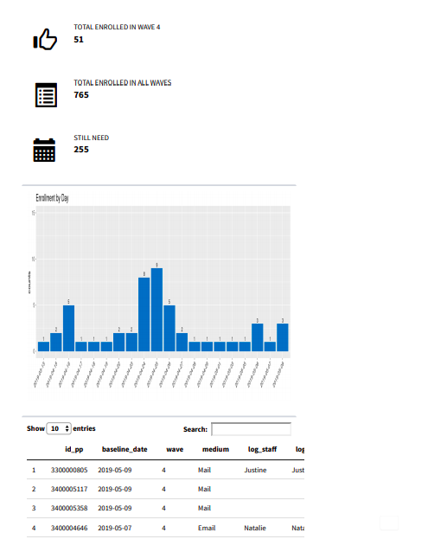
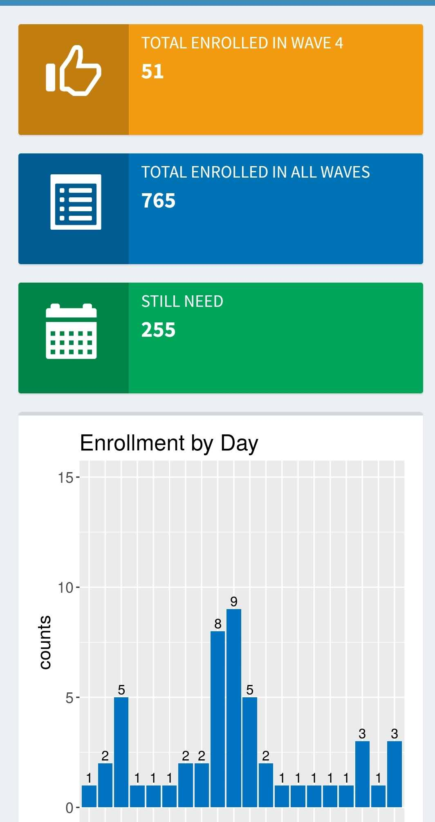
Pros and cons of shinydashboard
Scales nicely
Print friendly
Real-time!

Slide 15
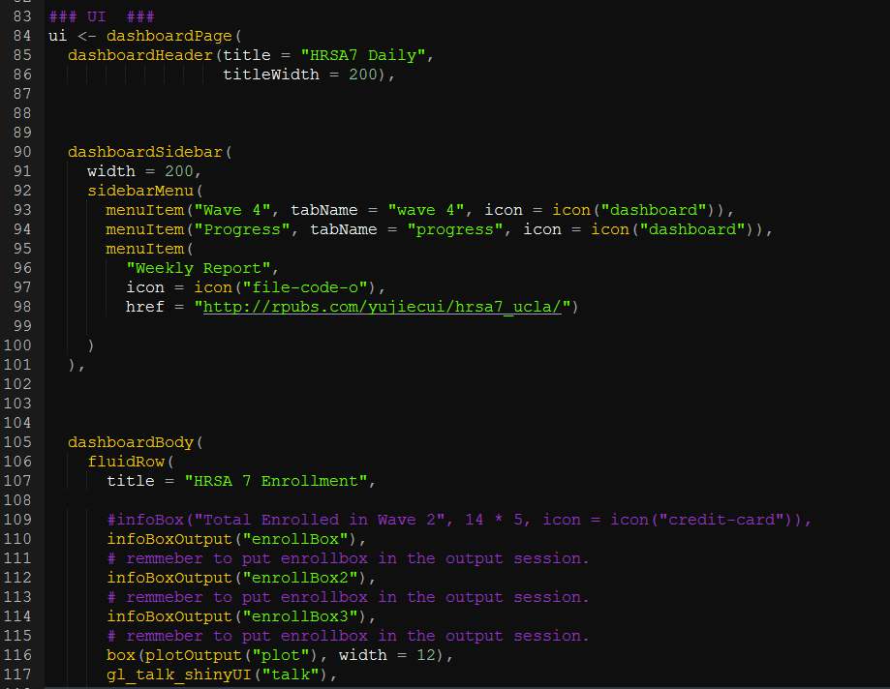
Shinydashboard is not perfect
But…more loading time
Not “free”
More advanced coding skills

Slide 16
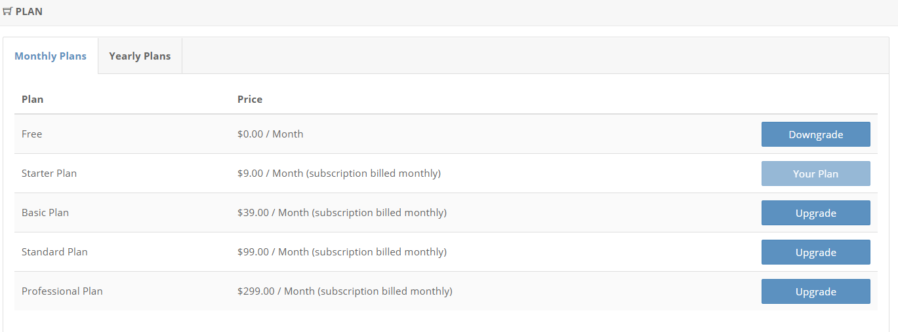
Cost

Slide 17
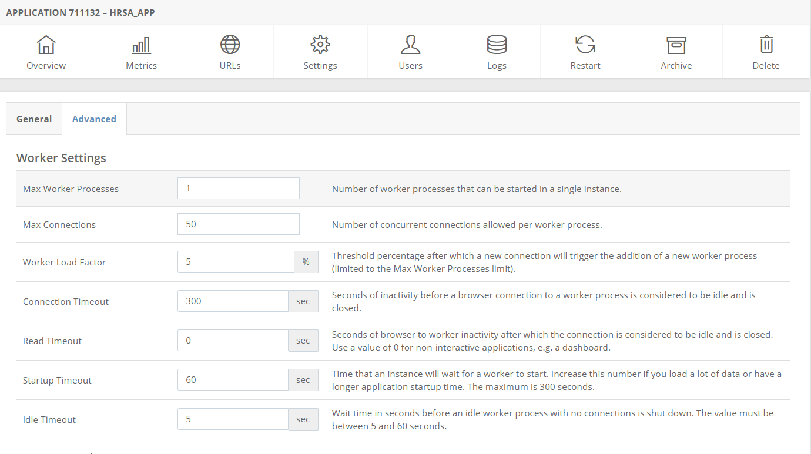
Some degree of control

Slide 18
Example 2
https://trikidney.shinyapps.io/HRSA_App/

Slide 19
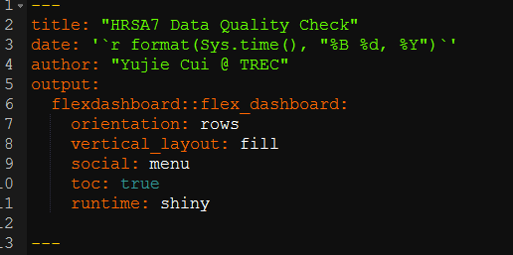
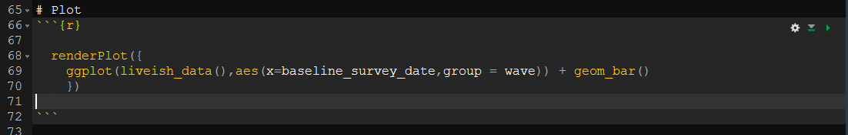
Combine flex- and shinydashboard?

Slide 20
To sum up…
Flexdashboard
fast to load
Easy to code
but does not adapt to screen sizes or print properly.
http, no SSL encryption, no native password protection
great for weekly/monthly reports.
Shinydashboard
less easier to code (need to plan out UI, needs a server) and
slow to load (“please wait…..”)
provides real-time monitoring
adaptive to screen sizes, print-friendly
HTTPS, password protection (if you pay more)
Deploy it, forget about it.

Slide 21
Resources
https://rmarkdown.rstudio.com/flexdashboard/
https://rstudio.github.io/shinydashboard/
https://www.shinyapps.io/

Slide 22
Thank you and fight on! Thoughts, Questions?

