Slide 1
Elements of computing
Project Title:
Universal shift register

Slide 2
Team Members:
B.E.Pranav Kumaar
Dabbara Harsha
Dinesh Kumar M R
Divi Eswar Chowdary

Slide 3
Abstract
Through this project we want to,
Understand the concept of universal shift register
Explore the working of universal shift register
Demonstrate a coded version of USR in hdl
Discover the underlying mechanisms of USR through a simulation

Slide 4
Introduction
Universal shift register is capable of converting input data to parallel or series which also do shifting of data bidirectional, unidirectional (PIPO , SISO , PISO , SIPO ) and also parallel load this is called universal shift register.
Register are used as :
Data storage devices Digital Electronics
Delay Element.
Communication lines. ( Temporary data storage , data transfer , data manipulation , counters )………. etc.

Slide 5
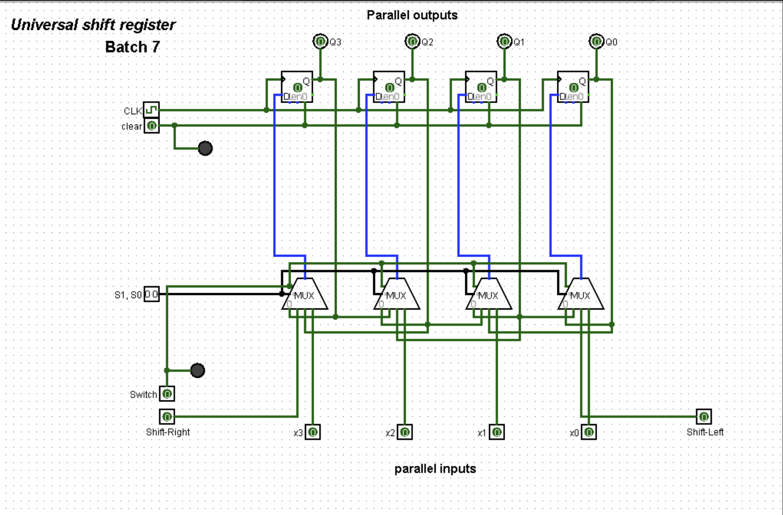
Diagram of universal shift register
Fig 1.1

Slide 6
S1 | S0 | Mode of operation
0 | 0 | No change
0 | 1 | Right shift
1 | 0 | Left shift
1 | 1 | Parallel shift
Fig 1.2
A bidirectional shift register with parallel load is a general purpose register capable of performing three operations : shift left, shift right and parallel load .

Slide 7
Working of USR

Slide 8
Right Shift
clock | Q3 | Q2 | Q1 | Q0
 | 0 | 0 | 0 | 0
↑ | 1 | 0 | 0 | 0
↑ | 1 | 1 | 0 | 0
↑ | 1 | 1 | 1 | 0
↑ | 1 | 1 | 1 | 1

Slide 9

Left Shift
Clock | Q3 | Q2 | Q1 | Q0
 | 0 | 0 | 0 | 0
↑ | 0 | 0 | 0 | 1
↑ | 0 | 0 | 1 | 1
↑ | 0 | 1 | 1 | 1
↑ | 1 | 1 | 1 | 1

Slide 10
Parallel Shift
Clock | Q3 | Q2 | Q1 | Q0
 | 0 | 0 | 0 | 0
↑ | 0 | 1 | 0 | 1
↑ | 0 | 1 | 0 | 1

Slide 11
Hold
Clock | Q3 | Q2 | Q1 | Q0
↑ | 0 | 1 | 1 | 1
↑ | 0 | 1 | 1 | 1

Slide 12
A 4-Bit USR consist of !!!!!!
S0 and S1 are the selected pins that are used to select the mode of operation of this register. It may be shift left operation or shift right operation or parallel mode.
Pin-0 of first 4x1 Mux is fed to the output pin of the first flip flop.
Pin-1 of first 4x1 Mux is connected to serial input for shift right . In this mode , The register shifts the data towards the right .
Similarly , pin-2 of 4x1 Mux is connected to the serial input for shift-left .In this mode , the universal shift register shifts the data towards the left.
10 is the parallel input data given to pin-3 of the first 4x1 mux to provide parallel mode operation and stores the data in register.
Similarly, remaining individual parallel input data bits are given to the pin-3 of related 4×1 MUX to provide parallel loading .

Slide 13
Q0, Q1, Q2, and Q3 are the outputs of Data Flip-flops, which are associated with the 4×1 MUX.
In parallel data transfer, all the parallel inputs and outputs lines are associated with the parallel load.
Clear pin clears the register and set to 0.
CLK pin provides clock pulses to synchronize all the operation.
In the control state, the information or data in the register would not change even though the clock pulse is applied.

Slide 14
Code of USR in hdl

Slide 15
The implementation of this 4-Bit Universal Shift register is done in HDL.
The chip is been named as USR and respective HDL code is below:
CHIP USR{
IN s0,s1,x3,x2,x1,x0,load,y1,y2
PARTS:
Twoonemux(i0=false,i1=y1,sel=load,y=in11);
FourOneMux(i0=q31,i1=in11,i2=q21,i3=x3,s0=s0,s1=s1,Y =in1);
DFF(in=in1,out=q3,out=q31);
FourOneMux(i0=q21,i1=q31,i2=q11,i3=x2,s0=s0,s1=s1,Y= in2);
DFF(in=in2,out=q2,out=q21);
FourOneMux(i0=q11,i1=q21,i2=q01,i3=x1,s0=s0,s1=s1,Y= in3);
DFF(in=in3,out=q1,out=q11);
FourOneMux(i0=q01,i1=q11,i2=in41,i3=x0,s0=s0,s1=s1,Y =in4);
DFF(in=in4,out=q0,out=q01);
Twoonemux(i0=false,i1=y2,sel=load,y=in41);
}
Implementation of USR in Hardware Simulator (Nand to Tetris) :

Slide 16
COMPONENT CODES:
CHIP Twoonemux {
IN i0, i1, sel;
OUT y;
PARTS:
Not(in=sel,out=nsel);
And(a=i0,b=nsel,out=w1);
And(a=i1,b=sel,out=w2);
Or(a=w1,b=w2,out=y);
}
CHIP FourOneMux {
IN i0,i1,i2,i3,s0,s1;
OUT Y;
PARTS:
Twoonemux(i0=i0,i1=i1,sel=s0,y1);
Twoonemux(i0=i2,i1=i3,sel=s0,y=w2);
Twoonemux(i0=w1,i1=w2,sel=s1,y=Y);
}

Slide 17
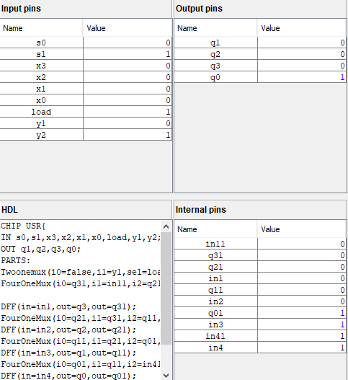
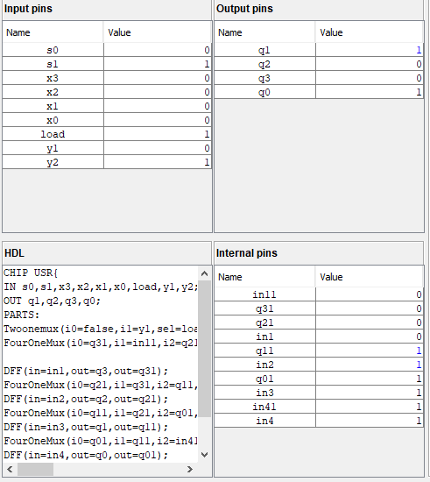
Left Shift
Condition for left shift from fig 1.2
S0=0 and S1=1

Slide 18
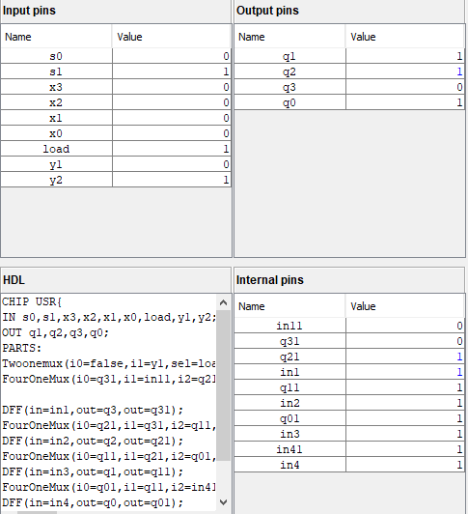
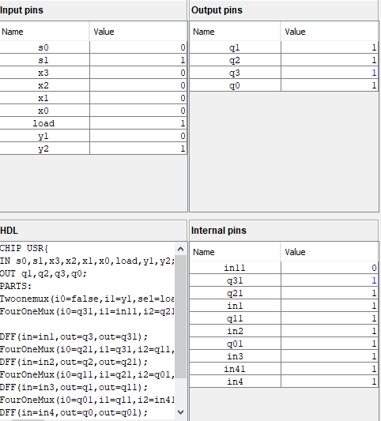
Left Shift

Slide 19
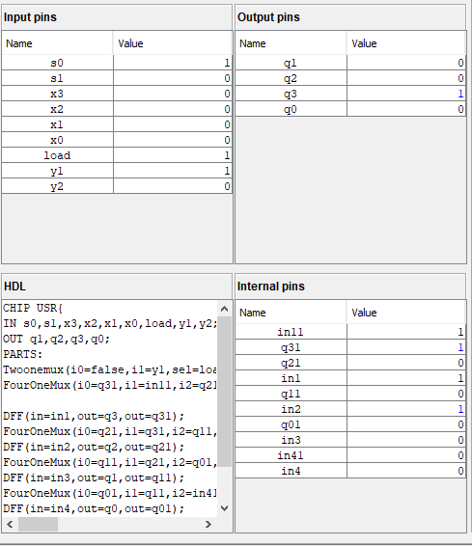
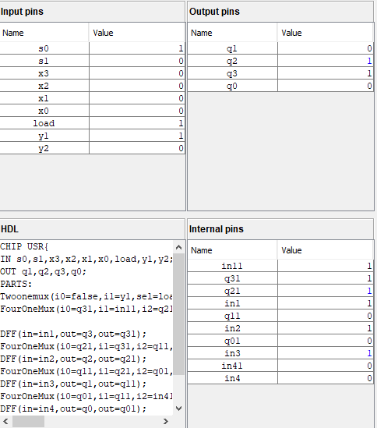
Right shift :
Condition for right shift from fig 1.2 S0=1,S1=0

Slide 20
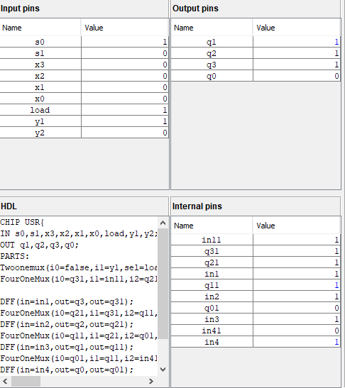
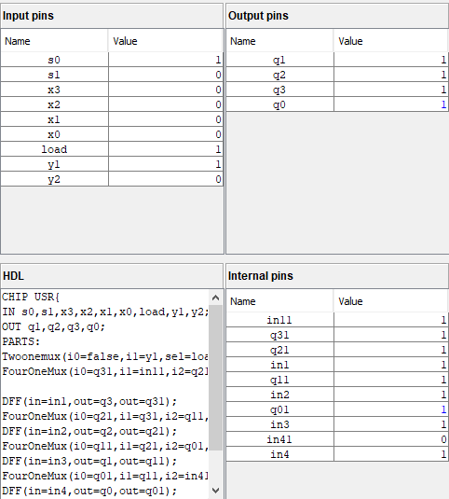
Right Shift

Slide 21
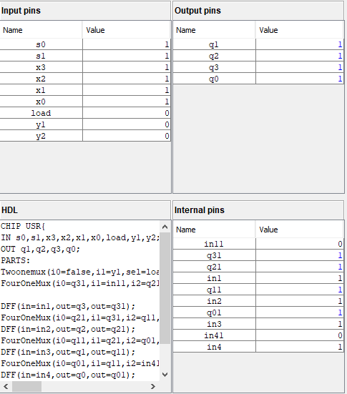
Parallel In and Parallel Out (PIPO) :
Condition for PIPO from fig 1.2
S0=1,S1=1

Slide 22
Simulation of USR

Slide 23
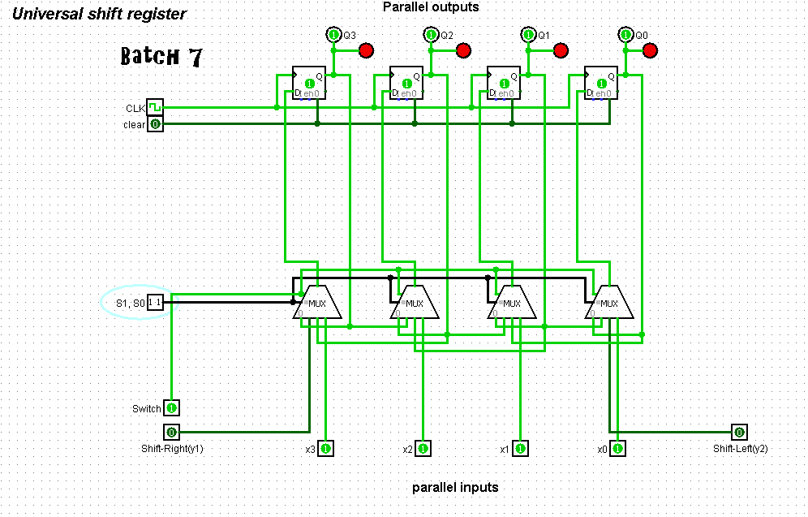
Simulation in Logisim

Slide 24

In digital electronics, shift registers are the sequential logic circuits that can store the data temporarily and provides the data transfer towards its output device for every clock pulse. These are capable of transferring/shifting the data either towards the right or left in serial and parallel modes. Based on the mode of input/output operations, shift registers can be used as a serial-in-parallel-out shift register, serial-in-serial-out shift register, parallel-in-parallel-out shift register, parallel-in-parallel-out shift register. Based on shifting the data, there are universal shift registers and bidirectional shift registers.
A register that can store the data and /shifts the data towards the right and left along with the parallel load capability is known as a universal shift register. It can be used to perform input/output operations in both serial and parallel modes. Unidirectional shift registers and bidirectional shift registers are combined together to get the design of the universal shift register. It is also known as a parallel-in-parallel-out shift register or shift register with the parallel load.
Summary

Slide 25

Universal shift registers are capable of performing 3 operations as listed below:
Parallel load operation – Shifts the data in parallel as well as the data in parallel
Shift left operation – shifts the data and transfers the data shifting towards left in the serial path
Shift right operation – shifts the data and transfers the data by shifting towards right in the serial path.
Hold operation-store/hold the data
Hence, Universal shift registers can perform input/output operations with both serial and parallel loads.
Application:

Slide 26
Bibliography
Definition
www.geeksforgeeks.org/
www.electronics-tutorials.ws/
Simulation
Logisim Application
Referred articles
www.sciencedirect.com/

Slide 27
Thank you

