Slide 1
19AIE212
Design and Analysis of Algorithm
Brandes Algorithm
Team - 8

Slide 2
Table of Content
Centrality
Betweenness Centrality
Vertex Betweenness Centrality
Brandes Algorithm
Edge Betweenness Centrality Brandes Algorithm

Slide 3
Introduction
In graph theory and network analysis, indicators of centrality assign numbers or rankings to nodes within a graph corresponding to their network position.
Centrality indices are answers to the question
“What characterizes an important vertex?”

Slide 4
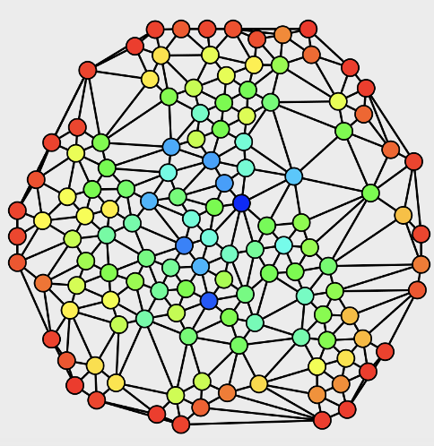
What is “Centrality”
In graph, centrality can imply :
Importance
Influence
General well-connectedness
“Betweenness” is the measure of centrality
Based on shortest paths

Slide 5
Betweenness Centrality
Betweenness is a centrality measure of a vertex within a graph. Betweenness Centrality quantifies the number of times of node acts as bridge along the shortest path between two other node.
Vertices that have a high probability to occur on a randomly chosen shortest path between two randomly chosen shortest between two randomly chosen vertices have a high betweenness
Betweenness centrality values influence shortest path influence.

Slide 6

Vertex Betweenness Centrality
The betweenness of a vertex $v$ in a graph $G ≔(V, E)$ with $V$vertices is computed as follows :
For each pair of vertices $(s, t)$, compute the shortest paths between them.
For each pair of vertices $(s, t)$, determine the fraction of shortest path that passes through the vertex in question (here, vertex $v$).
Sum this fraction over all pairs of vertices $\left(s,t\right).$

Slide 7


Formulation
More compactly the betweenness can be represented as :
$$C_{B}\left(v\right)=\sum_{s≠v≠tεV}{\frac{σ_{st}\left(v\right)}{σ_{st}}}$$
Where ,
$σ_{st}$ is total number of shortest paths from node $s$ to node $t$ and
$σ_{st}(v)$ is the number of those paths that pass through $v$.

Slide 8

Formulation
More compactly the betweenness can be represented as :
$$C_{B}\left(v\right)=\sum_{s≠v≠tεV}{\frac{σ_{st}\left(v\right)}{σ_{st}}}$$
If s = t, then σ(s, t) = 1
If v ∈ s, t, then σ(s, t|v) = 0

Slide 9

Example
A
F
*
C
D
B
E
 | $$σ_{uw}$$ | $$σ_{uw}(v)$$ | $$\frac{σ_{uw}\left(v\right)}{σ_{uw}}$$

Slide 10
Example
A
A
F
*
C
D
B
E
(A, B) | 1 | 0 | 0

Slide 11
Example
A
A
F
*
C
D
B
E
(A, D) | 1 | 1 | 1

Slide 12
Example
A
A
F
*
C
D
B
E
(A, E) | 1 | 1 | 1

Slide 13
Example
A
A
F
*
C
D
B
E
(A, F) | 1 | 1 | 1

Slide 14
Example
B
A
F
*
C
D
B
E
(B, D) | 1 | 1 | 1

Slide 15
Example
B
A
F
*
C
D
B
E
(B, E) | 1 | 1 | 1

Slide 16
Example
B
A
F
*
C
D
B
E
(B, F) | 1 | 1 | 1

Slide 17
Example
D
A
F
*
C
D
B
E
(D, E) | 1 | 0 | 0

Slide 18
Example
D
A
F
*
C
D
B
E
(D, F) | 1 | 0 | 0

Slide 19
Example
F
A
F
*
C
D
B
E
(E, F) | 1 | 0 | 0

Slide 20
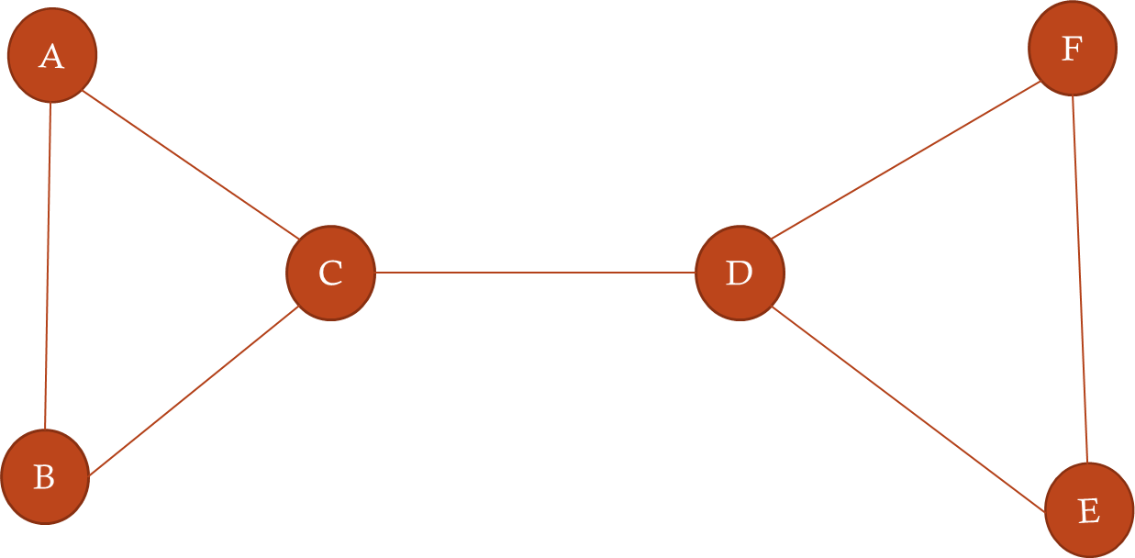

Lets calculate the between centrality for node C
 | $$σ_{uw}$$ | $$σ_{uw}(v)$$ | $$\frac{σ_{uw}\left(v\right)}{σ_{uw}}$$
(A, B) | 1 | 0 | 0
(A, D) | 1 | 1 | 1
(A, E) | 1 | 1 | 1
(A, F) | 1 | 1 | 1
(B, D) | 1 | 1 | 1
(B, E) | 1 | 1 | 1
(B, F) | 1 | 1 | 1

Slide 21

Calculate the between centrality of C
 | $$σ_{uw}$$ | $$σ_{uw}\left(v\right)$$ | $$σ_{uw}(v)/$$
(D, E) | 1 | 0 | 0
(D, F) | 1 | 0 | 0
(E, F) | 1 | 0 | 0

Slide 22
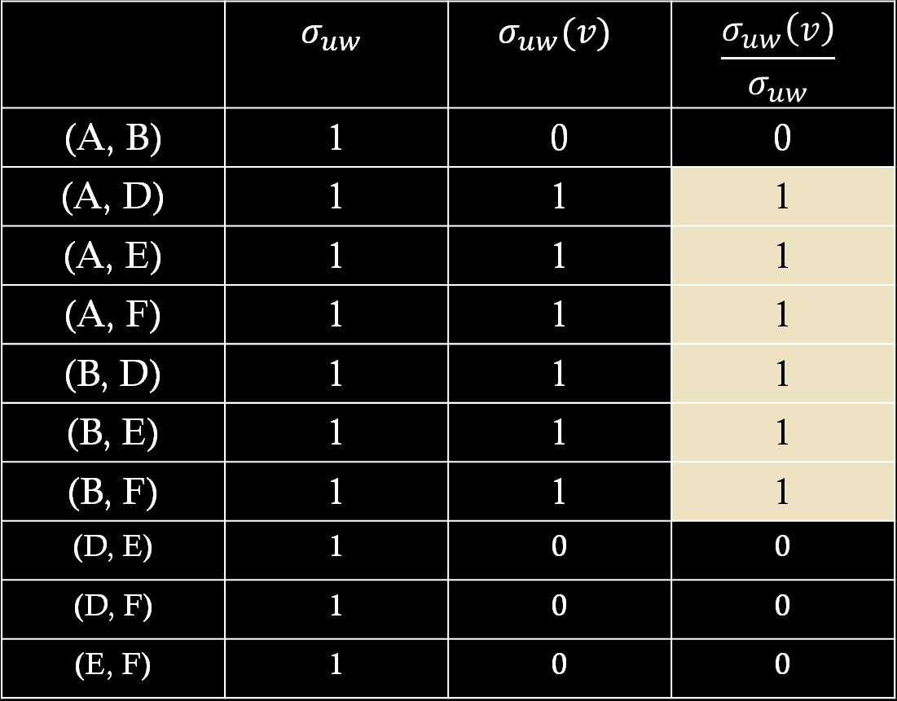
 | $$σ_{uw}$$ | $$σ_{uw}(v)$$ | $$\frac{σ_{uw}\left(v\right)}{σ_{uw}}$$
(A, B) | 1 | 0 | 0
(A, D) | 1 | 1 | 1
(A, E) | 1 | 1 | 1
(A, F) | 1 | 1 | 1
(B, D) | 1 | 1 | 1
(B, E) | 1 | 1 | 1
(B, F) | 1 | 1 | 1
(D, E) | 1 | 0 | 0
(D, F) | 1 | 0 | 0
(E, F) | 1 | 0 | 0
Betweenness Centrality for C = 6

Slide 23


Directed and Undirected graphs
The Betweenness may be normalised by dividing through the number of pairs of vertices not including v , which for directed graphs is $(n−1)(n−2)$ and for undirected pairs of graph is $\frac{\left(n−1\right)\left(n−2\right)}{2} .$
$$Ex :in a undirected star graph, the centre vertex would have a betweenness of\frac{\left(n−1\right)\left(n−2\right)}{2} while \\ the leaves would have betweenness of 0$$

Slide 24

Complexities
From a calculation aspect, both betweenness and closeness centralities of all vertices in a graph involve calculating the shortest paths between all pairs of vertices on a graph, which requires $O{\left(V\right)}^{3}$.
In case of unweighted graphs, the calculations can be done with Brandes Algorithm which takes $O(V2 +VE)$time.

Slide 25
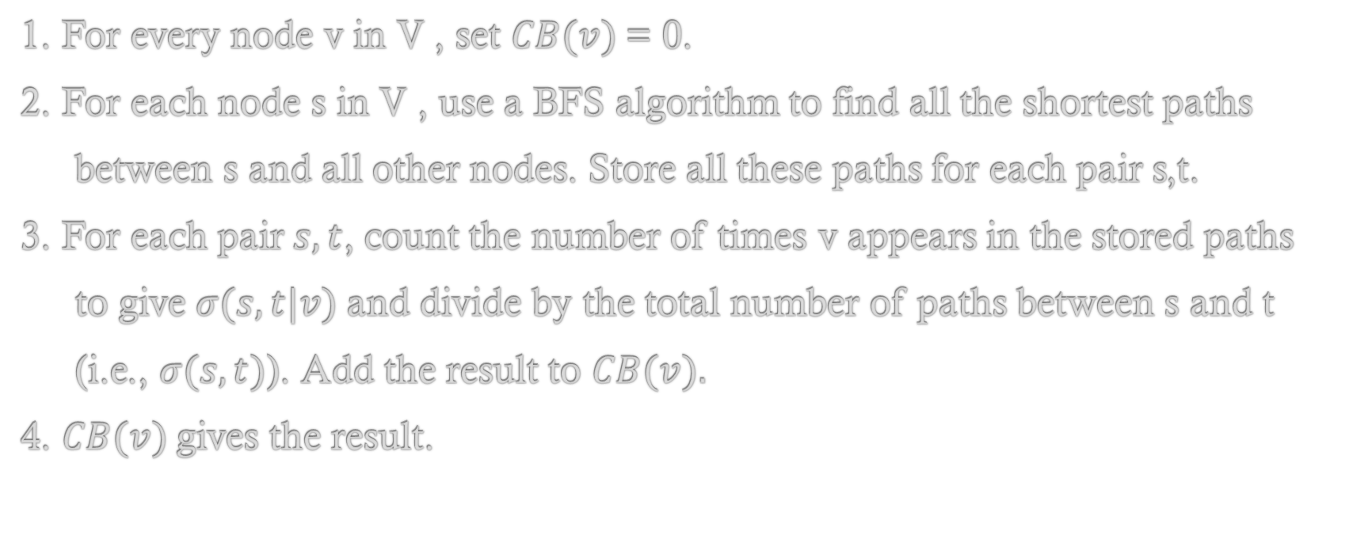
Naive Approach
1. For every node v in V , set $CB(v)$= 0.
2. For each node s in V , use a BFS algorithm to find all the shortest paths
between s and all other nodes. Store all these paths for each pair s,t.
3. For each pair$s,t$, count the number of times v appears in the stored paths
to give $σ(s, t|v)$and divide by the total number of paths between s and t
(i.e., $σ(s, t)$). Add the result to $CB(v).$
4. $CB(v)$gives the result.

Slide 26
Breadth First Search
Initialization: for each node w:
1. Mark w as unvisited by setting dist[w] (the distance between s and
the node w) to infinity.
2. Set Pred[w] (nodes that immediately precede w on a shortest path
from s) to the empty list.
3. Set Paths[w] (the list of all shortest paths from s to w) to the empty
list.
Starting node:
1. Choose the starting node s and put it on the queue Q.
2. Set dist[s] to 0.

Slide 27
2. while Q is not empty, do:
1. dequeue v from Q
2. For each node w such that is an edge in E from v to w, do
1. if dist[w] is infinity, then
1. set dist[w] to dist[v] + 1
2. enqueue w
2. if dist[w] = dist[v]+1 then
1. append v to Pred[w]
3. Collect all paths by following Pred[t] back to s for each t, storing paths on Paths[w].

Slide 28
Improving on the naive approach
These Below Steps Move towards Getting Closer to Brandes Algorithm
Storage Efficiency
Integration with the shortest paths algorithm
Recursive calculation

Slide 29
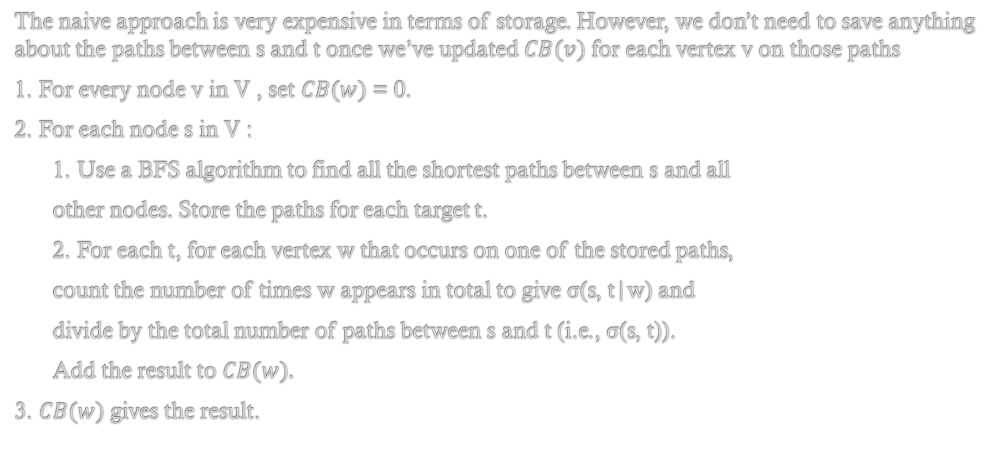
Storage Efficiency
The naive approach is very expensive in terms of storage. However, we don’t need to save anything about the paths between s and t once we’ve updated $CB(v)$ for each vertex v on those paths
1. For every node v in V , set $CB(w)$= 0.
2. For each node s in V :
1. Use a BFS algorithm to find all the shortest paths between s and all
other nodes. Store the paths for each target t.
2. For each t, for each vertex w that occurs on one of the stored paths,
count the number of times w appears in total to give σ(s, t|w) and
divide by the total number of paths between s and t (i.e., σ(s, t)).
Add the result to $CB(w).$
3. $CB(w)$gives the result.

Slide 30
Integration with the shortest paths algorithm
We observe that the BFS algorithm involves spreading out from s to find the shortest paths up to the terminal nodes and then stepping back via the saved predecessor nodes to output the paths for the terminal nodes and all the previous nodes.
Therefore, we are going back to s from each node t through all the nodes v which are on the shortest path between s and t.
We could therefore add up the shortest paths at that point, rather than saving them all and then checking whether v is a member.

Slide 31
1. For every node v in V , set CB(v) = 0.
2. For each node s in V :
1. set S(v, t) to zero for all nodes v and t in V.
2. Use the BFS algorithm, as above, to reach each target t from s.
3. In the backward phase, increment S(v, t) as appropriate when each
node v is reached, rather than creating full paths.
4. At the end, divide each S(v, t) by the total number of paths between
s and t (i.e., S(s, t)). Add the result to CB(v).
3. CB(w) gives the result.

Slide 32
Recursive calculation
The Main Difference Between Above Algorithm and Brandes is use of a recursive step in the backward phase to allow direct calculation of the ratios for each v based on its successor nodes on the shortest paths to every following t.
For now, let’s simply pretend we have such a function, which we call Magic, and
a value δ(v) such that the following conditions hold:
1. δ(t) = 0 if t is a terminal node (as described above).
2. We can increment δ(v) via Magic every time we reach v from a node w
on the backward phase based on the values of δ(w).
3. After we have finished with all the w values, δ(v) can be straightforwardly
accumulated into CB(v).

Slide 33
1. For every node v in V , set CB(w) = 0.
2. For each node s in V :
1. set δ(v) to zero for all nodes v in V .
2. Use the BFS algorithm (much as before, differences in bold below)
while Q is not empty, do:
1. dequeue v from Q and push v onto a stack S
2. For each node w such that is an edge in E from v to w, do
1. if dist[w] is infinity, then
set dist[w] to dist[v] + 1
enqueue w
2. if dist[w] = dist[v]+1 then
set σ(s, w) to σ(s, w) + σ(s, v)
append v to Pred[w]

Slide 34
3. while S is not empty, pop w off S
1. for all nodes v in Pred(w) set δ(v) to δ(v) + MAGIC(δ(w)).
2. unless w = s, set CB(w) = CB(w) + δ(w).
3. CB(v) gives the result.
The Following are Required by MAGIC
The number of shortest paths between s and each node v, so we create these values in the forward phase of the BFS as shown (i.e., σ(s, w)).
Nodes are visited in the correct order on the backward step, which we do by putting the dequeued elements of Q onto a stack in the forward pass, and then visiting the nodes in the order they are popped off the stack in the backward pass.

Slide 35
Brandes Algorithm
Dependencies
Pair Wise Dependency
One Sided Dependency

Slide 36
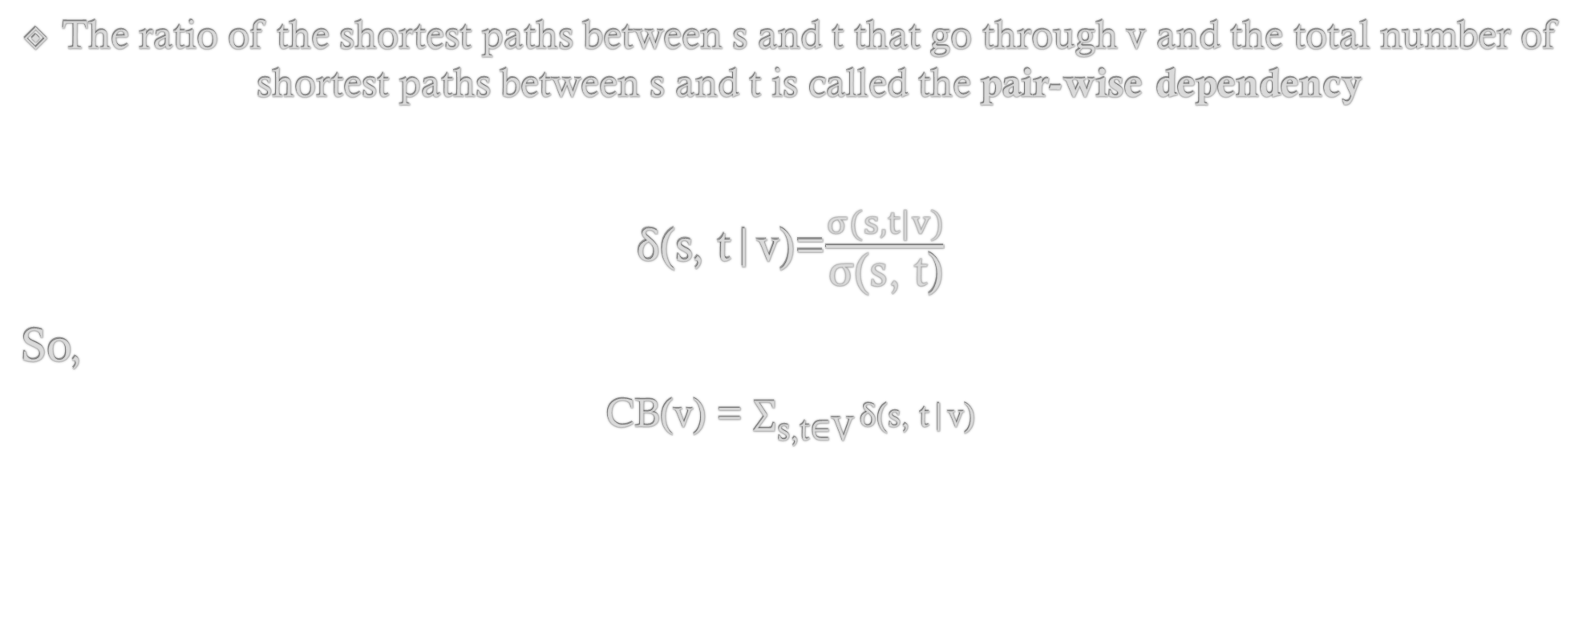
Pair Wise Dependency
The ratio of the shortest paths between s and t that go through v and the total number of shortest paths between s and t is called the pair-wise dependency
δ(s, t|v)=$\frac{σ(s, t|v)}{\text{σ}\text{(}\text{s}\text{, }\text{t}\text{)}}$
So,
CB(v) = $\sum_{\text{s}\text{,}\text{t}\text{∈}\text{V}}{\text{δ}\text{(}\text{s}\text{, }\text{t}\text{|}\text{v}\text{)}}$

Slide 37
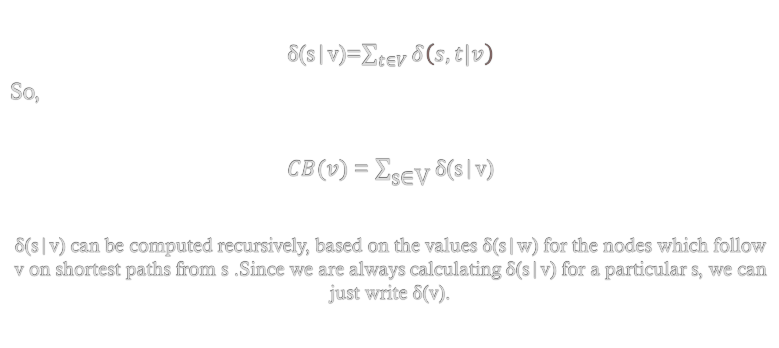
One-sided dependency
δ(s|v)=$\sum_{t∈V}{δ\left(s,t|v\right)}$
So,
$CB(v)$= $\sum_{\text{s}\text{∈}\text{V}}{\text{δ}\text{(}\text{s}\text{|}\text{v}\text{)}}$
δ(s|v) can be computed recursively, based on the values δ(s|w) for the nodes which follow v on shortest paths from s .Since we are always calculating δ(s|v) for a particular s, we can just write δ(v).

Slide 38
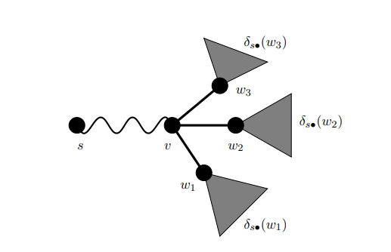

There is exactly one shortest path from s to each node t
The Pair Wise Dependency
δ(s, t|v) = 1, or does not lie on the path, in which case δ(s, t|v) = 0
δ(v) = $\sum_{\text{w}}{\text{(1 + }\text{δ}\text{(}\text{w}\text{)}}$

Slide 39
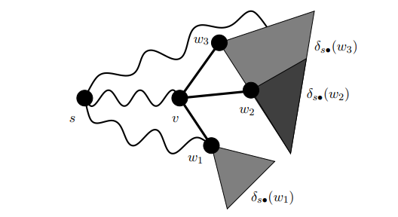

There is Alternative shortest path from s to each node t
The Pair Wise Dependency
δ(s, t|v) = 1, or does not lie on the path, in which case δ(s, t|v) = 0

Slide 40
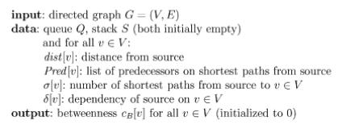
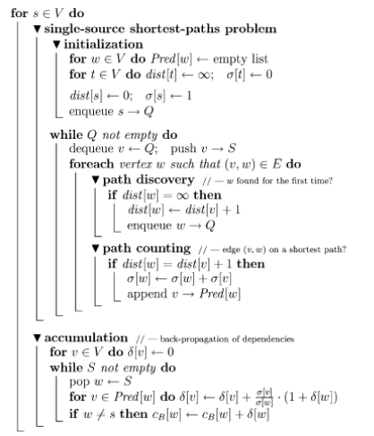
Final Brandes Algorithm

Slide 41
Prepare for BFS Tree Walk
Let's take an example
A
E
B
C
D
F
G
H
I
J
K

Slide 42
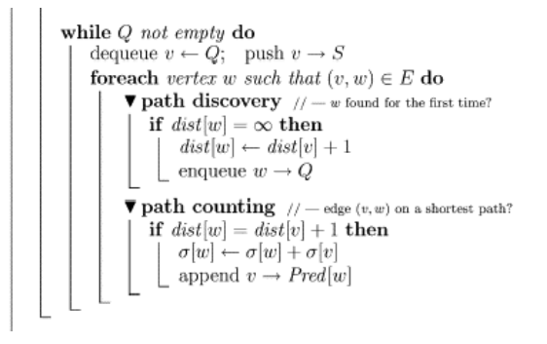
PHASE 1 - Pseudocode

Slide 43

Step 2 - Calculate σ(s, v), the number of shortest paths between s and v
A
E
1​​
1
B
C
1​
D
1​
$$σ\left(s, t\right)= \sum_{u ∈Pred(t)}{σ(s, u)}$$
F
G
H
I
J
K

Slide 44

A
E
1​​
1​
1
B
C
D
1​
F
G
H
2
1
2​
$$σ\left(s, t\right)= \sum_{u ∈Pred(t)}{σ(s, u)}$$
I
J
K

Slide 45

A
E
1​​
1​
1
B
C
D
1​
F
G
H
2​
2
1
$$σ\left(s, t\right)= \sum_{u ∈Pred(t)}{σ(s, u)}$$
J
3
3
I
K

Slide 46

So we have calculated the no of shortest paths possible and now lets move to phase 2 which is the dependency calculation
A
E
1​​
1​
1
B
C
D
1​
F
G
H
2
2
1
$$σ\left(s, t\right)= \sum_{u ∈Pred(t)}{σ(s, u)}$$
J
3
3
I
K
6

Slide 47
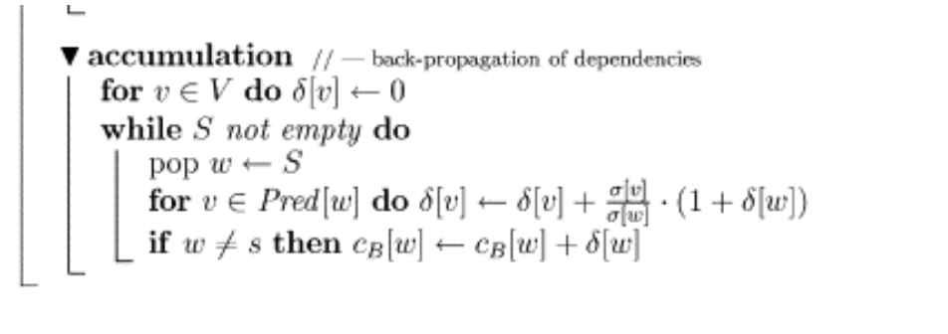
PHASE 2 - Pseudocode

Slide 48

Step 3 - Calculate δ(s|v), the dependency of s on v
A
E
1​​
1​
1
B
C
D
1​
F
G
H
2
2
1
J
3
3
I
K
0
6
δ(s|v) = $\sum_{\begin{aligned}\text{(}\text{v}\text{,}\text{w}\text{)∈}\text{E} \\ \text{w}\text{ : }\text{d}\text{(}\text{s}\text{,}\text{w}\text{)=}\text{d}\text{(}\text{s}\text{,}\text{v}\text{)+1}\end{aligned}}{\text{σ}\text{(}\text{s}\text{, }\text{v}\text{)/}\text{σ}\text{(}\text{s}\text{, }\text{w}\text{).(1 + }\text{δ}\text{(}\text{s}\text{|}\text{w}\text{))}}$

Slide 49

δ(s|v) = $\sum_{\begin{aligned}\text{(}\text{v}\text{,}\text{w}\text{)∈}\text{E} \\ \text{w}\text{ : }\text{d}\text{(}\text{s}\text{,}\text{w}\text{)=}\text{d}\text{(}\text{s}\text{,}\text{v}\text{)+1}\end{aligned}}{\text{σ}\text{(}\text{s}\text{, }\text{v}\text{)/}\text{σ}\text{(}\text{s}\text{, }\text{w}\text{).(1 + }\text{δ}\text{(}\text{s}\text{|}\text{w}\text{))}}$
A
E
1​​
1​
1
B
C
D
1​
F
G
H
2
2
1
J
3
I
0.5
3​
0.5​
½*(1+0)
½*(1+0)
K
0
6

Slide 50

δ(s|v) = $\sum_{\begin{aligned}\text{(}\text{v}\text{,}\text{w}\text{)∈}\text{E} \\ \text{w}\text{ : }\text{d}\text{(}\text{s}\text{,}\text{w}\text{)=}\text{d}\text{(}\text{s}\text{,}\text{v}\text{)+1}\end{aligned}}{\text{σ}\text{(}\text{s}\text{, }\text{v}\text{)/}\text{σ}\text{(}\text{s}\text{, }\text{w}\text{).(1 + }\text{δ}\text{(}\text{s}\text{|}\text{w}\text{))}}$
A
E
1​
1
B
C
D
1​
2
F
1​
1​
G
H
1​
1
2
2/3*(1+0.5)​
1/3*(1+0.5)​​​
1/3*(1+0.5)​​​
2/3*(1+0.5)​​
J
3
3​
I
0.5
0.5​
½*(1+0)
½*(1+0)
K
0
6

Slide 51

Now we have calculated the dependency metrics in reverse order for the total Graph ​
1​​0
A
1*(1+1)​​​​
1*(1+1)​​​​​
1*(1+1)​​​​​
E
1​​
1​
1​​
C
1*(1+3)​​​​​
1
B
1​​
D
1​
1/2*(1+1)​
1/2*(1+1)​
1/2*(1+1)​
2
F
1​
1​
G
H
1​
1/2*(1+1)
1
2
2/3*(1+0.5)​
1/3*(1+0.5)​​​
1/3*(1+0.5)​​​
2/3*(1+0.5)​​
J
3
I
0.5
3​
0.5​
½*(1+0)
½*(1+0)
K
0
6
δ(s|v) = $\sum_{\begin{aligned}\text{(}\text{v}\text{,}\text{w}\text{)∈}\text{E} \\ \text{w}\text{ : }\text{d}\text{(}\text{s}\text{,}\text{w}\text{)=}\text{d}\text{(}\text{s}\text{,}\text{v}\text{)+1}\end{aligned}}{\text{σ}\text{(}\text{s}\text{, }\text{v}\text{)/}\text{σ}\text{(}\text{s}\text{, }\text{w}\text{).(1 + }\text{δ}\text{(}\text{s}\text{|}\text{w}\text{))}}$

Slide 52
Step 4 - Calculate betweenness centrality
You saw one iteration with s = A.
Now perform V iterations, once with each node as source.
Sum up the δ(s|v) for each node: this gives the node’s betweenness centrality.

Slide 53
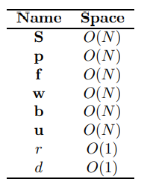
Vertex Complexity
The breadth-first search - O(N + M)
The centrality updates - O(N + M)
For each vertex acting as source in one-sided dependency,
These two loops are performed O(N) times
Overall time complexity = O(N² + MN)

Slide 54
Edge Betweenness Centrality
The edge betweenness centrality is defined as the number of the shortest paths that go through an edge in a graph or network . Each edge in the network can be associated with an edge betweenness centrality value.
An edge with a high edge betweenness centrality score represents a bridge-like connector between two parts of a network, and the removal of which may affect the communication between many pairs of nodes through the shortest paths between them.

Slide 55
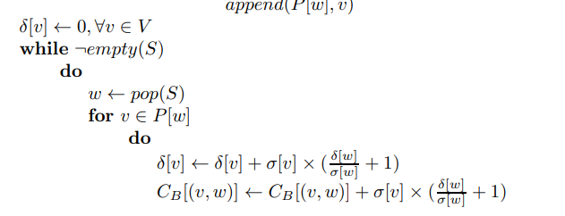
Edge Betweenness Centrality
A Vertex is identified/indexed by a single identifier/index I.e., we use a single value to represent a Vertex.
Equivalently with the same information an Edge is identified using the Vertices that it connects. Hence, we look for an unordered pair of values to represent an Edge in an undirected graph.

Slide 56

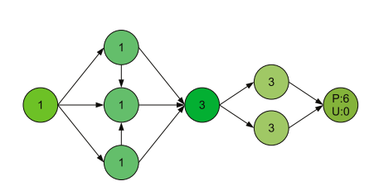

Slide 57
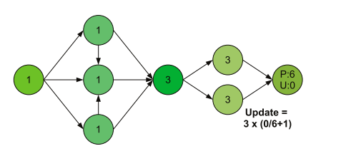

Slide 58
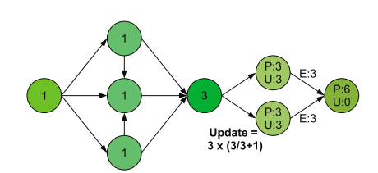

Slide 59
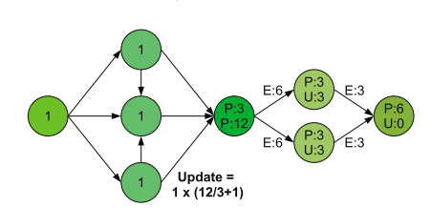

Slide 60
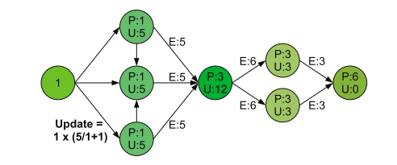

Slide 61
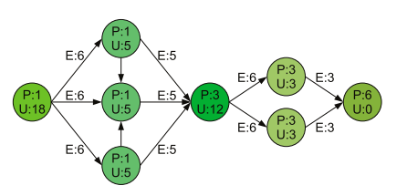

Slide 62
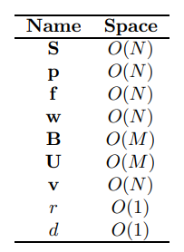
Edge Complexity
The breadth-first search - O(N + M)
The centrality updates - O(N + M)
For each vertex acting as source in one-sided dependency,
These two loops are performed O(N) times
Overall time complexity = O(N² + MN)

Slide 63
Thank You

