Slide 1

FUNDAMENTALS OF GOOGLE SEARCH ENGINE
DONE BY:
B.E. PRANAV KUMAAR

Slide 2
INTRODUCTION
What is a search engine?
A search engine is a software system that is designed to carry out web searches (Internet searches), which means to search the World Wide Web(www) in a systematic way for information specified in a textual web search query.
The search results are generally presented in a line of results, often referred to as search engine results pages (SERPs)

Slide 3
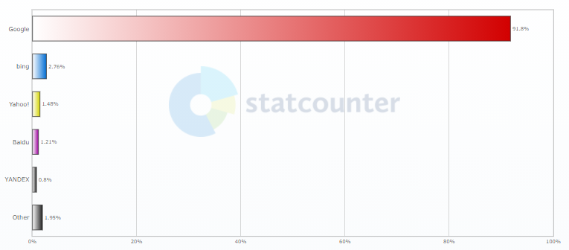
ANALYTICS
A quick search shows the following information on the search engine market share over the last 3 months (Nov 2020 - Jan 2021) globally,
Inference :
From the above chart we can see that google is the indisputable champion having more than 90% of the entire share. It is also individually the most used search engine in every country around the world except only to Baidu in China. Needless to say, Google has had a significant lead for long time now.

Slide 4
Reasons behind the success of google:
THE MAIN REASON BEHIND GOOGLES SUCCESS IS ATTRIBUTE TO HIGHER QUALITY OF THEIR SERP’S
A part of googles fame is attributed to its own web browser
It is user friendly and user appealing – Its simple design invites new users to fully experience it and mistakes are less frustrating as its algorithm copes for user mistakes like spelling. It also provides search suggestions and can give the right results if only a description about the item is given (true clarity of object is not known)
Framework of compatible apps – It also has multiple external apps like Google Maps, drive, YouTube and these are also very good apps that are complimentary to google providing everything a user might need enforcing the use of google
The program is highly tested and regularly updated, making its algorithms faster and more efficient. This comes in handy with user satisfaction
Despite achieving the top ranks in its field, they strive to delivery further by focusing their research on new technologies
Adds – we can pay google to rank our webpage higher than others to serve as advertisements (based on specific search results) this shows how much control they have over their engine.

Slide 5
How are they able to deliver better results ?
It all comes down to the fact that google has inherently had one of the best SERP generators that is based off of exploiting the link structure of the Web and this ranking system is called PageRank.
Page rank was developed as a part of Google by Page and Sergey Brin in 1998.

Slide 6

The Working of PageRank

Slide 7
Logical analysis
From the POV of any user, we see that he/she will find the SERP’s more useful if it gives him/her the most useful information.
the website he/she is most likely will find what he/she wants and spend most time given he/she spends equal time viewing each webpage.
If one spends equal time viewing content of each webpage then the chance that we find he will spend on a page lies on him selecting the page.
This makes the ranking of each page a question on probability

Slide 8
Web Crawlers
To find how a user will behave, the algorithm models the behavior of an idealized random Web surfer sometimes called Web crawlers.
This object is subjected to surfing the web endlessly (because an idealized person will never grow tired, and this rules out “starting luck” if enough repetitions and is the goal of the web - to make the user surf as much as possible (if he likes what he/she is given he will naturally do so))
We use the term PageRank score to evaluate our information as one single parameter.
Thus, the PageRank score of a webpage represents the probability that a random Web surfer chooses to view the webpage. We will now see that all of this is possible due to the webs structure.

Slide 9
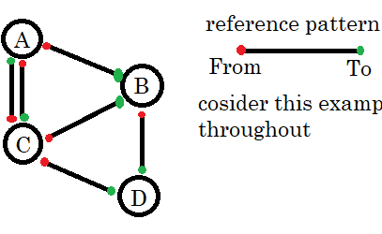
Structure of the Web
This view or manipulation of the web is called as Directed Web Graph (DWG).
This visualization, lets us represent the webpages as nodes (circles A, B, C, D) and the links used to traverse the web are edges (all connecting patterns). This type of visualization can be applied to any scale.
This figure shows and example structure (one such possible structure) of the web reduced down to 4webpages – A, B, C, D this can be further used to demonstrate some concepts.

Slide 10
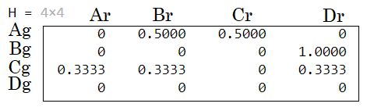
Mathematical analysis
The method used to determine the PageRank begins in representing the Web in a more mathematically workable manner (so it is easier to perform operations and understand the interaction between various websites).
We do this by expressing the DWG as a n x n “hyperlink matrix”, H, where n represents the number of webpages in the DWG.

Slide 11
Filling this matrix
If we consider any webpage i and that it has at least one link to another webpage j, then the element in the row i and column j of Hij = 1/ (no of links given away by page i or no of red dots) and if it does not have any link then Hij = 0 (no of red dots = 0).
By filling the matrix in the above order, the column represents the link of the webpage found in other webpages (the endorsements that they received) and the row represents the links of other webpages that the given webpage referenced in their webpage (the endorsements that they gave).
The Hij also account for the fact that links are more meaningful if less of them are given as the sum of columns of each row adds up to 1 (this makes it so that a website can split between 1 giving score).

Slide 12
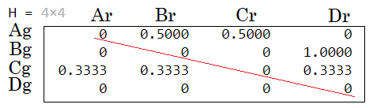
Observations
We observe from this matrix that all diagonal elements are 0 as it represents the links of the website given and received by itself which is not possible as websites never link to themselves (adds no meaning)

Slide 13
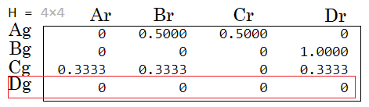
Dangling Node

Slide 14
What is dangling node
A dangling node represents a webpage that references no other webpage or that there are no links to continue to other webpages from it (in this case D is a dangling node). This In the matrix will be a row of zeros. Since majority of websites are dangling nodes, the object has two options
1. Stop browsing (not possible – since he is an ideal browser)
2. Enter a custom URL of any other random webpage in the address line of a Web browser.
H alone cannot model the possibility of moving from the dangling node webpages to other webpages, so we add another term to fix this issue.

Slide 15

Fix and modifying terms

Slide 16
0-vector fix
General procedure:
A set of closely related topics and their ranks are given more preference that is determined by a more wholesome calculation. And the term is more or less like the previous one which is then added to get S.
S = H + adapting term

Slide 17
One possible method
Each 0-vector row of H is replaced by an equal probability distribution vector, w, a vector with non-negative elements that sum to 1(all elements being 1/n except the one that represents itself which is 0 – cannot link to itself) (this removes any unwanted favorability)
The resulting matrix Is of the form,
S = H + R

Slide 18
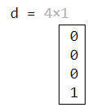

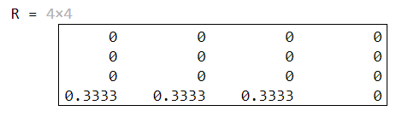
R = d*w
Here d is a column vector the identifies dangling nodes, d is filled by the condition that if all elements of a row is 0 then the value of the corresponding element is 1 otherwise it is 0.
What this allows us to do is by matrix multiplication it generates the missing terms without changing the old ones

Slide 19
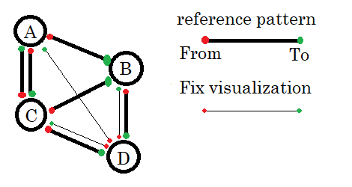
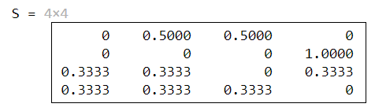
Revisualizing the Change
we can note here that this is a for of adapting term

Slide 20
Have we completely modeled a simulation ?
Ans: No
Why ?
Even after we deal with the 0-vector we need to address another possible way a real user would navigate through the web, he/she can also just hop from one site to another without using the links by using URLs and now we see how we can handle that situation.

Slide 21
Hopping fix
The general form of the matrix that accounts for hopping behavior of users is represented by G. we can also account for another feature of the search engine by making it user specific (we need to adjust for users based on their personal preferences on using the search engine) and this is done by using a personalization vector, v. This uses data from previous searches of its users to keep adjusting its values giving more frequently visited websites better probabilities than those less frequent.
V-vector is used to mimic user preferences. (the data required for these changes can be made to a ratio and appended to are stored in the cloud segment of each user).
The hopping is a common behavior for most users, and it also requires and experimental term with a ratio(value). This term is referred to as damping factor, a (scalar; 1>a>=0), in the matrix indicates that random Web surfer move to a different webpage by some means other than selecting a link with probability 1-a.(the range of values from 0.85 to 0.99)

Slide 22
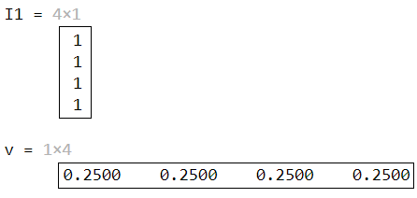
Formulation
Final Matrix:
G = a*S + (1-a) *İ*v

Slide 23
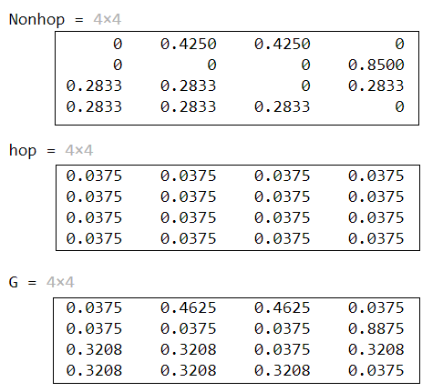

Slide 24
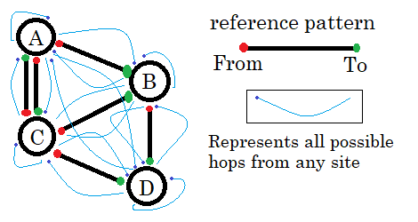
Revisualizing the change
Every possible hop for considered DWG
In the above matrix G is correct theoretically but we see that matrix diagonal terms are not zero – this represents the probability of entering the same link. (hopping to the same site)
2. İ is a column vector used to identify all rows of the matrix which can be used to add the personalized hop from any website in combination with the probability to do so.

Slide 25
Spam protection
If we closely look to inspect the final matrix, we see that on using v = w we make the matrix exposed to link spamming. Link spamming is the practice by some search engine optimization experts of adding more links to their clients’ webpages for the sole purpose of increasing the PageRank score of those webpages. This attempt to manipulate PageRank scores is one reason Google does not reveal the current damping factor or personalization vector for the Google matrix (we can be pretty sure that v is not equal to w). In
2004, however, Gy¨ongyi, Garcia-Molina, and Pederson developed the TrustRank algorithm to create a personalization vector that decreases the harmful effect of link spamming, and Google registered the trademark for TrustRank on March 16, 2005.

Slide 26
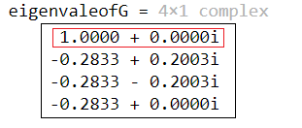
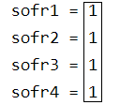
Interesting observations of G
All elements of G lie between 0 and 1 and the sum of each element in each row of G is 1 by definition this makes it a stochastic matrix.
Though not required, the personalization vector, v, and dangling node vector, w, often are defined to have all positive entries that sum to 1 instead of all nonnegative entries that sum to 1. Defined this way, the PageRank vector also has all positive entries that sum to 1.
λ = 1 is not a repeated eigenvalue of G and is greater in magnitude than any other eigenvalue of G. Hence, the eigensystem, πG = π, has a unique solution, where π is a row probability distribution vector.
For smaller a, v plays more role in G and vice-versa. Complimentary to the relation between a and S.

Slide 27

Evaluation of G matrix

Slide 28
PageRank Scores
The web has 6 billion webpages, a matrix account for all of these pages becomes computationally extensive. here we can use some clever mathematics to get an approximate value with control over the error term.
The power method converges when the dominant eigenvalue is not a repeated eigenvalue for most starting vectors. Since λ = 1 is the dominant eigenvalue of G and π is the dominant left eigenvector, the power method applied to G converges to the PageRank vector. This method was the original choice for computing the PageRank vector.

Slide 29
Score calculation
Given a starting vector π (0), e.g., π (0) = v, the power method calculates successive iterates
π (k) = π (k−1) G, where k = 1, 2, ...,
until some convergence criterion is satisfied. Notice that π (k) = π (k−1) G can also be stated π (k) = π (0)Gk . As the number of nonzero elements of the personalization vector increases, the number of nonzero elements of G increases. Thus, the multiplication of π (k−1) with G is expensive; however, since S = H + dw and G = αS + (1 − α)11v, we can express the multiplication as follows:
= π (k−1) [α (H + dw) + (1 − α) İ v]
= απ(k−1) H + α (π (k−1) d) w + (1 − α) (π (k−1) İ) v
= απ(k−1) H + α (π (k−1) d) w + (1 − α) v ,
since π (k−1) İ = 1.
The criterion used in the following code is e which stands for error (it is a term that replaces (k−1) in the above formula with error-controlled accuracy term e)
π (k) = π (k−1) G

Slide 30
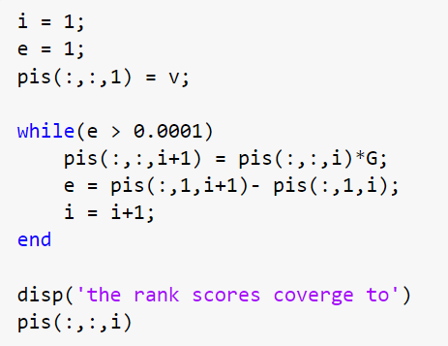
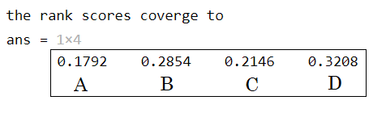
MatLab code:
This shows the priority order as D>B>C>A
On observing the used DWG, we can clearly see the pattern.

Slide 31
How can this approximation be justified ?
This is a sum of three vectors: a multiple of π (k−1) H, a multiple of w, and a multiple of v. (Notice that π (k−1) d is a scalar.)
The only matrix-vector multiplication require is with the hyperlink matrix H.
A 2004 investigation of Web documents estimates that the average number of out links for a webpage is 52. This means that for a typical row of the hyperlink matrix only 52 of the 25 billion elements are nonzero, so the majority of elements in H are 0 (H is very sparse). Since all computations involve the sparse matrix H and vectors w and v, an iteration of the power method is cheap (the operation count is proportional to the matrix dimension n).

Slide 32
Other factors that determine the quality of the result
Keywords used in the query – any portion of the text query if surrounded by double quotes “example query” is taken as a search query's keyword if not specified, it has a linguistic saturation algorithm to select keywords in a sentence and then bases its SERP on it.
The location of query – the search results vary based on the location of the request these are often managed by localized control servers and each of them have specific tweaks based off of their location. For example – on an Indian server the search for “Holi colors” lists places to buy colors but the same search on an American server might give results on description of the festival.
The time relevance of query –the freshness of the webpages also affects the SERP. For example – latest news about a topic is more likely to appear before older ones
We do not the extent of consideration of the size of the webpage, but we can say strongly that it won't play as big as a role as above factors because as a user is opting to surf to find solutions and won't be impressed by the size.

Slide 33
Search engine optimization
From all that we have learnt we can conclusively say that in order to optimize any website there are no shortcuts but to be committed towards delivering quality content. These set of rules can serve as a checklist to have the best chance.
Getting started.
Help Google find your content.
Tell Google which pages shouldn't be crawled.
Help Google (and users) understand your content.
Manage your appearance in Google Search results.
Organize your site hierarchy.
Optimize your content.
Optimize your images.

Slide 34
Bibliography
Definitions:
https://www.google.com/
Images and matrices:
All images used in this were generated as screenshots of computation experiments using Matlab
Only one statistical graph was with relation to https://statcounter.com/
Referred articles:
Article on page rank by Rebecca S. Wills
Article on using linear algebra for IIR by M.W Berry, S.T.Dumais and G.W.O'Brien
https://www.deepcrawl.com/knowledge/technical-seo-library/how-do-search-engines-work
Videos:
https://www.youtube.com/watch?v=0eKVizvYSUQ&t=247s
https://www.youtube.com/watch?v=qxEkY8OScYY&t=366s
https://www.youtube.com/watch?v=meonLcN7LD4

Slide 35
Thank you

