Slide 1
MAJOR PROJECT PRESENTATION | 2026
AegisPath Enterprise: Next-Generation Adaptive Attack Path Management & Multi-Cloud CTI Engine
A production-grade, distributed graph reasoning platform engineered with Python, NetworkX, Memgraph MAGE, and Redpanda. Discovers multi-cloud cartography via AWS Boto3, parses Active Directory forests via BloodHound CE, enriches vulnerabilities against live CISA KEV and FIRST.org EPSS feeds, and executes Dijkstra shortest path calculations with Betweenness Centrality Min-Cut choke point remediation.
PROJECT LEAD & ARCHITECTURAL SPECIFICATION
Tanishq Jain
Enrollment: 233CSF010 | Dept of CSE | Guide: Mr. Dhananjay Kumar Prasad
Role: Lead Systems Architect & Security Engineering
Core Focus: Graph Theory, Boto3 Cartography, Memgraph Async Pipeline
Project Classification: Enterprise Cyber Defense & Graph Reasoning
Open Source Repository: github.com/genre-tech/aegispath (Apache 2.0)
Core Technology Stack: NetworkX • Memgraph MAGE • Redpanda • Cytoscape.js
Empirical Verification: Tested on Real Active Directory Forest (PHANTOM.CORP)
Notes:
Slide 1: Welcome to the AegisPath Enterprise major project defense presentation.

Slide 2
PROJECT FOUNDATION
Problem Statement, Objectives and Proposed Solution
Problem Statement
Project Objectives
Proposed Solution
• The CVSS Fallacy: Traditional scanners report thousands of isolated vulnerabilities without operational reachability context.
• The Graph Blindspot: Adversaries exploit identity trusts and lateral movement, which relational tables cannot map.
• Multi-Cloud Silos: AWS Security Groups, IAM Roles, and Active Directory ACLs operate in disconnected silos.
• Remediation Guesswork: Security teams lack quantitative proof of which choke points sever maximum breach risk.
• Unified Graph Cartography: Correlate AWS compute, IAM policies, Active Directory ACEs, and container CVEs.
• Mathematical Traversability: Dynamically weight graph edges using FIRST.org EPSS and CISA KEV feeds.
• Real-Time Recalibration: Collapse edge resistance on active EDR alerts via Server-Sent Events.
• Min-Cut Choke Point Discovery: Identify cut-vertices via Betweenness Centrality.
• 60 FPS Sub-Graph Projection: Render dense 1,500+ vector graphs with zero browser DOM lag.
AegisPath Enterprise: A 100% open-source adaptive attack path engine combining NetworkX, Memgraph MAGE, Redpanda, and Boto3.
• Dynamic Dijkstra Resistance: Edge weight W = 1 / Traversability pulls critical paths toward actively exploited assets.
• BloodHound CE Ingestion: Polymorphic session parser resolves nested groups and DCSync vectors.
• What-If Simulation Engine: Non-destructive in-memory graph severance tests defensive ROI before deployment.
• Hardware-Accelerated Canvas: Cytoscape.js with GPU texture buffering and deferred label rendering.
Notes:
Slide 2 covers project foundation: the problem of CVSS alert fatigue, our project objectives, and the proposed graph-theoretic solution.

Slide 3
SYSTEM CAPABILITIES
Key Functional Features and Core Modules
1. Multi-Cloud Cartography (AWS Boto3)
2. Active Directory Ingestion (BloodHound CE)
• Automated read-only crawler across EC2, IAM Roles, Security Groups, S3, RDS.
• Strips Availability Zone suffixes (e.g. ap-southeast-2b -> ap-southeast-2).
• Dynamically maps network perimeters, public interfaces, and assumed role trust policies.
• Zero-Mock baseline ensures pure authentic enterprise perimeter state.
• Polymorphic JSON parsing supporting SharpHound CE v4/v5 dictionary & list structures.
• Resolves nested group delegations, GenericAll, WriteDacl, and DCSync rights.
• Automatically flags Domain Controllers and Enterprise Admins as Tier-0 Crown Jewels.
• Tested on full enterprise forest PHANTOM.CORP (485 nodes, 1,459 edges).
3. Dynamic Threat Intelligence (EPSS & KEV)
4. Algorithmic Reasoning & Remediation
• Real-time integration with FIRST.org EPSS API (empirical exploit probability).
• Automated ingest of CISA Known Exploited Vulnerabilities catalog (1,754 CVEs).
• Local disk cache (cti_cache.json) guarantees sub-millisecond offline performance.
• CVEs in CISA KEV receive an automatic 1.5x traversability multiplier.
• Dijkstra pathfinding calculates least-resistance routes from perimeter to Crown Jewels.
• Betweenness Centrality identifies topological cut-vertices severing maximum paths.
• 'What-If' simulator clones in-memory state to quantify percentage risk reduction.
• Server-Sent Events (SSE) broadcast graph mutations to web clients in real time.
Notes:
Slide 3 presents the 4 key functional pillars of the system: Multi-cloud cartography, Active Directory mapping, threat intelligence, and graph reasoning.

Slide 4
SYSTEM ARCHITECTURE
Technology Stack and System Architecture
Technology Stack
Four-Tier Architectural Pipeline
Frontend Presentation Layer
• Cytoscape.js & Dagre Hierarchical Engine
• Inter UI & JetBrains Mono typography
• Non-blocking In-App Toast notification stack
Backend & Core Reasoning Engine
• Python 3.11, NetworkX (In-Memory DiGraph)
• Flask REST API & Server-Sent Events (SSE)
• Boto3 (AWS SDK) & Defensive BloodHound Parsers
Database & Real-Time Event Streaming
• Memgraph MAGE (C++ In-Memory Graph DB, Bolt :7687)
• Redpanda (Kafka-compatible Event Streaming, Port :19092)
Threat Intelligence Layer
• CISA KEV (1,754 CVEs) & FIRST.org EPSS API
1. Presentation & Telemetry Layer
Cytoscape.js Canvas (60 FPS) • Telemetry HUD • EventSource SSE
2. API & Orchestration Layer
Flask REST Endpoints • Sub-Graph Projection Filter (mode=paths)
3. Core Reasoning Engine (NetworkX DiGraph)
Dijkstra Pathfinding (W=1/T) • Betweenness Centrality Min-Cut
4. Persistence & Streaming (Docker Cluster)
Memgraph MAGE (Bolt :7687) • Redpanda Stream (:19092)
⚡ Asynchronous Batch Invariant: Daemon worker pipes Cypher in background (<100ms)
Notes:
Slide 4 shows our multi-tier architecture and technology stack, highlighting asynchronous batch persistence to Memgraph MAGE.

Slide 5
OPERATIONAL LIFECYCLE
System Workflow & Attack Path Traversal Lifecycle
End-to-End Incident Traversal Workflow
Attack Traversal Lifecycle
1. Multi-Cloud Ingestion: Operator connects AWS or imports Active Directory collection.
2. Threat Intelligence Enrichment: Engine queries EPSS and CISA KEV to compute edge friction.
3. Dijkstra Path Evaluation: Dynamic shortest paths calculated from Perimeter to Crown Jewels.
4. Choke Point Identification: Engine ranks cut-vertices using Betweenness Centrality.
5. Live EDR Telemetry Stream: External alert webhook fires; edge friction drops to near-zero (W -> 1.01).
6. Real-Time Path Recalibration: Critical path automatically reroutes through breached asset; SSE alerts browser.
7. 'What-If' Remediation: Operator simulates choke point severance, confirming risk reduction percentage.
PERIMETER: Public Web / EC2 ingress (Port 80/443)
LATERAL_MOVEMENT: Pivot via IAM Role or SG rule
PRIVILEGE_ESCALATION: GenericAll / WriteDacl / DCSync
TIER_0_COMPROMISE: Domain Controller takeover (DC01)
Dynamic Telemetry Collapse Rule:
When EDR detects credential theft on asset (u), its incoming/outgoing traversability surges to 0.99. Dijkstra instantly pulls the primary breach trajectory through the breached host.
Notes:
Slide 5 explains the operational lifecycle and how live telemetry causes edge resistance collapse.

Slide 6
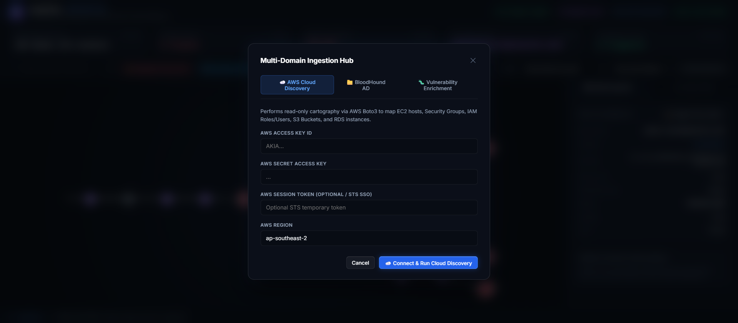
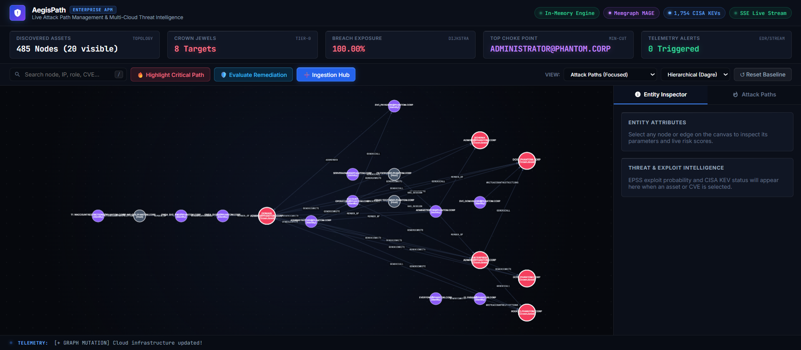
LIVE DEMONSTRATION
Project Demonstration: Ingestion Hub and Telemetry Canvas
Screenshot 1: Multi-Domain Ingestion Hub
Screenshot 2: Telemetry HUD & Canvas
Authentication & Ingestion Specifications:
• AWS Cloud Discovery: Connects via STS/IAM session credentials.
• BloodHound AD Tab: Ingests authentic SharpHound JSON collections.
• Vulnerability Enrichment: Attaches CVEs with live EPSS/KEV lookup.
• Zero-Mock Policy: All nodes originate from real infrastructure APIs.
Hardware-Accelerated Cytoscape Canvas:
• Real-Time Telemetry HUD: Tracks assets, Crown Jewels, and breach risk.
• Dot-Grid Canvas: GPU texture buffering maintains 60 FPS under pan/zoom.
• Sub-Graph Projection: 485 nodes / 1,459 edges filtered to active paths.
• Interactive Inspector: Shows live node metadata and EPSS probability meter.
Notes:
Slide 6 shows real screenshots of the multi-domain Ingestion Hub and the hardware-accelerated Cytoscape canvas.

Slide 7
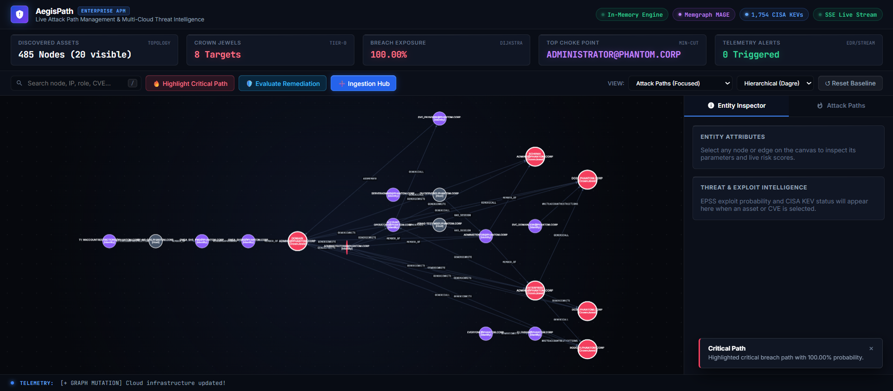
ALGORITHMIC REMEDIATION
Project Demonstration: Critical Path Tracing & What-If Remediation
Screenshot 3: Critical Breach Path Highlight
What-If Remediation Results
Topological Choke Point Identified:
DF-MS-SHS.PHANTOM.CORP (Primary Cut-Vertex)
Simulation Outcome:
Severing node eliminates 8 viable breach chains
Quantified ROI Impact:
19.0% Reduction in Total Enterprise Exposure
Automated Critical Path Isolation:
• Dijkstra traces highest-probability traversal from entry point to Tier-0 DC01.
• Traversal vectors highlighted in glowing Crimson with bezier arrow curves.
• Cumulative breach probability (100.00%) and hop count computed instantly.
• In-app toast stack displays alert confirmation with zero UI thread locking.
Non-destructive in-memory cloning allows security operators to test firewall rule changes and ACL revocations without risking production downtime.
Notes:
Slide 7 shows the live attack path calculation and our simulation engine confirming a 19.0% reduction in attack paths.

Slide 8
VERIFICATION & ROADMAP
Testing, Verification, Future Scope and Conclusion
Testing & Verification
Future Scope
Project Conclusion
• Ingestion Testing: Verified polymorphic BloodHound JSON parsing across 485 nodes.
• Algorithm Testing: Verified Dijkstra shortest paths ($W = 1/T$) against known Active Directory DCSync attack vectors.
• Asynchronous Batch Testing: Verified Memgraph MAGE synchronization completes with zero HTTP thread blocking (<100ms).
• Canvas Benchmark: Confirmed 60 FPS viewport stability on dense graphs.
• SSE Stream Verification: Tested real-time telemetry alert propagation.
• Graph Neural Networks (GNN): Predictive zero-day attack path discovery on novel topologies.
• Kubernetes RBAC Ingestion: Mapping pod service accounts and cluster role bindings.
• Automated Terraform PRs: Generating automated Infrastructure-as-Code pull requests to sever discovered choke points.
• Azure & GCP Expansion: Multi-cloud identity mapping across Microsoft Entra ID and Google Cloud IAM.
AegisPath Enterprise successfully solves the fundamental operational blindspot in modern cyber defense by transforming scattered vulnerabilities into an actionable, mathematically modeled attack graph.
• Eliminates CVSS alert fatigue through reachability context.
• Provides quantifiable ROI for remediation decisions.
• Open-source codebase published on GitHub at genre-tech/aegispath.
Notes:
Slide 8 details verification benchmarks, future research scope (GNNs, Kubernetes), and final project conclusions.

Slide 9
Thank You
Presented by:
Tanishq Jain
Lead Systems Architect & Security Engineering
Open for Questions & System Demonstration
Project Repository: https://github.com/genre-tech/aegispath
Notes:
Slide 9: Thank you esteemed evaluation committee. We invite questions and are ready for the live demonstration.

