Slide 1
A Concrete Truth: predicting concrete strength and carbon footprint
Daniel Freese & Konrad Genser

Slide 2
Dataset and initial plan

Slide 3
Plot of plots, outliers

Slide 4
Different Models
Linear – plain and simple, baseline
Random Forest – Robust and usually works for interpolative
XGBoost – Random forest but better
Histogram-based Gradient Boosting Regression Tree – also robust
Neural Networks – Potential and seems like fun

Slide 5
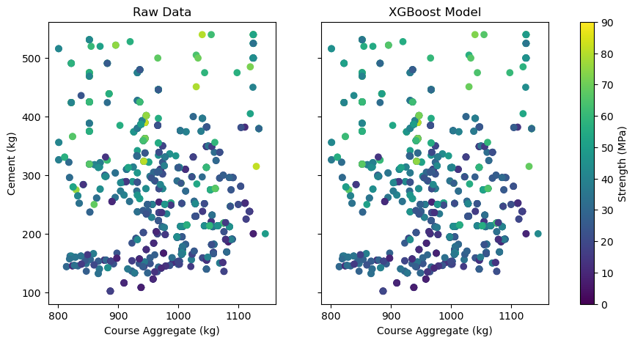
XGBoost Model!

Slide 6
Carbon contour

Slide 7
Conclusion (if we had more time)
Analysis on ash and slag
More neural network training time and other models in general
Build an inverse function that take strength, carbon footprint, price and give ingredients
Make a million dollar concrete startup based off a dataset on Kaggle

