Slide 1

Exploratory Data Analysis
Descriptive Statistics
Project Proposal
Dataset Description
Problem Statement
Data Analysis
DAB 103 Analytic Tools & Decision Making Team 8 - 003
Final Project - Slide Deck
Data Product
Data Cleaning
Recommendation

Slide 2
Team 008 ( Section – 03 )
1. | Piyush Piyush | 789965
2. | Kuldip Dilipbhai Rajput | 789960
3. | Smit Hareshkumar Rana | 792056
4. | Anurag Umesh Rohra | 794506
5. | Pradeep Kumar Tomar | 789140
Exploratory Data Analysis
Descriptive Statistics
Project Proposal
Dataset Description
Problem Statement
Data Analysis
Data Product
Data Cleaning
Recommendation

Slide 3
In the gaming industry, there is a lot of rivalry for new game developers and getting noticed on the Play Store is quite difficult.
Thousands of fresh developers decide to create new types of games every day, but in order to create a successful game, they must first learn what gamers are looking for and which types of games have the best user reaction.
Fresh graduate Game Developers want to gain a better understanding of the many game genres that are popular among customers and gamers around the world on Google Play so that they may concentrate their efforts on high-demand regions and increase their earning potential.
Exploratory Data Analysis
Descriptive Statistics
Project Proposal
Dataset Description
Problem Statement
Data Analysis
Data Product
Data Cleaning
Recommendation

Slide 4
Original Dataset Link : https://www.kaggle.com/dhruvildave/top-play-store-games
Each of the 17 game categories is represented in the data collection. 1500+ rows and 14 columns make up this data set. Each game includes all rating information, as well as the number of users that have downloaded the game. We cleaned all data to ensure that there are no errors or missing data in the dataset, and our analysis will be based on the cleaned dataset playstore_games_final.csv, which is hosted on GitHub repository.
Exploratory Data Analysis
Descriptive Statistics
Project Proposal
Dataset Description
Problem Statement
Data Analysis
Data Product
Data Cleaning
Recommendation

Slide 5
Our team is working on a project that will combine Play Store data with user ratings to produce a descriptive analytics solution that will help developers grasp the newest gaming trends and needs fast, allowing them to enhance their games and give better gameplay to their customers.
Exploratory Data Analysis
Descriptive Statistics
Project Proposal
Dataset Description
Problem Statement
Data Analysis
Data Product
Data Cleaning
Recommendation

Slide 6
Descriptive analysis is a sort of data analysis that helps to explain, show, or summarize data points in a constructive way so that patterns can develop that satisfy all the data's conditions. It is one of the most crucial steps in the statistical data analysis process.
Mean, Median, Standard Deviation, No. of rows/columns, null values, numerical variables, outliers, distinct values etc.
Exploratory Data Analysis
Descriptive Statistics
Project Proposal
Dataset Description
Problem Statement
Data Analysis
Data Product
Data Cleaning
Recommendation

Slide 7
The practice of finding and repairing (or deleting) faulty or erroneous records from a record set is known as data cleaning or cleansing.
Standardizing data sets, and repairing faults like empty fields, missing codes or finding duplicate data points, Fixing spelling and grammar issues, are all examples of data cleaning.
Exploratory Data Analysis
Descriptive Statistics
Project Proposal
Dataset Description
Problem Statement
Data Analysis
Data Product
Data Cleaning
Recommendation

Slide 8
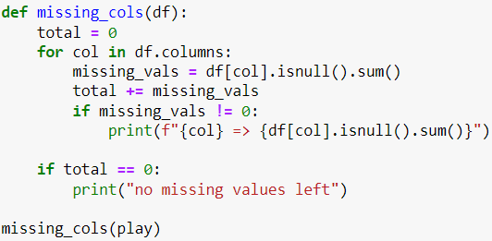
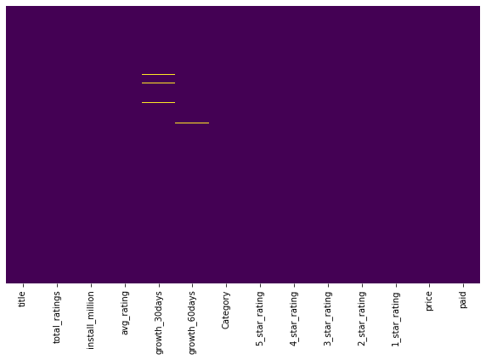
There 12 and 9 null values in growth_30days and growth_60days columns, respectively.
Exploratory Data Analysis
Descriptive Statistics
Project Proposal
Dataset Description
Problem Statement
Data Analysis
Data Product
Data Cleaning
Recommendation

Slide 9
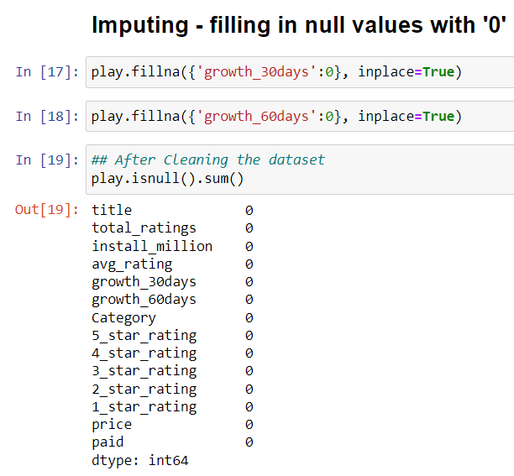
Exploratory Data Analysis
Descriptive Statistics
Project Proposal
Dataset Description
Problem Statement
Data Analysis
Data Product
Data Cleaning
Recommendation

Slide 10
Exploratory Data Analysis is an approach of analyzing data sets to summarize their main characteristics, often using statistical graphics and other data visualization methods
An EDA is a detailed study that is used to identify the underlying structure of a data set. It is beneficial to a business because it reveals trends, patterns, and linkages that are not easily visible.
Exploratory Data Analysis
Descriptive Statistics
Project Proposal
Dataset Description
Problem Statement
Data Analysis
Data Product
Recommendation
Data Cleaning

Slide 11
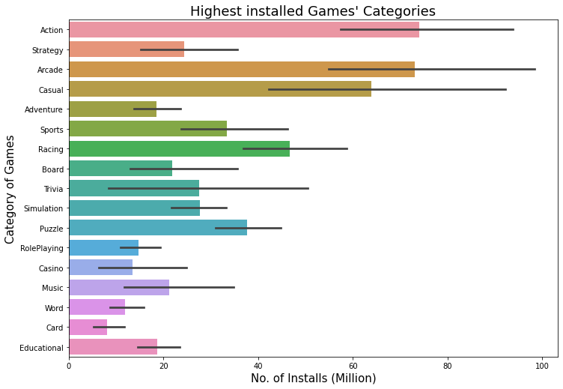
Which is the most installed game genre?
Exploratory Data Analysis
Descriptive Statistics
Project Proposal
Dataset Description
Problem Statement
Data Analysis
Data Product
Recommendation
Data Cleaning

Slide 12
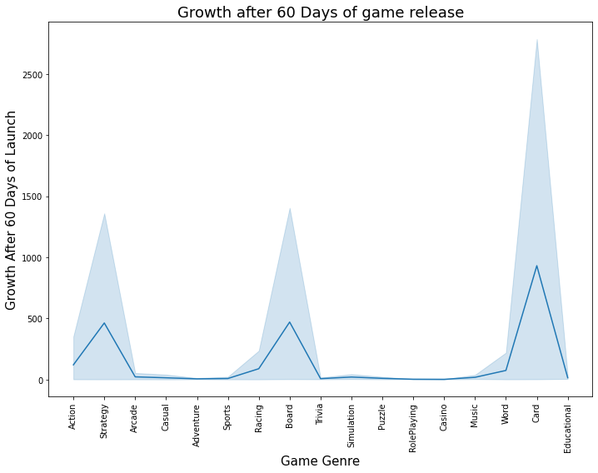
Which genre caught highest growth after 60 days of launch ?
Exploratory Data Analysis
Descriptive Statistics
Project Proposal
Dataset Description
Problem Statement
Data Analysis
Data Product
Recommendation
Data Cleaning

Slide 13
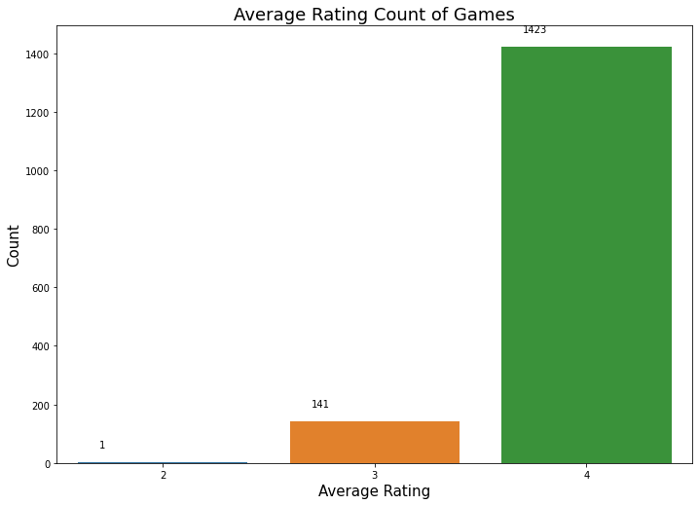
Count the average ratings given to games on Play Store
Exploratory Data Analysis
Descriptive Statistics
Project Proposal
Dataset Description
Problem Statement
Data Analysis
Data Product
Recommendation
Data Cleaning

Slide 14
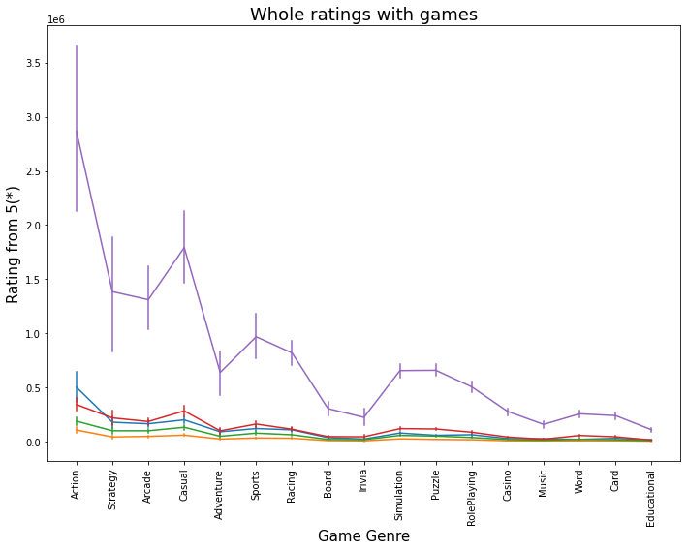
Show the rating(1-5) for different games group.
Blue 1 Star Rating
Yellow 2 Star Rating
Green 3 Star Rating
Red 4 Star Rating
Purple 5 Star Rating
Exploratory Data Analysis
Descriptive Statistics
Project Proposal
Dataset Description
Problem Statement
Data Product
Data Analysis
Recommendation
Data Cleaning

Slide 15
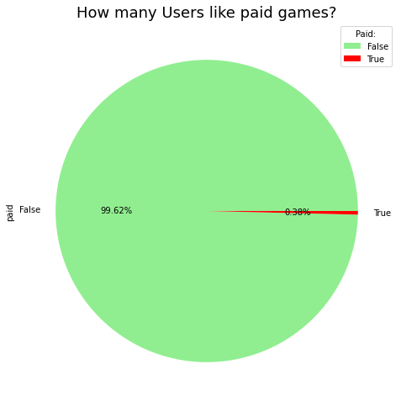
How many users prefer to download paid/free games from Google Play Store?
Exploratory Data Analysis
Descriptive Statistics
Project Proposal
Dataset Description
Problem Statement
Data Product
Data Analysis
Recommendation
Data Cleaning

Slide 16
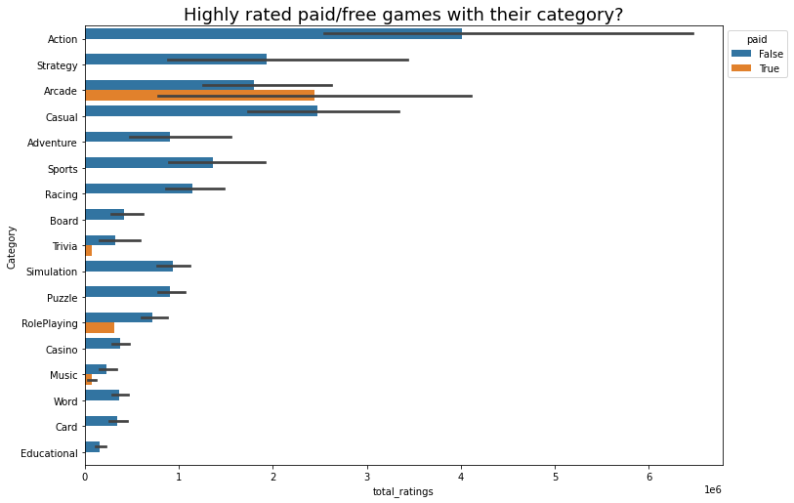
Which genres of games are highly rated with paid/free norm?
Exploratory Data Analysis
Descriptive Statistics
Project Proposal
Dataset Description
Problem Statement
Data Product
Data Analysis
Recommendation
Data Cleaning

Slide 17
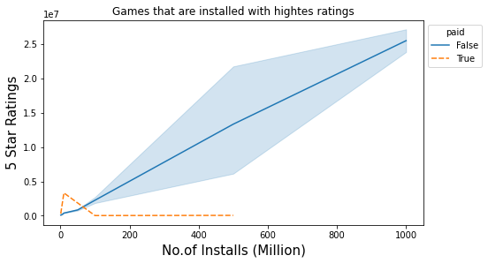
How is relation between installation count and highest rating of game based on paid criteria ?
Exploratory Data Analysis
Descriptive Statistics
Project Proposal
Dataset Description
Problem Statement
Data Product
Data Analysis
Recommendation
Data Cleaning

Slide 18
A data product is a program or tool that uses data to assist businesses in making better decisions and procedures. Non-data scientists can utilize data science to provide predictive analytics, descriptive data modelling, data mining, machine learning, risk management, and a variety of analysis methodologies through data products with a friendly user interface.
Exploratory Data Analysis
Descriptive Statistics
Project Proposal
Dataset Description
Problem Statement
Data Analysis
Recommendation
Data Product
Data Cleaning

Slide 19
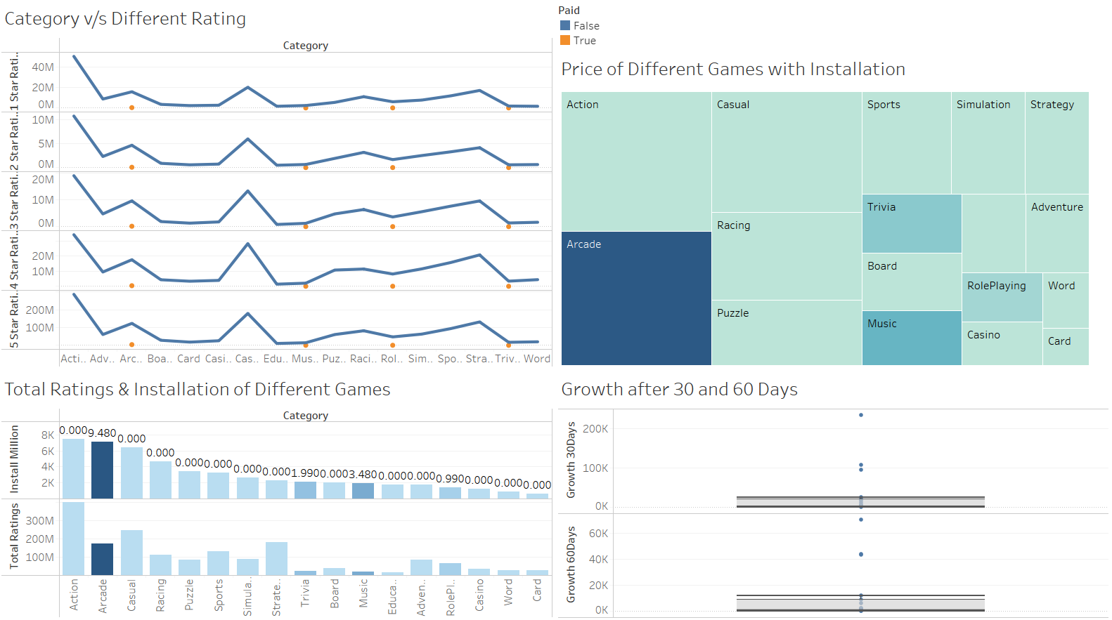
A data dashboard is a tool for tracking, analysing, and displaying important performance indicators, metrics, and data points. A dashboard can be used to keep track on the overall health of a company, a department, or a specific procedure.
With the help of Tableau, we were able to produce this.
Exploratory Data Analysis
Descriptive Statistics
Project Proposal
Dataset Description
Problem Statement
Data Analysis
Recommendation
Data Product
Data Cleaning

Slide 20
We've gone through a variety of analyses, each with its own set of parameters. Finally, we'd argue that the factors that have the most impact on free games are as follows. A Google PlayStore user expresses an interest in free games.
Users are interested in downloading and rating action games, as well as games from other genres. Because an action game is a type of video game that focuses on physical tasks such as hand–eye coordination and response time. People are more interested in strategy, arcade, and casual games after activity than other categories. Gamers prefer paid arcade games to free arcade games. Unfortunately, instructional games are among the least popular among users.
Exploratory Data Analysis
Descriptive Statistics
Project Proposal
Dataset Description
Problem Statement
Data Analysis
Recommendation
Data Product
Data Cleaning

Slide 21
Paid Trivia, Role-Playing and Music type of games, hardly make a growth on PlayStore. If developers wants to create games, then they must refer first die-hard fans of a certain free-to-play game titles who don't need anything else to have a good time or who are fine with a limited choice of free games.
Paid arcade gamers, on the other hand, are never satisfied with the restricted options available. Because some paid games necessitate the purchase of microtransactions in order to enjoy a satisfying gaming experience. There are also a number of excellent free-to-play games that only offer cosmetic items that have no influence on the game's gameplay. In terms of playing experience, though, silver spooners have a huge advantage over cheapskates.
Developers first need analyze which type of games has largest gamers base and try to create according to their interest in order to increase earning potential.
Exploratory Data Analysis
Descriptive Statistics
Project Proposal
Dataset Description
Problem Statement
Data Analysis
Data Product
Recommendation
Data Cleaning

Slide 22
THANK
YOU
Exploratory Data Analysis
Descriptive Statistics
Project Proposal
Dataset Description
Problem Statement
Data Analysis
Data Product
Recommendation
Data Cleaning

