Slide 1

CREDIT SCORE CLASSIFICATION
DAB402 Capstone Project
https://github.com/gentallman/Capstone-Project
Group 11 - Section 005
Avikumar Patel (0790966)
Smit Rana (0792056)
Vaibhav Patel (0772934)
Yashkumar Patel (0797825)

Slide 2
Outline
Problem Statement
About Data
Workflow
Data Cleaning and Preparation
Descriptive Statistics
Exploratory Data Analysis
Machine Learning and Scaling
Evaluation and Feature Importance
Data Visualization
Model Deployment
Integration with Web Application
Challenges
Conclusions
A

Slide 3
Problem Statement
At the present time, everyone needs to have good credit because it is seen as a sign of trustworthiness. Financial institutions and credit card issuers use credit scores to determine creditworthiness. It enables banks and credit card companies to issue loans to customers with excellent creditworthiness immediately.
In today's fast-paced world, doing a manual investigation into each portfolio and generating a credit report both take a significant amount of time. Most of the banks and credit card companies use Machine Learning algorithms to categorize all their customers based on their credit history.
We made a classification system for credit scores to get rid of having to do work by hand. Based on banking data, it is possible to put people into three groups: excellent, standard, and poor.

Slide 4

Statso is a Data Science Community to Find Case Studies, Datasets and more!
This site generates and compiles data from many online sources, and its authors then use this information to develop case studies that show how various types of data can be used to address specific problems.
https://statso.io/credit-score-classification-case-study/
We have 100,000 banking data for credit score classification based on 28 features.
*ID, Customer ID, Name, and SSN are not required fields for credit score calculation because they contain a significant number of unique values. We used additional columns to classify the score.

Slide 5
Workflow
Data Cleaning and Preparation
Exploratory Data Analysis
Descriptive Statistics
Machine Learning and Scaling
Evaluation and Feature Importance
Data Visualization
Model Deployment
Integration with Web Application
executed of data cleaning procedures without eliminating impure data
F1 Score, Accuracy Score, Confusion Matrix and feature relevance determine model performance.
analyze and summarize data characteristics
deployed best possible efficiency model
analyze the data, find trends, and present findings more effectively.
determining the type, mean, and median of data
integrated into the target system
utilize appropriate algorithms, train and test models, scale down data

Slide 6
Data Cleaning and Preparation
We removed the ID, Customer_ID, Name, and SSN fields from the dataset because they were irrelevant. We iterate through the dataset and replace any odd numbers, weird digits and undesirable symbolic patterns with nulls.
There was a column with the name 'Credit_History_Age' that contained data in the format "XX years and XX months", which was irrelevant for analysis and ML modelling. Thus, we converted those columns to months only.
Then, we partition the column operation into two categories: numerical and categorical. For categorical NA values, the customer's most recent non-null value will be used to attempt to update the NA. The mean value of the variable is substituted for null values in numerical ones.

Slide 7
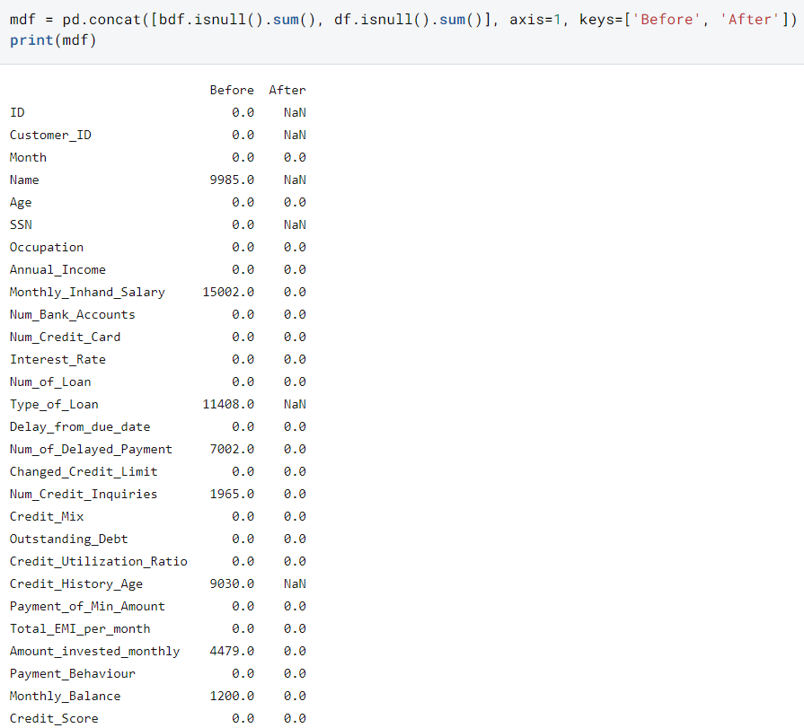
Results..
The presence of NaN in this context suggests that those columns were eliminated during the data cleaning procedure.

Slide 8
Descriptive Statistics (handling Outliers)
Descriptive statistics were utilized for each column of data. And what we discovered was that some of the values in it were completely worthless, while others were much farther away from most of the data points. They are referred to as outliers.
We resolve on a particular range for the variable's possible values after consulting a variety of sources. The number of credit cards, bank accounts, credit inquiries, and loans that an individual may possess. This stage is performed to make data meaningful because their values were excessively high.
In the end, we apply the label encoder to the text-based column in order to get our data ready to fit into the model.

Slide 9
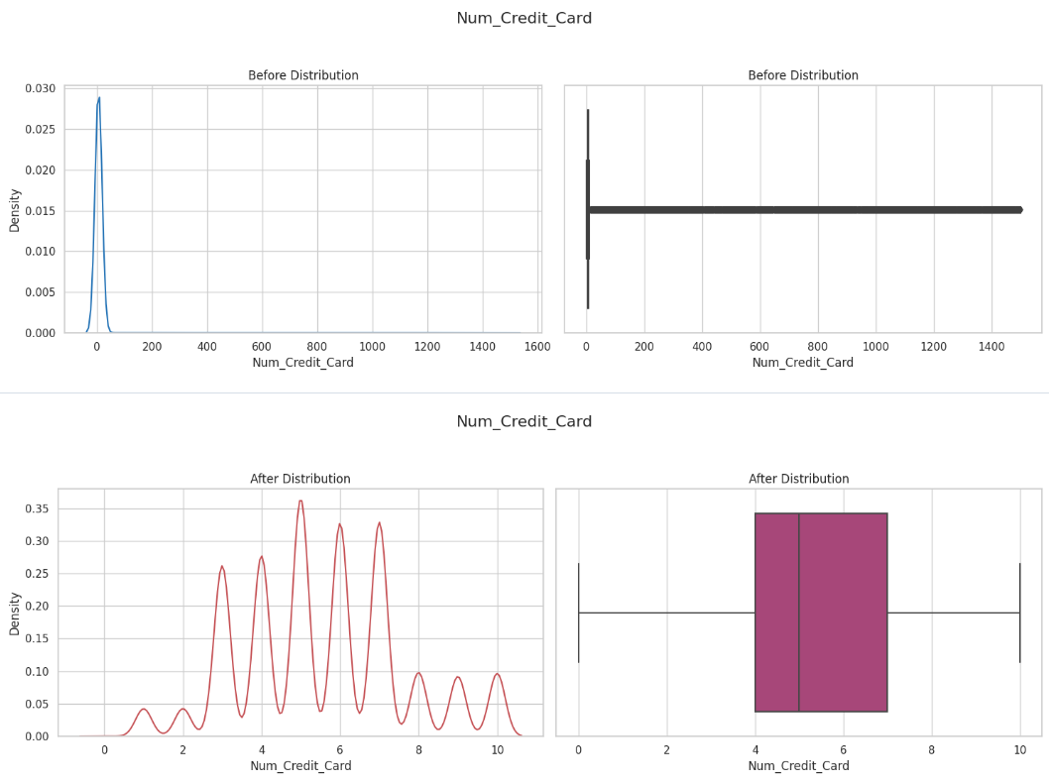
For Example…

Slide 10
Exploratory Data Analysis
After dealing with the outliers, the next step in the EDA process was to take the columns that had been handled and determine the relationship between those columns and our target variable.
We were interested in determining how the value of the multiclass target variable changes in response to the values presented in column.
Y

Slide 11
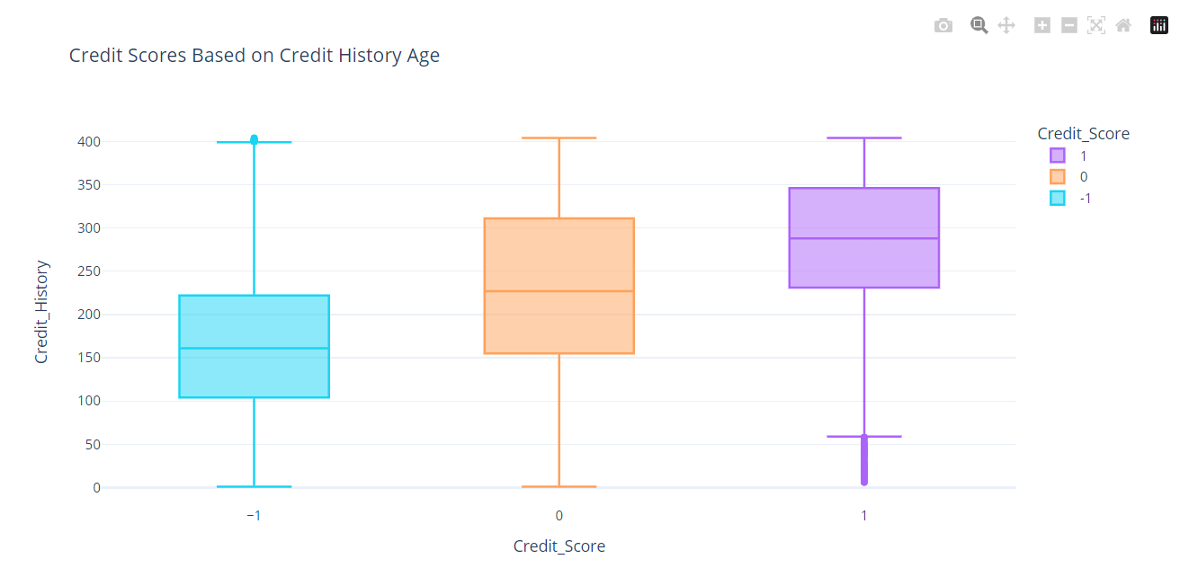
Few Examples…
Hence, higher credit ratings are achieved by those who have a lengthy credit history.

Slide 12
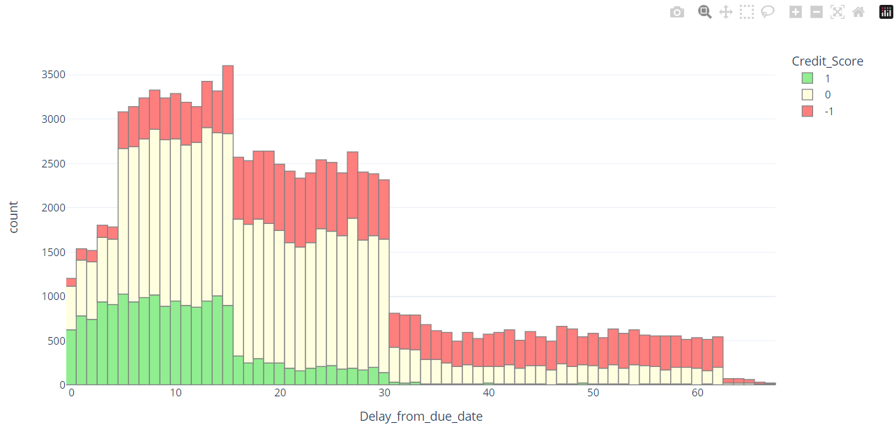
Few Examples…
Your credit score will suffer the most damage if you make a payment after the due date of the billing cycle has passed.

Slide 13
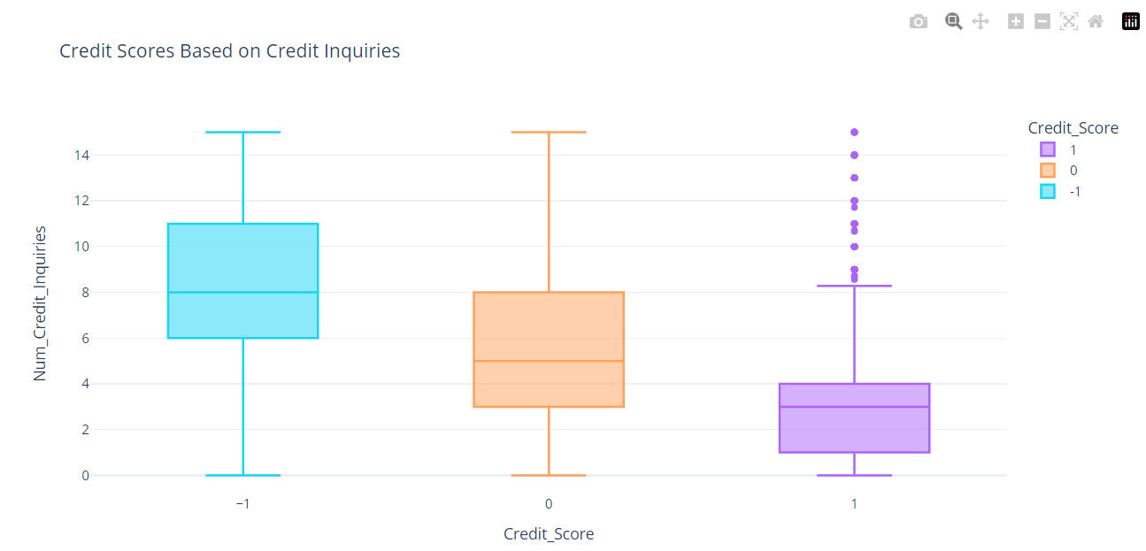
Few Examples…
Your credit score will drop by an amount that is directly proportional to the number of credit inquires done.

Slide 14
Scaling Data
By looking at the correlation matrix, we can quickly see if any two features have a strong positive or negative correlation (close to 1 or -1, respectively), which means they are highly linearly dependent on each other.
Some machine learning algorithms believe that features are independent, so this can be a problem. Having features that are highly related to each other can cause the model to overfit or reduced model performance.
We use MinMax Scaler prior to fitting the data to the model. It scales the features of a dataset to a predetermined range, typically between 0 and 1, by subtracting the minimum value of each feature and dividing by the feature's range.
It can improve the performance of specific machine learning algorithms and make it simpler to compare the relative significance of various features.

Slide 15
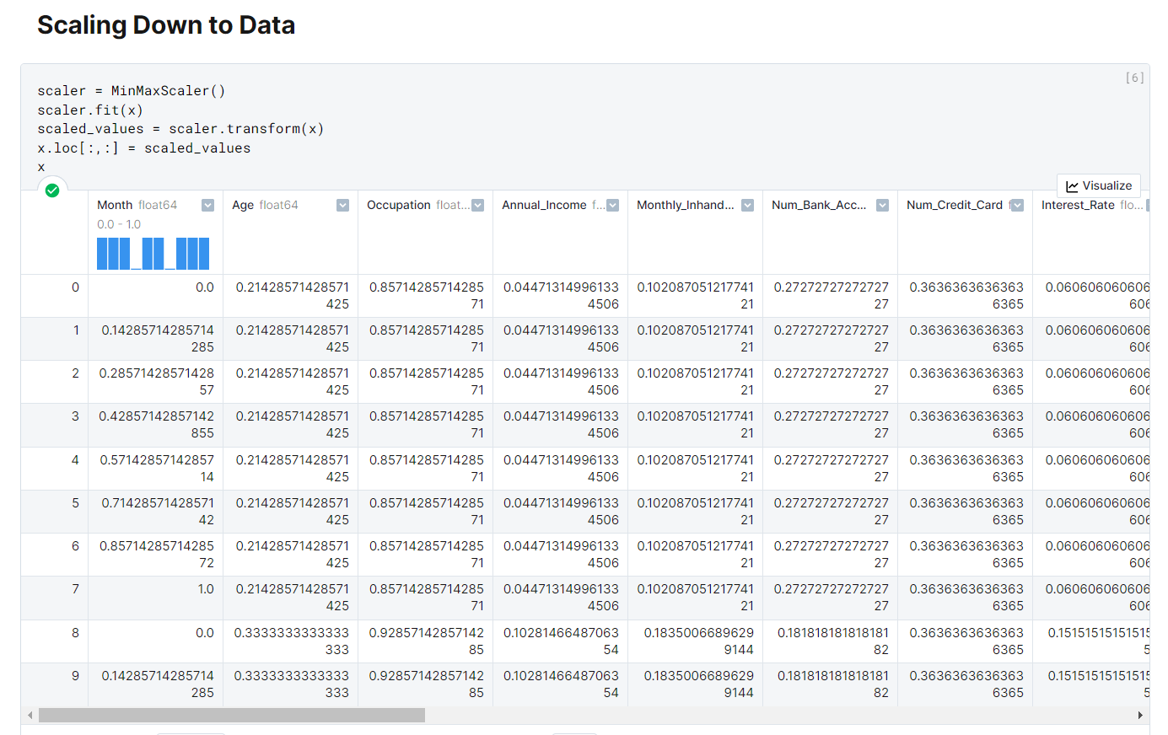
Results..

Slide 16
Machine Learning
We have Multiclass classification Problem. This problem could entail classifying credit score into three distinct categories, such as "poor," "standard" and "good." In this situation, we are working with a multiclass classification problem, hence we cannot utilize a binary classification metrics.
Accuracy, Confusion Matrix, Correlation Plot, and F1 Score are going to be the performance measurements that we use.
We have utilized the following seven classifiers : Random Forest, Decision Tree, XGBoost, AdaBoost, KNN, and Logistic Regression. Voting has also been utilized. For each, we used the performance indicators that were discussed above and plotted the prediction pattern and a feature significance graph.
This gives us the ability to select the model that will work best for integrating it into the production environment so that it can make predictions based on new data as it is being collected.

Slide 17
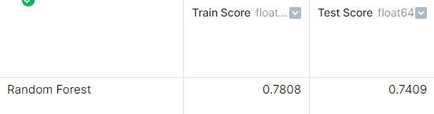
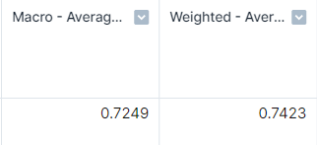
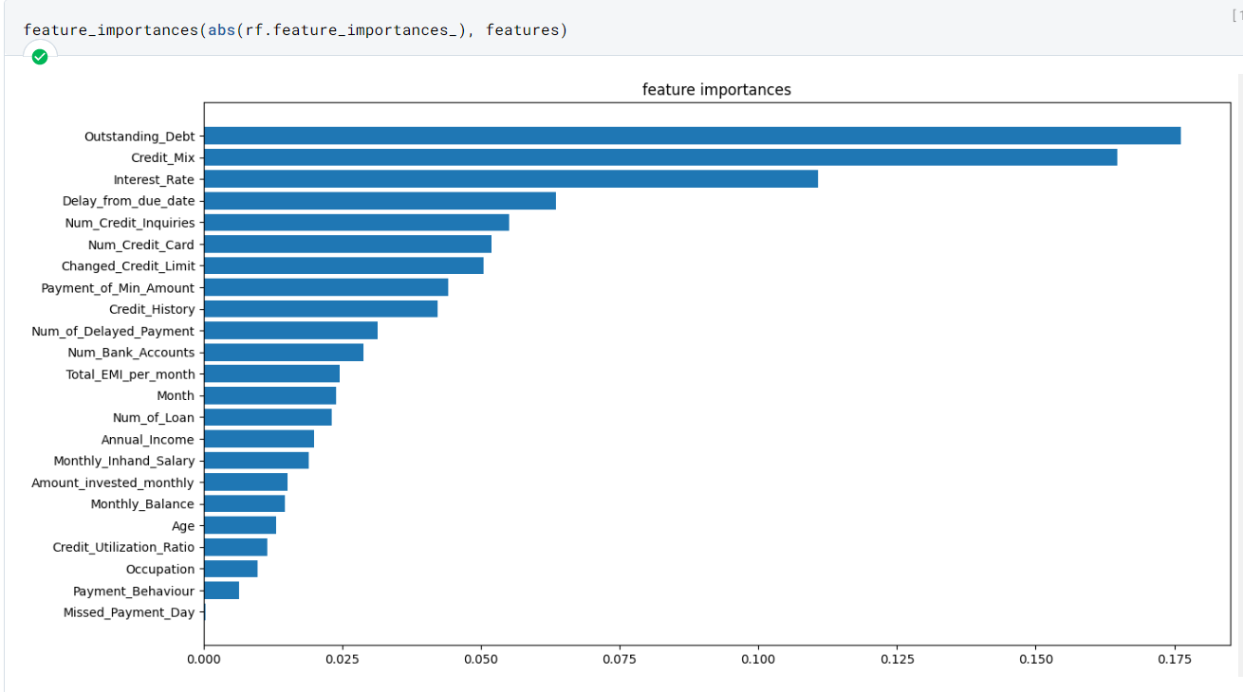
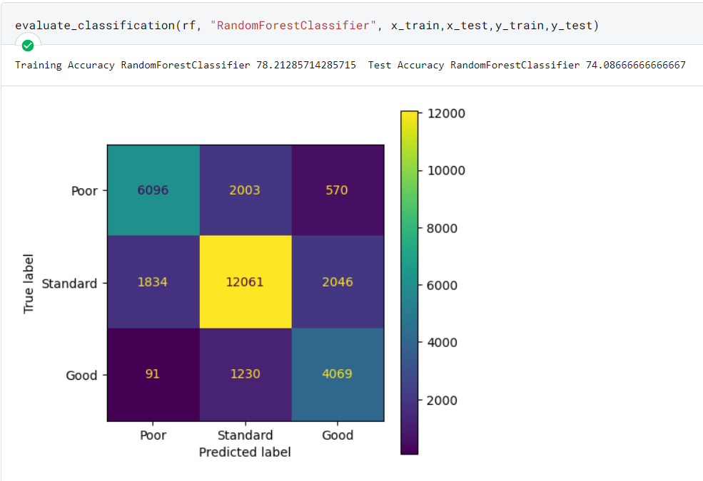
Evaluation

Slide 18
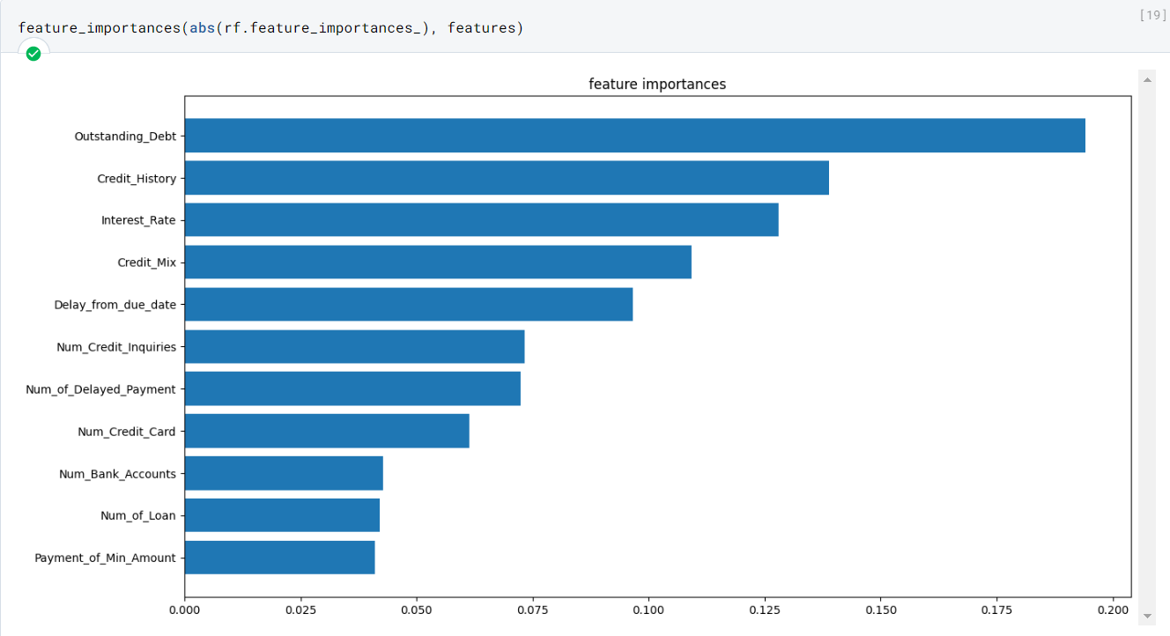
Feature Importance
Feature importance is a metric used in machine learning to identify the most significant input variables (or features) that contribute to a model's ability to predict.
In other words, it helps in determining which features are most crucial for predicting the target variable
There are 23 features in our data that can determine the class of our objective variable. Nevertheless, some features have a negligible impact or have no real-world significance. Adding 23 fields to an application is also not an ideal choice. Therefore, we select the eleven most important features for our model deployment. That will be used for application integration

Slide 19
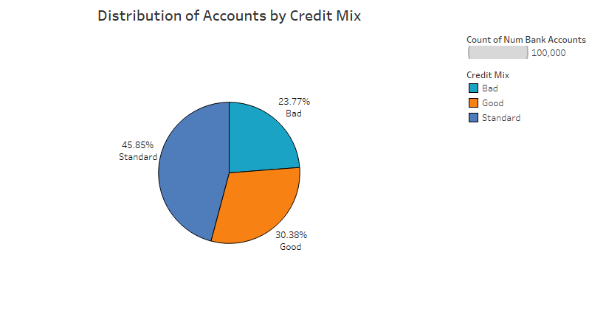
Data Visualization
This pie chart displays the percentage of bank accounts and credit mix, with credit mix shown by different colours. Slices reveal the type of each credit mix with the label, while percentages shows the bank accounts number.

Slide 20
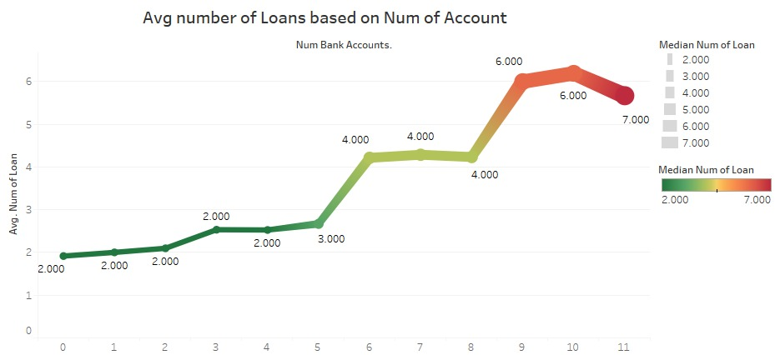
Continue..
This visualisation displays the average number of loans based on the average number of bank accounts. Trends and correlations between the quantity of loans and the typical number of bank accounts can be seen here.

Slide 21
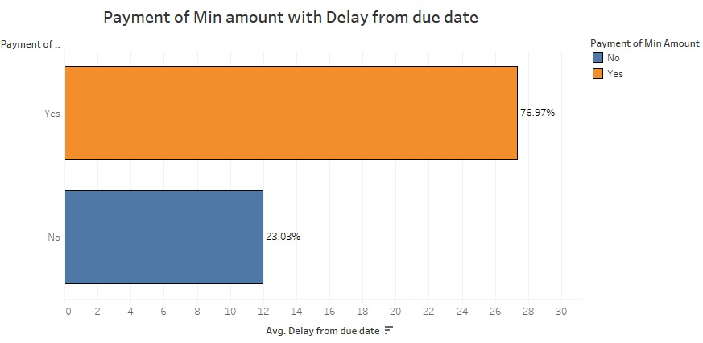
Continue..
This visualization displays the customers' payment patterns over time based on whether they make the minimum payment by the deadline or postpone their payments.

Slide 22
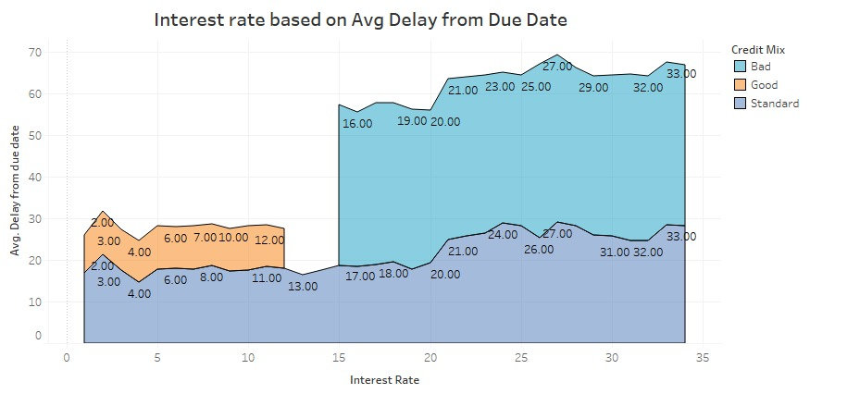
Continue..
This chart displays the average interest rate over time for average Delay from due date. and shows the trends or correlations in the interest rate based on customers' historical payment behaviors and talks about their credit mix.

Slide 23
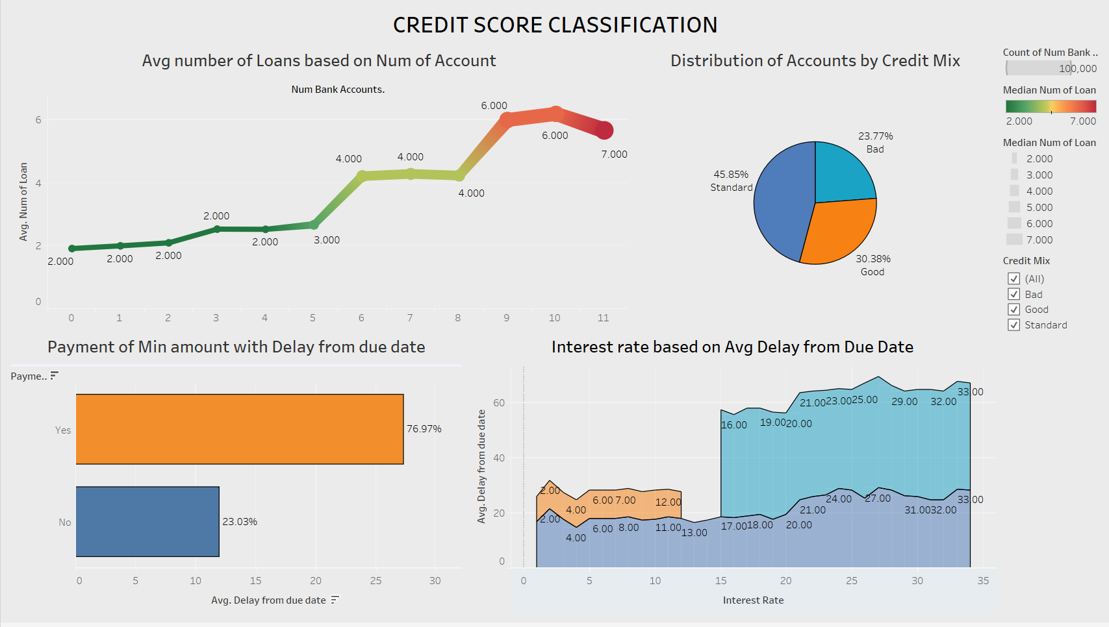
Continue..

Slide 24
Model Deployment
According to the performance metric that we presented, the Random Forest Classifier was the most effective model for the data. The Random Forest model and the MinMax model are both exported into the.obj format.
This format makes it possible to save the trained model on a drive and then load it back into memory whenever it's required. It is easy to integrate with other applications and may be used to deliver the trained model to production environments where it can be used
In this section of the ML model, we additionally export Scaler because, in the event that the application receives input from the real world, we will need to scale those values down before feeding them to the Random forest model.

Slide 25
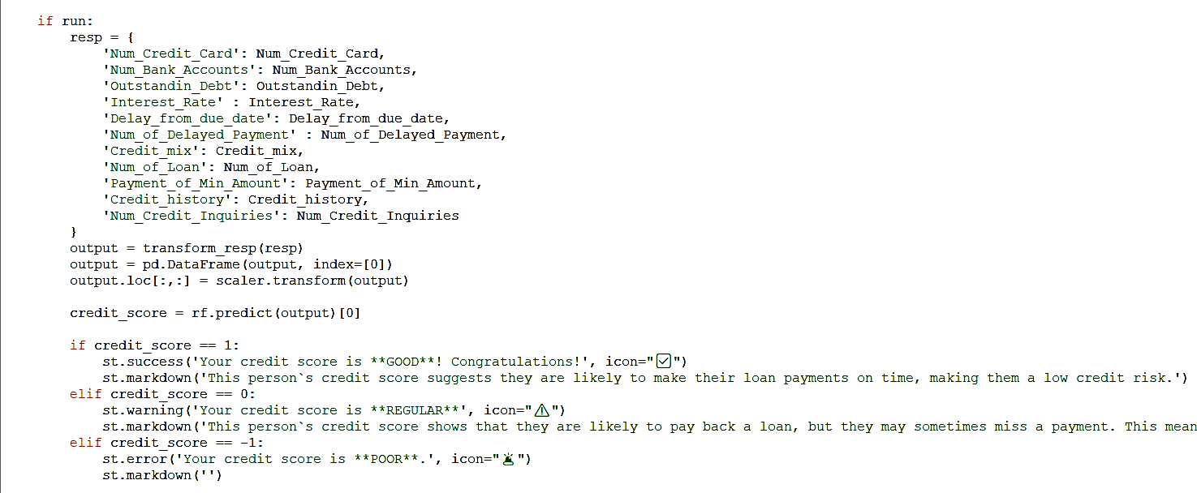
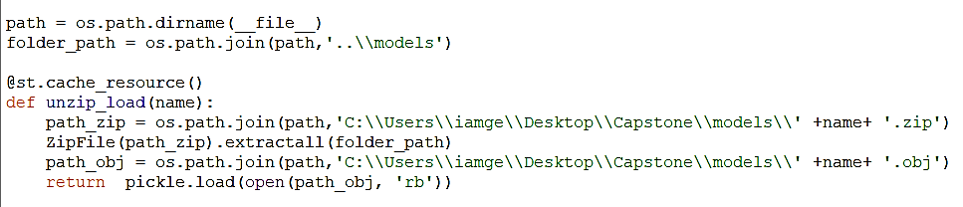
Integration with Web Application (StreamLit)
The Resp {} begins by gathering data from the real world, after which scaler scales this data down, draws conclusions from the model, and generates output .

Slide 26
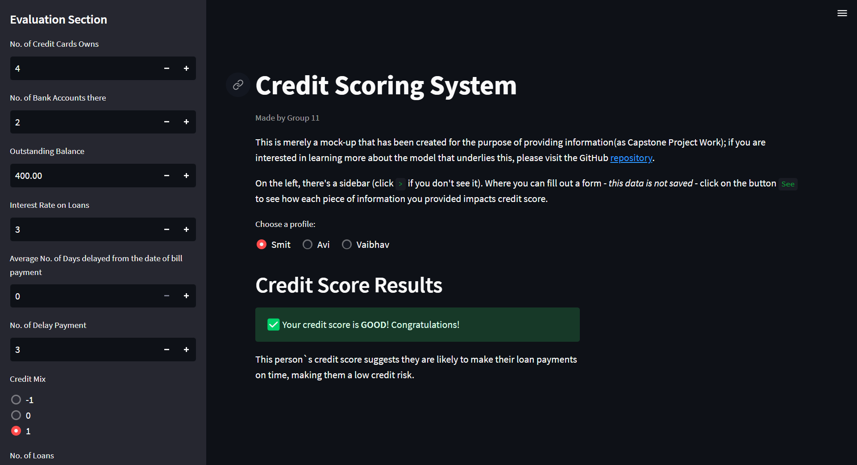

Slide 27
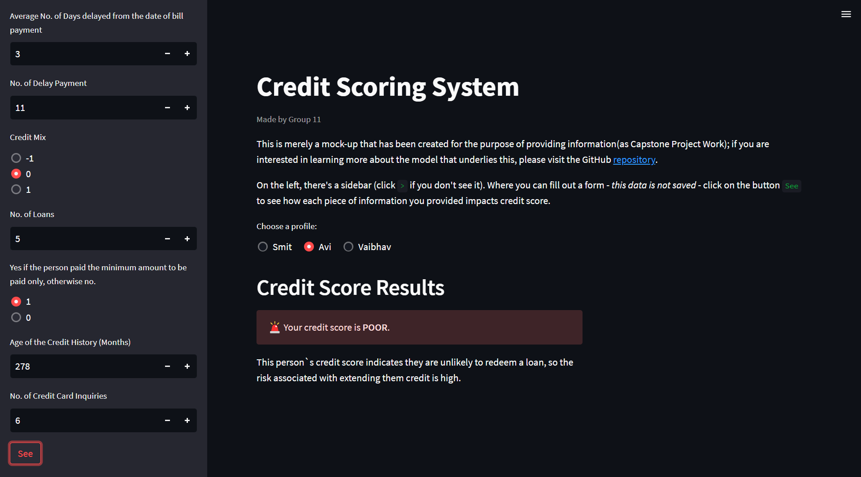

Slide 28
Challenges
We are faced with challenges that are comparable to dummy data:
Data preprocessing: we require extensive preprocessing, including feature scaling, feature engineering, and outlier detection, to prepare the data for analysis.
Missing data: we had missing and bogus values, which influenced analysis.
Imbalanced classes: one class has few samples. This can skew data and forecasts.
Overfitting: data has many characteristics, which may overfit the model to the training data and perform poorly on new data.
Model selection: it requires careful consideration of the best model for the classification task, as certain models are better for particular types of data than others.

Slide 29
Let's review what we've learned
In order to finish the project without any problems, we gave careful consideration to the data that was readily available, carried out thorough preprocessing, cleaning, visualization, feature engineering and selection, scaling down data, chose suitable machine learning models, deploying and integration to web apps.
In addition to this, The decisions that are made by our model can have a significant impact on the lives of people. So, it is essential to guarantee that our model is explainable (it should be possible to explain the model to stakeholders such as regulators, customers, and lenders). In verdict, our project was challenging but also had a significant amount of an impact. Because it enables financial institutions and credit card firms to promptly extend loans to customers who have an excellent creditworthiness.
When calculating credit scores, Neither FICO nor Our System consider :
Age, SSN, ethnicity, color, religion, national origin, sex, or marital status.
Additionally, no to salary, profession, employer, date of employment, and employment history
Our Credit Score System
20% outstanding debt
15% Credit History
14% Interest Rate
10% Credit Mix
10% Delay days of bill payment
38% (Credit Inquires, No. of Credit Card, Bank Account, Loan and Payment of Min Amount)
FICO Score System
35% On-time and Delay days of bill payment
30% Outstanding Debt
15% Credit History
10% Credit Mix
10% New Credit

Slide 30
¡Thank You!

