Slide 1

Project 1
Decode Gaming Behavior
By Smit Rana
Notes:
Hi folks, today I am going to present a project which I did under internship from Mentorness as data analyst. Title is decode gaming behavior. I used Microsoft SQL Server to perform this analys

Slide 2
Overview :
This project focuses on the analysis of a large gaming dataset, which includes numerous characteristics of player involvement and performance.
Purpose of Analysis
The main objective is to understand how players engage with the game.
Understand how players proceed via various levels and obstacles.
Identify gaming trends, such as kill numbers, headshots, and scoreboards.
Importance of Understanding Game Behavior
Understanding player behavior helps with game creation and optimization.
Helps to modify game elements to increase user engagement and happiness.
The analysis' findings can help inform decisions about level design, difficulty balance, and reward systems.

Slide 3
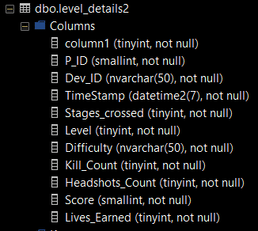
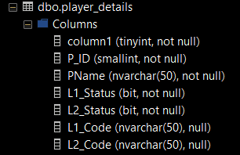
Dataset

Slide 4
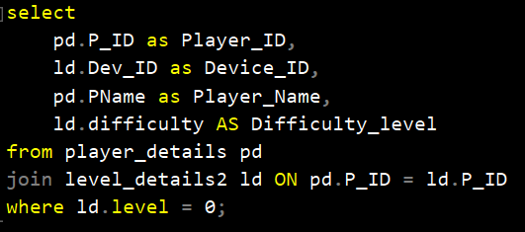
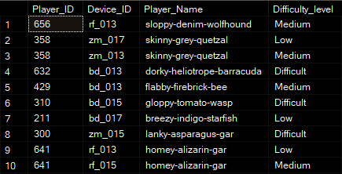
Q1)Extract P_ID,Dev_ID,PName and Difficulty_level of all players at level 0
Notes:
This query selects player ID, device ID, player name, and difficulty level from the player_details and level_details2 tables, joining them on matching player IDs and filtering for players at difficulty level 0.

Slide 5
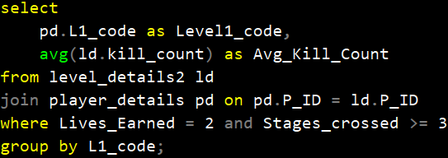

Q2)Find Level1_code wise Avg_Kill_Count where Lives_earned is 2 and atleast 3 stages are crossed
Notes:
In this query we are taking l1_code from player_details table and avg of kill count from level details and join them on matching player_ID. Then filtering out players who have earned two lives and crossed at least three stages. At end grouping the results by Level1_code to obtain the average kill count for each level.

Slide 6
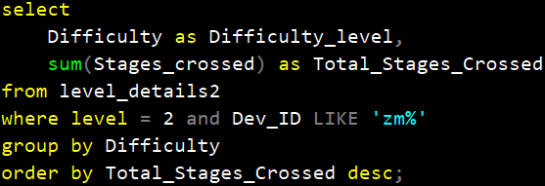

Q3) Find the total number of stages crossed at each difficulty level where for Level2 with players use zm_series devices. Arrange the result in decreasing order of total number of stages crossed.
Notes:
This query selects the Difficulty level from the level_details2 table, and computes the total stages crossed for each difficulty level. Then e filter the data for players at difficulty level 2 and with device IDs starting with zm. After grouping the results by difficulty, order them based on the total stages crossed, descendingly.

Slide 7
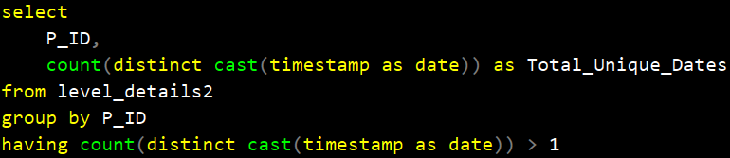
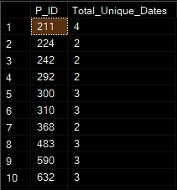
Q4)Extract P_ID and the total number of unique dates for those players who have played games on multiple days.
Notes:
This query selects the player ID from the level_details2 table and calculates the count of distinct dates on which they've played, casting the timestamp as a date. group the results by player ID. Then filter the groups to include only those players who have played on more than one unique date

Slide 8
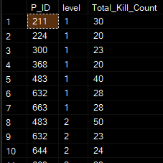
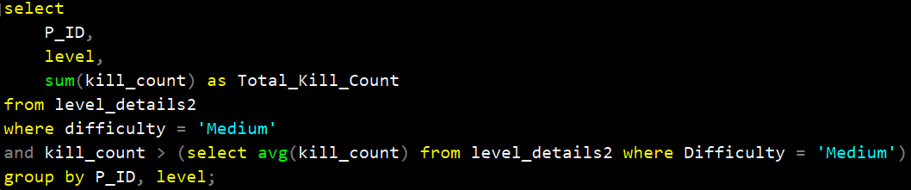
Q5)Find P_ID and level wise sum of kill_counts where kill_count is greater than avg kill count for the Medium difficulty.
Notes:
This query selects the player ID , level, and calculates the sum of kill counts from the level_details2 table. Then Filter the data for players at the 'Medium' difficulty level and whose individual kill counts exceed the average kill count for that difficulty level.

Slide 9
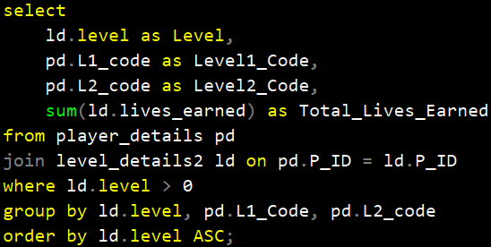
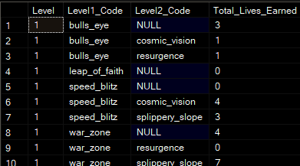
Q6)Find Level and its corresponding Level code wise sum of lives earned excluding level 0. Arrange in ascending order of level.
Notes:
This query selects the level from the level_details2 table, along with the Level1 and Level2 codes from the player_details table. calculates the sum of lives earned. data is filtered to include only levels greater than 0. After grouping the results by level, Level1 code, and Level2 code, they're ordered in ascending order based on the level.

Slide 10
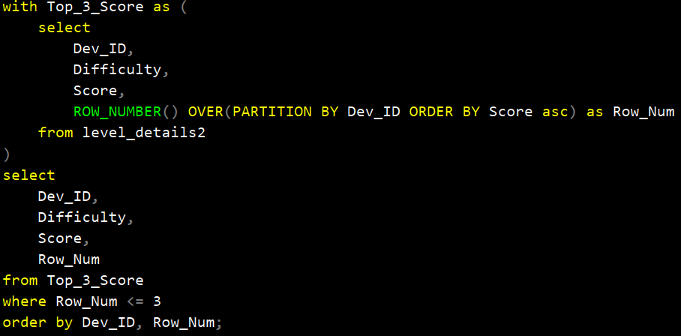
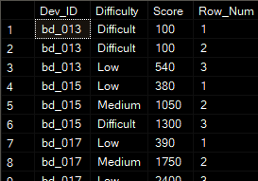
Q7)Find Top 3 score based on each dev_id and Rank them in increasing order using Row_Number. Display difficulty as well.
Notes:
In this query, a Common Table Expression (CTE) named Top_3_Score is created. selects the device ID, difficulty level, score, and
Window function which assigns a row number to each score within each device group, ordered by score in ascending order.
Then, from CTE, we select the device ID, difficulty level, score, and row number, filtering only the rows where the row number is less than or equal to 3, indicating the top three scores for each device and ordered by device ID and row number.

Slide 11
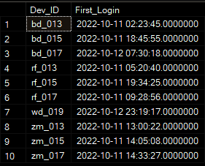
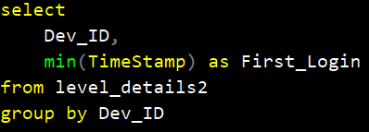
Q8) Find first_login datetime for each device id
Notes:
IN THIS QUERY identifY the first login timestamp for each device in our database
This query selects the device ID and calculates the minimum timestamp recorded for each device from the level_details2 table.
The data is then grouped by device ID, ensuring that we capture the earliest login timestamp for each device.

Slide 12
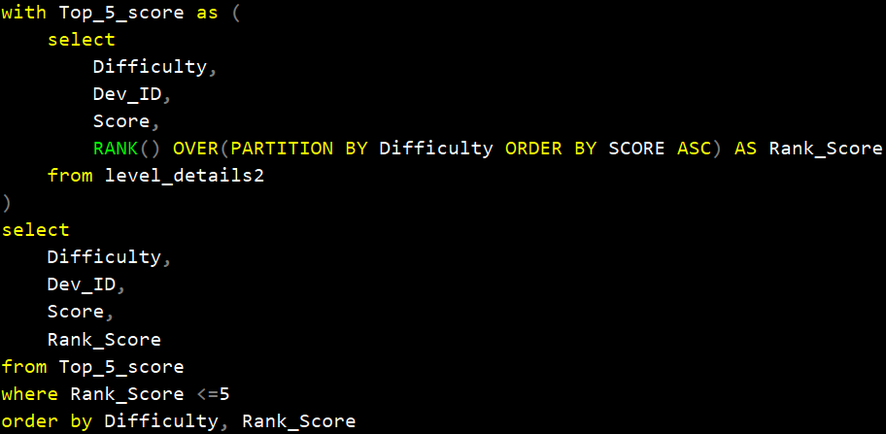
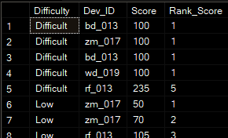
Q9)Find Top 5 score based on each difficulty level and Rank them in increasing order using Rank. Display dev_id as well.
Notes:
identify the top 5 scores achieved by players on each difficulty level and device.
This query employs a CTE named Top_5_score. Within this CTE, we select the difficulty level, device ID , score, and assign a rank to each score within each difficulty level group, ordered by score in ascending order.
From the Top_5_score CTE, we select the difficulty level, device ID, score, and rank, filtering only the rows where the rank is less than or equal to 5 and results are ordered by difficulty level and rank

Slide 13
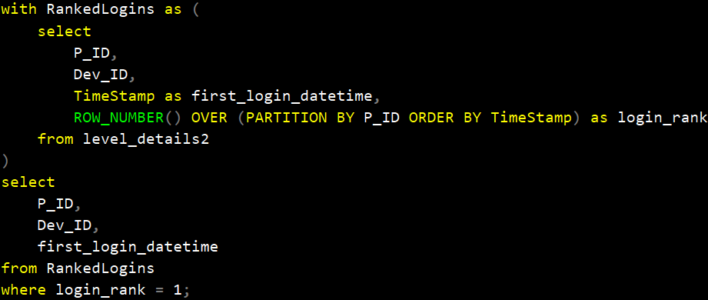
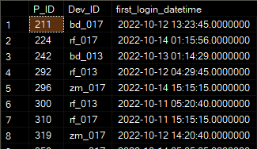
Q10) Find the device ID that is first logged in(based on start_datetime) for each player(p_id). Output should contain player id, device id and first login datetime.
Notes:
WE JUST WANT FIRST LOGGED IN SO WE FILTER THE ROW BY GIVING LOGIN_RANK = 1

Slide 14

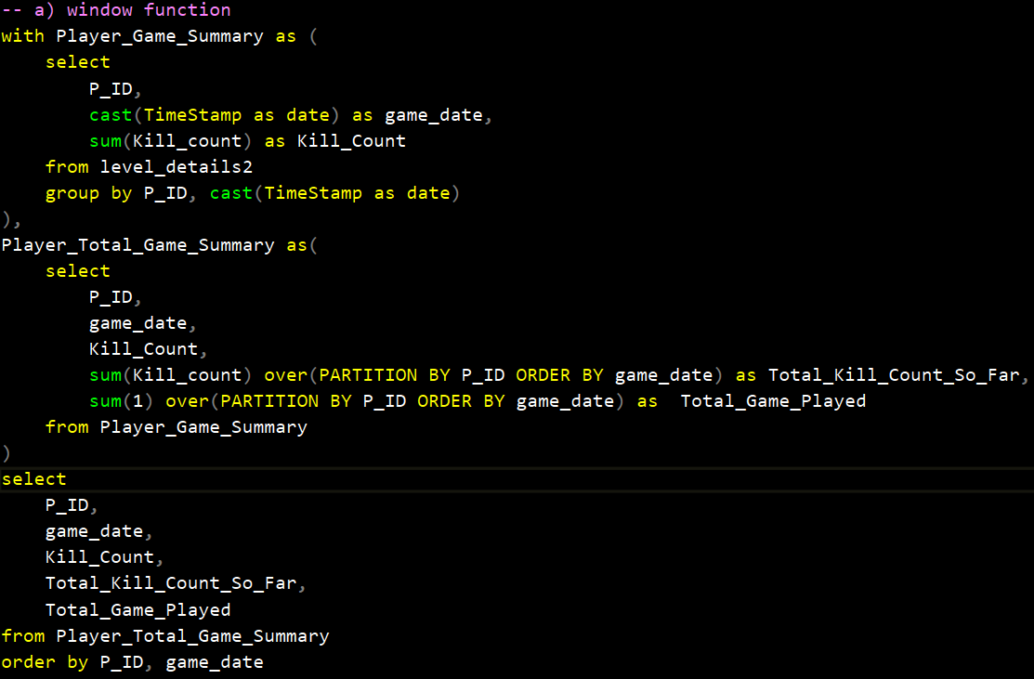
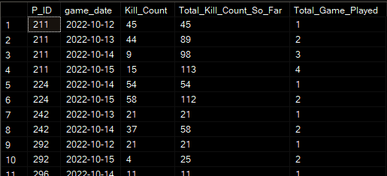
Q11) For each player and date, how many kill_count played so far by the player. That is, the total number of games played by the player until that date.
Notes:
First CTE summarizes each player's kill count per game
Another CTE further aggregates the data from first CTE, using Window Function we calculate the total kill count and the total number of games played till date for each player. the main query selects required columns and ordered them by player ID and game date

Slide 15
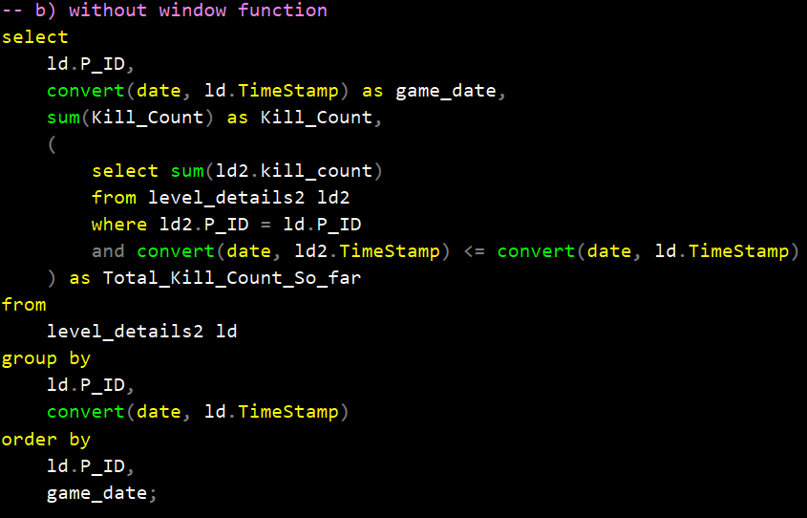
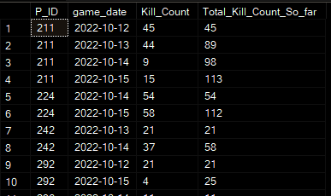
Q11) For each player and date, how many kill_count played so far by the player. That is, the total number of games played by the player until that date.
Notes:
We use aliased ld for outer query and ld2 to inner subquery
Subquery calculates total kill count up to the current game date
Both implementations achieve the same result, providing insights into players' game performance and progress over time.

Slide 16
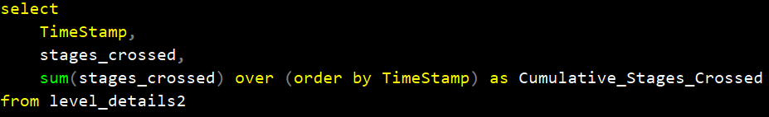
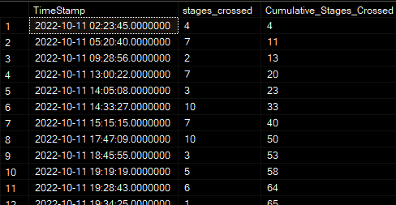
Q12)Find the cumulative sum of stages crossed over a start_datetime
Notes:
Here I utilized a window function, it computes the cumulative sum of stages crossed, ordered by timestamp. This cumulative sum reflects the total stages crossed by all players up to each specific timestamp.

Slide 17
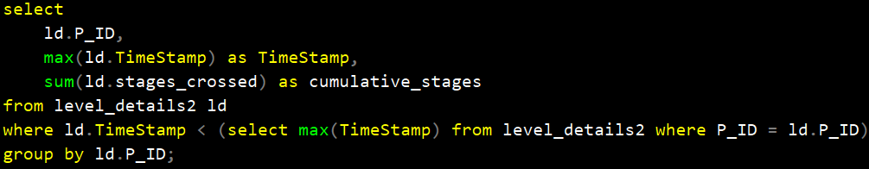
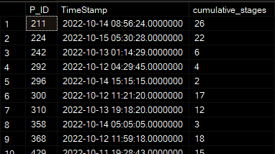
Q13) Find the cumulative sum of an stages crossed over a start_datetime for each player id but exclude the most recent start_datetime
Notes:
In this query, we have to find cumulative sum of stages and exclude most recent datetime for each player. First we used max and sum functions on respected columns.
For excluding recent time, where clause filters the data to include only rows where the timestamp (TimeStamp) is less than the maximum timestamp recorded for each player.

Slide 18
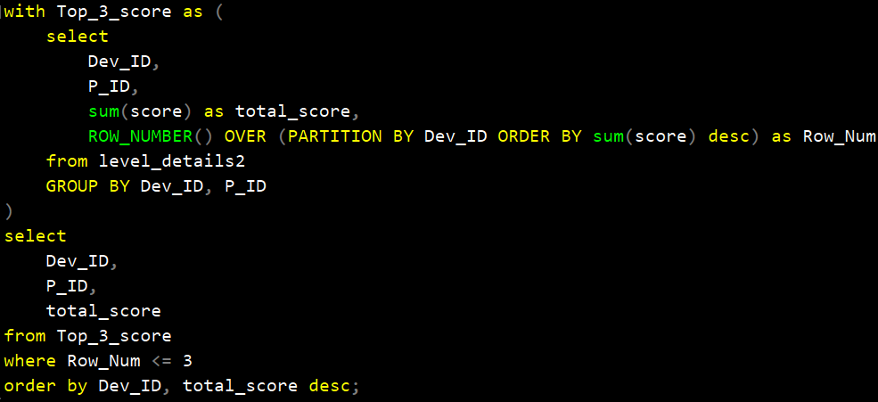
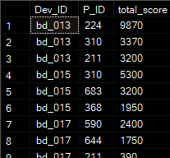
Q14) Extract top 3 highest sum of score for each device id and the corresponding player_id
Notes:
CTE named Top_3_score, the query aggregates the total score for each player on each device. Window function assigns a row number to each player within each device group, ordering them by the sum of their scores in descending order.
Filter the results to include only the top 3 scoring players for each device
results are ordered by device ID and total score in descending order

Slide 19
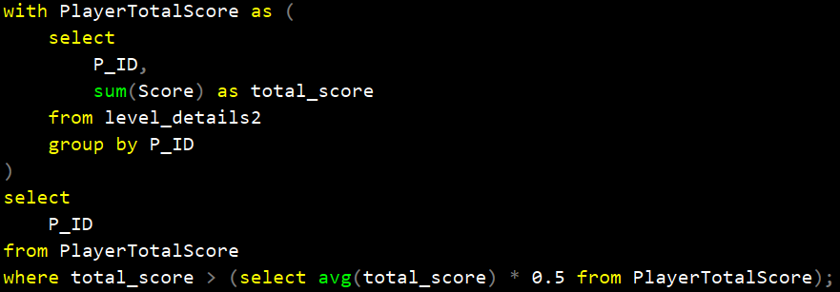

Q15) Find players who scored more than 50% of the avg score scored by sum of scores for each player_id
Notes:
In this CTE, the query find total score of each player ID
Then, in the main query, it selects player IDs from CTE where their total score is greater than 50% of the average total score among all players.

Slide 20
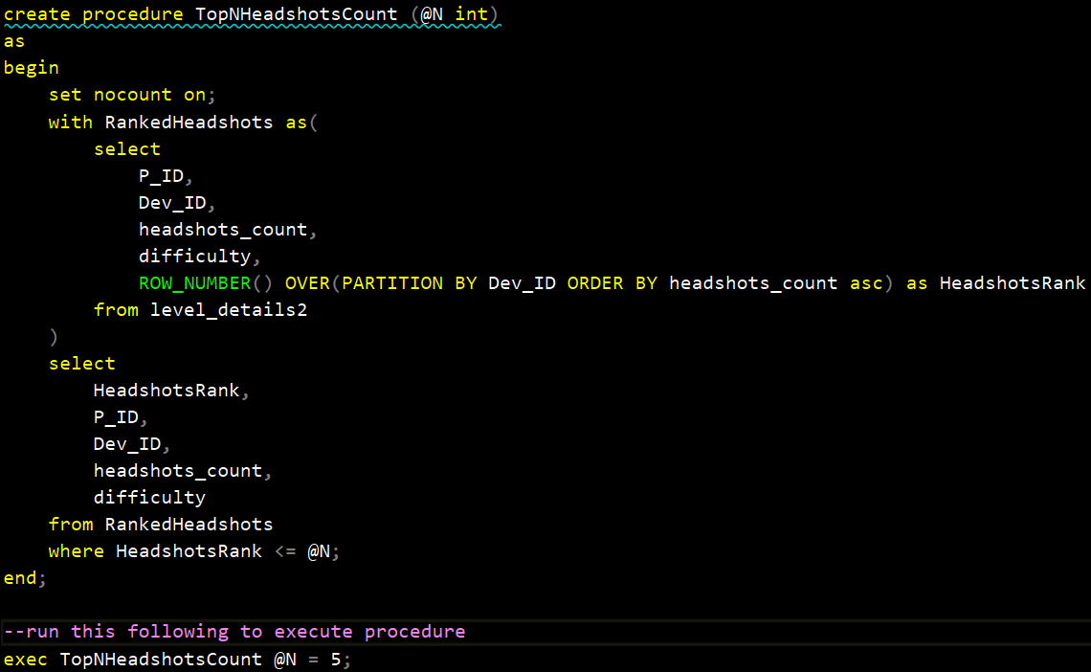
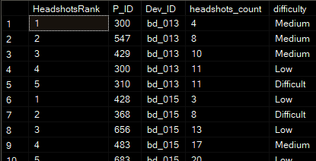
Q16) Create a stored procedure to find top n headshots_count based on each dev_id and Rank them in increasing order using Row_Number. Display difficulty as well.
Notes:
Created stored procedure named TopNHeadshotsCount that retrieves the top N players with the lowest headshots count for each device
CTE select the required columns and window function assigns a row number to each player within each device group based on their headshots count in ascending order.
And to find top n headshots_count we put condition for N number in where clause.

Slide 21
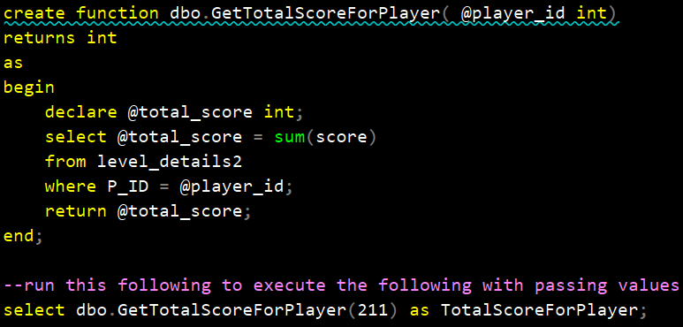

Q17) Create a function to return sum of Score for a given player_id.
Notes:
variable @total_score of type integer is declared to store the total score. Sum(score) calculated the summation for player_id which we passed in arguments.
the result is assigned to the @total_score variable.
function returns the value stored in the @total_score variable.

Slide 22
Learning Outcome
Common Table Expressions
&
Window Functions
Sub Queries
&
JOIN
Stored Procedures
Aggregate Functions
Notes:
In a past interview, I struggled with subqueries, but this project helped me improve. It also gave me valuable practice with CTEs and window functions

Slide 23
Thank You

