Slide 1

FASTag Fraud Detection Exploring Factors Contributing to Fraud and Developing Models for Real-Time Data
MIP-ML-07
SMIT RANA

Slide 2
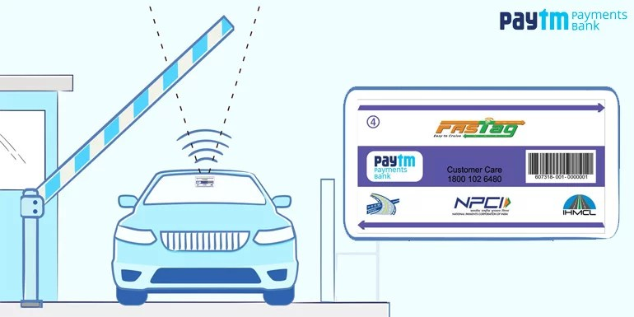
FASTag is an electronic toll collection system in India, operated by the National Highway Authority of India (NHAI). FASTags stickers are typically placed on the inside of the vehicle's windshield, usually on the top, near the rearview mirror.
It employs radio frequency identification (RFID) technology to enable automatic deduction of toll charges from a prepaid or linked account as a vehicle passes through a toll plaza.
FASTag fraud includes cloning legitimate tags, phishing for account details, tampering with stickers, and identity theft for unauthorized access.
To reduce risks:
Buy FASTags from authorized sources.
Secure account details.
Monitor transactions.
Avoid unsolicited links/messages.
Report suspicious activity to the provider/authorities.
Notes:
FASTag is an electronic toll collection system in India managed by NHAI. It uses RFID technology for automatic toll deduction. Fraudulent activities include cloning tags, phishing, sticker tampering, and identity theft. To minimize risks, purchase FASTags from authorized sources, secure account details, monitor transactions, avoid unsolicited messages, and report suspicious activity.

Slide 3
PROBLEM STATEMENT
This project focuses on leveraging machine learning classification techniques to develop an effective fraud detection system for FASTag transactions. The dataset comprises key features such as transaction details, vehicle information, geographical location, and transaction amounts. The goal is to create a robust model that can accurately identify instances of fraudulent activity, ensuring the integrity and security of FASTag transactions.

Slide 4
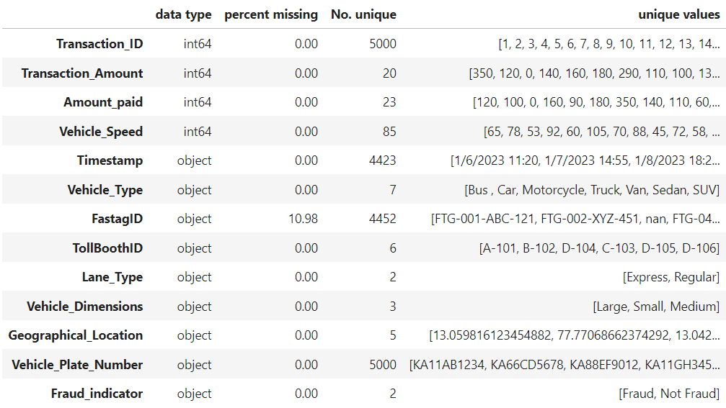
About Data
Unique identifier for each transaction.
Amount associated with the transaction.
Amount paid for the transaction.
Speed of the vehicle during the transaction.
Date and time of the transaction.
Type of vehicle involved in the transaction.
Unique identifier for FASTag.
Identifier for the toll booth.
Type of lane used for the transaction.
Dimensions of the vehicle.
Location details of the transaction.
License plate number of the vehicle.
Binary indicator of fraudulent activity
(target variable).

Slide 5
PROJECT OBJECTIVES
Data Exploration
Exploratory Data Analysis
Feature Engineering
Model Development
Real-time Fraud Detection
Explanatory Analysis

Slide 6
Data Exploration
&
Exploratory Data Analysis

Slide 7

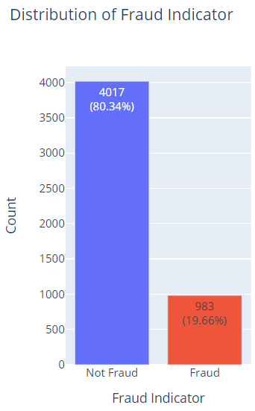
There are 5000 instances of fraudulent activity related to FASTtag, each associated with 13 distinct factors.
The "Fraud_indicator" column indicates the presence or absence of fraud alongside the Transaction ID. The analysis reveals that nearly 80% of the transactions show no signs of fraud, while the remaining represent fraudulent activity. This discrepancy highlights an imbalance in the dataset, likely stemming from the infrequent instances of fraud.

Slide 8
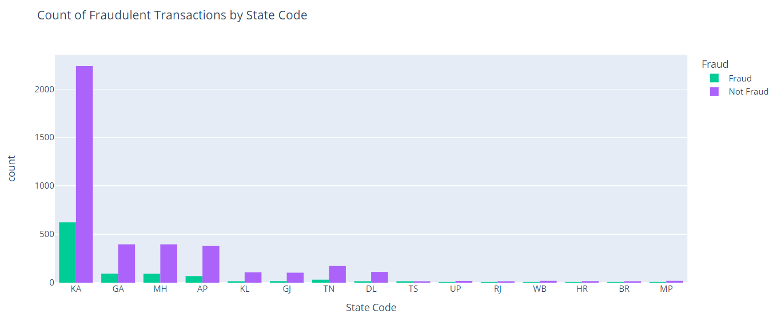
Fraudulent Transaction by State Code
KA: Karnataka
GA: Goa
MH: Maharashtra
AP: Andhra Pradesh
TN: Tamil Nadu
GJ: Gujarat
KL: Kerala
DL: Delhi
TS: Telangana
RJ: Rajasthan
BR: Bihar
HR: Haryana
UP: Uttar Pradesh
WB: West Bengal
MP: Madhya Pradesh
According to our data, it appears that Karnataka (State Code: KA) has the highest count of fraud compared to other states included in the dataset.

Slide 9
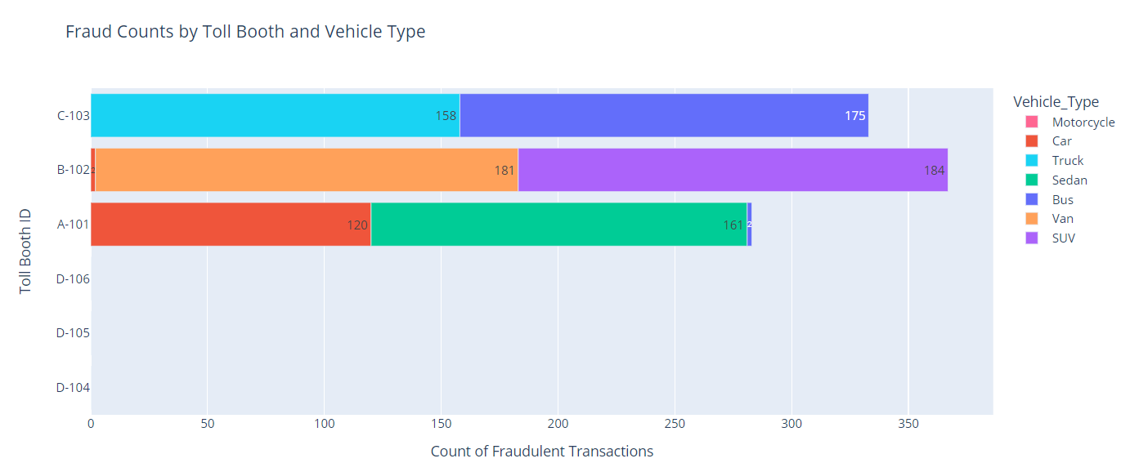
Fraud at Different Tollbooth with diverse vehicle
The majority of fraudulent transactions occur at the B-102 tollbooth involving SUV and VAN types of vehicles. Following closely, C-103 reports fraudulent activity involving buses and trucks. Conversely, A-101 has fewer fraudulent transactions compared to the other two tollbooths, mainly involving medium-sized vehicles such as cars and sedans. No fraudulent transactions have been reported at D-104, D-105, and D-106 tollbooths.

Slide 10
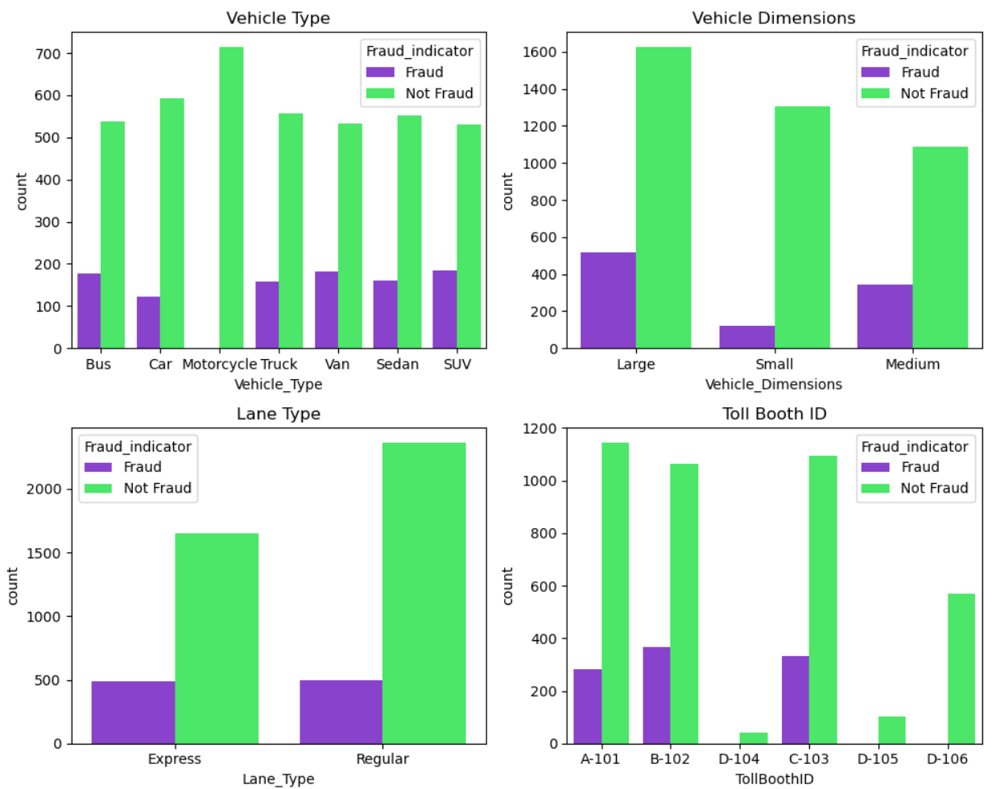
Distribution of Fraud Indicator by Categorical Features
According to the analysis, motorcycles have not been linked to any recorded fraud cases across all toll booths. SUVs show a relatively high number of both fraudulent and non-fraudulent instances. Buses, sedans, trucks, and vans demonstrate a mixture of both fraudulent and non-fraudulent instances. In summary, fraudulent activities are commonly associated with heavy vehicles.

Slide 11
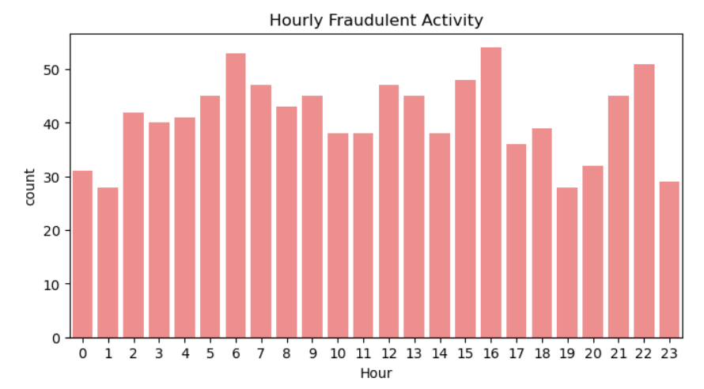
Distribution of Fraud by Hours
The hours with the highest occurrence of fraudulent activity fall between 10 to 16 (10 AM and 4 PM), with consistently over 40 fraudulent activities recorded. This indicates that fraudulent activities are most common during these midday hours. Conversely, during the low hours from 23 to 5 (midnight to 5 AM), the count significantly drops, fluctuating around 20. This suggests a decrease in fraudulent activities during these early morning hours.

Slide 12
Feature Engineering

Slide 13
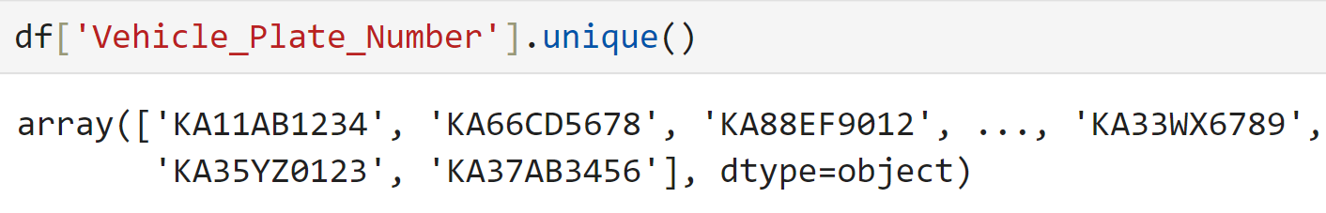
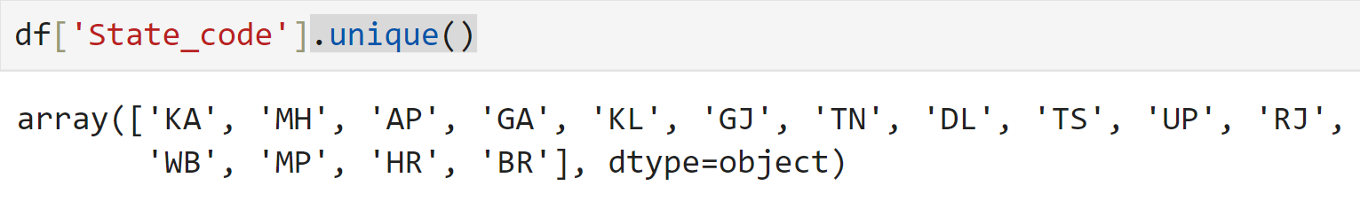
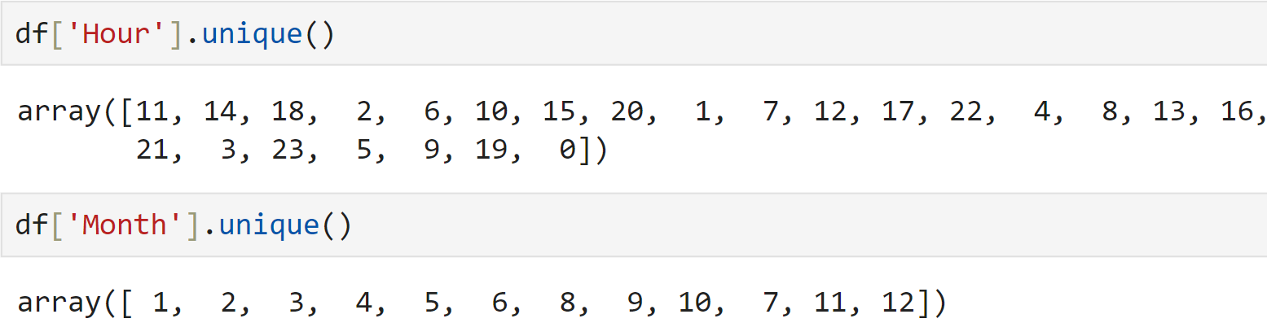
Take first two letters from Vehicle_Plate_Number to create State_code columns
Extract Hour and Month from Timestamp

Slide 14
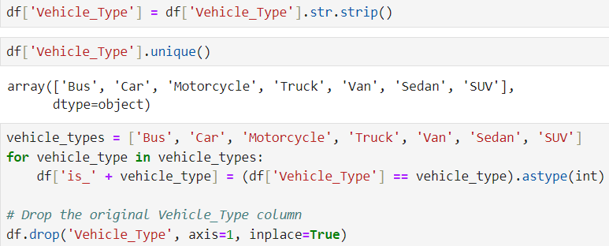
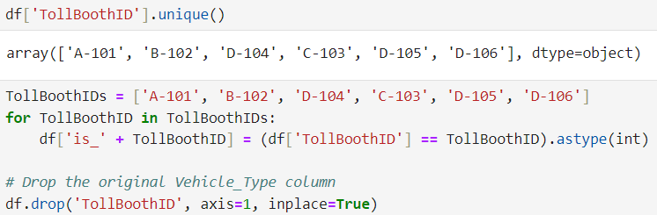
Discovered that there's extra space following the bus value in the vehicle_type column. Therefore, we'll eliminate it. Then Binary encoding for vehicle_Type and TollBoothID columns

Slide 15
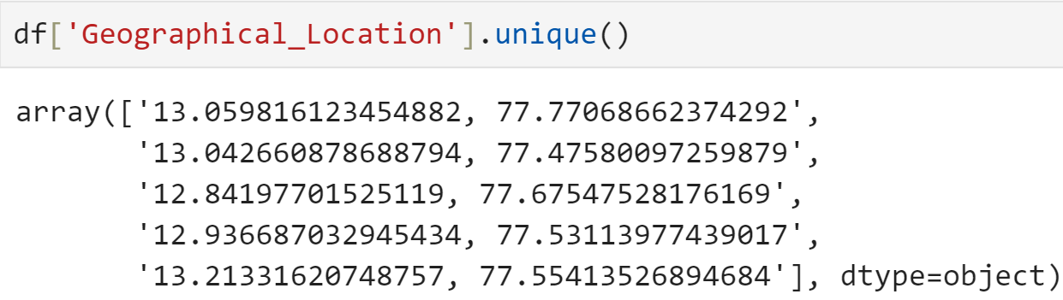
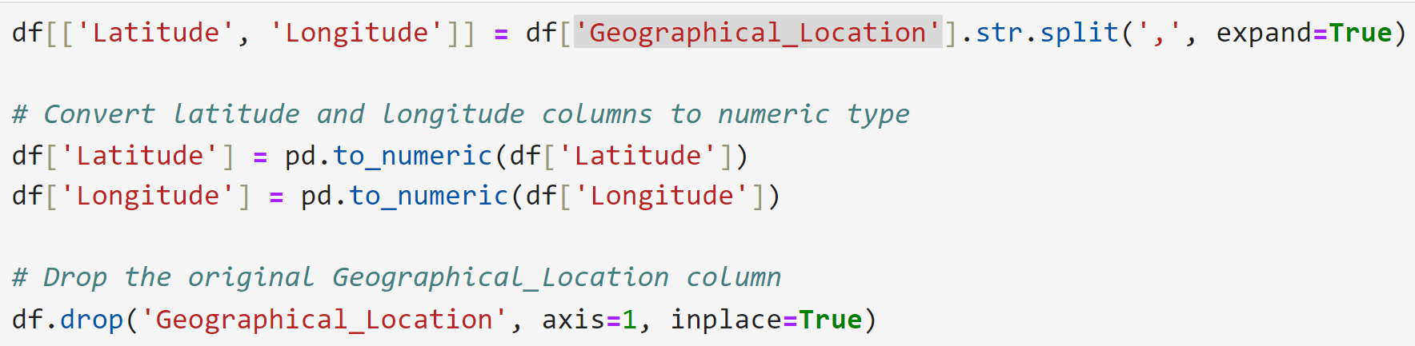
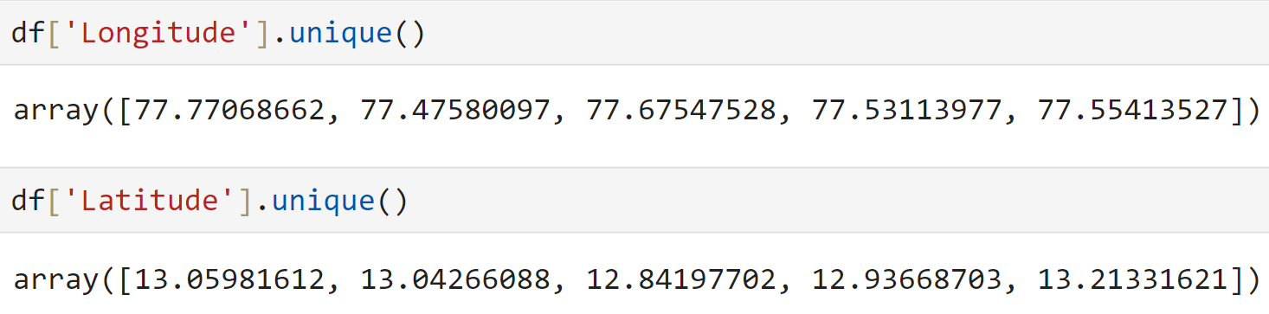
Geographical_Location column is to split it into two separate columns representing latitude and longitude.

Slide 16
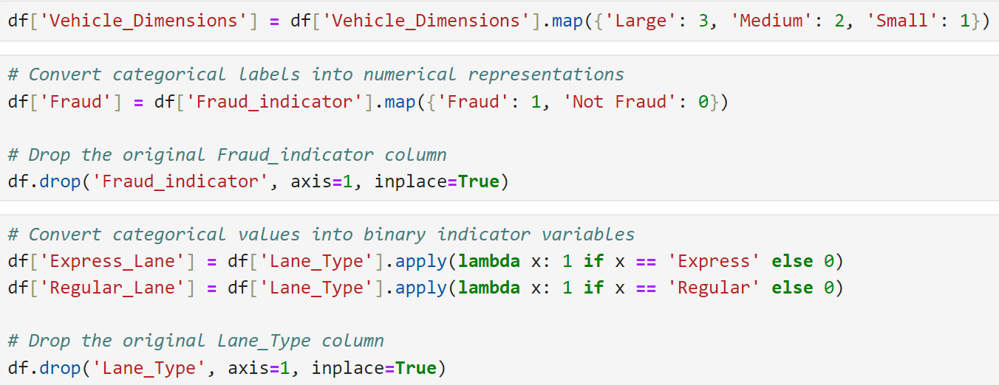
Convert categorical labels into numerical representations and binary indicator variables
Removing unnecessary columns

Slide 17
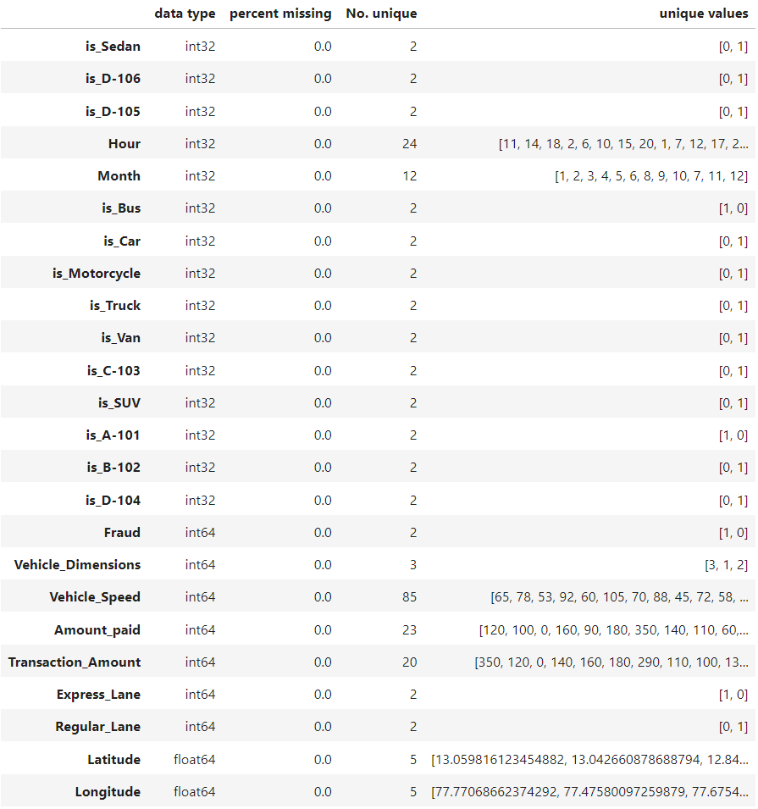
We generated new columns by manipulating existing ones. This involved splitting values, extracting specific information, applying binary encoding, and converting categorical columns into numerical representations.
Following this feature engineering process, our dataset is now prepared for input into the machine learning model.

Slide 18
Model Development

Slide 19
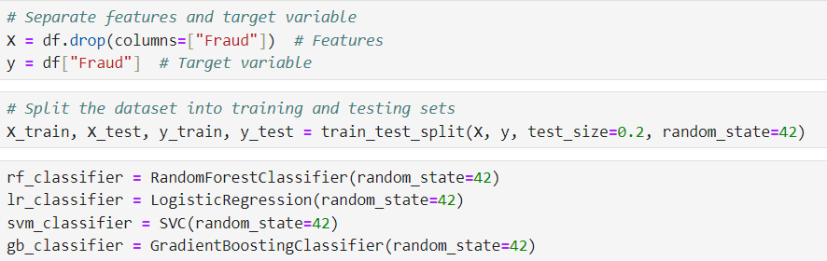
Building Models and Training
Begin by partitioning the dataset into features (denoted as 'X') and the target variable (denoted as 'y'). Proceed to divide the data into training and testing sets. Employ four distinct models to forecast fraudulent activities, assessing their performance through precision, recall, F1 score, and accuracy metrics. Additionally, generate feature importance graphs for each model.

Slide 20
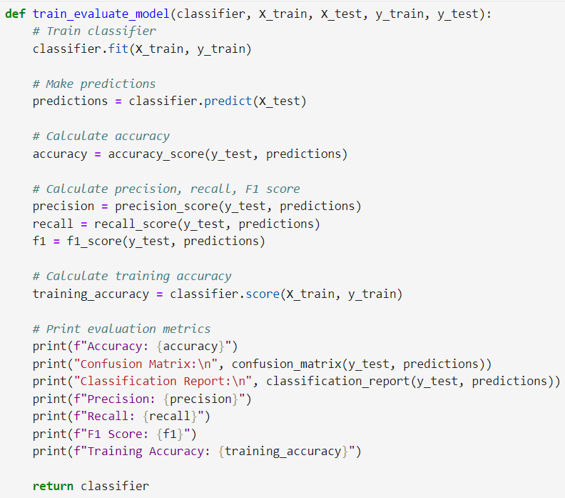
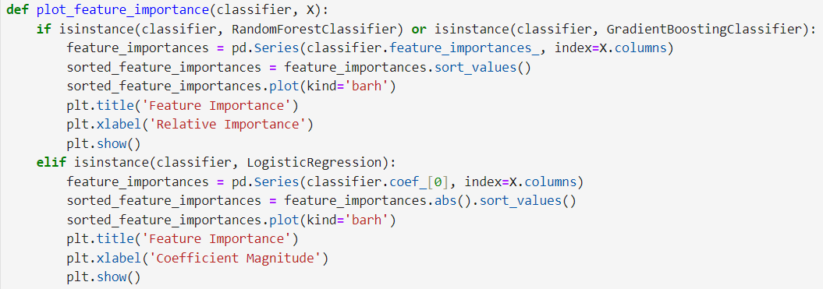
Model Evaluation and Feature Importance Visualization
This function takes a classifier object, training features (X_train), training labels (y_train), testing features (X_test), and testing labels (y_test) as input. It trains the classifier using the training data, makes predictions on the testing data, and then calculates and prints various evaluation metrics such as accuracy, precision, recall, F1 score, confusion matrix, and training accuracy. Finally, it returns the trained classifier.
This function takes a classifier object and the features (X) as input. Depending on the type of classifier (Random Forest, Gradient Boosting, or Logistic Regression), it extracts feature importances or coefficients and plots them in a horizontal bar chart to visualize the importance of each feature in the model.

Slide 21
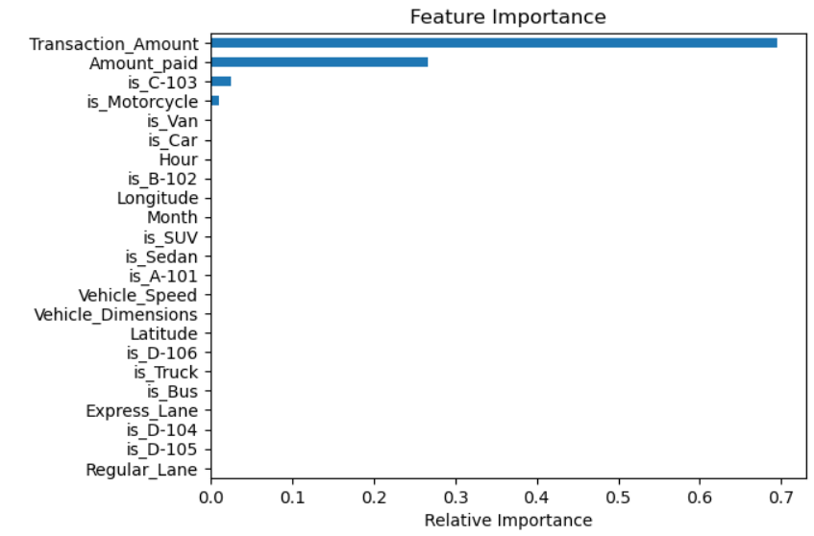
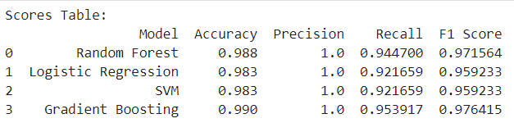
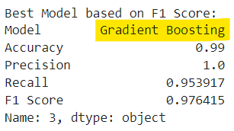
Choosing Best Model
Feature Importance : Transaction amount and amount paid are the primary factors that significantly contribute to predicting fraud in the Gradient Boosting classifier. Another highly effective classifier is the Random Forest model. Additionally, incorporating features such as vehicle speed, dimensions, and the hour of the fraudulent transaction can also influence prediction accuracy.

Slide 22
Real-time Fraud Detection

Slide 23
FASTag is a device used for electronic toll collection on highways in India. The idea behind real-time fraud detection for FASTag is to continuously monitor transactions made through FASTag devices and promptly identify any fraudulent transactions as they happen.
Data Collection: Gather real-time FASTag transaction data including transaction amount, vehicle details, and timestamp.
Model Development: Create a machine learning model trained on historical FASTag data using algorithms like Random Forest, Logistic Regression, or Gradient Boosting.
Real-time Prediction: Implement a system to continuously monitor FASTag transactions, using the model to predict fraud in real-time.
Alerting Mechanism: Set up alerts to notify relevant parties when potential fraud is detected, via email, SMS, or monitoring dashboards.
Evaluation and Monitoring: Continuously assess system performance, monitoring key metrics like detection rate and false positives.
Integration: Integrate the fraud detection system seamlessly into existing FASTag infrastructure.
Compliance and Regulations: Ensure system compliance with relevant regulations and security standards.
Implementing real-time FASTag fraud detection enhances fraud prevention and minimizes financial losses.

Slide 24
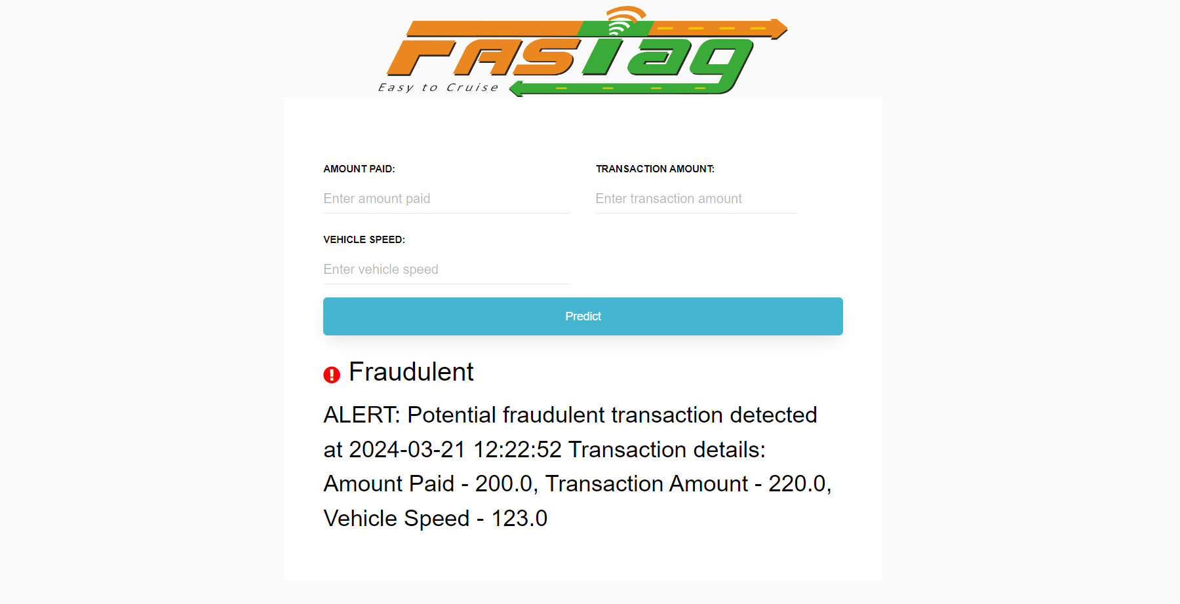
Development of a Prototype for Real-Time Fraud Detection
This implementation utilizes the Flask framework. The Gradient Boosting model is exported to a .pkl file, which is then loaded into the Flask application. By considering the values of 'amount_paid' and 'transaction_amount' along with a specified threshold, the system determines whether a transaction is legitimate or fraudulent. In the event of fraud, pertinent information such as timestamp, transaction details, and vehicle speed is recorded. Integration with CCTV cameras enables capturing the license plate of the vehicle.

Slide 25
Explanatory Analysis

Slide 26
Based on the analysis provided, several insights into the factors contributing to fraudulent transactions can be derived:
1. Geographical Distribution: The data indicates that Karnataka (State Code: KA) has the highest count of fraud compared to other states included in the dataset. This suggests that fraudulent activities may be more prevalent in certain regions.
2. Toll Booth Analysis: The majority of fraudulent transactions occur at the B-102 tollbooth, followed closely by the C-103 tollbooth. Conversely, tollbooths such as A-101 have fewer reported fraudulent transactions. This indicates that certain tollbooths may be more susceptible to fraudulent activities.
3. Vehicle Types: Fraudulent activities are commonly associated with heavy vehicles such as SUVs, buses, trucks, and vans. Motorcycles, on the other hand, have not been linked to any recorded fraud cases across all toll booths. This suggests that the type of vehicle involved may influence the likelihood of fraudulent transactions.
4. Time of Day Analysis: The analysis reveals that fraudulent activities are most common between 10 AM and 4 PM, with over 40 fraudulent activities recorded during these hours. Conversely, fraudulent activities significantly decrease during the early morning hours between midnight and 5 AM. This indicates that the time of day may play a significant role in the occurrence of fraudulent transactions.
5. Feature Importance Analysis: The feature importance graph suggests that several factors, including amount_paid, transaction_amount, vehicle_speed, vehicle_dimension, hours, and month, are most influential in predicting fraud. This indicates that these features may serve as important indicators or predictors of fraudulent transactions.

Slide 27
Challenges
Consistently high performance across all models suggests potential overfitting to the training data, where the models capture noise rather than true data patterns.
Additionally, data imbalance, where one class like fraudulent transactions is significantly less represented than others, can distort model performance.
Complex models, especially with limited data, are more susceptible to overfitting, further complicating the issue.

Slide 28
Thank You

