Slide 1

Mall Customer Segmentation Unlocking Insights, Enhancing Experiences
DATA SCIENCE
SMIT RANA

Slide 2
PROBLEM STATEMENT
In the bustling world of retail, understanding customer behavior and preferences is essential for optimizing marketing strategies and enhancing the shopping experience. Mall operators and retailers seek to leverage data-driven insights to segment their customer base effectively, tailoring offerings and experiences to different demographic and psychographic profiles.
To address this challenge, the project aims to utilize K-means clustering, a powerful unsupervised machine learning technique, to segment mall customers based on various characteristics such as age, gender, income, and spending behavior. By employing K-means clustering, the goal is to identify distinct customer segments within the mall's diverse clientele, enabling targeted marketing campaigns, personalized promotions, and optimized tenant mix.

Slide 3
PROJECT OBJECTIVES
Introduction
Data Exploration
EDAs
Proposed Method for Segmentation
Methodology
Implementation
Conclusion

Slide 4
Introduction

Slide 5
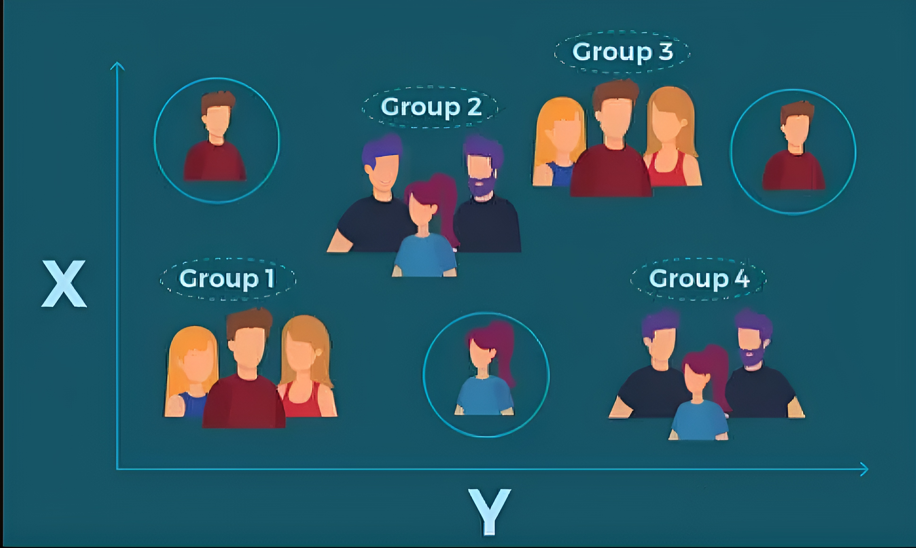
What is Customer Segmentation ?
Customer segmentation is the process of dividing a customer base into groups of individuals who are similar in specific ways relevant to marketing, such as demographics, behaviors, preferences, or needs. The goal of segmentation is to better tailor marketing efforts and product offerings to the distinct characteristics and needs of different customer groups, ultimately improving customer satisfaction and profitability.

Slide 6
How customer segmentation applies to a mall setting?
Demographic Segmentation: Customers are divided based on factors like age, gender, income, occupation, and family size. For example, promotions or events might target families with young children, affluent shoppers, or young professionals.
Psychographic Segmentation: Understanding shoppers' lifestyles, values, interests, and attitudes helps tailor offerings. Some may prefer upscale brands and luxury experiences, while others prioritize convenience and value.
Behavioral Segmentation: Analyzing shoppers' behavior in the mall provides insights like visit frequency, time spent, store preferences, and purchasing habits. Segments might include regulars, occasional visitors, bargain hunters, or luxury shoppers.
Geographic Segmentation: Location influences the customer base, considering nearby neighborhoods, cities, or regions. Understanding local demographics helps tailor marketing and store offerings.
Loyalty Segmentation: Loyalty programs segment customers based on engagement and spending. This allows for targeted promotions, rewards, and personalized communication to boost repeat visits and retention.

Slide 7
Data Exploration and EDAs

Slide 8
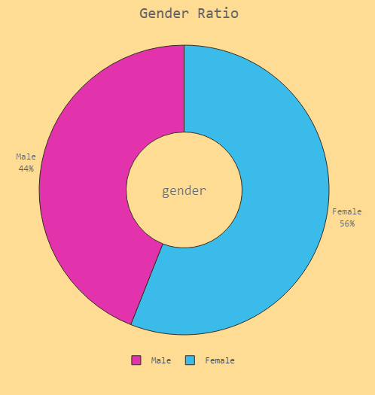
Gender Distribution
There is a slight predominance of female customers compared to male customers, with 112 females as opposed to 88 males. Females comprise 56% of the total customer base.

Slide 9
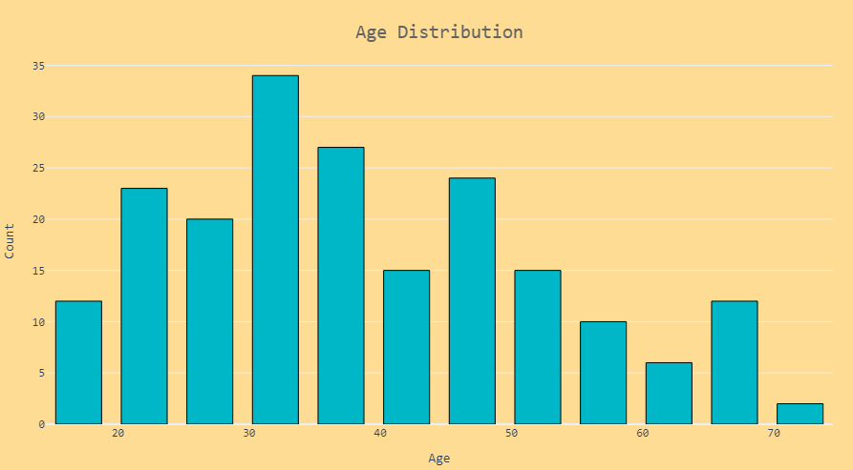
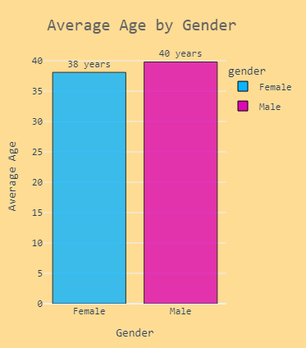
Age Distribution
On average, male customers tend to be slightly older than female customers, with an average age of 40 years compared to 38 years for females.
The distribution of ages among male customers appears to be more evenly spread out compared to females, among whom the largest age group falls within the range of 30-35 years old.

Slide 10
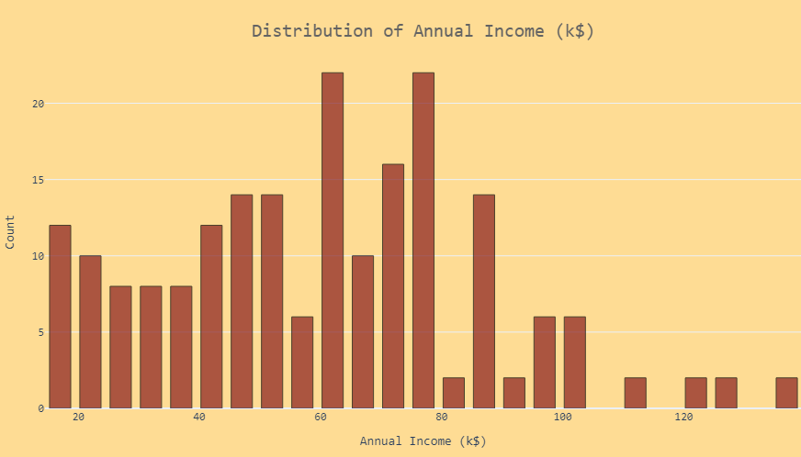
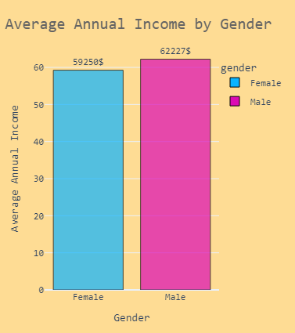
Annual Income Distribution
The average income for male customers is higher compared to female customers, with males having a mean income of $62,227 compared to $59,250 for females.
Additionally, the median income for male customers, at $62,500 is also higher than that of females, which is $60,000. Despite these differences, the standard deviation of incomes is almost similar($26,638 and $26,012) for both groups. Notably, there is one outlier in the male group with an annual income of approximately $137,000.

Slide 11
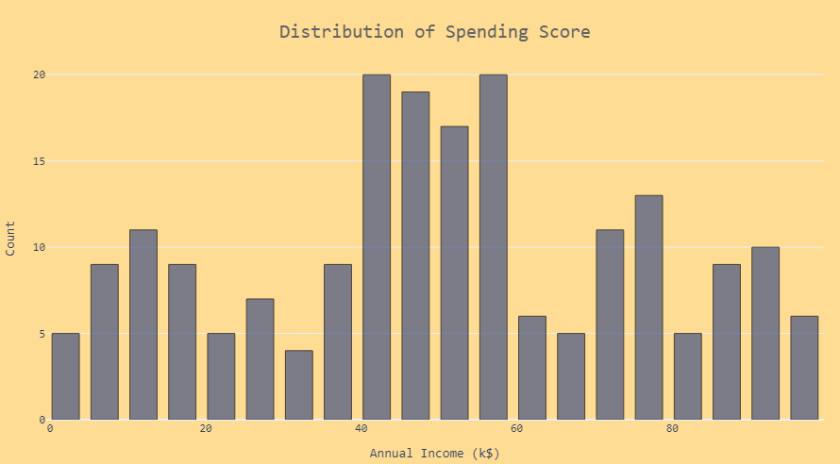
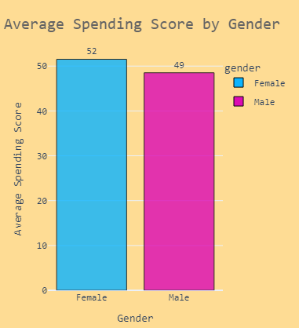
Spending Score Distribution
The average spending score for women, at 52, appears to be higher than that of men, which stands at 49.

Slide 12
Proposed Method for Segmentation

Slide 13
Selected relevant features for segmentation based on three combinations of variables:
a. Age and Spending Score
b. Spending Score and Annual Income
c. Age, Spending Score, and Annual Income

Slide 14
Methodology

Slide 15
Data Preparation
Extract the relevant features from the dataset:
X1 = df[['age', 'spending_score']].values
X2 = df[['annual_income','spending_score']].values
X3 = df[['age', 'annual_income', 'spending_score']].values
Used Elbow method to find optimal Numbers of Clusters
K-means Clustering:
Define the K-means algorithm with specified parameters (e.g., number of clusters, initialization method, maximum iterations).
Fit the algorithm to the data to obtain cluster labels and centroids.
Visualization:
Create a meshgrid to visualize the decision boundaries of the clusters.
Predict cluster labels for each point in the meshgrid.
Plot the clusters using imshow for the decision boundaries and scatter plot for the data points colored by cluster labels.
Display centroids as red points.
Overall, this method helps visualize the segmentation of mall customers based on feature selection, identifying distinct clusters and centroids to understand customer behavior patterns.

Slide 16
Implementation

Slide 17
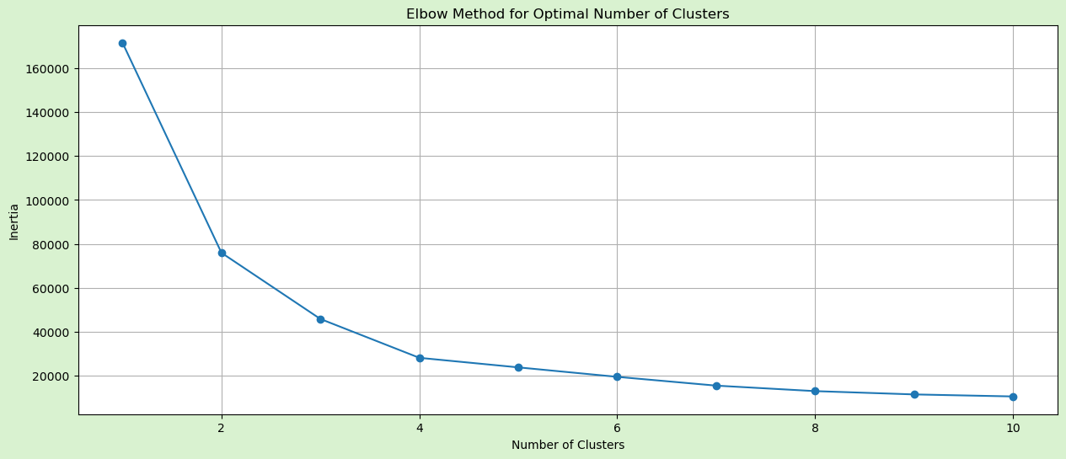
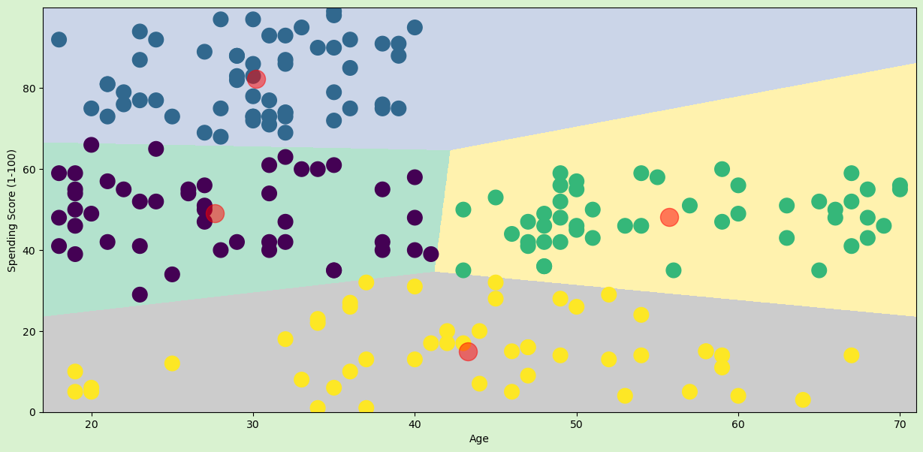
Age and Spending Score: Utilized a segmentation approach based on age and spending score to identify clusters of customers with similar age profiles and spending behavior.
When observing the plot, look for a juncture where the decrease in inertia slows down notably, typically forming a bend known as the "elbow". The rationale is that after this bend, introducing additional clusters doesn't substantially reduce the inertia. Hence, in this case, cluster=4 would be the optimal choice.

Slide 18
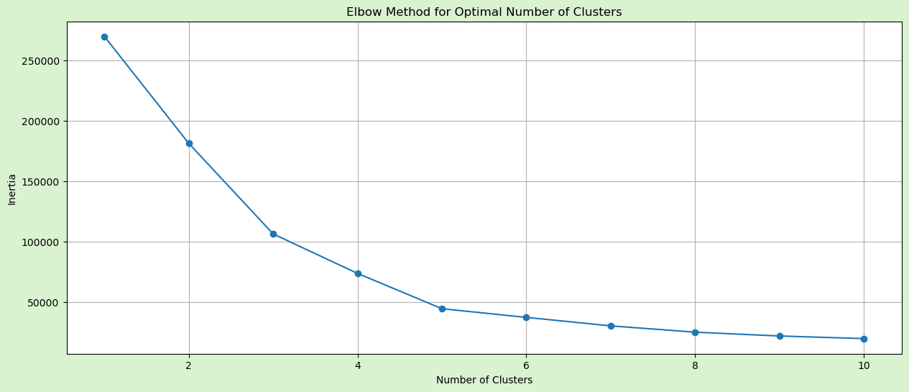
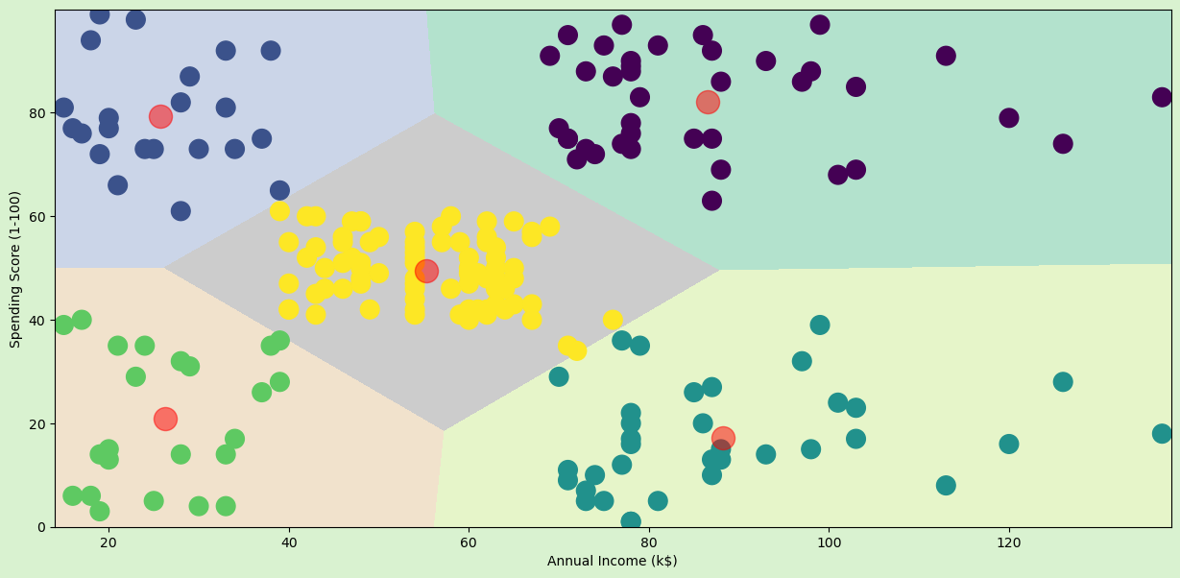
Spending Score and Annual Income: Employed segmentation techniques using spending score and annual income to categorize customers based on their purchasing power and spending habits.
In the second segmentation, pinpoint the spot where the inertia's descent becomes less pronounced is 5, Therefore, selecting cluster=5 would be most appropriate.

Slide 19
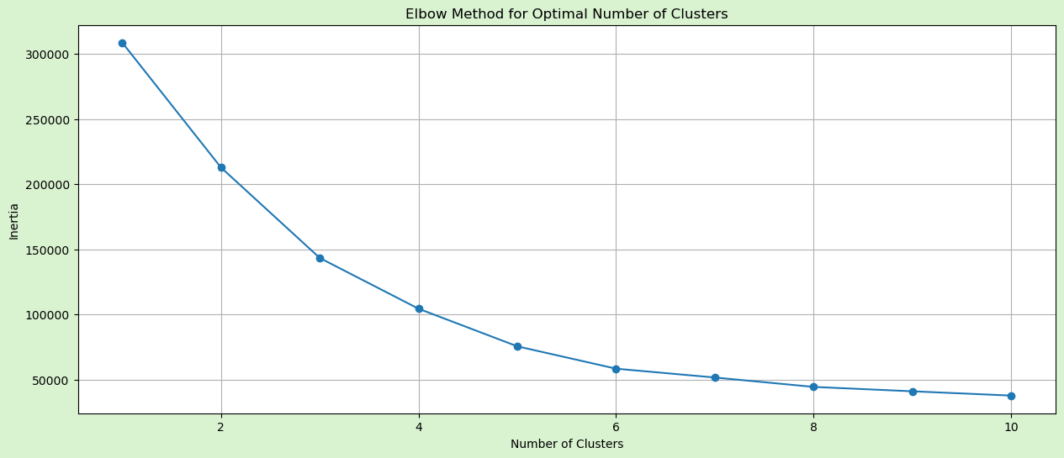
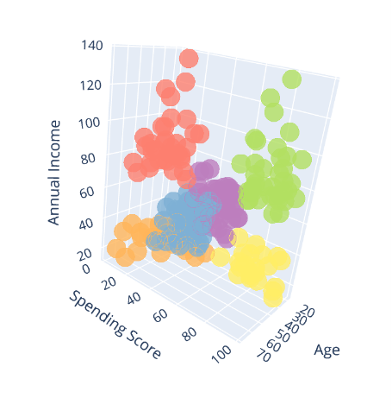
Age, Spending Score, and Annual Income: Integrated all three variables (age, spending score, and annual income) to perform comprehensive customer segmentation, considering both demographic and behavioral aspects.
In this thrid plot, point 6 is the juncture where the inertia reduction rate becomes less steep, Consequently, for this scenario, selecting cluster=6 would be ideal.

Slide 20
Conclusions

Slide 21
In this analysis, segmentation was performed on three combinations of variables:
Age and Spending Score:
No clear distinctions based on age were observed among the identified clusters. But we can say that people with age below 40 have high spending score.
Spending Score and Annual Income:
The K-Means algorithm identified five distinct clusters based on spending score and annual income:
Customers with lower annual incomes but higher spending scores.
Customers with moderate annual incomes and spending scores.
Customers with higher annual incomes but lower spending scores.
Customers with higher annual incomes and higher spending scores.
Customers with lower annual incomes and lower spending scores.
Age, Spending Score, and Annual Income
Targeting customers with higher spending scores (above 60) identified by the K-Means model could be beneficial for membership programs.
These clusters predominantly include customers under the age of 40, suggesting a focus on younger customers with higher spending scores for membership programs.
Strategies involving popular products and promotions could engage customers with lower spending scores and aged above 40.
Future analyses could incorporate additional data such as purchase frequency and types of purchases to gain deeper insights into customer preferences, allowing for more customized product offerings tailored to each segment.

Slide 22
THANK YOU

