Slide 1



+
Codebasics Resume Project Challenge #14
[ Insights for a Strategic Merger in the OTT Domain ]
SMIT RANA

Slide 2
AGENDA
Understanding Problem
Data Model
Primary Questions
Further Analysis & Recommendations
Strategic Recommendations for Lio-Jotstar Merger

Slide 3



Why, What and Ways
(The Need for Analysis)
Lio plans to merge with Jotstar to combine its subscriber base with Jotstar’s content library, aiming to dominate the Indian OTT market. Data-driven insights are needed to optimize post-merger strategies.
W
HY
(Key Areas of Analysis)
HAT
The analysis covers subscriber trends, content engagement, inactivity patterns, and subscription upgrades/downgrades to understand platform performance.
AYS
(How to Conduct the Analysis)
By integrating data, tracking key metrics, and using Power BI visualizations, actionable insights will be derived to enhance user retention and content strategy.

Slide 4

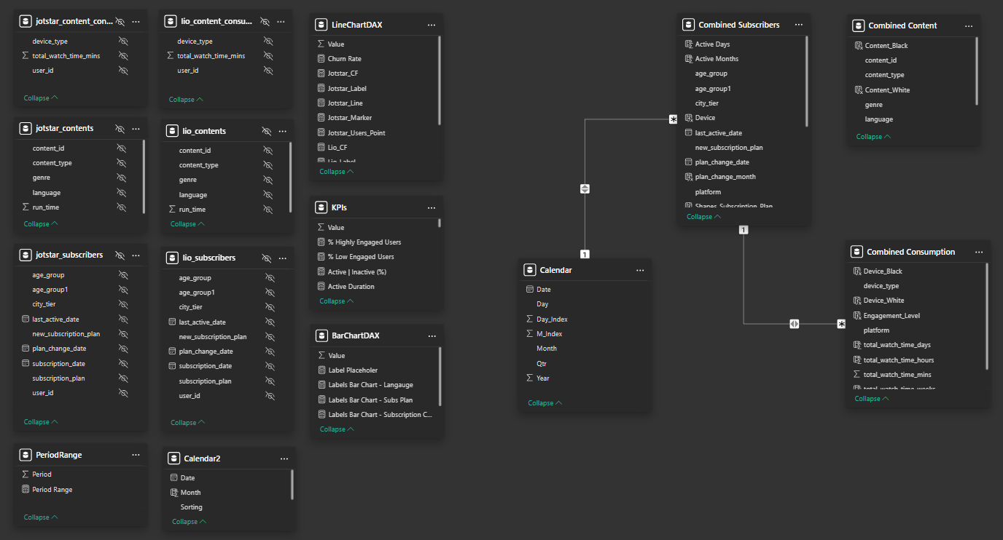
Data Model View

Slide 5
Primary Analysis

Slide 6
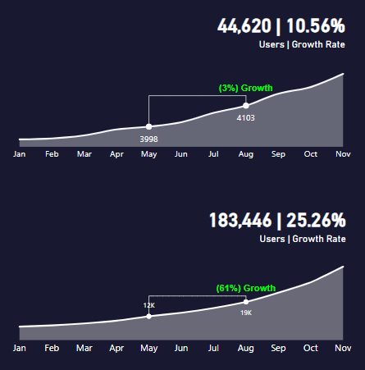
Total Users & Growth Trends
LioCinema has a significantly larger user base, with 183,446 subscribers, compared to 44,620 users on Jotstar. In terms of growth, LioCinema is expanding 2.4x faster, with a 25.3% monthly growth rate, while Jotstar grows at 10.6% between January and November 2024.

Slide 7

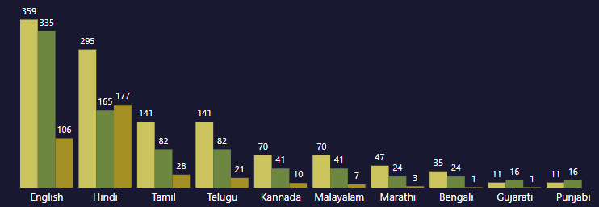
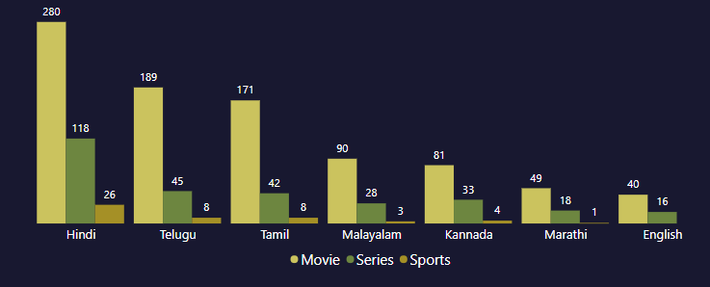
Content Library Comparison
Content : 2360
Content : 1250
Jotstar has a larger content library with 2,360 titles, compared to 1,250 titles on LioCinema.
Language Diversity:
Jotstar offers content in 10 languages, including three additional languages—Bengali, Gujarati, and Punjabi—that are not available on LioCinema.
The most popular languages on Jotstar are English, Hindi, and Tamil, while Bengali, Gujarati, and Punjabi have the least content.
For LioCinema, Hindi, Telugu, and Tamil dominate, while Marathi and English have the least content.

Slide 8
Content Library Comparison
Content : 2360
Content : 1250
Jotstar has a larger content library with 2,360 titles, compared to 1,250 titles on LioCinema.
Content Type Preferences:
Movies are the most-watched content on both platforms, followed by series, with sports being the least preferred.
However, on Jotstar, sports content in Hindi is more popular than series in Hindi, indicating strong regional sports engagement.

Slide 9
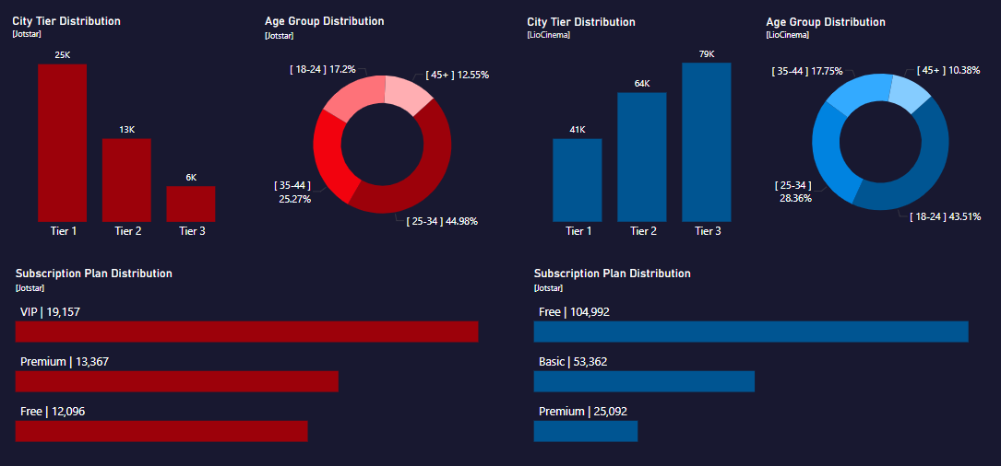
User Demographics
Age Group: Jotstar's most popular age group is 25-34 (45%), while Liocinema's is 18-24 (44%).
City Tier: Jotstar's subscribers (25K) are mostly from Tier 1 cities, while Liocinema's subscribers (79K) are mainly from Tier 3 cities.
Subscription Plan: Jotstar has many paid users on VIP and Premium plans, whereas Liocinema mainly attracts free users, with very few opting for Basic or Premium plans.

Slide 10
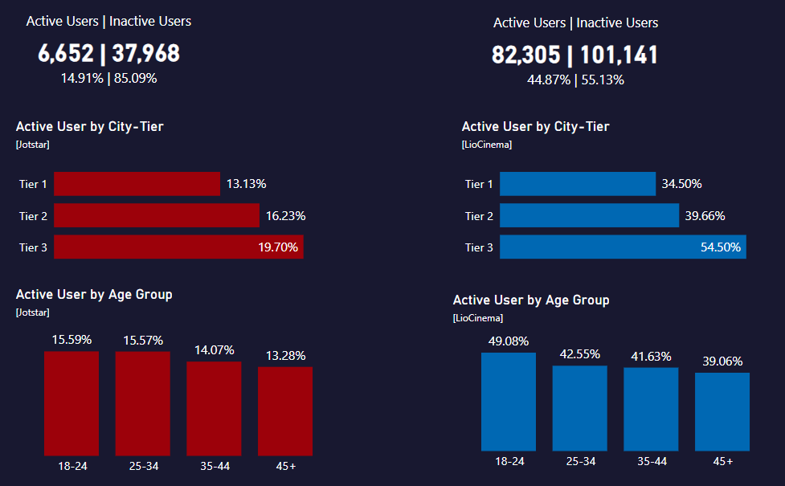
Active Users
Liocinema clearly leads user engagement with 45% active users, outperforming Jotstar's 15%.
Users from Tier 3 cities drive most activity on both platforms, especially the energetic 18-24 segment.
Jotstar also sees strong engagement from the 25-34 age group.
Notes:
Peak and Low Demand Months by City
February saw the highest trip counts in Jaipur, Lucknow, and Chandigarh, while May and April were peak months for other cities. Conversely, June and January recorded the lowest trip counts, with cities like Jaipur, Kochi, Indore, Vadodara, and Coimbatore experiencing reduced demand. In summary, February, May, and April are peak months, while June and January have the lowest demand across the cities.

Slide 11
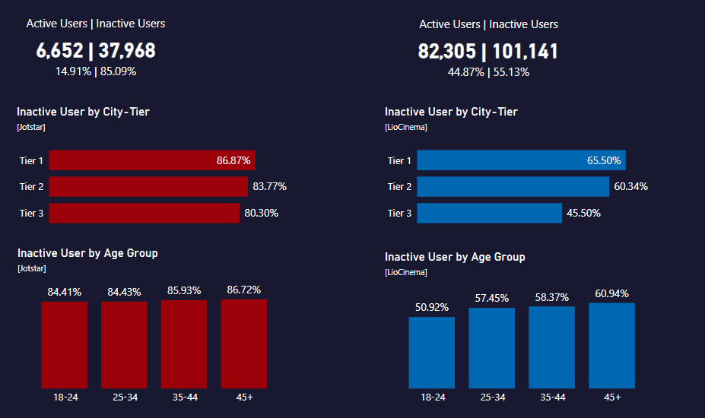
Inactive Users
Conversely, inactivity heavily affects Jotstar (85% inactive) compared to Liocinema (55% inactive).
Users from Tier 1 cities remain largely disengaged on both platforms, notably the older demographic (45+) and, specifically for Jotstar, the nearly equally inactive group aged 35-44, underscoring the need for targeted reactivation strategies.
Notes:
Peak and Low Demand Months by City
February saw the highest trip counts in Jaipur, Lucknow, and Chandigarh, while May and April were peak months for other cities. Conversely, June and January recorded the lowest trip counts, with cities like Jaipur, Kochi, Indore, Vadodara, and Coimbatore experiencing reduced demand. In summary, February, May, and April are peak months, while June and January have the lowest demand across the cities.

Slide 12
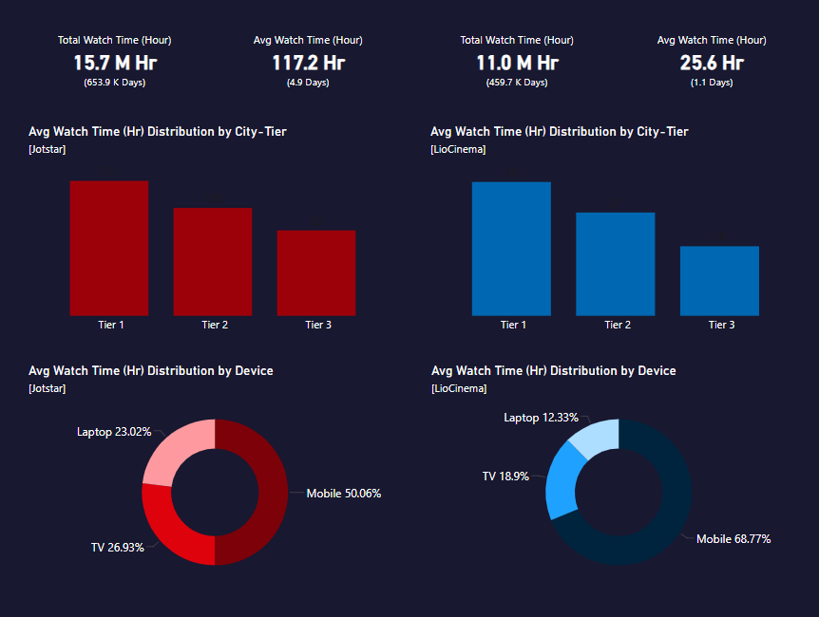
Watch Time Analysis
Jotstar significantly outpaces Liocinema in viewer engagement, with an impressive average watch time of 117 hours (~5 days) versus Liocinema’s 26 hours (~1 day).
Users in Tier 1 cities drive the highest watch duration on both platforms. Mobile devices dominate content consumption, capturing 50% of views on Jotstar and a commanding 67% on Liocinema.
On Jotstar, TV and laptops closely follow mobile usage, whereas Liocinema experiences minimal laptop viewing (12%), strongly highlighting its mobile-first viewer preference.

Slide 13
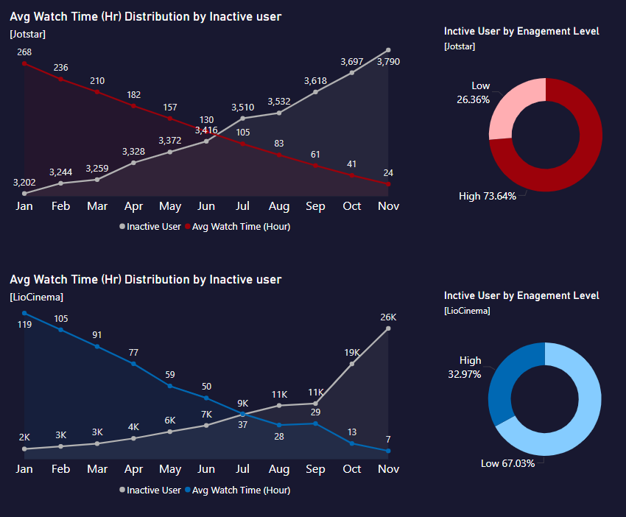
Inactivity Correlation
For Jotstar, inactive user counts steadily rise month-over-month, clearly coinciding with declining average viewing hours.
Surprisingly, 74% of inactive users previously demonstrated high engagement, indicating a significant drop-off risk even among highly engaged audiences.
Liocinema exhibits a similar pattern, with inactive users increasing progressively, but notably surging after September—coinciding with a sharp decline in average watch hours.
Unlike Jotstar, however, Liocinema’s inactivity predominantly affects already low-engagement users (67%), highlighting the importance of proactive retention strategies focused on this segment.
Notes:
Inactivity on both platforms strongly correlates with decreasing average watch time. For Jotstar, inactive user counts steadily rise month-over-month, clearly coinciding with declining average viewing hours. Surprisingly, 74% of inactive users previously demonstrated high engagement, indicating a significant drop-off risk even among highly engaged audiences.
Liocinema exhibits a similar pattern, with inactive users increasing progressively, but notably surging after September—coinciding with a sharp decline in average watch hours. Unlike Jotstar, however, Liocinema’s inactivity predominantly affects already low-engagement users (67%), highlighting the importance of proactive retention strategies focused on this segment.

Slide 14
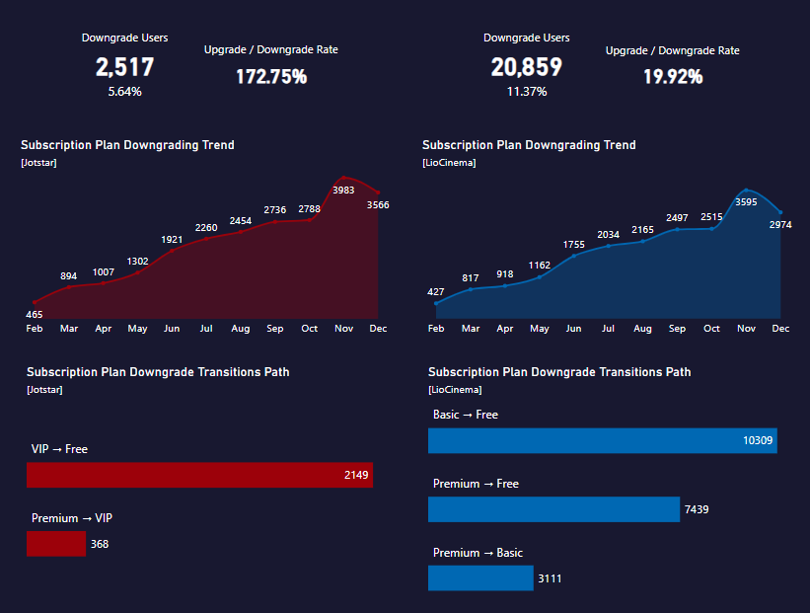
Downgrade Trends
Downgrade patterns for both Jotstar and Liocinema steadily intensify month-over-month, sharply peaking in November, before slightly easing in December.
On Jotstar, users predominantly shift from VIP directly down to Free plans, significantly exceeding downgrades from Premium to VIP. Remarkably, users show no tendency to downgrade directly from Premium to Free, indicating more deliberate, step-by-step decisions.
Conversely, Liocinema sees a more abrupt downgrade pattern, with most users actively switching from Basic straight to Free, closely followed by direct moves from Premium to Free. Very few users choose the intermediate step (Premium to Basic), suggesting quicker disengagement behavior compared to Jotstar.

Slide 15
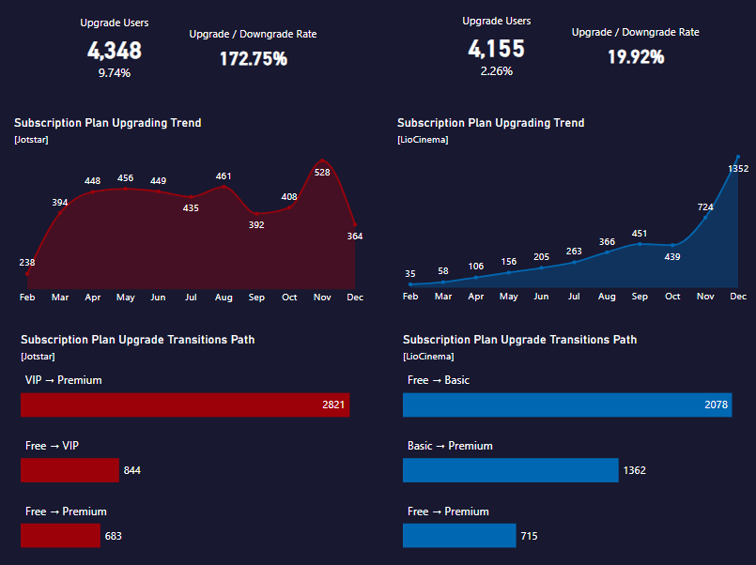
Upgrade Patterns
Jotstar actively attracts more upgrades than downgrades, although the upgrade trends fluctuate notably throughout the year—spiking sharply after February, gradually rising until a dip after August, rebounding strongly after October, then dropping again after November.
Users typically upgrade from VIP to Premium, followed by Free to VIP, with very few directly upgrading from Free to Premium.
In contrast, Liocinema sees fewer upgrades compared to downgrades. The platform shows a steady increase in upgrades throughout the year, with a noticeable surge after October.
The most frequent upgrade path is Free to Basic, then Basic to Premium, with only a minor portion of users directly upgrading from Free to Premium, reflecting incremental upgrade behavior on Liocinema.

Slide 16
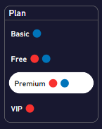
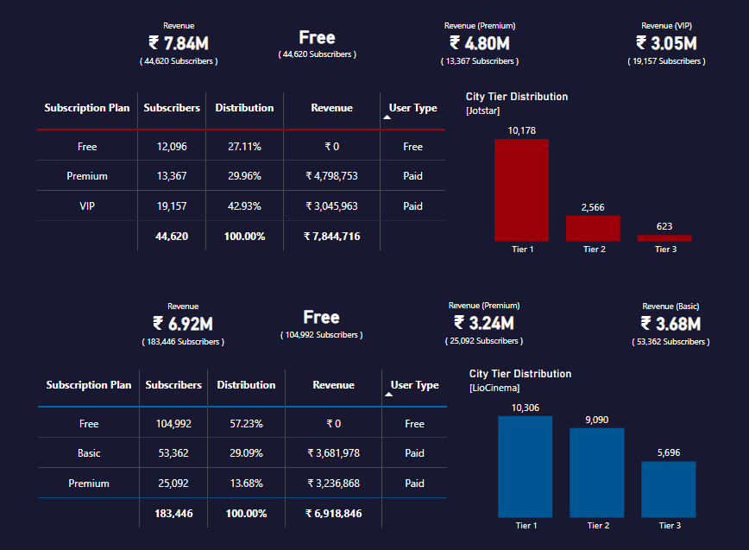
Paid Users Distribution
Jotstar strongly attracts paid subscribers, with 67% of its user base actively subscribed to paid plans (43% VIP, 30% Premium). Premium remains the leading paid plan on both platforms, particularly concentrated in Tier 1 cities (10,178 users), significantly dropping in Tier 2 (2,566) and Tier 3 (623).
In contrast, Liocinema has fewer paid subscribers (43% total, comprising 29% Basic and 14% Premium), leaving 57% on free plans. Premium users also peak in Tier 1 cities (10,306 users), but unlike Jotstar, Liocinema maintains stronger Premium presence in lower tiers (Tier 2: 9,090; Tier 3: 5,696), highlighting broader reach across city tiers compared to Jotstar.

Slide 17
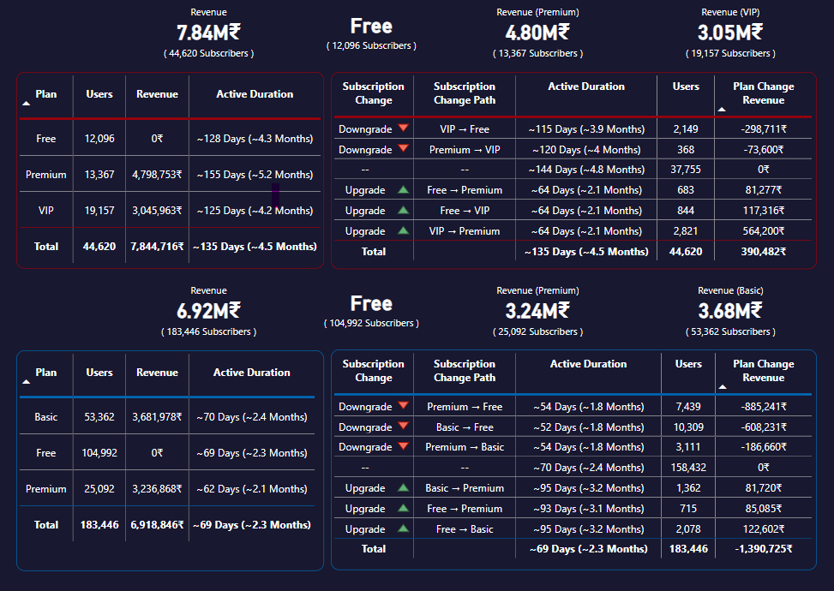
Revenue Analysis
Jotstar generated a robust revenue of ₹7.8M, with premium plans (₹4.8M from 13,367 users, avg. 5.2 months active) outperforming VIP plans (₹3M from 19,157 users, avg. 4.2 months active).
Downgrades notably impacted revenue (-₹372,311 total), particularly VIP-to-Free transitions, but this was offset by significant gains (₹762,793) from user upgrades.

Slide 18
Revenue Analysis
In comparison, Liocinema achieved ₹6.8M in revenue, primarily driven by Basic plans (₹3.6M from 53,362 users, avg. 2.4 months active) and Premium plans (₹3.2M from 25,092 users, avg. 2.1 months active).
Downgrades severely affected earnings (-₹1.68M total), particularly Premium-to-Free transitions. Upgrades contributed modestly (₹289,407), highlighting potential to improve user retention and revenue optimization strategies.

Slide 19
Further analysis & Recommendations

Slide 20
1. What strategies can the merged platform implement to increase engagement among inactive users and convert them into active users?
Personalized Campaigns:
Segment users by age, city tier, and language preferences.
Send personalized recommendations, promotions, and event-based notifications.
Content Diversification:
Expand content in underserved languages (e.g., Bengali, Gujarati, Punjabi).
Localized content for Tier 2 and Tier 3 cities.
Bundle popular content to enhance watch time.
Flexible Pricing & Promotions:
Introduce micro-plans or pay-per-view options.
Offer time-limited discounts and free trials.
Implement loyalty programs to reward activity.

Slide 21
1. What strategies can the merged platform implement to increase engagement among inactive users and convert them into active users?
Mobile Experience Optimization:
Enhance mobile app UI/UX and streaming quality.
Promote download-and-watch-later features.
Use push notifications for personalized recommendations.
Sports & Cross-Promotion:
Leverage sports content with regional promotions.
Collaborate with sports leagues for exclusive streaming rights.
Cross-promote content between LioCinema and Jotstar.
Retention & Upgrade Paths:
Offer affordable mid-tier plans to prevent downgrades.
Provide discounts before users downgrade.
Enhance user journey from Free to Premium.

Slide 22
2. What type of brand campaigns should the merged platform launch to establish itself as the go-to OTT platform in India?
“Cinema of the People” (User-Curated Content Playlists)
Allow users to create and share their own playlists (e.g., “Best of 2024,” “Top Regional Hits,” “Underrated Gems”).
Feature the most popular user-generated playlists on the homepage.
Monthly contests for “Best Curator” with rewards like Premium subscriptions or merchandise.
“Hustle & Shine” (Small Creator Partnerships)
Collaborate with YouTube and Instagram micro-influencers from Tier 2 & Tier 3 cities.
Create content series where influencers showcase their hometowns or cultural uniqueness.
Promote their content through special pages or playlists on the platform.
“Festival Fever” (Regional Festival Content Drives)
During major regional festivals, launch exclusive series or movie marathons celebrating those events.
Collaborate with creators to produce festival-related documentaries, series, or even short live-streamed events.
Promote offers targeting regional festivals (e.g., Diwali Binge Pack, Onam Special, Durga Puja Premium Access).

Slide 23
2. What type of brand campaigns should the merged platform launch to establish itself as the go-to OTT platform in India?
“Flashback Fridays” (Nostalgia-Driven Engagement)
Release classic movies and shows from different regions every Friday.
Host watch parties with creators or actors from those classics.
Run nostalgia-themed social media challenges (e.g., “Guess the Dialogue”).
“The Marathon Challenge” (Gamified Viewing Experience)
Introduce gamification by setting up watch challenges (e.g., “Complete 3 Movies in 24 Hours”).
Users earn badges, discounts, or exclusive previews upon completion.
Make challenges theme-based (“Horror Week,” “Romantic Week,” “Regional Hits Week”).

Slide 24
3. How should the merged platform price its subscription plans to compete effectively while maintaining profitability?
Freemium Model (Ad-Supported Tier)
Offer a Free Tier: Provide access to limited content with ads, particularly regional content that appeals to Tier 3 cities and budget-conscious users.
Purpose: Build a large user base quickly and monetize through ads while providing a gateway to convert free users to paid plans.
Revenue Source: Advertisement revenue.
Multi-Tiered SVOD Model (Subscription Video on Demand)
Three Subscription Plans:
Basic Plan: ₹69/month - SD streaming, 1 device. Targeted at Tier 2 & 3 users.
Standard Plan: ₹129/month - HD streaming, 2 devices, Download & Watch Later. Popular plan for families.
Premium Plan: ₹359/month - 4K streaming, 4 devices, exclusive content access. Targeted at sports enthusiasts and urban viewers.
Purpose: Appeal to different economic demographics while maximizing revenue through premium content offerings.

Slide 25
3. How should the merged platform price its subscription plans to compete effectively while maintaining profitability?
Regional Pricing & Flexible Payment Options
Localized Pricing: Reduced prices for Tier 2 & Tier 3 cities to attract subscribers from low-income areas.
Flexible Payment Plans: Offer monthly, quarterly, and annual subscriptions. Annual plans receive discounted pricing to encourage long-term commitment.
Purpose: Boosts affordability, improves retention, and taps into broader market segments.
Telecom Partnerships & Bundling
Collaborate with telecom providers: Integrate subscription offers with data and broadband plans (e.g., Jio, Airtel, VI).
Bundled Offers: Combine sports content with movies or series at attractive rates (e.g., “VIP Sports Pack” or “Weekend Movie Pack”).
Purpose: Leverage existing telecom user bases and provide high-value bundled experiences.
Promotional Pricing & Upgrade Incentives
Introductory Offers: Offer discounts for first-time subscribers (e.g., ₹49 for the first month of the Basic Plan).
Upgrade Offers: Provide temporary access to Premium features for Basic and Standard users to encourage upgrading.
Loyalty Discounts: Reward long-term subscribers with discounted annual plans or exclusive content access.
Purpose: Reduce churn, attract new users, and encourage users to move up the subscription ladder.

Slide 26
4. How can the platform leverage partnerships with telecom companies to expand its subscriber base?
Bundled Subscription Offers
Strategy: Integrate OTT subscriptions into mobile or broadband data plans (e.g., LioCinema bundled with Lio’s mobile plans).
Benefit: Immediate access to millions of telecom subscribers, enhancing visibility and convenience.
Data Incentives & Zero-Rating
Strategy: Offer zero-data charges or additional data incentives when subscribers stream content through partner telecom services.
Benefit: Encourages more viewing time, boosts engagement, and increases the perceived value of both services.
Exclusive Content Collaborations
Strategy: Develop telecom-exclusive content packages, premieres, or early-access content, similar to Jotstar’s exclusive sports content offerings.
Benefit: Drives telecom users to adopt or upgrade their subscription plans to access exclusive offerings.

Slide 27
4. How can the platform leverage partnerships with telecom companies to expand its subscriber base?
Joint Marketing and Promotions
Strategy: Collaborate on marketing campaigns through telecom channels—SMS marketing, telecom apps, physical stores, and websites.
Benefit: Increased visibility, consumer trust, and faster user acquisition.
Flexible Payment Integration
Strategy: Facilitate payments directly via telecom billing or prepaid mobile balance deductions.
Benefit: Simplifies the subscription process, improving conversion rates especially among Tier 2 and Tier 3 audiences.

Slide 28
5. What role can AI and machine learning play in personalizing the user experience and improving content discovery?
Personalized Recommendations
AI Capability: Analyze users' viewing history, preferences, and interactions.
Benefit: Deliver customized suggestions, increasing engagement and reducing churn.
Dynamic Homepage & Content Curation
AI Capability: Dynamically adjust the homepage layout based on individual user interests, trending content, or regional popularity.
Benefit: Faster content discovery and improved viewer satisfaction.
Predictive Analytics for User Retention
AI Capability: Predict which users might become inactive or downgrade subscriptions.
Benefit: Implement proactive strategies (e.g., personalized offers or recommendations) to retain and re-engage these users.

Slide 29
5. What role can AI and machine learning play in personalizing the user experience and improving content discovery?
Enhanced Search & Discovery
AI Capability: Utilize Natural Language Processing (NLP) for smarter searches, better language detection, and content tagging.
Benefit: Users find relevant content quicker, improving satisfaction and platform usage.
Content Performance Forecasting
AI Capability: Predict content performance by analyzing viewership data, user engagement, and regional preferences.
Benefit: Enables informed decisions on future content acquisition and creation, optimizing content investments.

Slide 30





6. Who should be the brand ambassador for the newly merged OTT platform (LioCinema-Jotstar) to effectively represent its identity and attract a diverse audience?
Allu Arjun
Widely popular due to pan-India success (Pushpa), strong appeal in both South and North India, particularly Tier 2 & 3 cities.
Youth, regional viewers, and mass-market appeal.
Pankaj Tripathi
Known for authenticity, credibility, and diverse content (OTT and films), appeals strongly to mature, urban and rural audiences.
Mature viewers, Tier 2 & 3 audiences, wide demographic appeal.
Shraddha Kapoor
Broad nationwide recognition and appeal across urban, semi-urban, and rural areas.
Versatile roles in Bollywood attract diverse demographics, from youth to families.
Young adults, urban/semi-urban women, families, and Tier 2 & Tier 3 city viewers.
Hardik Pandya
Popular sports figure with nationwide recognition, youthful and aspirational, aligns well with Jotstar’s strong sports content presence.
Sports enthusiasts, younger audience, energetic urban and rural viewers.
Rashmika Mandanna
Widely admired for her energetic presence and versatile roles, especially appealing to younger audiences.
Achieved significant pan-Indian popularity through blockbuster films across Telugu, Tamil, Kannada, and Hindi industries,
Youth, Gen-Z, regional and urban viewers across all tiers

Slide 31
Strategic Recommendations for Lio-Jotstar Merger
Content Strategy Optimization:
Expand LioCinema’s content library by acquiring regional language content (e.g., Bengali, Gujarati, Punjabi) from Jotstar to enhance appeal across diverse audiences.
Prioritize content in popular languages (Hindi, English, Tamil) and diversify content types, particularly focusing on movies and regional sports.
Subscriber Growth & Retention:
Leverage LioCinema’s superior growth rate (25.3%) by integrating Jotstar’s premium user base for cross-promotion.
Develop targeted marketing campaigns to retain Jotstar’s high-engagement users (25-34 age group) and LioCinema’s dominant segment (18-24).
Inactivity Reduction & User Engagement:
Implement targeted reactivation strategies for inactive users, especially Jotstar’s 35-44 age group and LioCinema’s low-engagement users.
Focus on personalized content recommendations and discounts to encourage activity among Tier 1 city users.
Upgrade & Downgrade Management:
Promote seamless upgrade pathways by incentivizing VIP-to-Premium transitions on Jotstar and Basic-to-Premium on LioCinema.
Address abrupt downgrades on LioCinema by offering intermediate plans or customized retention offers.
Notes:
Diversify Content Portfolio: Integrate Jotstar’s regional content (Bengali, Gujarati, Punjabi) into LioCinema’s library.
Maximize User Retention: Leverage cross-platform marketing to retain high-engagement segments (Jotstar: 25-34, LioCinema: 18-24).
Reduce Inactivity: Implement personalized reactivation offers targeting inactive users, especially in Tier 1 cities.
Boost Upgrades & Minimize Downgrades: Incentivize VIP-to-Premium upgrades on Jotstar and Basic-to-Premium on LioCinema.

Slide 32
Strategic Recommendations for Lio-Jotstar Merger
Revenue Maximization:
Improve retention strategies for Premium users on LioCinema to mitigate revenue losses from downgrades.
Focus on converting Jotstar’s VIP users to Premium plans through value-add services or exclusive content.
Platform Consolidation & Synergy:
Utilize LioCinema’s extensive reach across Tier 3 cities and Jotstar’s paid user base in Tier 1 cities to create a unified and inclusive OTT platform.
Develop an integrated platform offering tailored subscription plans, considering city tiers, age groups, and content preferences.
Performance Tracking & Continuous Improvement:
Regularly monitor engagement metrics and inactivity patterns to enhance retention strategies.
Continuously analyze content consumption trends to optimize the content library for broader audience appeal.
Notes:
Enhance Revenue Streams: Mitigate LioCinema’s revenue loss from downgrades; convert Jotstar’s VIP users to Premium.
Synergize Platforms: Utilize LioCinema’s Tier 3 reach and Jotstar’s Tier 1 paid user base for holistic growth.
Continuous Performance Monitoring: Track engagement metrics and preferences to refine retention and content strategies.

Slide 33
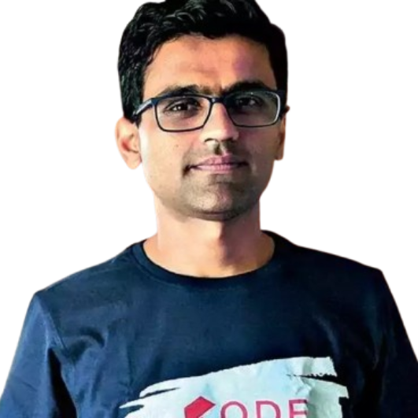

Special Thanks to . .
Dhaval Patel
Hemanand Vadivel
&
T E A M

Slide 34


Thank You

