Slide 1

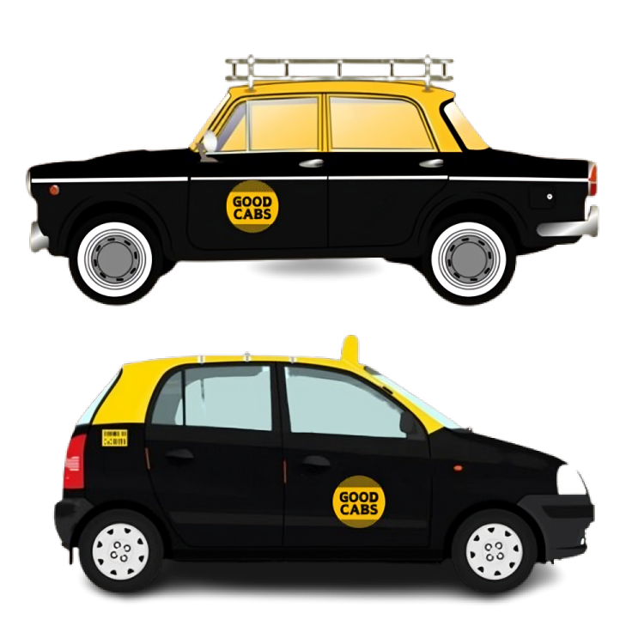

Codebasics Resume Project Challenge #13
SMIT RANA
Notes:
Good day, everyone. Today, I’ll be presenting key insights from Resume Project Challenge 13, focusing on Goodcabs’ performance metrics. These insights are aimed at supporting our growth goals for 2024 and enhancing passenger satisfaction. Let’s dive in.

Slide 2
AGENDA
Understanding Problem
Data Model
Primary Questions
Ad-Hoc Request
Further Analysis & Recommendations
Final Note : End-of-Year Targets

Slide 3



What , Why and Ways
Goodcabs aims to assess its performance in 2024 to drive growth and improve passenger satisfaction, focusing on key metrics like trip volume, passenger satisfaction, repeat passenger rate, and the balance between new and repeat passengers.
W
HY
HAT
The Chief of Operations seeks an assessment of key metrics: trip volume, passenger satisfaction, repeat passenger rate, trip distribution, and the balance between new and repeat passengers.
AYS
analyze the data, generate insights, and report findings directly to the Chief of Operations, following the notes provided by the analytics manager.

Slide 4

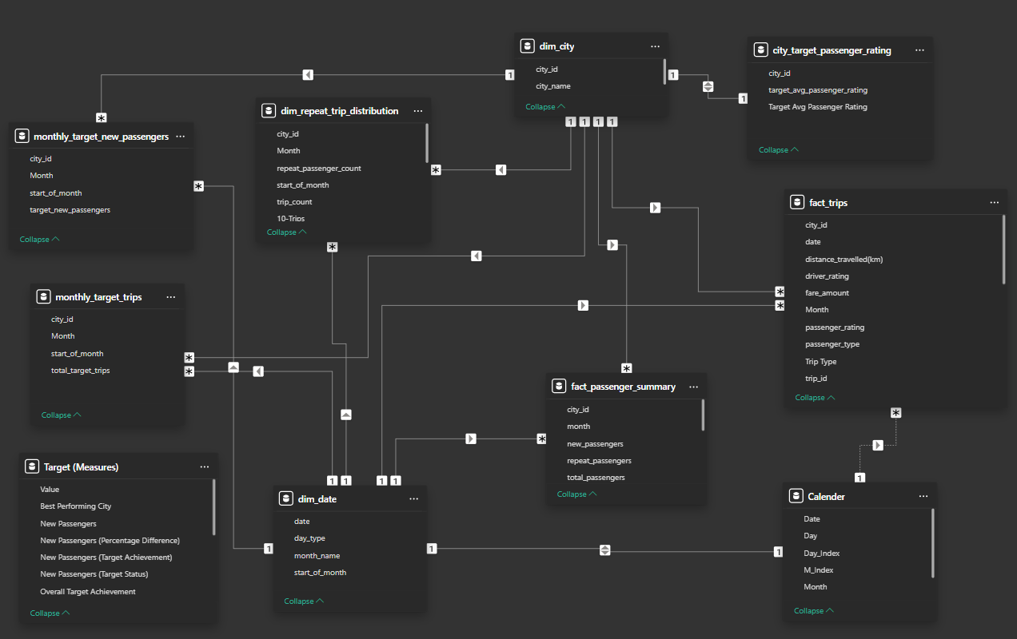
Data Model View

Slide 5
Primary Analysis

Slide 6

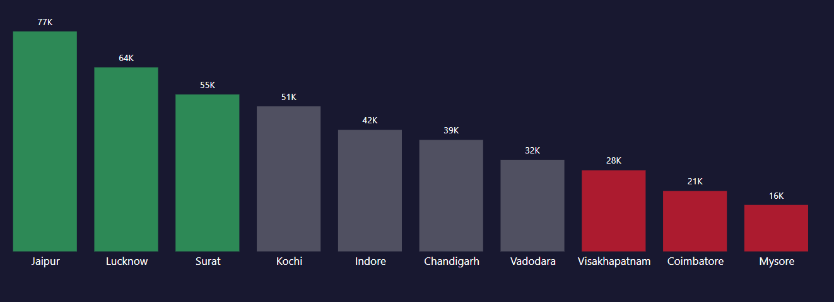
Top and Bottom Performing Cities
Jaipur, Lucknow, and Surat rank as the top three cities with the highest number of trips, while Visakhapatnam, Coimbatore, and Mysore remain at the bottom of the list.

Slide 7
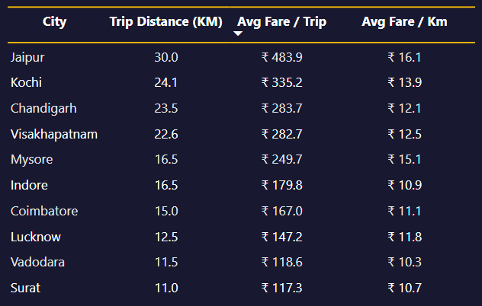
Average Fare per Trip by City
Jaipur records the highest average fare of 484 ₹ for a 30 KM trip, while Surat has the lowest at 117 ₹ for 11 KM. Similarly, Vadodara's average fare is close to Surat, at 119 ₹ for 12 KM.
For a one-kilometer cab ride, Jaipur's fare is 16 ₹, while Surat's is lower at 11 ₹.

Slide 8
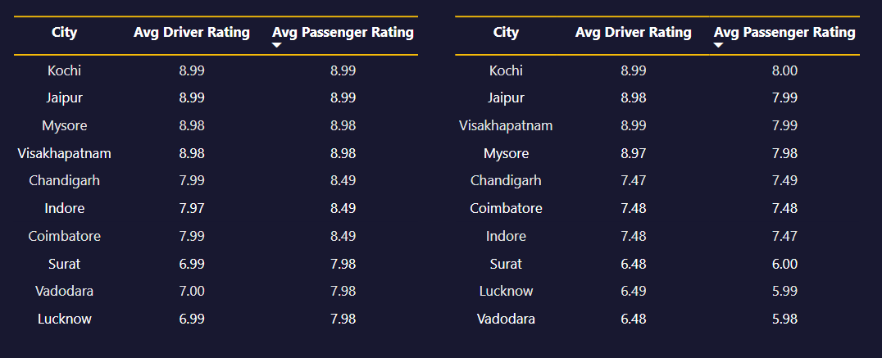
Average Ratings by City and Passenger Type
New Passenger
Returning Passenger
Kochi, Jaipur, and Mysore shine with top ratings of 8.98 for both new and returning passengers, while Surat, Vadodara, and Lucknow lag behind, with ratings as low as 5.99 for drivers and passengers.

Slide 9
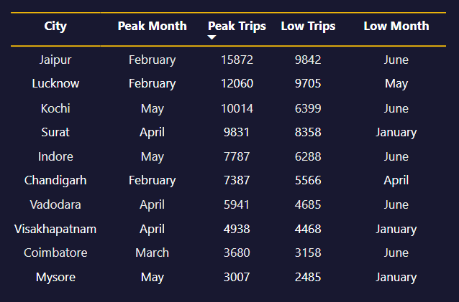
Peak and Low Demand Months by City
Jaipur, Lucknow, and Chandigarh experienced the highest trip volumes in February, with May and April also standing out as peak months for other cities. On the flip side, June and January marked the lowest trip counts, particularly in Jaipur, Kochi, Indore, Vadodara, and Coimbatore.
In conclusion, February, May, and April are the busiest months, while June and January see the least demand across the cities.
Notes:
Peak and Low Demand Months by City
February saw the highest trip counts in Jaipur, Lucknow, and Chandigarh, while May and April were peak months for other cities. Conversely, June and January recorded the lowest trip counts, with cities like Jaipur, Kochi, Indore, Vadodara, and Coimbatore experiencing reduced demand. In summary, February, May, and April are peak months, while June and January have the lowest demand across the cities.

Slide 10
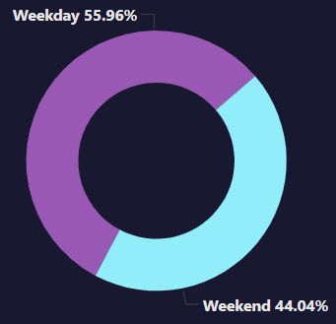
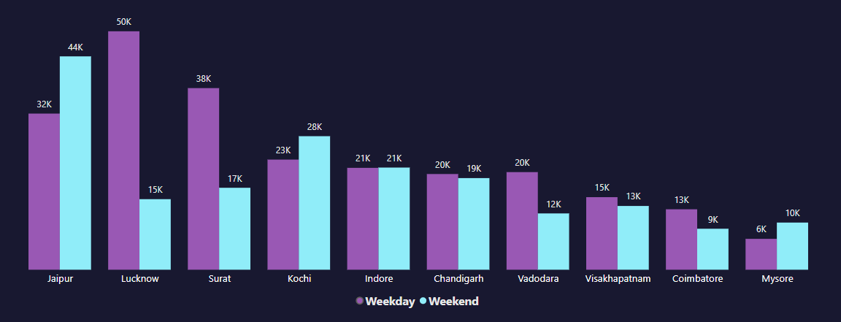
Weekend vs. Weekday Trip Demand by City
Weekdays were busier in Lucknow, Surat, and Jaipur, while Mysore, Coimbatore, and Visakhapatnam saw fewer trips.
On weekends, Jaipur, Kochi, and Surat led in demand, while Mysore, Coimbatore, and Visakhapatnam lagged behind, showing a clear preference for weekdays in some cities and weekends in others.

Slide 11
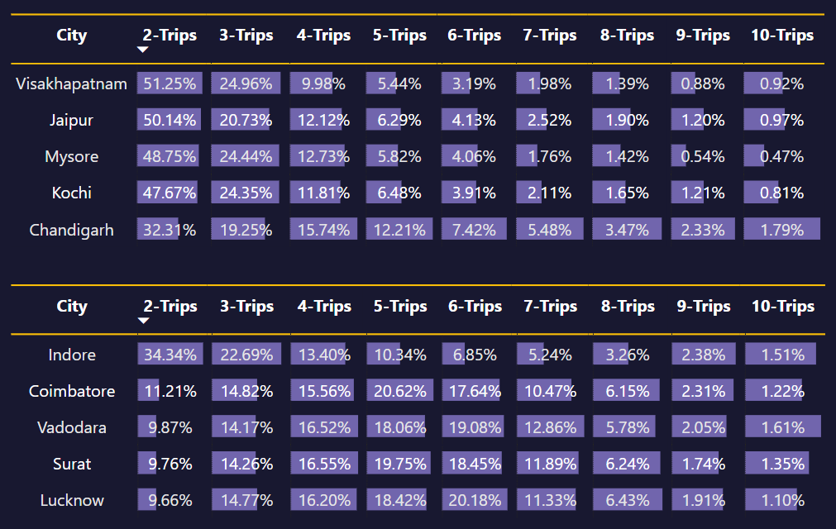
Repeat Passenger Frequency & City Contribution Analysis
Tourism
Business
Visakhapatnam, Jaipur, and Mysore, repeat passengers predominantly take 2 trips, averaging 50%, with a notable decline thereafter.
Lucknow, Coimbatore, Vadodara, and Surat show an upward trend, where repeat trip frequency steadily increases, peaking at 6 trips, reflecting contrasting patterns of travel behavior.

Slide 12
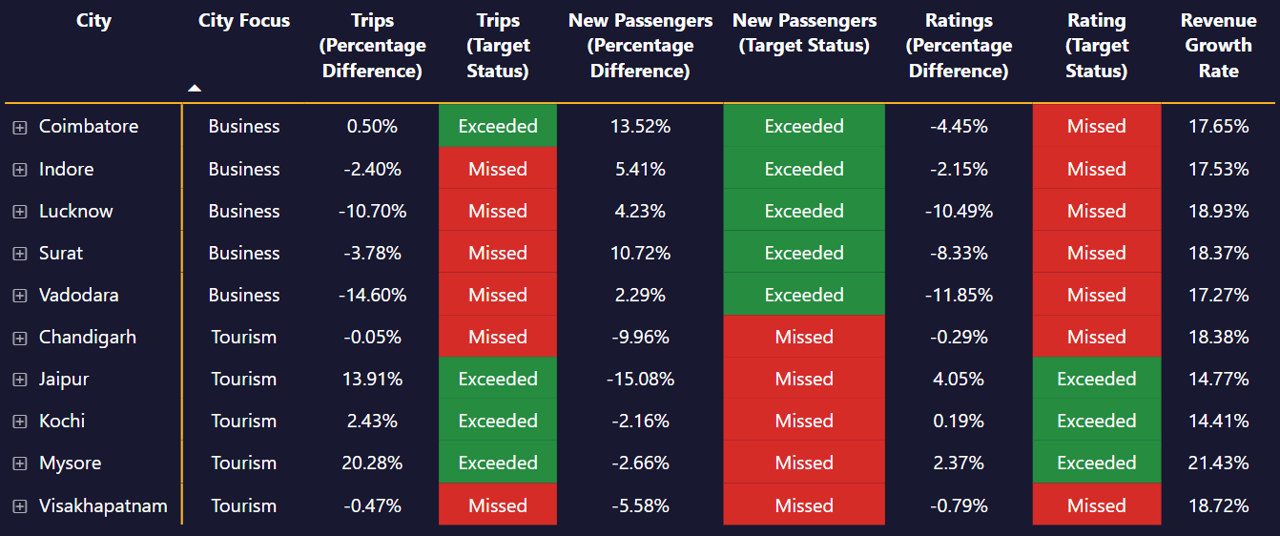
Monthly Target Achievement Analysis for Key Metrics
Business cities generally hit their target for new passengers but struggled with trip and rating goal.
In contrast, tourism cities like Jaipur, Kochi, and Mysore excelled in meeting trip and rating targets but fell short on new passengers. Chandigarh and Visakhapatnam, however, missed all targets across trips, new passengers, and ratings, highlighting a clear gap in performance.

Slide 13
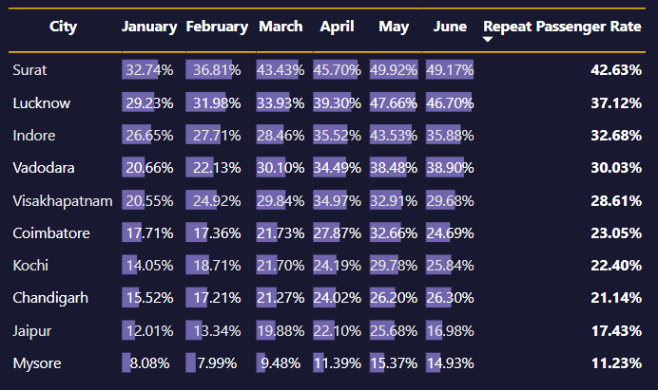
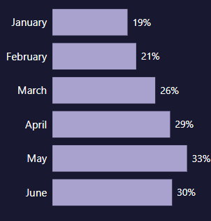
Highest and Lowest Repeat Passenger Rate (RPR%) by City and Month
The Repeat Passenger Rate (RPR%) showed a steady rise from January, reaching its peak in May, with a slight dip in June. Visakhapatnam was the exception, experiencing a sharp rise in April followed by a decline.
Surat and Lucknow led with the highest RPR at 42.63% and 37.12%, while Jaipur and Mysore trailed with the lowest RPR at 17.43% and 11.23%, respectively.

Slide 14
Ad-Hoc Requests

Slide 15
Business Request - 1 City-Level Fare and Trip Summary Report
City | Trips | Average Fare per KM (₹) | Average Fare per Trip (₹) | Contribution to Trips (%)
Chandigarh | 38981 | 12.06 | 283.69 | 9.15
Coimbatore | 21104 | 11.15 | 166.98 | 4.96
Indore | 42456 | 10.9 | 179.84 | 9.97
Jaipur | 76888 | 16.12 | 483.92 | 18.05
Kochi | 50702 | 13.93 | 335.25 | 11.9
Lucknow | 64299 | 11.76 | 147.18 | 15.1
Mysore | 16238 | 15.14 | 249.71 | 3.81
Surat | 54843 | 10.66 | 117.27 | 12.88
Vadodara | 32026 | 10.29 | 118.57 | 7.52
Visakhapatnam | 28366 | 12.53 | 282.67 | 6.66

Slide 16
Business Request - 2 Monthly City-Level Trips Target Performance Report
City | Month | Actual Trips | Targeted Trips | Performance Status | Difference (%)
Mysore | Feb-24 | 2668 | 2000 | Above Target | 33.4
Kochi | Mar-24 | 9495 | 7500 | Above Target | 26.6
Jaipur | Feb-24 | 15872 | 13000 | Above Target | 22.09
Vadodara | Jun-24 | 4685 | 6500 | Below Target | -27.92
Lucknow | Jan-24 | 10858 | 13000 | Below Target | -16.48
Indore | Jun-24 | 6288 | 7500 | Below Target | -16.16
Surat | Jun-24 | 8544 | 10000 | Below Target | -14.56

Slide 17
Business Request - 3 City-Level Repeat Passenger Trip Frequency Report
# City | 2-Trips | 3-Trips | 4-Trips | 5-Trips | 6-Trips | 7-Trips | 8-Trips | 9-Trips | 10-Trips
Chandigarh | 32.31 | 19.25 | 15.74 | 12.21 | 7.42 | 5.48 | 3.47 | 2.33 | 1.79
Coimbatore | 11.21 | 14.82 | 15.56 | 20.62 | 17.64 | 10.47 | 6.15 | 2.31 | 1.22
Indore | 34.34 | 22.69 | 13.4 | 10.34 | 6.85 | 5.24 | 3.26 | 2.38 | 1.51
Jaipur | 50.14 | 20.73 | 12.12 | 6.29 | 4.13 | 2.52 | 1.9 | 1.2 | 0.97
Kochi | 47.67 | 24.35 | 11.81 | 6.48 | 3.91 | 2.11 | 1.65 | 1.21 | 0.81
Lucknow | 9.66 | 14.77 | 16.2 | 18.42 | 20.18 | 11.33 | 6.43 | 1.91 | 1.1
Mysore | 48.75 | 24.44 | 12.73 | 5.82 | 4.06 | 1.76 | 1.42 | 0.54 | 0.47
Surat | 9.76 | 14.26 | 16.55 | 19.75 | 18.45 | 11.89 | 6.24 | 1.74 | 1.35
Vadodara | 9.87 | 14.17 | 16.52 | 18.06 | 19.08 | 12.86 | 5.78 | 2.05 | 1.61
Visakhapatnam | 51.25 | 24.96 | 9.98 | 5.44 | 3.19 | 1.98 | 1.39 | 0.88 | 0.92

Slide 18
Business Request - 4 Identify Cities with Highest and Lowest Total New Passengers
# City | New Passengers | City Category
Jaipur | 45856 | Top 3
Kochi | 26416 | Top 3
Chandigarh | 18908 | Top 3
Surat | 11626 | Bottom 3
Vadodara | 10127 | Bottom 3
Coimbatore | 8514 | Bottom 3

Slide 19
Business Request - 5 Identify Month with Highest Revenue for Each City
# City | Month | Revenue (₹) | Revenue Contribution (%)
Jaipur | February 2024 | 7747202 | 20.82
Kochi | May 2024 | 3333746 | 19.61
Chandigarh | February 2024 | 2108290 | 19.07
Lucknow | February 2024 | 1777269 | 18.78
Visakhapatnam | April 2024 | 1390682 | 17.34
Indore | May 2024 | 1380996 | 18.09
Surat | April 2024 | 1154909 | 17.96
Mysore | May 2024 | 745170 | 18.38
Vadodara | April 2024 | 706250 | 18.6
Coimbatore | April 2024 | 612431 | 17.38

Slide 20
Business Request - 6 Repeat Passenger Rate Analysis
Monthly Repeat Passenger Rate
# City | Month | Passengers | Repeat Passengers | Monthly Passengers Repeat Rate (%)
Chandigarh | May 2024 | 3699 | 969 | 26.2
Coimbatore | May 2024 | 1543 | 504 | 32.66
Indore | May 2024 | 3591 | 1563 | 43.53
Jaipur | May 2024 | 7174 | 1842 | 25.68
Kochi | May 2024 | 6222 | 1853 | 29.78
Lucknow | May 2024 | 3487 | 1662 | 47.66
Mysore | May 2024 | 2270 | 349 | 15.37
Surat | May 2024 | 3217 | 1606 | 49.92
Vadodara | May 2024 | 2256 | 868 | 38.48
Visakhapatnam | May 2024 | 2890 | 951 | 32.91

Slide 21
Business Request - 6 Repeat Passenger Rate Analysis
City Wide Repeat Passenger Rate
# City | Passengers | Repeat Passengers | City-wise Passengers Repeat Rate (%)
Surat | 20264 | 8638 | 42.63
Lucknow | 25857 | 9597 | 37.12
Indore | 22079 | 7216 | 32.68
Vadodara | 14473 | 4346 | 30.03
Visakhapatnam | 17855 | 5108 | 28.61
Coimbatore | 11065 | 2551 | 23.05
Kochi | 34042 | 7626 | 22.4
Chandigarh | 23978 | 5070 | 21.14
Jaipur | 55538 | 9682 | 17.43
Mysore | 13158 | 1477 | 11.23

Slide 22
Further Analysis & Recommendations

Slide 23

1. Factors Influencing Repeat Passenger Rates
Quality of Service:
Cities with higher RPR% (e.g., Surat: 42.63%, Lucknow: 37.12%) likely offer reliable service (e.g., punctuality, cleanliness, and professionalism).
Cities with lower RPR% (e.g., Jaipur: 17.43%, Mysore: 11.23%) may face service inconsistency or customer dissatisfaction.
Competitive Pricing:
Surat (₹11/km) and Vadodara (₹12/km) have affordable fares, correlating with higher RPR%.
Jaipur (₹16/km) has higher fares, which may deter repeat usage despite its popularity.
City Demographics:
Business-focused cities (e.g., Surat, Indore) show consistent repeat usage due to frequent commuting needs.
Tourism-focused cities (e.g., Jaipur, Mysore) see seasonal repeat patterns, with peaks during travel seasons.

Slide 24
1. Factors Influencing Repeat Passenger Rates
Socioeconomic Patterns:
Cities with higher disposable income (e.g., Jaipur) attract repeat passengers during peak months.
In Mysore and Coimbatore, lower income levels or reliance on public transport may reduce RPR%.
Seasonal Demand:
February, May, and April are peak months for most cities, aligning with higher RPR%.
June and January show lower demand, particularly in cities like Jaipur and Kochi.
Customer Loyalty Programs:
Incentives like discounts or rewards may boost RPR% in cities with competitive markets (e.g., Surat).

Slide 25
2. Tourism vs. Business Demand Impact Tourism-Oriented Cities
Jaipur:
January: Jaipur Literature Festival boosts transportation demand.
March/April: Holi Festival increases footfall, raising demand for rides to heritage sites.
Kochi:
January: Kochi-Muziris Biennale attracts international visitors, increasing transportation needs.
April: Easter celebrations drive demand for travel to religious sites.
Mysore:
March/April: Increased demand during Holi and early Dasara Festival preparations.
Chandigarh:
April/May: Baisakhi and Cultural Festivals raise demand for trips to temples and local events.
Visakhapatnam:
April/May: Summer holidays lead to higher demand for beach vacations and local attractions.

Slide 26
2. Tourism vs. Business Demand Impact Business-Oriented Cities
Indore:
January: Business conferences and trade fairs, especially in textiles and industry.
March: Holi celebrations increase demand for business travel.
Coimbatore:
January/February: Coimbatore Vizha boosts demand for business trips and sightseeing.
Vadodara:
March/April: Holi and business events raise demand for local and tourist travel.
Surat:
January/February: Business exhibitions in the textile industry cause a slight uptick in demand.
Lucknow:
February/March: Business conferences and cultural events, along with Holi celebrations, drive weekday demand.

Slide 27
2. Tourism vs. Business Demand Impact
Tailoring Marketing Efforts
Tourism-Oriented Cities:
During peak tourist seasons and festivals, Goodcabs can tailor marketing efforts by offering special packages or discounted rides for tourists attending major events like the Jaipur Literature Festival or Kochi-Muziris Biennale.
Partnering with local event organizers or tourist agencies to offer transportation bundles (e.g., rides to and from events or tourist destinations) could increase trip volume in these cities.
Business-Oriented Cities:
For cities with a strong business focus, Goodcabs can promote corporate packages or business trip offers around key events like trade fairs or conferences. Offering discounts or loyalty programs for business travelers could help maintain a steady demand for rides throughout the weekdays.

Slide 28
3. Emerging Mobility Trends and Goodcabs' Adaptation
Emerging trends like electric vehicle (EV) adoption and green energy are gaining traction in tier-2 cities. Key factors driving this shift include:
Government Incentives: Subsidies and tax breaks for EVs make them more affordable.
Environmental Awareness: Growing concern over pollution is pushing demand for eco-friendly transport.
Cost Efficiency: EVs have lower operating costs compared to fuel-powered vehicles, offering long-term savings.
Consumer Preference: Increasing demand for sustainable services is encouraging businesses to adopt green solutions.

Slide 29
3. Should Goodcabs Integrate Electric Vehicles or Eco-Friendly Initiatives?
Goodcabs should consider integrating electric vehicles (EVs) and eco-friendly initiatives to stay competitive in tier-2 cities. Benefits include:
Market Differentiation: Offering EVs can set Goodcabs apart from competitors.
Cost Savings: EVs reduce fuel and maintenance costs.
Government Support: Aligning with EV policies could provide financial incentives.
Brand Loyalty: Eco-friendly services attract environmentally conscious customers.
Integrating EVs and green initiatives would align Goodcabs with emerging trends and provide long-term benefits.

Slide 30
4. Partnership Opportunities with Local Businesses
Goodcabs can benefit from partnerships with local businesses, particularly in tourism-heavy and high-footfall areas, to boost demand and improve customer loyalty:
Tourism Cities (e.g., Jaipur, Kochi, Mysore): Partnering with hotels, resorts, and tourist attractions can offer seamless transportation options for tourists. Bundled packages or discounts for hotel guests can increase trip volumes, especially during peak tourist seasons.
Business Cities (e.g., Indore, Surat, Vadodara): Collaborating with business hotels, corporate offices, and event venues can cater to business travelers, offering exclusive rides and corporate packages, especially for weekday trips.
Event & Seasonal Opportunities: Partnering with event organizers for conferences, exhibitions, and festivals in cities like Chandigarh and Visakhapatnam can drive demand during specific months and improve loyalty.

Slide 31
4. Partnership Opportunities with Local Businesses
High-Footfall Locations: Collaborations with shopping malls or transport hubs in cities like Surat and Jaipur can increase visibility and trip volumes, offering special discounts for frequent trips to these locations.
Loyalty Programs: Cross-promotions with local businesses (e.g., discounts at malls or restaurants for Goodcabs passengers) can enhance customer loyalty and attract new users.
These partnerships can drive both tourism and business demand, expanding Goodcabs' reach and strengthening customer retention.

Slide 32
5. Data Collection for Enhanced Data-Driven Decisions
Customer Demographics: Age, gender, income, occupation, and passenger type (tourist vs. business) to understand demand patterns and personalize marketing.
Trip Behavior: Data on trip duration, distance, time of day, frequency, and popular routes to optimize pricing and service offerings.
Customer Satisfaction: Feedback, ratings, and survey data to identify service improvement areas and enhance the customer experience.
Operational Efficiency: Driver performance, vehicle utilization, trip cancellations, and no-shows to improve fleet management and reduce costs.
Market Trends: Competitor pricing, local events, and emerging mobility trends (e.g., electric vehicles) to stay competitive and adjust strategies.
Real-Time Data: Trip tracking, route optimization, and demand forecasting to improve operational efficiency and resource allocation.
Loyalty Program Data: Participation in loyalty programs and promotion effectiveness to drive repeat business and improve retention.

Slide 33
Final Note : End-of-Year Targets
Increase Repeat Passenger Rate (RPR%)
Target: 5% increase in RPR% in Jaipur and Mysore.
Focus: Improve service consistency and implement loyalty programs.
Optimize Marketing Campaigns
Target: 10% increase in demand in tourism cities like Jaipur and Kochi during key festivals.
Focus: Tailor campaigns and partner with local event organizers for special ride packages.
Expand Electric Vehicle (EV) Integration
Target: 10% of fleet in tier-2 cities to be electric by year-end.
Focus: Launch EV pilots in Surat and Vadodara with eco-friendly services and government incentives.
Partnerships with Local Businesses
Target: 5 new strategic partnerships with hotels, resorts, and event organizers.
Focus: Offer bundled packages for tourists and corporate clients during peak seasons.

Slide 34
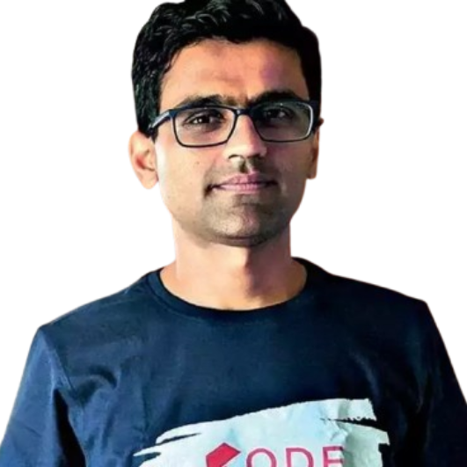

Special Thanks to . .
Dhaval Patel
Hemanand Vadivel
&
T E A M

Slide 35
Thank You

