Slide 1
Encryption using AES_128.
Gentjan Gjeci

Slide 2
Overview
AES (Advanced Encryption Standard)
Communication Security
Protect personal and business communication between parties
Protect files shared between parties
Device Security
Encrypt Devices (e.g. hard drives)
Removing encryption key makes encrypted device unusable elsewhere

Slide 3
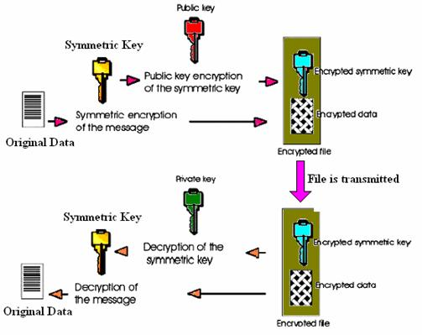
Overview
AES Key sharing and usage
Create Symmetric Key
Share Key using Public/Private Key
Start using the secured channel

Slide 4
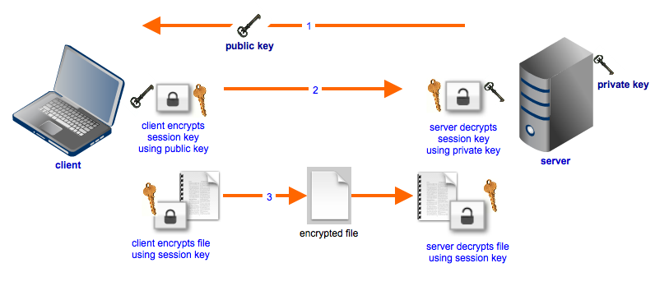
Testing

Slide 5
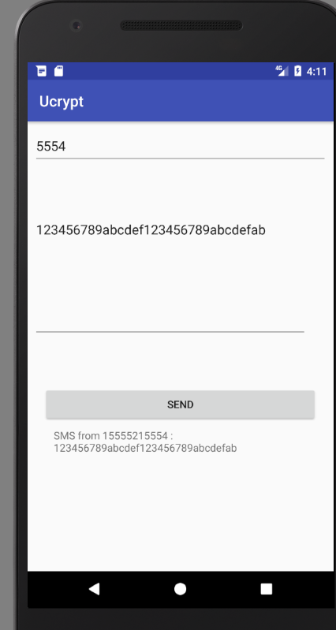
Testing
No Encryption

Slide 6
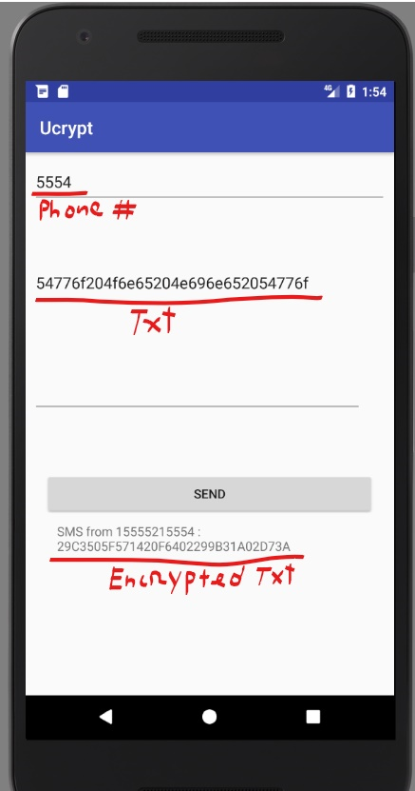
Testing
Sending an Encrypted Message

Slide 7
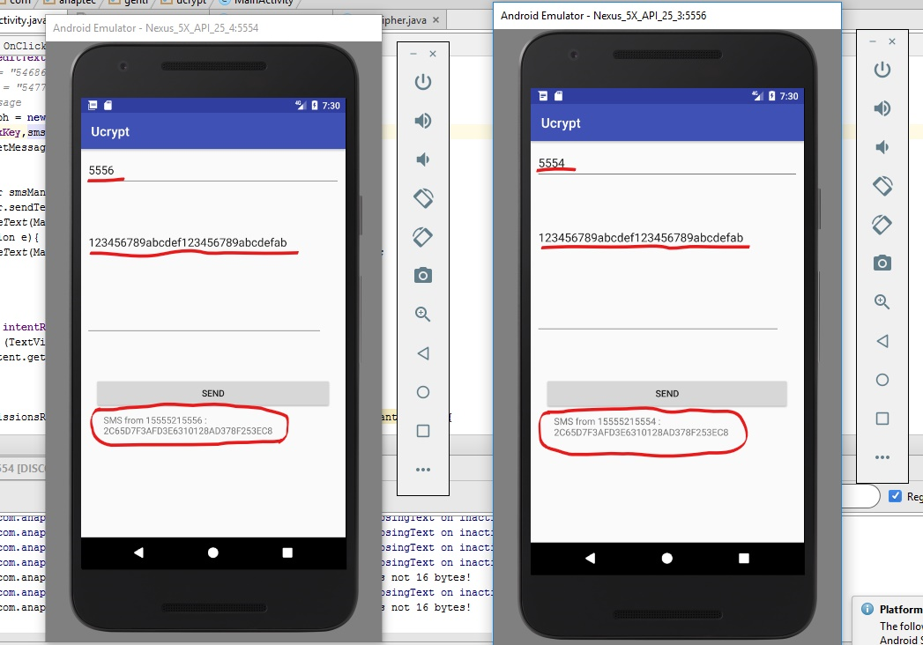
Testing

Slide 8
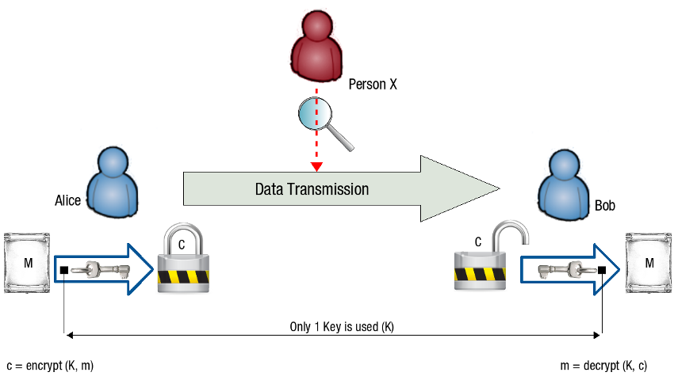
Man in the Middle Attack
If Alice and Bob did not use encryption a person in the middle can read the message and compromise the whole conversation. AES Encryption does not prevent such a person from reading the messages, but they will read only the encrypted message, and it will be impossible for them to decrypt the message without the key.

Slide 9
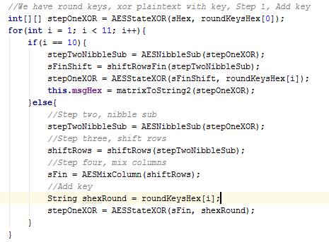
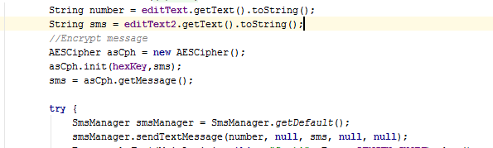
Source Code

Slide 10
Questions?

