Slide 1
Mini Project 1
February 2021
Jin Yang

Slide 2
Disclaimer
Past performance is no guarantee of future results.
The analysis presented in this presentation is to provide information on historical data and has no intention to provide any financial advice.

Slide 3
Background
The market capitalization of the Australian Securities Exchange has increased from $1.629 trillion as at December 2015 to $2.237 trillion as at December 2020 (ASX, 2021).
With a low cash rate of 0.10% (effectively from 2 December (RBA,2021)), many retail investors are investing more into Australian share market (Vickovich, 2020).
However, the market is risky, volatile and uncertain.
These investors may not outperform the market.

Slide 4
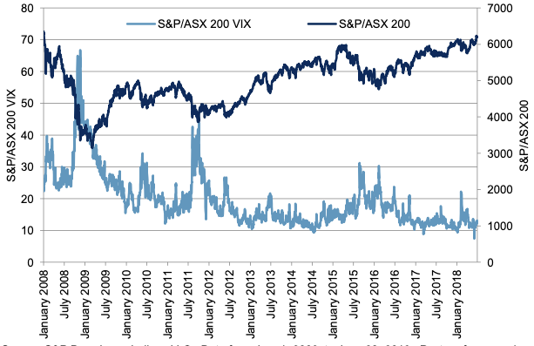
Market ASX200 index and volatility

Slide 5
Business Question
Is there a relationship between value portfolio criteria and share price?
Can we predict the returns using value investing criteria?
Does value investing portfolio outperform ASX200 index for the past 5 years?
Objectives
  To determine value investing criteria
  To examine the relationship between value investing criteria and returns
  To investigate the relationship between value investing portfolio and ASX 200 index.
Alternative – can value investing criteria predict the share price returns (t+1)?

Slide 6
Pipeline
Data source
  Financials from Morningstar database
  Share price from Yahoo Finance
Data acquisition
Clean & Exploring
Visualization
Hypothesize
Build Models

Slide 7
Value investing criteria
Selected periods from 2011 to 2020.
Selection criteria (based on Benjamin Graham’ criteria)
  Current ratio >= 1.5
  Debt to Equity ratio < 0.5
  Earnings per share = increase in EPS for the last two consecutive years
  Price to earnings ratio < 15
  Price to book value per share < 1.5

Slide 8
Summary statistics
For each year as well

Slide 9
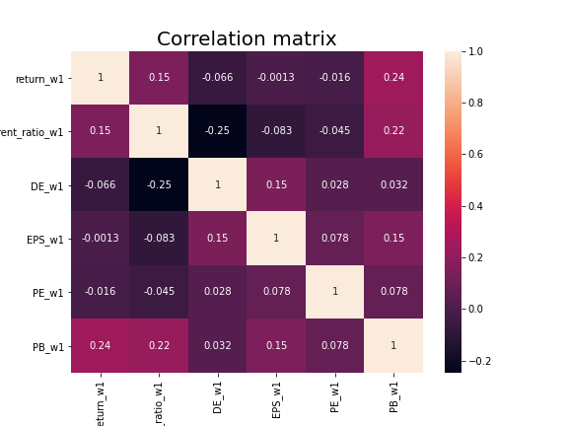
Correlation between key variables (all years)

Slide 10
Correlation
Spearman for dummy vars of value investing criteria.
Pearson for continuous vars of value investing criteria.

Slide 11
Scatter plot/ line plot
Return vs each ind variables

Slide 12
Difference between those firms that made +ve vs –ve returns?
Split the sample between positive and negative returns.
re-run correlation
Scatter plot
Bar plot for each industry

Slide 13
Hypothesis
Hypothesis using Z-test:
Significance level: 5%
H0: There is no difference in returns between ASX200 and value investing portfolio.
H1: There is difference in returns between ASX200 and value investing portfolio.

Slide 14
Hypothesis
Hypothesis using Z-test:
Significance level: 5%
H0: There is no difference in returns between ASX200 and value investing portfolio.
H1: There is difference in returns between ASX200 and value investing portfolio.
Cum.return = criteria 1 + 2 + 3 + 4 + 5
H0: Value investing approach does not lead to higher cumulative returns from 2015.
H1: Value investing approach leads to higher cumulative returns from 2015.

Slide 15
Univariate test results

Slide 16
Experiment
Comparing the portfolio returns with ASX200.
How much would $1 be in 5 years.

Slide 17
Methodology
Summary statistics
Correlation heatmap
Boxplot for all key variables comparison between 2015 and 2019
  May be a line plot??
Scatter plot between ind vars and share price correlation
Cumulative returns from 2015 to today
Regression whether the independent variables are associated with share price.

Slide 18
Cumulative returns stw vs value portfolio
Equal capital allocation over 5 firms
Correlation/scatter plot of returns between ASX200 and value portfolio

Slide 19
Summary
Data
External Considerations (limitations)
  Selection of the undervalued stocks in value investing portfolio are bias to certain GIC Industry (e.g., materials).
  May not be diversified.
Outcomes
  Numbers

Slide 20
regression
Share price
Ind_vars: current_ratio, de, eps, pe, pb

Slide 21
Reference
ASX, 2021, Historical market statistics, ASX, viewed on 28th Jan 2021 (https://www2.asx.com.au/about/market-statistics/historical-market-statistics).
RBA, 2021, Cash Rate Target, Reserve Bank of Australia, viewed on 28th Jan 2021 (https://www.rba.gov.au/statistics/cash-rate/).
Vickovich, A, 2020, Investors ‘take a punt’ on Australia’s riskiest stocks, Australian Financial Review.

Slide 22
Appendix 1 – distribution graph (including transformed variables)

Slide 23
Appendix 2 – bar graph - variables in each sector
Return
Current ratio
DE
EPS
PE
PB

Slide 24
Appendix 3 – bar plots for each var (positive vs negative returns)

Slide 25
Appendix 4 – Time series for each variables (all, positive, negative in same graph)

