Slide 1


Slide 2
CS1428
Foundation of Computer Science
Bonus Content: Creating Libraries

Slide 3
Bonus Content
This content will not be included on the final.
This content will not be included in any lab or assignment.
There is not “Check On Learning” for this module.

Slide 4
Why We Put Code into Libraries
Libraries make general-purpose code easy include in multiple projects.
Libraries are easy to transport.
Libraries can be pre-compiled to obscure the source code from another programmer while exposing the interface.

Slide 5
How We Put Code into Libraries
We split our code into two files:
  Header: saved with a .h extension. This file contains function prototypes and data type definitions. We should also include explanations for how to use every function and data type.
  Source: saved with a .cpp extension. This file contains all of the definitions and implementations required to make the functions and data types in our header files work.
The header file shows the “interface” of our code, i.e. how to use everything.
The source file can be pre-compiled.

Slide 6
Libraries in Code::Blocks
Local libraries need to be compiled and included along with your main file.
Projects automatically link your local libraries at build time
Local libraries are included using “library name.h” rather than <library name>

Slide 7
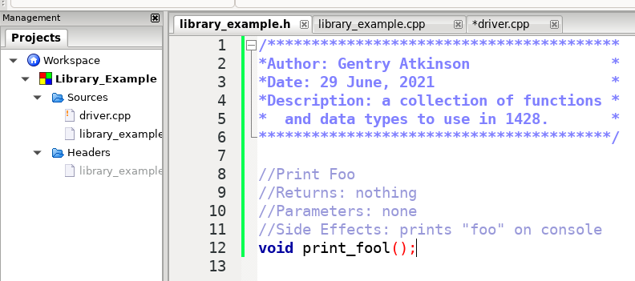
Writing Libraries

Slide 8
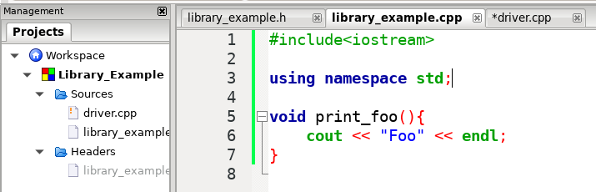
Writing Libraries

Slide 9
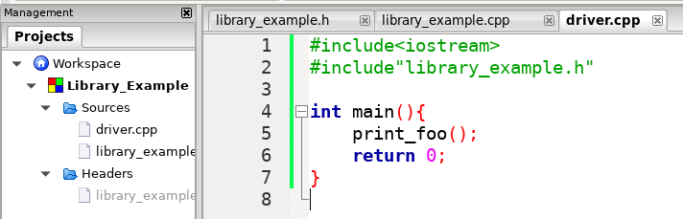
Writing Libraries

Slide 10
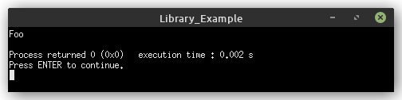
Writing Libraries

Slide 11
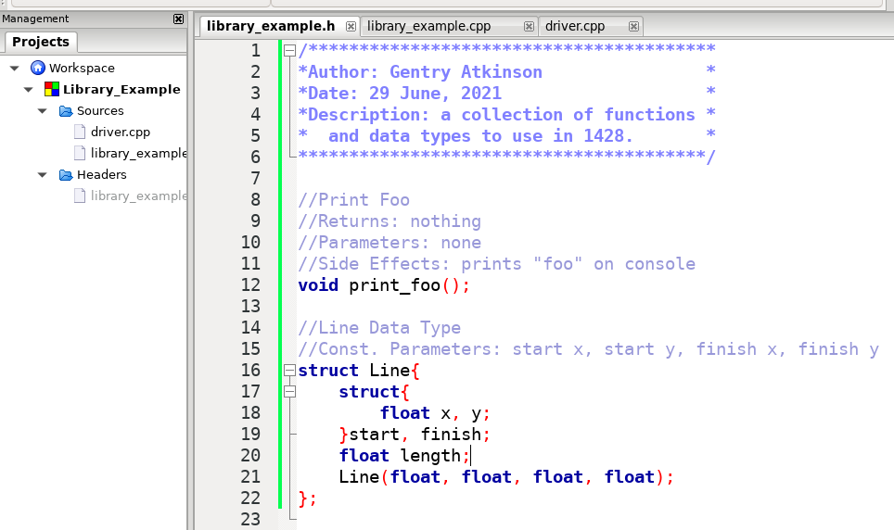
Data Types in Libraries

Slide 12
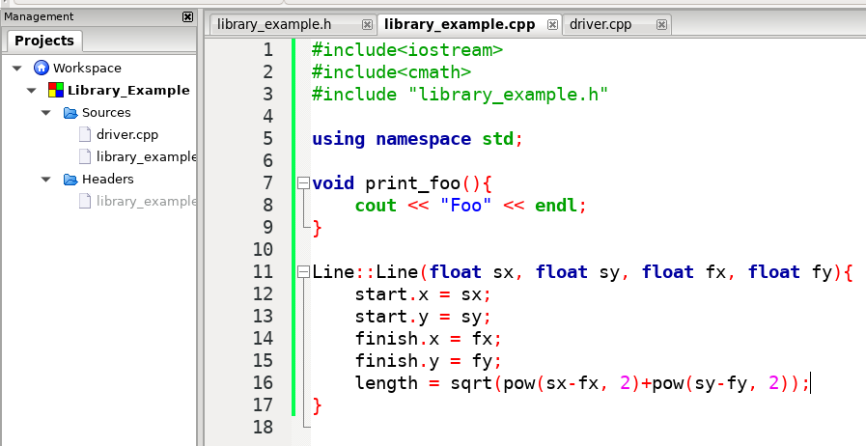
Data Types in Libraries

Slide 13
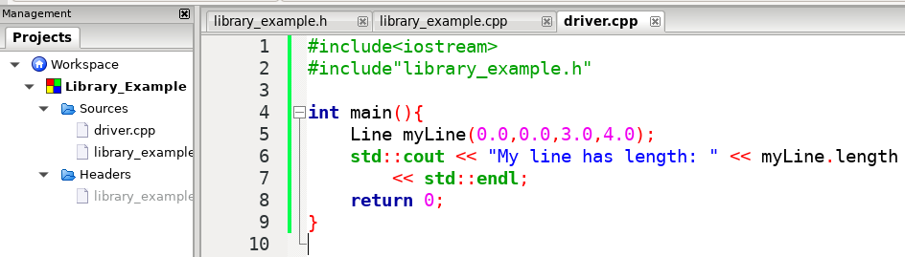
Data Types in Libraries

Slide 14
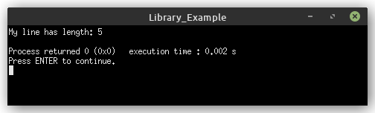
Data Types in Libraries

Slide 15
When to Move Code to a Library
The first code file that your reader reads should be relatively short.
Header files represent long and complicated code as simple interfaces that are easy to understand and remember.
Libraries let us logically encapsulate functions and data types in the same way that data types let us logically encapsulate variables.
Code that is very likely to be re-used should be in a library.

