Slide 1
CS1428
Foundation of Computer Science
Lecture 1.1: Installing CodeBlocks

Slide 2
What is CodeBlocks?
An Integrated Development Environment is the software that we use to write software.
Each IDE is actually a collection of different programs.
CodeBlocks is free and available on all on-campus CS lab computers.

Slide 3
Where is CodeBlocks?
https://www.codeblocks.org/downloads/
Click “Download the binary release”
Windows Users: click either source for codeblocks-20.03mingw-setup.exe
Mac Users: click either source for CodeBlocks-13.12-mac.zip
Linux Users: install Codeblocks through your Software Manager

Slide 4
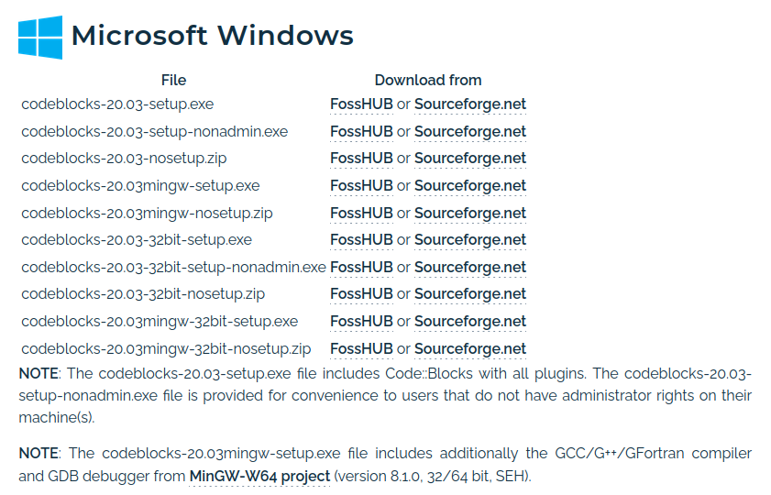
Windows Download

Slide 5
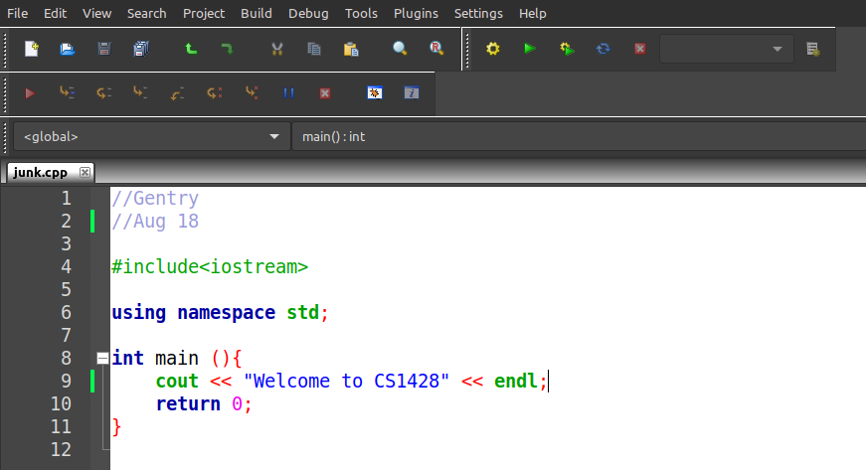
Using CodeBlocks
Create a new program file
Create a new program file
Build and Run a program.
Type your program here.

Slide 6
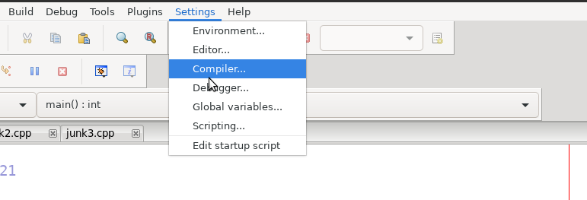
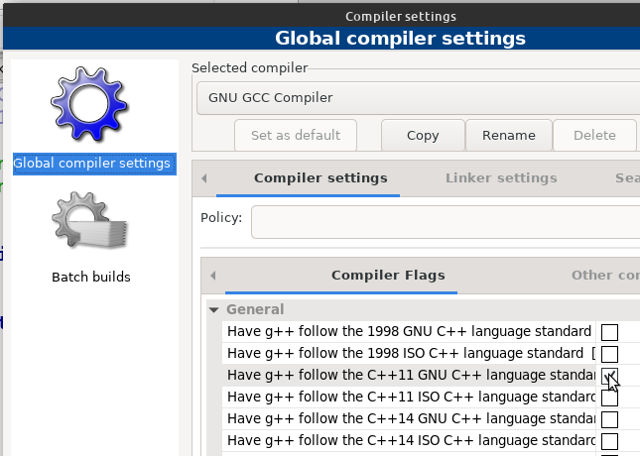
Setting Compiler Version
C++11 OR LATER is required for some techniques taught in this class.

Slide 7
Other IDEs?
Not supported by me or by lab instructors, but might work better for you.
X-Code: good for Mac
  https://apps.apple.com/us/app/xcode/id497799835?mt=12
Repl.it: browser based
  https://replit.com/
C-Lion: free student license
  https://www.jetbrains.com/clion/download/

