Slide 1
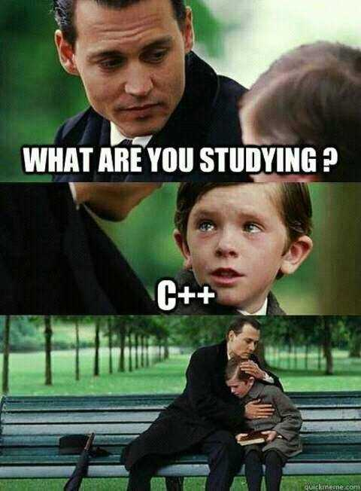

Slide 2
CS1428
Foundation of Computer Science
Lecture 1: Introduction

Slide 3
Who am I?
Gentry Atkinson
Recently graduated PhD
Born in Houston, TX
My research focus is machine learning and bio-signal processing.
Two truths and a lie:
  My favorite food is Korean Barbecue.
  Both of my parents are from Oklahoma.
  My wife and I were married on the lawn of the Texas Capitol.

Slide 4
What is this class?
Introductory! (but you should be familiar with some math)
Two purposes:
  We will study the broadest possible concepts from the field of Computer Science.
  We will learn how to construct simple programs in C++.

Slide 5

Why study programming?
Broadly applicable.
Broadly employable.
It’s a powerful tool for studying information processing.
4 Color Theorem
  Kenneth Appel and Wolfgang Haken
  1976
  1,834 graph configuration generated by computer.

Slide 6
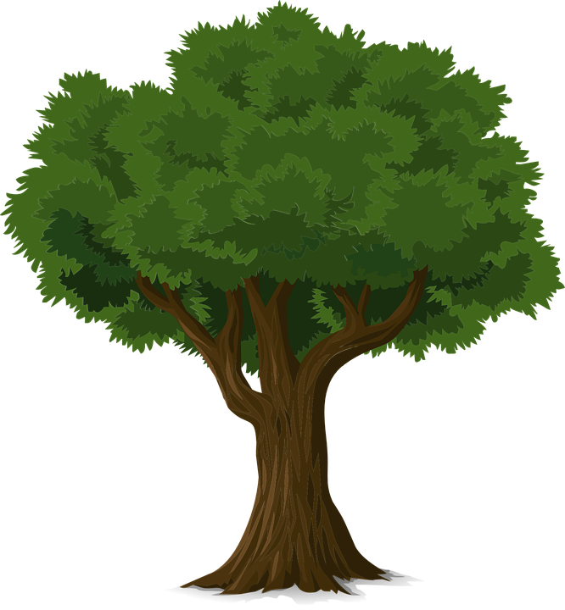
Why study C++?
Python
Broadly applicable.
“Trunk” of a family of languages.
Teaches more about the computer that other languages (e.g. memory management)
Compromises the needs of many fields.
Java
C#
Go
C++
C

Slide 7
Communication Overview:
My email: gma23@txstate.edu
  24 hour response time on weekdays
  48 hour response time on weekends
  Please use email to contact me. I don’t check the Canvas messaging system.
Modules should be studied on Canvas before attending lecture.
Treat each other with civility.

Slide 8
Grading Policy:
Breakdown:
  10% in class
  10% modules on Canvas
  40% 4 coding projects
  15% Midterm
  15% Final
  10% Lab
Final grades will not follow the “plus minus” system.
Up to 3 points of extra credit can be earned on HackerRank

Slide 9
Required Materials:
The C++ Workshop
  Dale Green, Kurt Guntheroth, and Shaun Ross Mitchell
  Available free from Alkek
Integrated Development Environment:
  CodeBlocks is supported by the department.
  You can use whatever IDE you want but your work should be submitted as a .cpp file.
Canvas→ make sure that you have access.
Bringing a laptop or tablet to class is encouraged. You will need to have a laptop of tablet to take the midterm and final.

Slide 10
Late Work:
Very fast pace!
Only Coding Projects can be submitted late (up to 24 hours).
  Excused absences can be arranged with the Dean of Students.
Meeting everyday can be tiring but is actually a great way to learn coding.

Slide 11
Questions or Comments?

