Slide 1
CS1428
Foundation of Computer Science
Lecture 2.1: Using Other People’s Code

Slide 2
Can I use other people’s code?
Short Answer: yes, with a but...
Long Answer: using code from other coders is very normal and important but you need to be careful to avoid theft and plagiarism. Always attribute the work to the original author and don’t copy the majority of your code from a single source. It is better to take one or two lines, give credit to the original author, and write most of your code yourself.
Giving credit is the difference between borrowing and stealing.

Slide 3
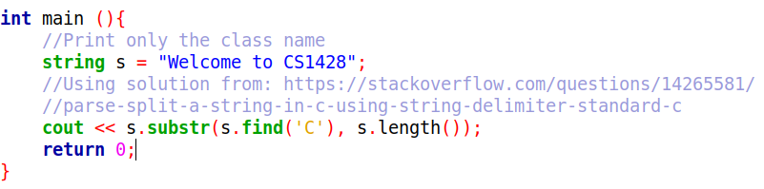
Using One Line of Code:
I have copied one line of code from an internet source, modified it to fit my problem, and included the URL of the original source.

Slide 4
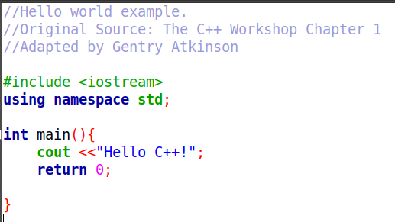
Adapting a Block of Code:
I have copied an example from our textbook, modified it to fit my problem, and attributed the original source.

Slide 5
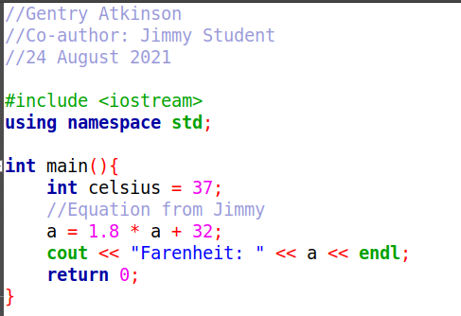
Working with Another Author:
I have worked along with another author, listed them as an author of the work, and identified code that was written mostly by them.

Slide 6
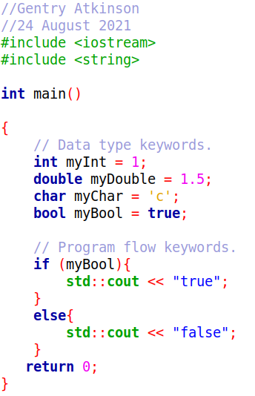
Plagiarism:
I have copied an example from the textbook, changed it in ways that do not affect the function of the code, and put my name on it. This implies to readers that I am the original author when I am not.

Slide 7
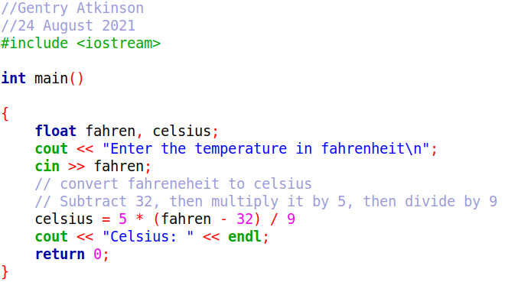
Stealing Code:
I have copied several lines of code from techcrashcourse.com and included them in my program without giving credit to the original source. Code is protected by copyright.

Slide 8
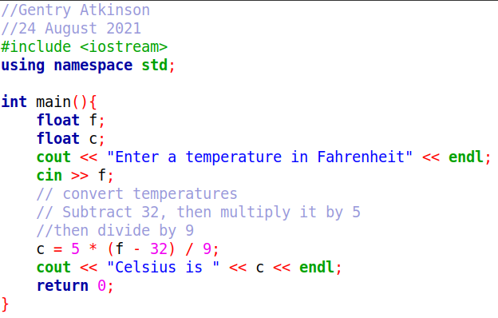
Not Fooling Anybody:
Any coder will recognize these as being the same code. This is still plagiarism

Slide 9
Avoid Using Too Much Too Early:
The point of this class is to encounter problems and find solutions for them.
Borrowing too much code from other coders may interfere with you finding a solution of your own.
Try coding your own solution before using someone else’s.

Slide 10
Consequences of Plagiarism:
Students who plagiarize another student will earn a 0 on that assignment and for the assignment of the original author.
Students may have to defend their actions in front of a university honor council.
Copying code degrades the reputation of a coder and of our university.
When in doubt, give credit to an original author.

