Slide 1
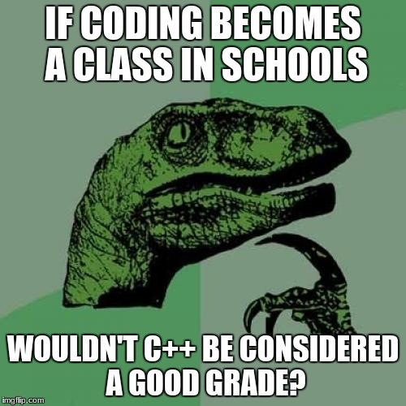

Slide 2
CS1428
Foundation of Computer Science
Lecture 2: What is Computing?

Slide 3
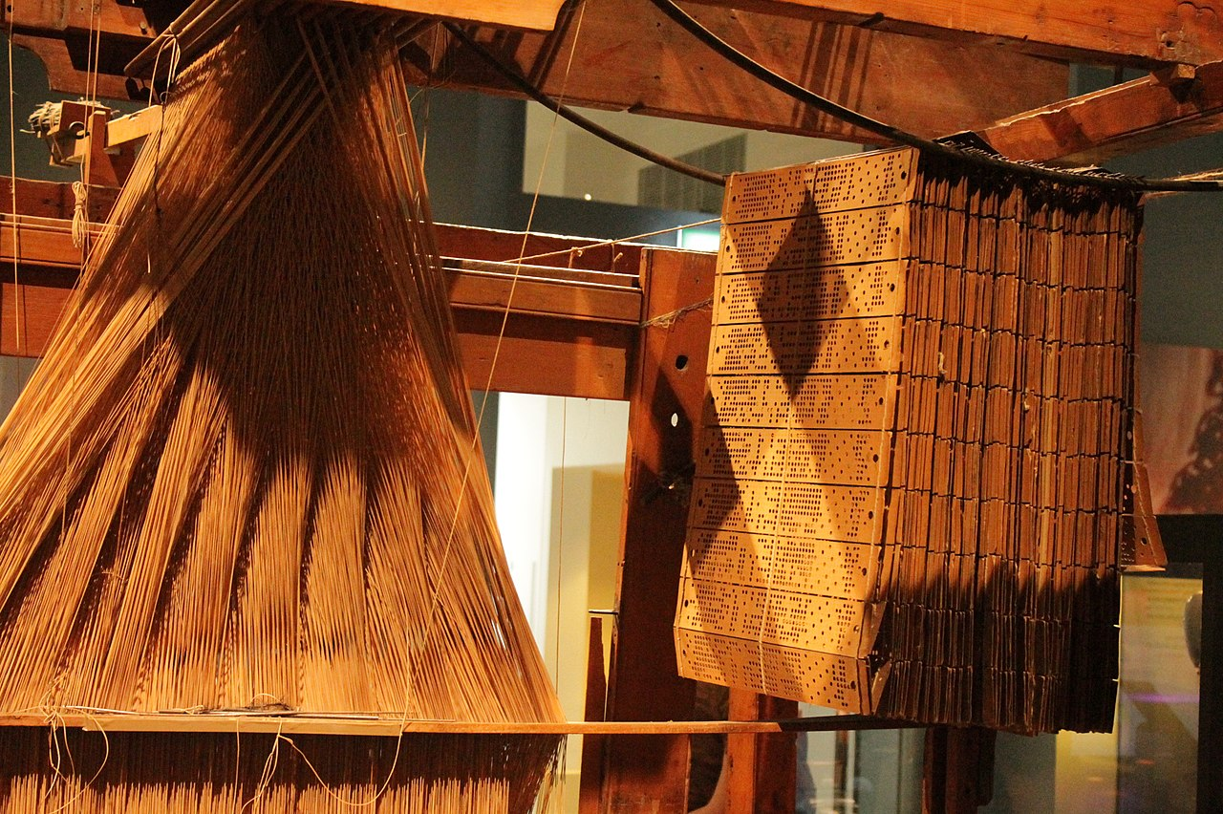
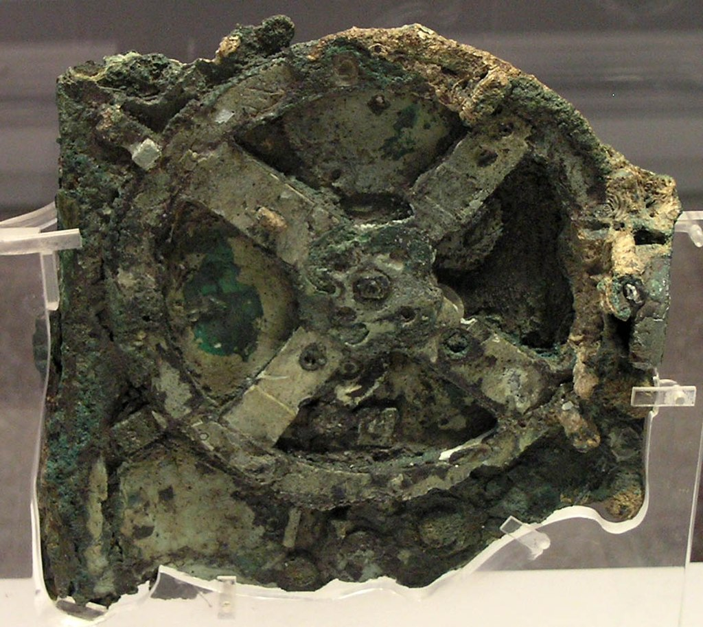
A super brief history of computers:
Representing knowledge on physical media:
Using machines to process information:
The Jacqard Loom
By Stephencdickson - Own work, CC BY-SA 4.0, https://commons.wikimedia.org/w/index.php?curid=79746138
The Antikythera mechanism
CC BY 2.5, https://commons.wikimedia.org/w/index.php?curid=469865

Slide 4
A super brief history of computers:
Charles Babbage proposed (but never built) the Analytical Engine in 1837 but never built it. Ada Lovelace’s correspondence with him were some of the earliest work in “computer science”.
“Colossus” was built in the UK in 1943 to support wartime code breaking.
“ENIAC” was built in the US in 1946 to calculate artillery firing tables.
“FLOW-MATIC”, the first English-like programming language, was designed in 1955 by Grace Hopper. That language later became COBOL (which is still used)

Slide 5
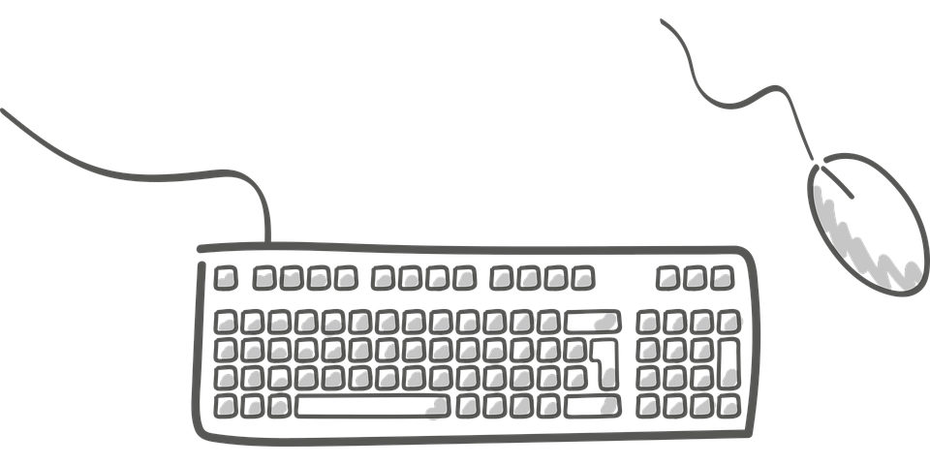
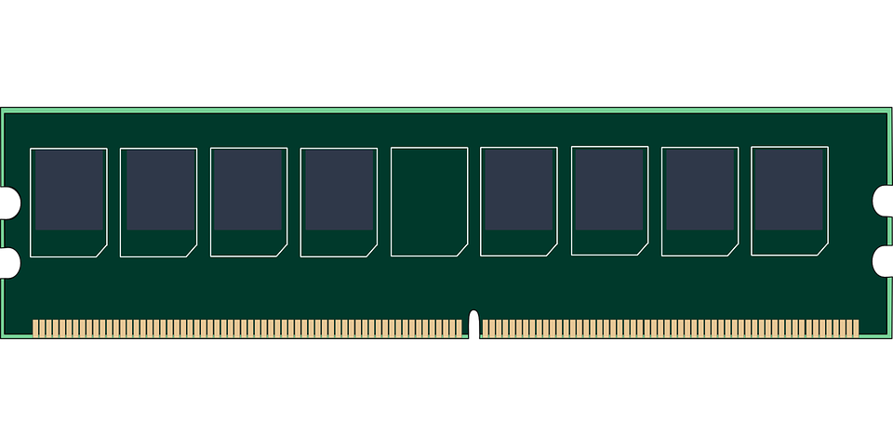


The simplest parts of a computer:
Memory stores data and instructions
Input Devices take instruction and data
Output devices return information to the user.
A processor uses instructions to transform data

Slide 6
How does memory store information:
Electrical switches use high or low voltages to represent the numbers 0 and 1.
Strings of 0s and 1s are interpreted as:
  Integers (whole numbers)
  Floating point numbers (real numbers)
  Characters (letters)
  Strings (several characters in a row)
  Instructions (tell the processor to change some other values)

Slide 7

How does memory store data:
0
1
0
1
0
1
1
0
Integer
86

Slide 8
Machine Language:
Every block of memory can either be a value or an instruction. They are stored together in the same computer memory (RAM).
The computer has a small, built-in set of operations. Each instruction in memory makes one of those operations happen.

Slide 9
Assembly Language:
Early computers were programmed by setting blocks of switches to 1 or 0 to represent values and machine language instructions
Later punch cards were used to represent 1s and 0s.
Better input/output devices let programmers write code using alphanumeric keyboards.
Assembly language was developed to let coders write instructions in a way that looks more like English. Some example instructions:
  LOAD- read one number out of memory
  STORE- write one number into memory
  ADD- sum two number and store the result somewhere

Slide 10
Higher Level Language:
Assembly is easier to write than machine language but still very difficult.
Assembly is also tied to one kind of hardware. So every computer had a unique language.
“Higher level languages” were developed to look even more like English or algebra and are also machine independent.
C++ is one of many higher level languages.

Slide 11
Translating Computer Languages:
Assemblers turn assembly language into machine language.
Compilers turn higher level language into assembly or higher level language into another higher level language.
Higher Level
Higher Level
High Level
Low Level
C++
Assembly
Machine
Language
C++
Compiler
Assembler

Slide 12
Allocating memory in C++:
“variables” are used to store some kind of value in computer memory
Every variable has a “data type”:
  int- stores a number without a decimal place
  float- stores a number with a decimal place
  char- stores one letter
  string- stores many characters
  bool- stores a true/false value

Slide 13
Precision of variables:
Variables have to be stored in a certain amount of space in memory so every data type has a maximum and a minimum possible value:
  int- (32 bits) -2147483648 to 2147483647
  float- (32 bits) 3.4E +/- 38 (7 digits)
The keyword long and short can be used to store integers in more or less space.
  long int- (64 bits) -9,223,372,036,854,775,808 to 9,223,372,036,854,775,807
  short int- (16 bits) -32768 to 32767
  unsigned int- (32 bits) 0 to 4294967295
The keyword double can be used to store a float in 64 bits.

Slide 14
Constants:
Variables are values stored in memory that can be changed.
We sometimes want to store values that cannot be changed.
The const keyword tells the compiler that a value should be stored but never modified.
Constants are usually named in ALL CAPS.
const float PI = 3.14159;

Slide 15
Literals:
Any value that you type into your program is called a literal.
“Hi there” is a string literal.
Literals also get stored in memory as part of your program, but cannot be referenced by name.

Slide 16

Modifying values:
Operators can be used to change values and to store values.
Operators act on operands
Operators have to be applied in a particular order (PEMDAS)
  ()
  ^ * /
  + -
variable
operand
operator
operand

Slide 17
Operators in C++:
+ add
- subtract
* multiply
/ integer or floating point division (!!!)
% modulus: the remainder from integer division
= assignment: fully resolves the right hand side and then stores it in the left hand side.
++ increment: increase the value of a variable by 1
-- decrement: decrease the value of a variable by 1

Slide 18
Integer Division:
Think back to first learning long division in elementary school.
  10 / 3 = 3 remainder 1
Floating point division:
  10.0 / 3.0 = 3.33333…..
Integer division:
  10 / 3 = 3
  10 % 3 = 1
The compiler automatically chooses integer division if both operands are integers and floating point division otherwise.

Slide 19
Combining Operators:
x += 1 is the same as x = x+1
Operators that can be combined with assignment:
  +, -, *, /, %
Increment and decrement are also combined operators
  x++ is the same as x+=1 is the same as x=x+1
  x-- is the same as x-=1 is the same as x=x-1

Slide 20
Style Guide:
Good style makes code easier to read, share, and maintain.
Variable names should tell the reader how the variable is going to be used.
  “a” is a bad variable name
  “this_number” is a bad variable name
  “number_of_students” is a good variable name
  “timeOfBirth” is a good variable name
Notice that variable can be either snake_case or camelCase (but pick one and stick with it)

Slide 21
Algorithms:
An algorithm is step by step instructions to complete some task.
A recipe is similar to the algorithm to prepare an item of food.
The word comes from the name of 9th century mathematician Muḥammad ibn Mūsā al-Khwārizmī, which was romanticized as “Algorithmi”.
Most code is an implementation of some algorithm.
Never assume that the computer “knows what you mean”.

