Slide 1


Slide 2
CS1428
Foundation of Computer Science
Lecture 3: Input/Output

Slide 3
Streams:
Input devices and output devices all have dedicated memory that they write to and read from.
Programs are not allowed to read or write each other’s memory, so a program reading the memory dedicated to a keyboard or writing to the memory dedicated to a monitor could be a hard problem.
“Streams” are an abstraction that let us hide the actions taken by the operating system to move values from input devices to programs to output devices.

Slide 4




Stream

Slide 5
The Output Stream:
cout connects your program to the console (the block of text that shows up on your monitor when you run a program).
The stream insertion operator << puts values into the stream. The arrows will always point into the stream.
Multiple values can be sent to cout with the same line of code, but each value should be separated by another <<
endl sends one line break to the console
There are other output streams but you won’t be required to know them for this class.

Slide 6
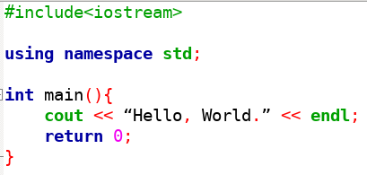
Hello World:

Slide 7
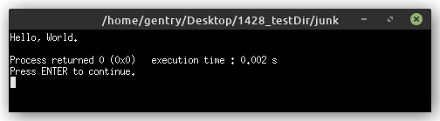
Hello World:

Slide 8
The Input Stream:
cin connects your program to the keyboard through the console.
The stream extraction operator >> takes values out of the stream. The arrows will always point into the stream.
Multiple values can be read from cin with the same line of code, but each variable should be separated by another >>
White space will be read by cin as separating strings.

Slide 9
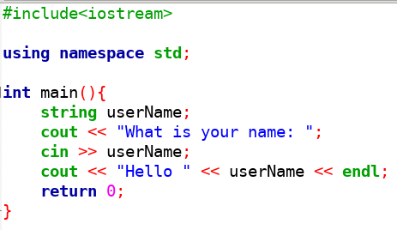
Hello User:

Slide 10
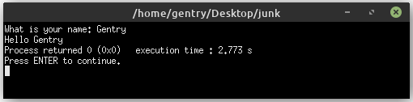
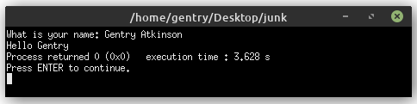
Example Output

Slide 11
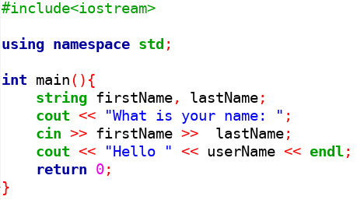
cin With Multiple Inputs:

Slide 12
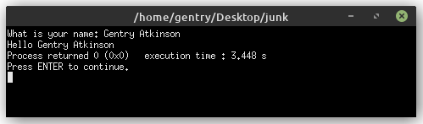
Example Output

Slide 13
Libraries:
Libraries are collections of tools that we can add into our programs.
cin, cout, and endl come from the <iostream> library.
Libraries are included using the #include directive
Each library requires its own #include
Some useful libraries:
  iostream
  fstream
  cmath
  iomanip
  string

Slide 14
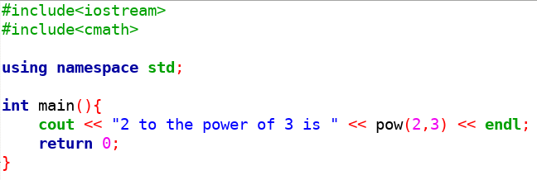
Program With Multiple Libraries:

Slide 15
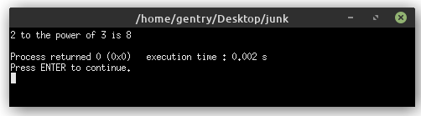
Example Output

Slide 16
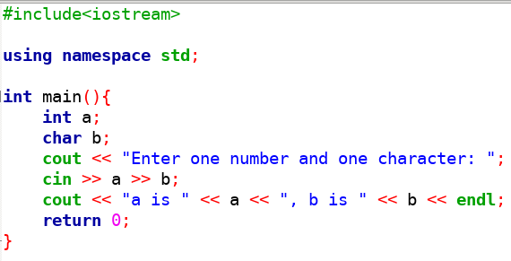
cin Will Fit Input to the Variable:

Slide 17
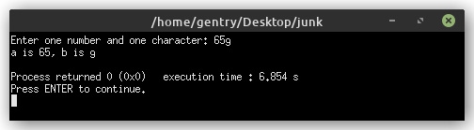
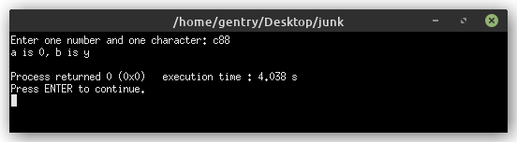
Example Output

Slide 18
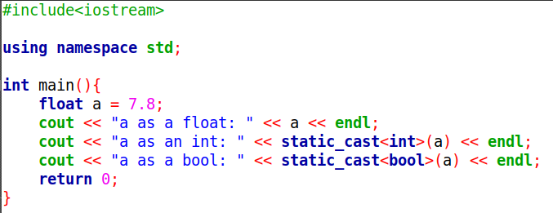
Manually Changing Data Types:

Slide 19
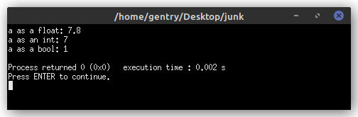
Example Output

Slide 20
File Streams:
Rather than taking input from the keyboard and sending output to the screen, we can also read from and write to files.
File I/O creates a permanent copy.
We also use streams to read and write files, which come from <fstream>
Input file streams are created like variables with the type ifstream. Output filestreams are created with ofstream.
File streams have to be manually opened and closed.

Slide 21
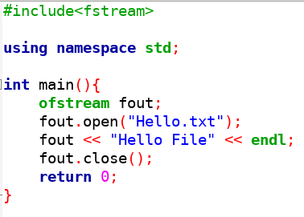
Hello File:

Slide 22
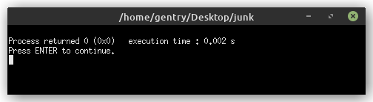
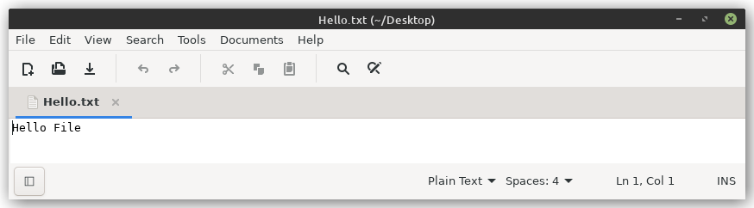
Example Output

Slide 23
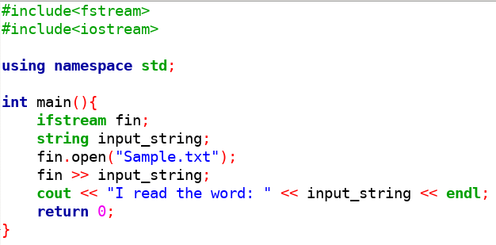
Reading a File:

Slide 24

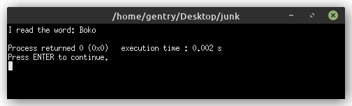
Example File and Output

Slide 25
Formatting I/O:
The library <iomanip> provides many great tools for making your output easily readable.
Well formatted text better convey the information your program generates.
<iomanip> is used along with streams, either console or file.
Tags to now:
  setprecision and fixed
  setw
  left and right

Slide 26
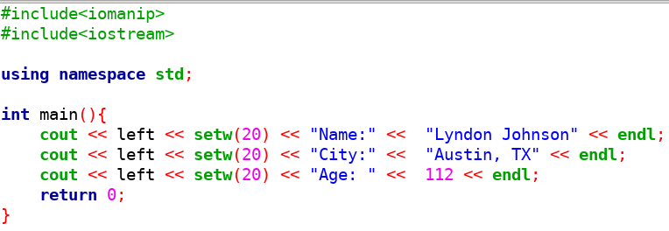
Aligning Columns:

Slide 27
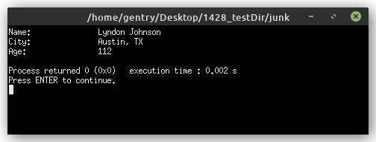
Example Output

Slide 28
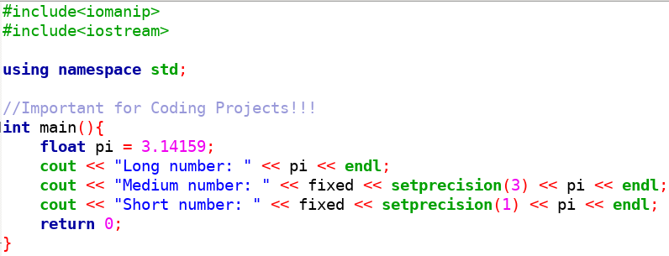
Numbers With Fixed Decimals:

Slide 29
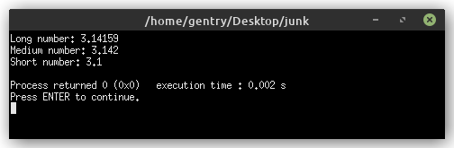
Example Output

Slide 30
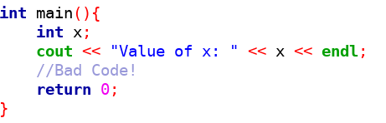
Default values:
Sometimes a compiler will assign a default value to a variable, like automatically storing the number 0 in an int.
Sometimes variables just start off holding whatever junk was left over in memory.
Never assume that C++ will give you a safe default variable.

Slide 31
Run Time vs. Compile Time:
There are two times that a bug might show up in our programs.
Errors in syntax are violations in the grammar of coding languages. Syntax errors are easy to find because the compiler will throw an error.
Errors in semantics are grammatically correct but do the wrong thing. Semantics errors are hard to find because the program may still run, but produce erroneous output.

Slide 32
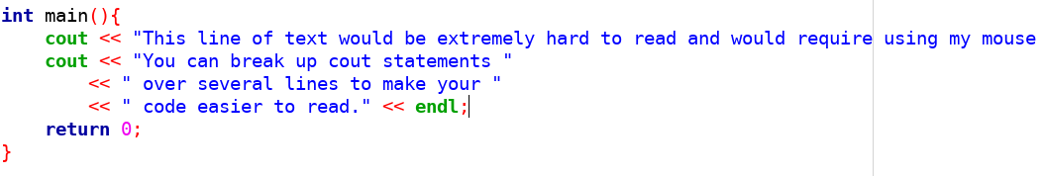
Style guide:
Keep every line shorter than 80 characters.
This makes code much more readable, especially with two files positioned side-by-side.

