Slide 1
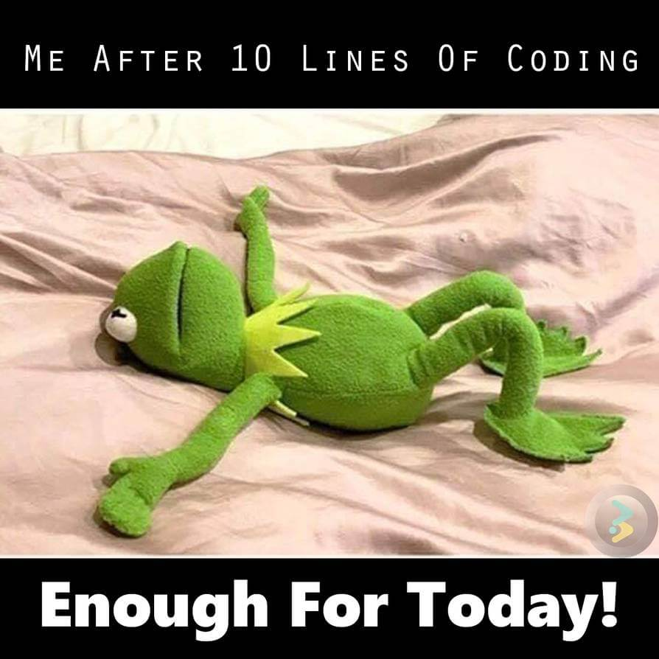

Slide 2
CS1428
Foundation of Computer Science
Lecture 4: Branching

Slide 3
Branching:
Programs can choose to execute some instructions or not based on a “condition”.
This makes programs responsive to user input.
Programs can change their output based on computed conditions.
The if...else block is the simplest form of branching.

Slide 4
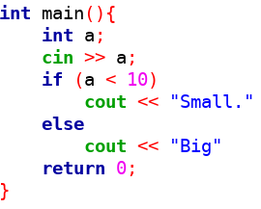
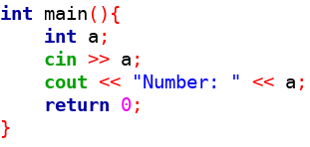
Branching:
Un-branched Program
Branched Program
a<10
true
false

Slide 5
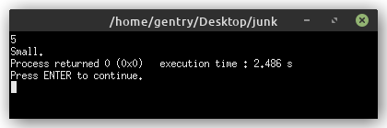
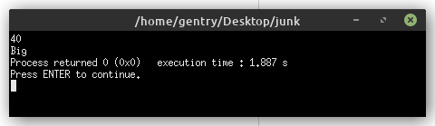
Branched Example Output:

Slide 6
Syntax of if...else:
if is a reserved keyword in C++ that begins a conditional statement.
Every conditional statement has to have a condition in parenthesis.
Every condition must resolve to true or false (boolean values).
The if applies to everything in the {curly brackets} that follow it or just the one line following if there are no curly brackets
An else can follow the if block optional. The statements in the else block are executed only if the condition is false.

Slide 7
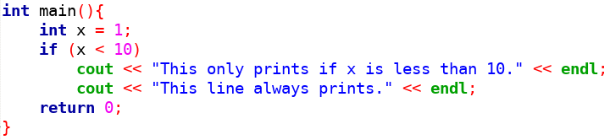
if blocks without brackets:

Slide 8
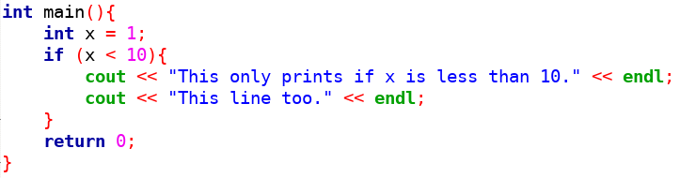
if blocks with brackets:

Slide 9
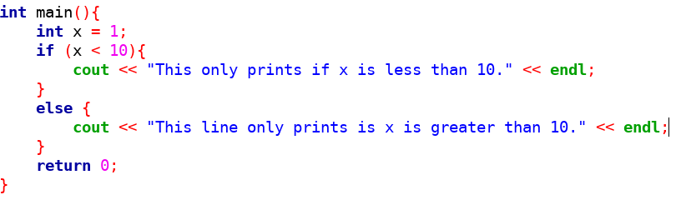
if...else blocks:
The else is actually >=. Do you see why?

Slide 10
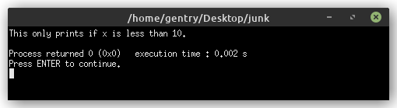
if...else Output:

Slide 11
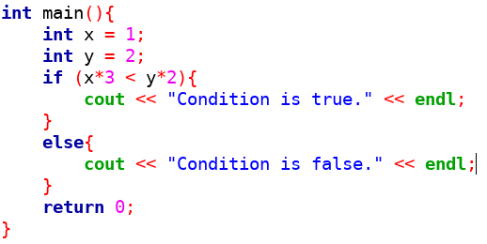
Conditions can be operations:

Slide 12
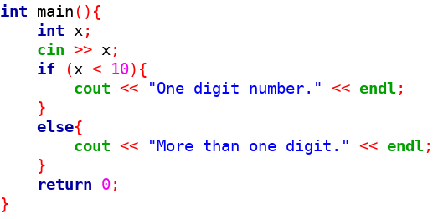
Conditions can be user input:

Slide 13
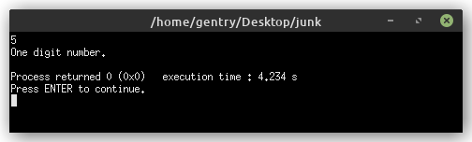
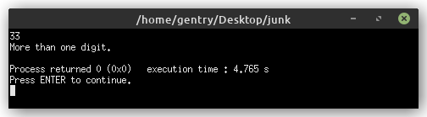
Output from User Input:

Slide 14
Comparison Operators:
Always produce a true or false value.
Resolved after arithmetic operators (after PEMDAS)
Provided by C++:
  < less than
  > greater than
  <= less than or equal to
  >= greater than or equal to
  == equal to
  != not equal to

Slide 15
Comparison Examples:
1 < 3 | true
3 < 3 | false
3 <= 3 | true
4 > 3 | true
4 != 3 | true
4 != 4 | false
4 == 4 | true
(3 – 1) < 3 | true

Slide 16
= vs. ==:
=
assignment operator
changes values stored in memory
Think of it as “takes the value”
==
comparison operator
evaluates values for equality and returns true of false.
Think of it as “is equal to”

Slide 17
Logical Operators:
&& “and” returns true if both sides are true and false otherwise.
|| “or” returns false if both sides are false and true otherwise.
Both sides of && or || have to be valid logical expressions.
! “not” returns the opposite of its one operand. This makes not a “unary” operator.

Slide 18
AND examples:
1 < 3 && 3 > 1
(1 < 3) && (3 > 1)
true && true
true
1 < 3 && 3 > 10
(1 < 3) && (3 > 10)
true && false
false

Slide 19
OR examples:
1 < 3 || 3 > 10
(1 < 3) || (3 > 10)
true || false
true
10 < 3 || 3 > 10
(10 < 3) || (3 > 10)
false || false
false

Slide 20
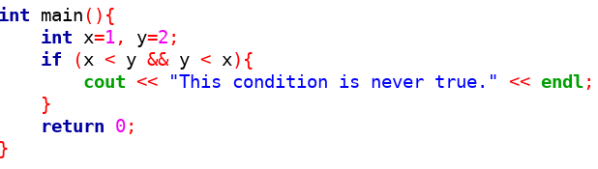
Code example of compound conditions:
Why is the condition never true?

Slide 21
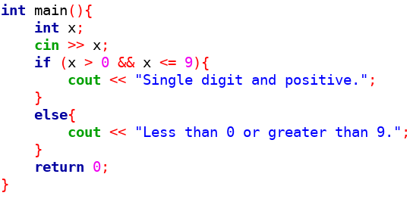
Code example of compound conditions:

Slide 22
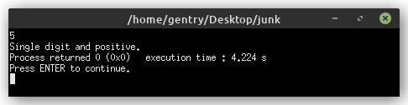
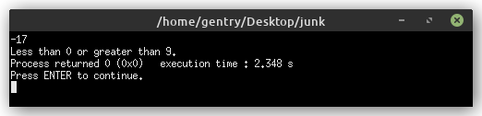
Output from User Input:

Slide 23
Multi-way Branching:
if...else let us implement 2-way branching, but often we want to write programs that follow three or more paths.
We can add as many else if block between the if and the else as we want.
Every else if needs its own condition. Only the else does not need a condition.

Slide 24
Multi-way Branching:
if
true
Block 1
Rest of Program
false
else if
Block 2
true
else
false
Block 3

Slide 25
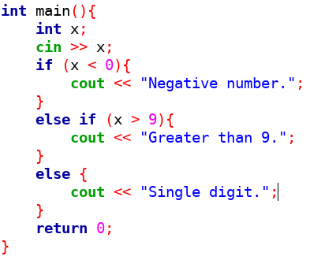
3 Way Branching:

Slide 26
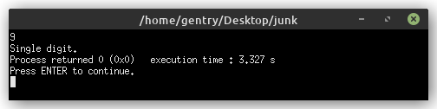
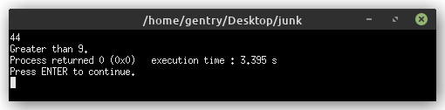
3 Way Output:

Slide 27
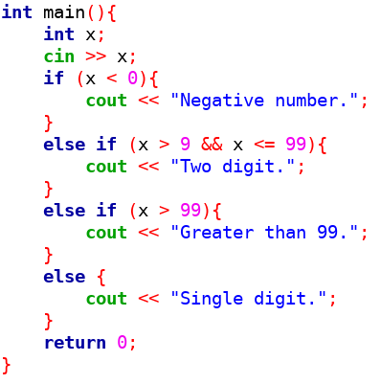
4 Way Branching:

Slide 28
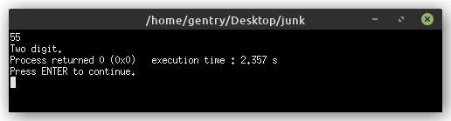

4 Way Output:

Slide 29
Nesting ifs:
if statements can be placed inside of other if statements.
The inside if only has its condition checked if the outside if is true.
Branches can be placed inside of else if blocks and else blocks just like ifs
Compound conditions (with && or ||) can often be replaced with nested ifs

Slide 30
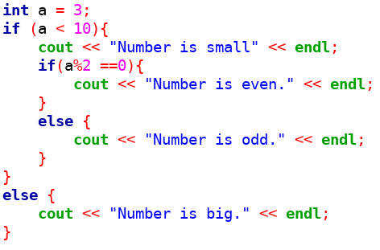
Nested ifs:

Slide 31
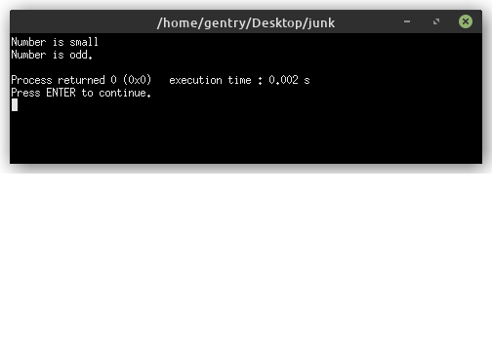
Nested if output:

Slide 32
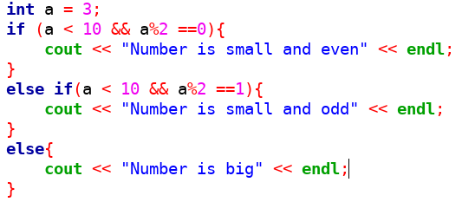
Compound condition or nesting:

Slide 33
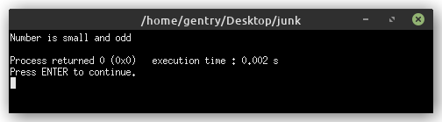
Compound output:

Slide 34
Multi-way Branching with switch:
When there are many cases that all depend on the same variable, switch statements can be used instead of if...else if...else
Programs written to use switch sometimes has a faster run-time than the same program written using if...else if...else
Every switch can be rewritten as an if...else if...else, but not the other way around.
The keyword break marks the end of a case.
The else becomes the default case of a switch statement.

Slide 35
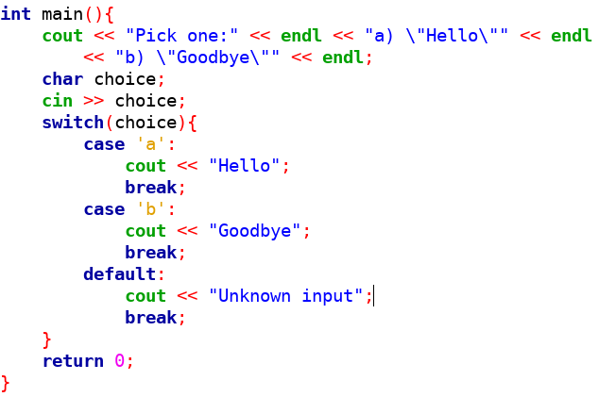
Switch statements:

Slide 36
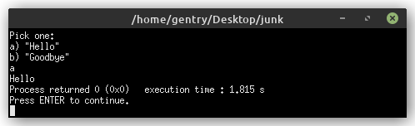
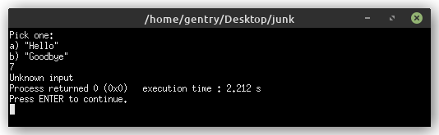
Switch output:

Slide 37
“Trapping” characters:
“Quotation marks”, ‘single quotes’, and new lines are all special characters but we sometimes need to include them in string literals.
A single backslash \ tells the compiler that the next character is part of a literal.
Common trap characters:
  \” a literal double quote
  \’ a literal single quote
  \n a new line
  \t a tab
  \\ a literal backslash

Slide 38
When to use switch:
All conditions must depend on one variable
All comparisons are equality (not greater than or less than)
There is a “big” number of cases

Slide 39
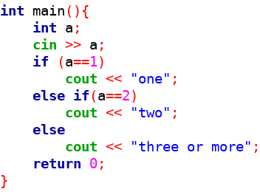
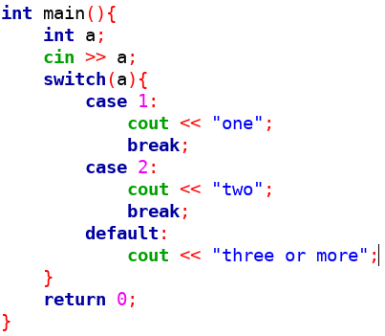
if...else to switch:

Slide 40
Switch statements can “fall through”:
Every case in a switch can be terminated with a break, but that’s not necessary.
Without a break the program will “fall through” and continue to execute the next case.
This behavior can be good or bad depending on whether it is done on purpose.

Slide 41
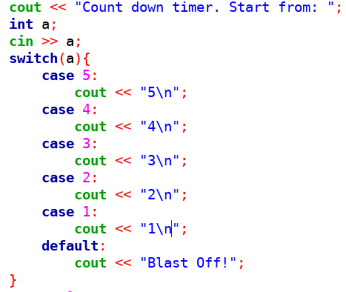
Fall through example:

Slide 42
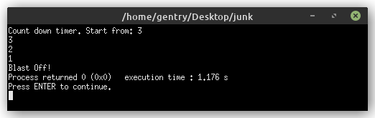
Fall through output:

Slide 43
Style Guide, Indentation:
Code in C++ is written in “blocks”, which are often enclosed by {curly brackets}.
Indenting each block by one tab or 4 spaces from its parent statement makes code that is easier for humans to read.
Extra whitespace does not affect the execution of C++ programs, so indenting will not affect the compiler or program.

Slide 44
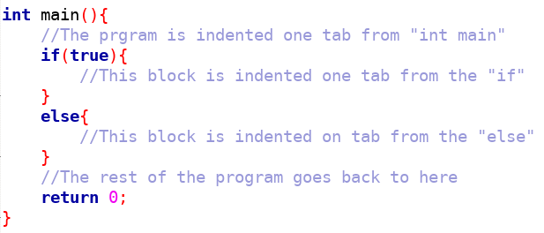
Indentation:

