Slide 1
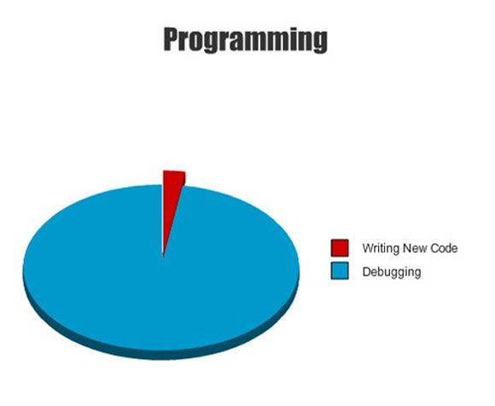

Slide 2
CS1428
Foundation of Computer Science
Lecture 5: Looping

Slide 3
What is Looping?
Our simplest programs executed each instructions one after the other.
Branching gave us a tool to conditionally execute some statements and not others.
Looping is a tool which let’s us conditionally repeat some statements in our programs.

Slide 4
Looping Flowchart
Simple
Branching
Looping
Block 1
Block 1
Block 1
Block 2
Condition
Block 2
Block 2
Condition
Block 3
Block 3
Block 3

Slide 5
While Loop Syntax
The C++ keyword while is one common way to implement looping in a program.
Every while must be followed by a condition in (parenthesis).
Without {curly brackets}, then only the next statement is in the body of the loop. With {curly brackets}, everything in the brackets is in the loop.
The variable that the condition depends on must be changed in the body of the loop to avoid an infinite loop.

Slide 6
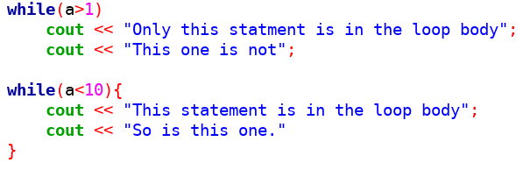
While Loop Body

Slide 7
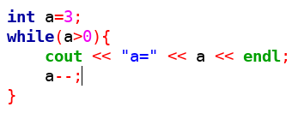
Always Update the Loop Variable

Slide 8
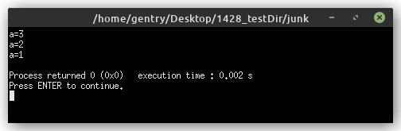
Loop Output

Slide 9
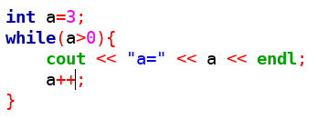
Infinite Loops

Slide 10
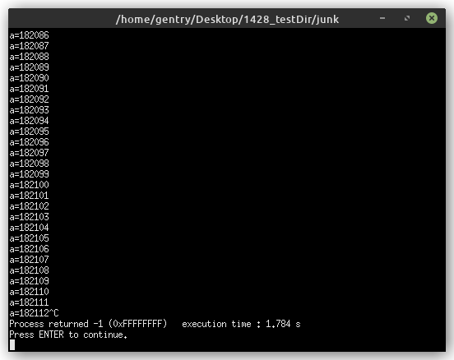
Infinite Loop Output
This is where I manually stopped the program.

Slide 11
Do...While Loop Syntax
The C++ keyword do...while also implements looping in programs but checks the condition after the loop body.
{curly brackets} can be used to enclose multiple statements, otherwise only one statement is in the loop body.
The loop body is written between the do and the while.
The condition is written following the while, in (parenthesis).
The condition must be terminated with a semicolon;

Slide 12
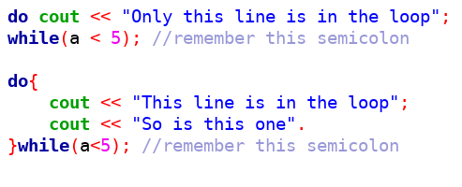
Do...While Loop Body

Slide 13
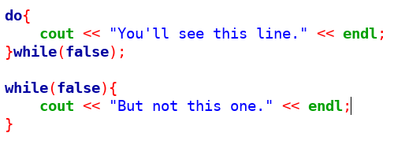
Do...While Runs at Least Once

Slide 14
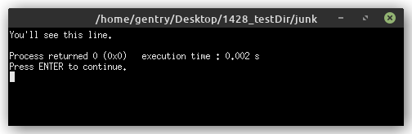
Which Loop had Visible Output?

Slide 15
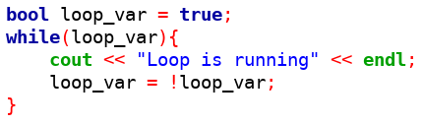
Boolean Variables can be Conditions

Slide 16
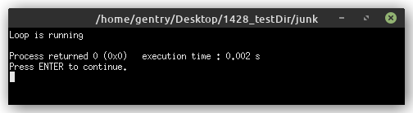
Loop Output

Slide 17
For Loop Syntax
The C++ keyword for loops over a fixed range of values.
{curly brackets} can be used to enclose multiple statements, otherwise only one statement is in the loop body.
The for loop lets us create a loop variable, define a condition, and define the update to the variable all at the same time.
for(declaration; condition; update){loop body}

Slide 18
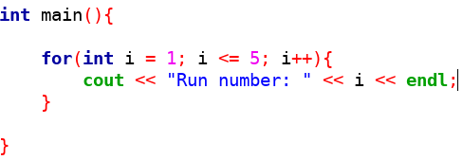
Counting with a For Loop

Slide 19
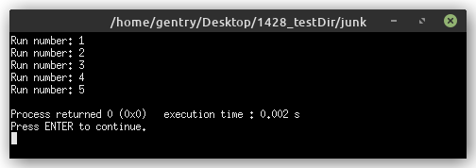
Counting Output

Slide 20
Unrolling a For Loop
Start → create a variable named i and give it the value 1
i is less than or equal to 5 so do the loop body
After the body has run, update i to 2.
2 is less that or equal to 5, run again, update i to 3.
3 is less that or equal to 5, run again, update i to 4.
4 is less that or equal to 5, run again, update i to 5.
5 is less that or equal to 5, run again, update i to 6.
6 is not less than or equal to 5, break the loop.

Slide 21
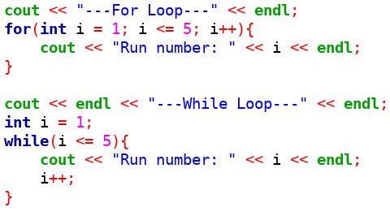
Converting For to While

Slide 22
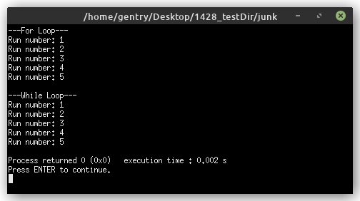
Same Output

Slide 23
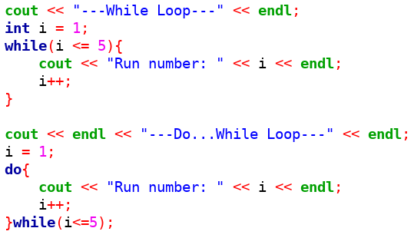
Converting While to Do...While

Slide 24
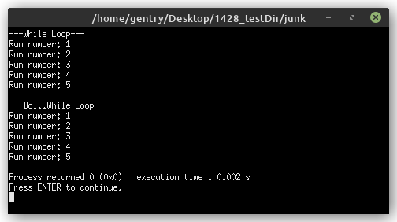
Same Output

Slide 25
Which Loop to Use
Every loop can usually be re-written as one of the other kinds of loop, so choosing which loop to use often comes down to programmer preference.
while is a good choice when the body may not run at all, or for long loop bodies to make the condition easily visible.
do...while is a good choice when the loop variable is initialized inside of the loop body.
for is a good choice when iterating over a fixed range of numbers.

Slide 26
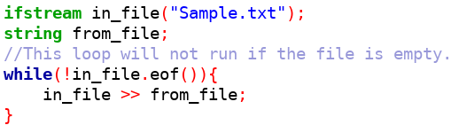
While is a Good Choice

Slide 27
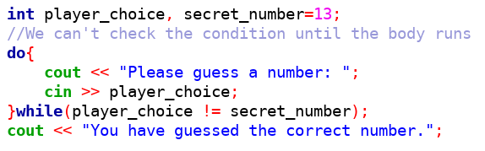
Do...While is a Good Choice

Slide 28
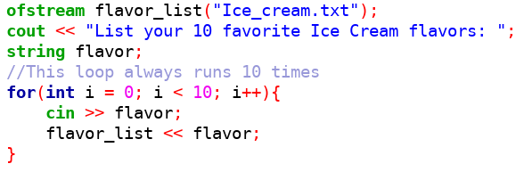
For is a Good Choice

Slide 29
Nesting Loops
Just like branching, loops can be “nested” inside of one another.
The inner loop will run completely for every one iteration of the outer loop.
Nested loops can add a lot of run time to programs.

Slide 30
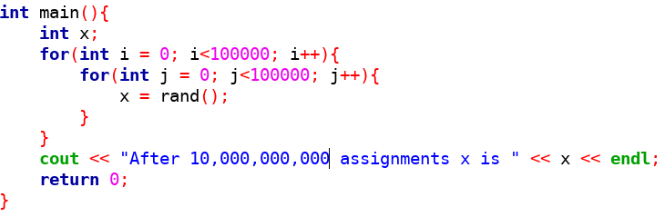
Nested Loops

Slide 31
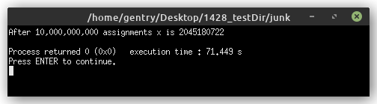
Nested Output
I waited more than a minute for this to run.

Slide 32
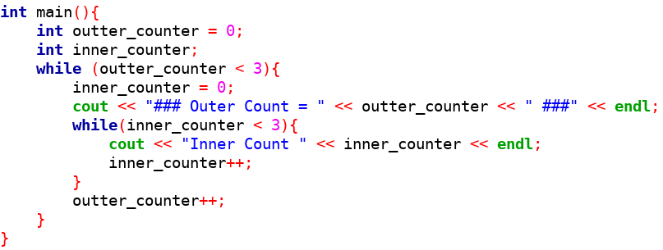
Tracking Iterations

Slide 33
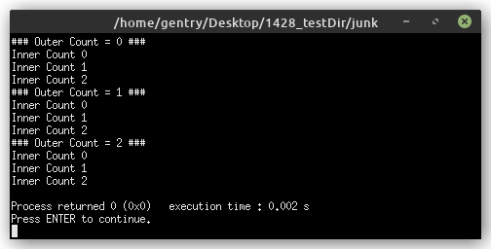
Nested Output

Slide 34
Who Noticed This?
Two variables with the same name?

Slide 35
Scope
In C++, many variables can have the same name. Each new variable “shadows” the other variables that share its name.
The scope refers to the portion of the program where a variable can be referenced.
A variable name must be unique within a particular scope.

Slide 36
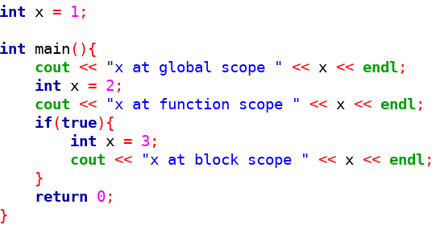
3 Layers of Scope

Slide 37
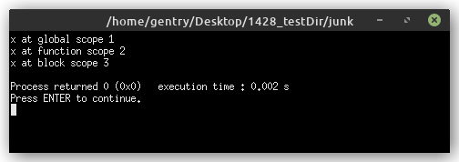
Same Output

Slide 38
3 Layers of Scope
Global- visible to the entire program.
Function- only visible to one function (like main)
Block- can only be referenced inside of the block (e.g. an if...else statement, or a loop) that its declared in.
Block and functions are both types of local scope.

Slide 39
Global Scope
Generally not a good idea! (in C++)
Global variables can accidentally be referenced in any part of the program.
Global variables can expose “private” information in accessible regions of memory.
Global constants are perfectly acceptable and encouraged.

Slide 40
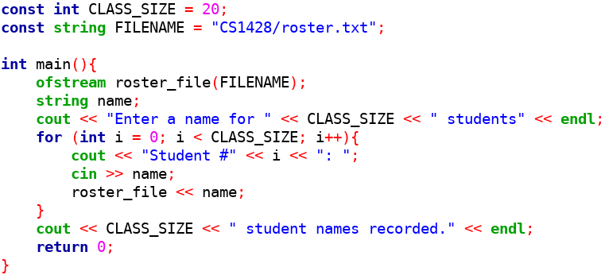
Global Constants

Slide 41
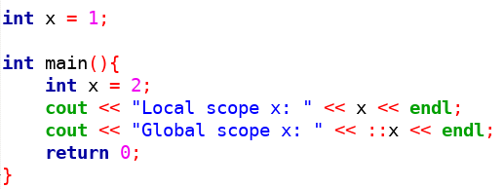
Referencing Variables at Higher Scope

Slide 42
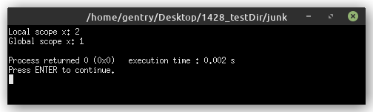
Global Scope Output

Slide 43
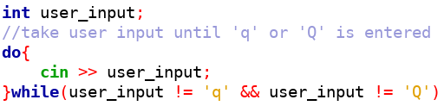
Style Guide, Comments
Our programs are starting to get more complicated, making good comments important to include.
One comment should describe the action being performed by several statements or a whole block.

