Slide 1
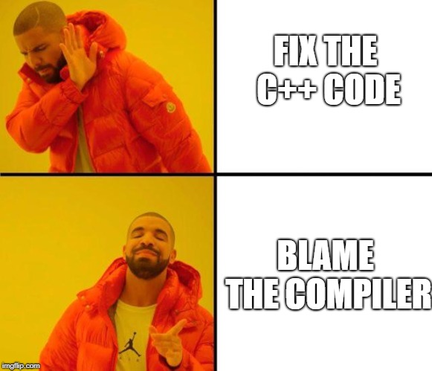

Slide 2
CS1428
Foundation of Computer Science
Lecture 6: Functions

Slide 3
Let’s Think about Algebra
f(x) = 2x + 2
f(4) = 2*4 + 2
f(4) = 10
y = 3
f(y) = 2*3 + 2
f(y) = 8
g(x) = 3x
f(g(5)) = f(3*5)
f(15) = 32

Slide 4
Functions in C++
Just like pure math, C++ let’s us define functions which we can use over and over again.
Every function returns one value with a defined datatype.
Every function has a list of variables that it expects to be passed, called the parameters.
The parameters of a function are only in scope for that function.
Program execution always begins in the main function.

Slide 5
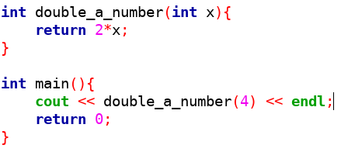
A Very Simple Function

Slide 6
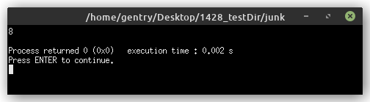
Simple Function Output

Slide 7
Function Parameters
The parameters are the best way to send information into a function.
The parameters are declared in the parenthesis of the function definition.
The parameters are local variables, so their name does not have to match the variable names in main but can.

Slide 8
Function Return
Every function has a return type. Functions that do not return any value have the type “void”.
The value that is returned by the function must match the return type.
Even void functions should have a return statement (although the compiler might let you ignore it).

Slide 9
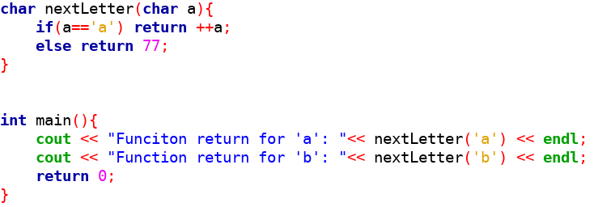
Return Type

Slide 10
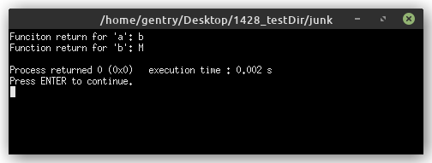
Function Output

Slide 11
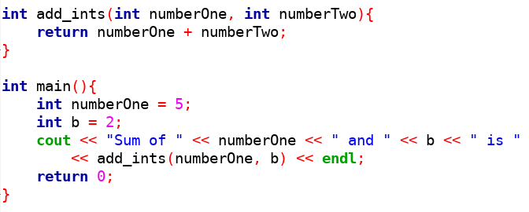
Variable Names Don’t Have to Match
(but can)

Slide 12
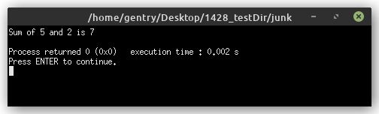
Function Output

Slide 13
Arguments vs. Parameters
Parameters are declared in the function definition and are scoped locally to the called function.
Arguments are passed to the function when it is called. They are locally scoped to the calling function. Arguments can be variables, constants, or literal.
The value of arguments are copied into the parameter variables when the function is called.

Slide 14
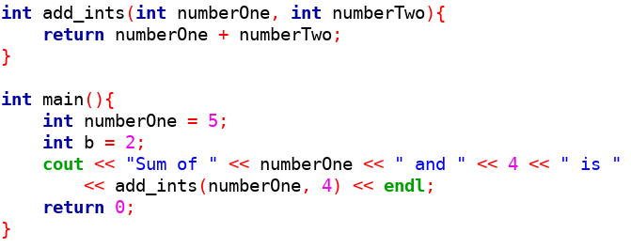
Arguments vs. Parameters
Parameters
Arguments

Slide 15
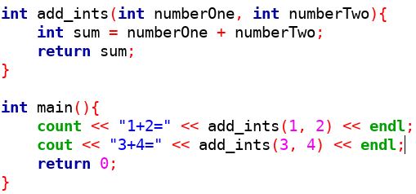
Functions Don’t “Remember” Variables
The variable sum is re-declared every time this function runs.

Slide 16
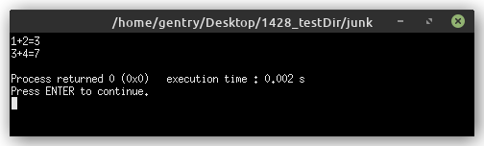
Function Output

Slide 17
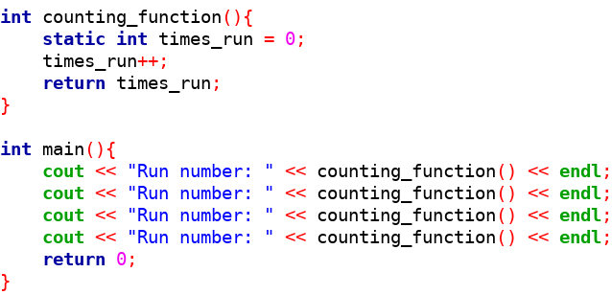
Functions Remember ‘static’ Variables

Slide 18
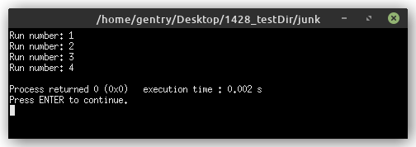
Function Output

Slide 19
The static Keyword
Keeps a function variable from being re-declared. Instead the declaration and initialization happen the first time the function is called in a program.
The variable stays in memory for as long as the program is still running. Normally, functions variables are freed when the function returns.
Global variables can also be static (it works differently but we don’t use global variables anyway).

Slide 20
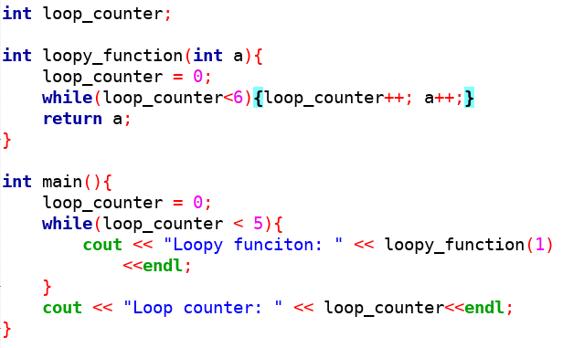
The Danger of Global Variables

Slide 21
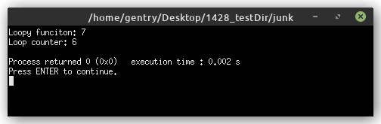
Function Output

Slide 22
Functions can be….
Conditions
The right hand side of assignments
An operand in an operation
A standalone statement

Slide 23
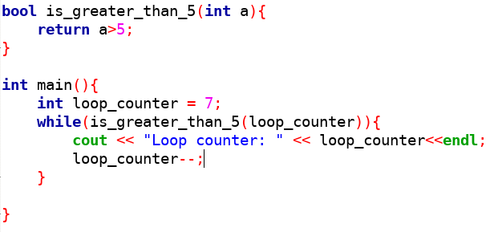
Function as a Condition

Slide 24
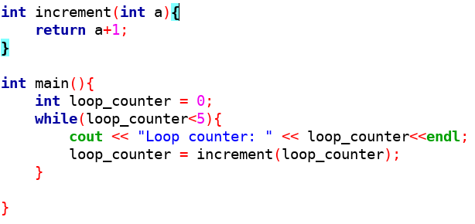
Function with Assignment

Slide 25
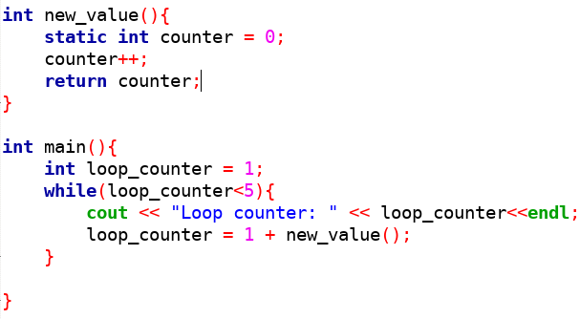
Function in Operation

Slide 26
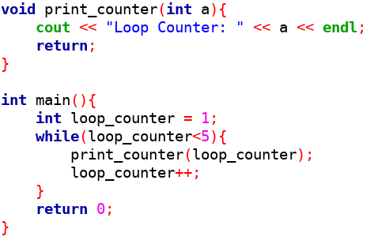
Function as a Statement

Slide 27
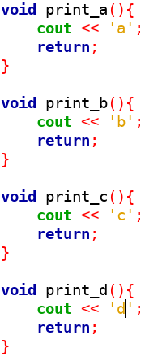
You Can Define Many Functions!
The main function has been pushed out of sight.

Slide 28
Function Prototypes
Adding so many functions that the main function is no longer visible in the first page of a program makes hard to read programs.
Prototypes are short function signatures that warn the compiler that a function will be used, but don’t define the function.
Using function prototypes lets us push the function definitions to below the main function.
Prototypes are optional in this class, but are a good practice.

Slide 29
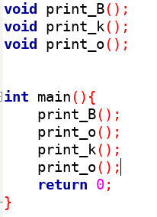
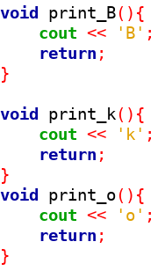
Function Prototypes

Slide 30
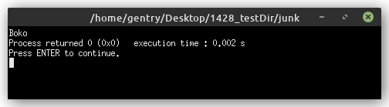
Function Output

Slide 31
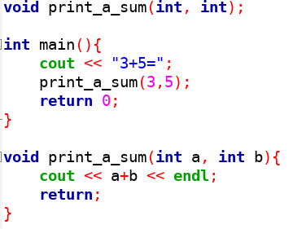
Prototypes with Parameters

Slide 32

Function Output

Slide 33
Function Overloading
Several functions in the same program can have the same name.
The “signature” of a function is the combination of its name and its parameters’ data types.
Every function must have a unique signature.
We can write several versions of a function to allow for flexibility for our users.

Slide 34
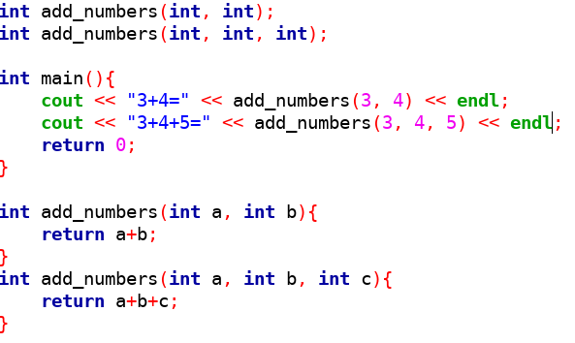
Overloaded Function

Slide 35
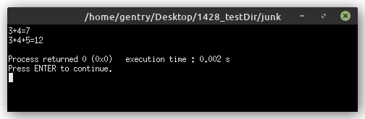
Function Output

