Slide 1
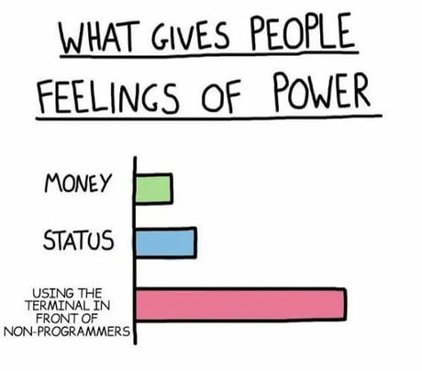

Slide 2
CS1428
Foundation of Computer Science
Lecture 7: Arrays

Slide 3
Arrays
Arrays are fixed-size collections of same-type values.
Arrays are created using a variable declaration followed by [square brackets]
We put the size of the array (the number of values) in the [square brackets].
We reference the different values using a numerical index in the [square brackets].
The first index in the array is 0.

Slide 4
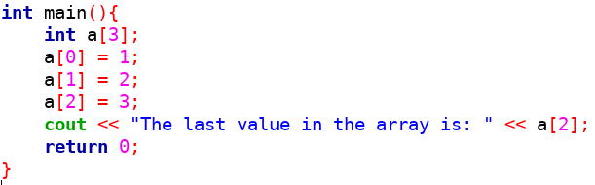
A Very Simple Array

Slide 5
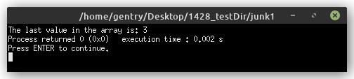
Simple Array Output

Slide 6
Arrays
Memory
a[0]
a[1]
a[2]
a[3]
a[4]
a[5]
a[6]
a[7]
a[8]
a[9]
a[10]
int a[10];

Slide 7
Out of Bounds Errors
Arrays have a size in memory equal to the size of one variable * the number of elements in the array.
  So “float x[10];” allocates 32*10 bits or 40 bytes of memory.
Indexing an array with a value that is less than 0 or greater than or equal to the size of the array access un-allocated memory. This is called referencing an “out of bounds”.
Out of bounds references can crash a program or return junk values.

Slide 8
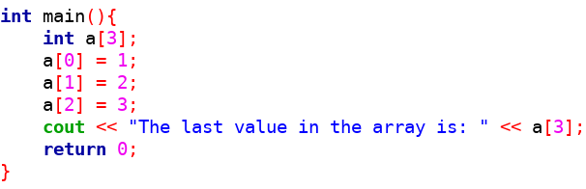
Out of Bounds Indexing

Slide 9
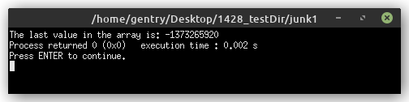
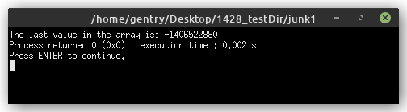
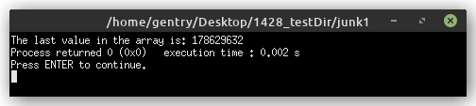
Out of Bounds Output

Slide 10
For an array a[SIZE]
The first index is a[0]
The last index is a[SIZE-1]

Slide 11
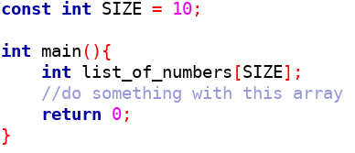
Using Global Constants for Size

Slide 12
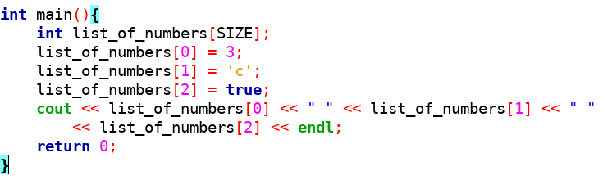
Every Value in an Array has the Same
Data Type

Slide 13
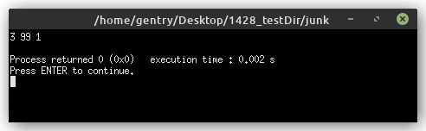
Array Output

Slide 14
For Loops + Arrays
We often need to access every element (or many elements) in an array.
A common method for this is to use a for loop with the loop variable (usually named i) being used as the index of the array.
Remember: the first index is 0
The condition must prevent out-of-bounds error.

Slide 15
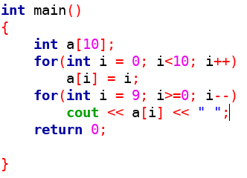
For Lops and Arrays

Slide 16
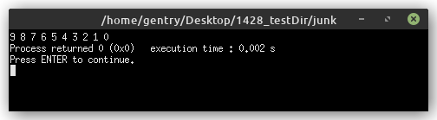
Array Output

Slide 17
2D Arrays
Arrays can have more than one size value when the are declared.
We can think of these two dimensional arrays as being tables with both rows and columns.
The syntax for this is:
  dataType name[row][column];
The actual values are stored contiguously in memory grouped by row.

Slide 18
2D Arrays
Table Abstraction
Actual Memory
a[0][0]
a[0][1]
a[0][2]
a[1][0]
a[1][1]
a[1][2]
a[2][0]
a[2][1]
a[2][2]
a[0][0] a[0][1] a[0][2]
a[1][0] a[1][1] a[1][2]
a[2][0] a[2][1] a[2][2]
int a[3][3];

Slide 19
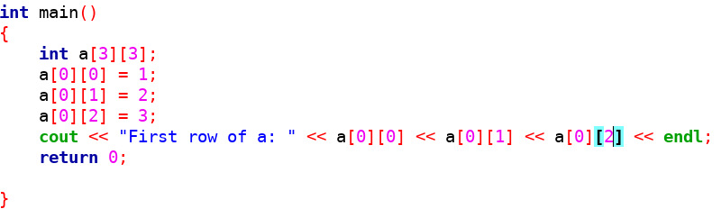
Accessing 2D Arrays

Slide 20
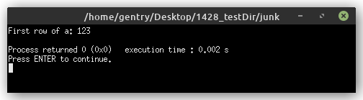
Array Output

Slide 21
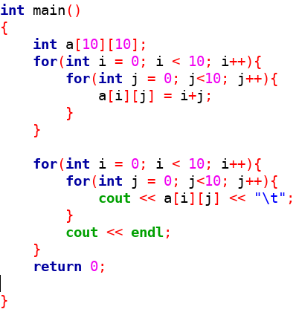
For Loops + 2D arrays

Slide 22
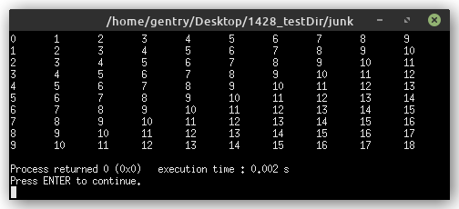
Array Output

Slide 23
Initializing Arrays
We can initialize arrays with comma separated list of values inside of {curly brackets}.
This can only be done on the same line as the array declaration.
You do not have to explicitly give the size of the array if you are using an initialization list.

Slide 24
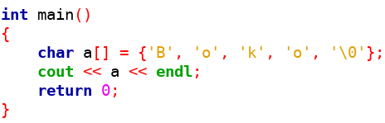
Initializing Arrays

Slide 25
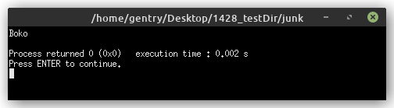
Array Output

Slide 26
‘C’ Strings
String as a data type is a new-ish addition to C++.
The C programming language used arrays of characters instead of strings.
Every C-string has to be terminated with a special character called the “null terminator”, written like this ‘\0’
This makes the size of C-strings one greater than the number of characters in them.
Some older functions prefer to use C-strings rather than strings.

Slide 27
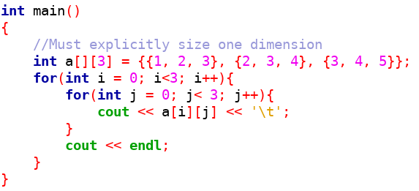
2D Initialization Lists

Slide 28
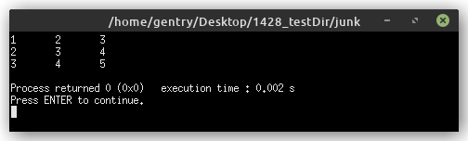
Array Output

Slide 29
Multi-dimensional Arrays
We don’t have to stop at 2-dimensional arrays, we can continue to add an arbitrary number of dimensions.
The syntax for a 4-D array looks like this:
  int a[SIZE][SIZE][SIZE][SIZE];
The usefulness of higher dimensional arrays diminishes as the get harder to visualize and process.
It is often better to use more, lower dimensional arrays than it is to use on high dimensional array.

Slide 30
Other Containers in C++
An array is only one method for storing multiple values in a single named “variable”.
C++ also provides:
  Vector
  List
  Dequeue
  Many others
We won’t be looking at these any further in this class, but they can be helpful.

Slide 31
The first valid index in an array is 0!!!

