Slide 1


Slide 2
CS1428
Foundation of Computer Science
Lecture 8: Passing by Reference

Slide 3
Variables in Memory:
Address | Values
0x00001 | 0
0x00002 | junk
0x00003 | junk
0x00004 | 1
0x00005 | junk
0x00006 | junk
0x00007 | 2
0x00008 | junk
int a = 0;
int b = 1;
int c = 2;

Slide 4
Pointers in Memory:
Address | Values
0x00001 | 0
0x00002 | junk
0x00003 | junk
0x00004 | 1
0x00005 | junk
0x00006 | junk
0x00007 | 0x00004
0x00008 | junk
int a = 0;
int b = 1;
int* c = &b;

Slide 5
Pointers in C++:
Imagine a variable that stored the address of a memory location, rather than the value stored there.
We call this kind of variable a “pointer” because it points to a specific memory location.
Pointers are created by putting an asterisk * in front of a variable name.
Passing a pointer to a function allows the function alter the value of a variable created in the calling functions.

Slide 6
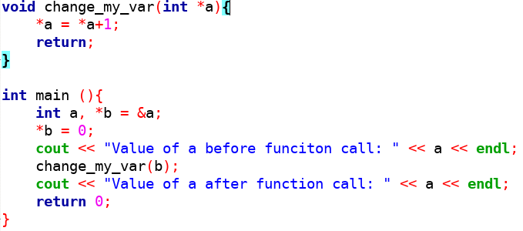
Pointer Parameters:

Slide 7
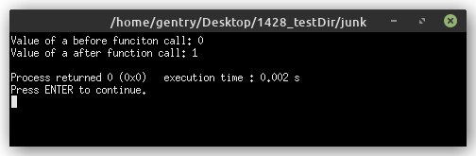
Pointer Output:

Slide 8
The Problem with Pointers:
Pointers give us the ability to directly control the values written at particular memory addresses.
This is very powerful but also very easy to misuse. Referencing an illegal location can cause a segmentation fault.
C++ let’s us declare that a parameter is “passed by reference” which has the same effect without worrying about pointers.

Slide 9
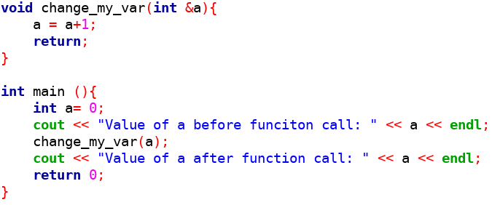
By-reference Parameters:

Slide 10
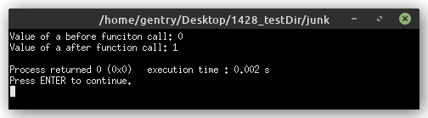
By-reference Output:

Slide 11
By Value vs By Reference:
Function arguments are copied into new variables.
Function parameters are only visible to functions.
Changes to variables passed as arguments only affect the function.
Functions are passed the memory location of arguments.
Functions can alter the value of variables in other scopes.
By reference parameters use &.

Slide 12
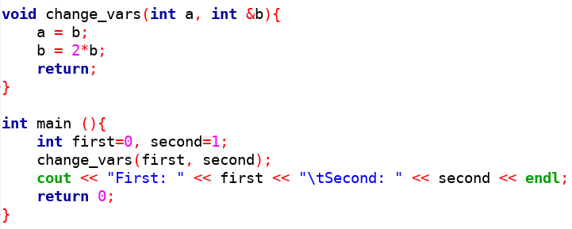
By-reference vs. By-value:

Slide 13
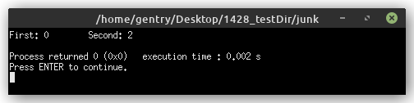
By-reference vs. By-value:

Slide 14
Side Effects:
We have been discussing functions only in terms of inputs(parameters) and outputs(return).
Functions can also affect programs in other ways. We call these other ways “side effects”
Examples of Side effects:
  Changes to by-reference variables.
  Console and file output.
  Changes to global variables.

Slide 15
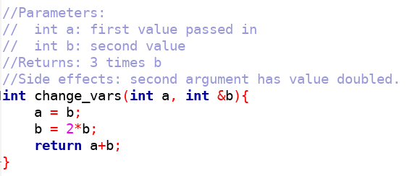
Function Comments:

Slide 16
Passing Arrays to Functions:
Arrays are always passed by reference.
Arrays can be very “large” in memory, so copying them into a function parameter would be expensive.
You do not have to use & to pass an array by reference.

Slide 17
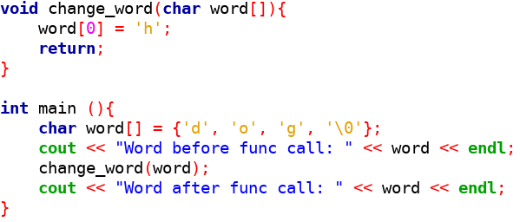
Passing an Array:

Slide 18
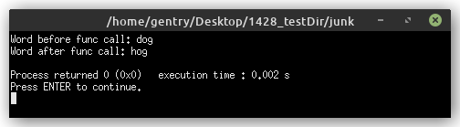
Passing Arrays:

Slide 19
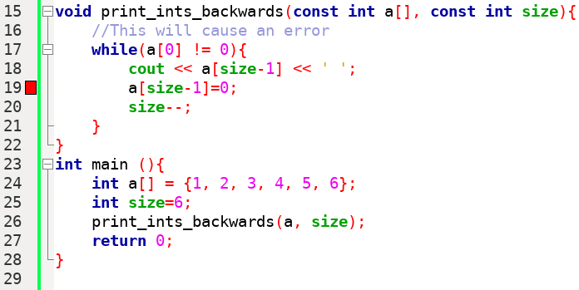
Avoiding Side Effects:

Slide 20
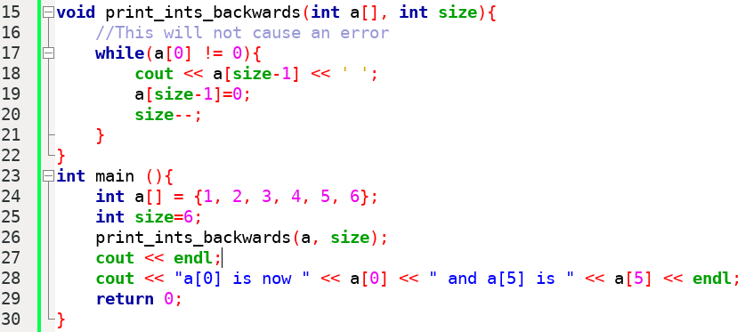
Avoiding Side Effects:

Slide 21
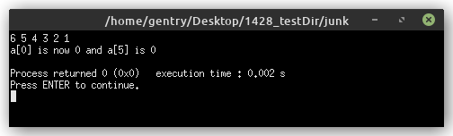
Side Effects Output:

Slide 22
const Parameters:
The const keyword can be used with any parameter to keep its value from being changed.
Pass-by-value parameters that are marked const act just like local constants.
Pass-by-reference const parameters are “protected” by the function and cannot be changed.
const is part of the “contract” that teams of coders can use to make their segments of code work together.

Slide 23
What is the Size of an Array:
Functions must know the size of an array argument to avoid out-of-bound errors.
It is a good practice to always pass in the size of an array that is being processed by a function.
sizeof can be used to measure the size of arrays.
strlen can be used to measure the length of c-strings.

Slide 24
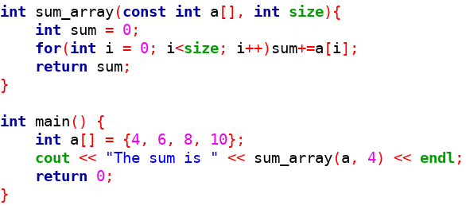
Passing in an Array Size:

Slide 25
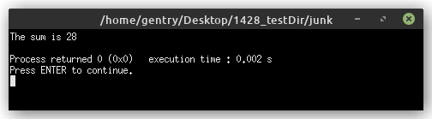
Passing in an Array Size:

Slide 26
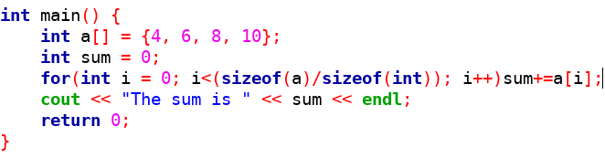
Using sizeof:

Slide 27
Using sizeof:

Slide 28
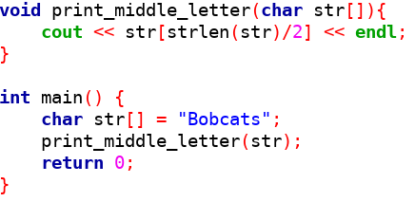
Using strlen:

Slide 29
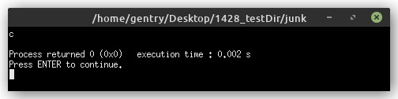
Using strlen:

Slide 30
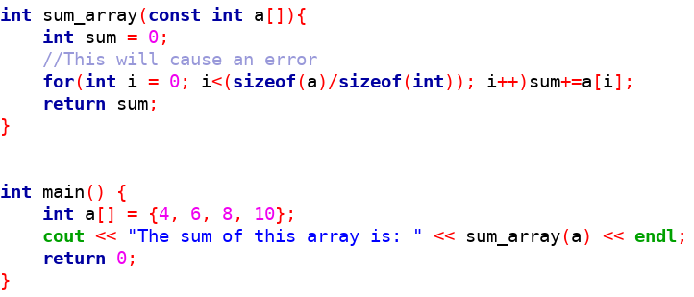
Using sizeof with a Function Parameter:

Slide 31
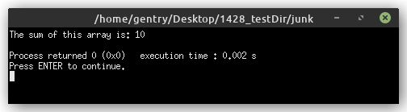
Using sizeof with a Function Parameter:
4+6+8+10=10???

Slide 32
Why Doesn’t sizeof Work with Parameters:
Remember that by-reference parameters in C++ are passed using pointers.
AND arrays are always passed by reference.
So an array in C++ is always passed as a pointer to the first value in the array.
This causes sizeof to return the size of the pointer, not the size of the array.
On my machine a memory address is 64bits, so sum_array only counted two values.

Slide 33
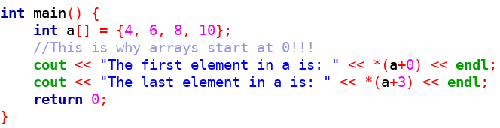
Arrays are Secretly Pointers :

Slide 34
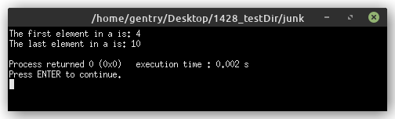
Arrays are Secretly Pointers :

Slide 35
Pointer Arithmetic:
We can apply basic operators to pointer variables just like other variables.
Changing the value of a pointer makes it point to a different address.
Incrementing or decrementing a pointer moves by a number of bytes determined by the data type.

Slide 36
Arguments to the Main Function:
Functions can have parameters and the main function is a function, so does it have parameters?
We often ignore the parameters of main but they do exist and we can use them.
The parameters of main are:
  int argc: a count of the arguments
  char* argv[]: an array of C-strings

Slide 37
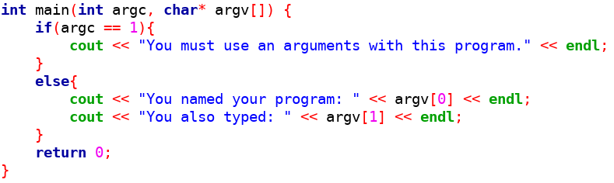
Arguments to main :

Slide 38
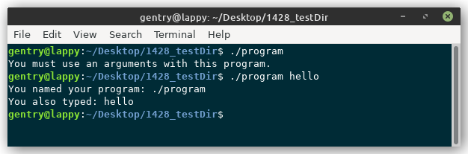
Arguments to main :

Slide 39
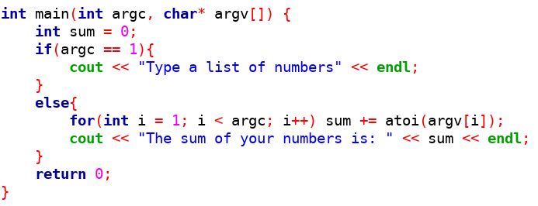
Using Arguments to main :

Slide 40
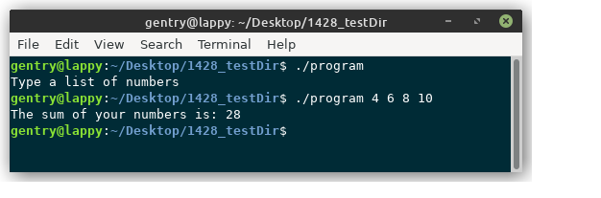
Using Arguments to main :

Slide 41
When to Pass by Reference:
Passing by value is safer because the variables of the calling function cannot be changed.
Passing by reference can be more efficient when large blocks of memory are being passed as arguments.
Passing by reference can let a function have more output than just a return.

Slide 42
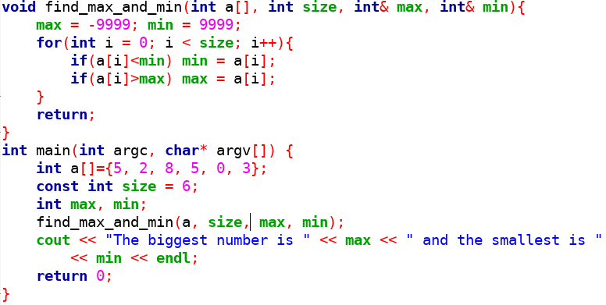
Reference Parameters as Outputs:

Slide 43
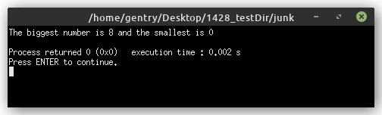
Reference Parameters as Outputs:

