Slide 1
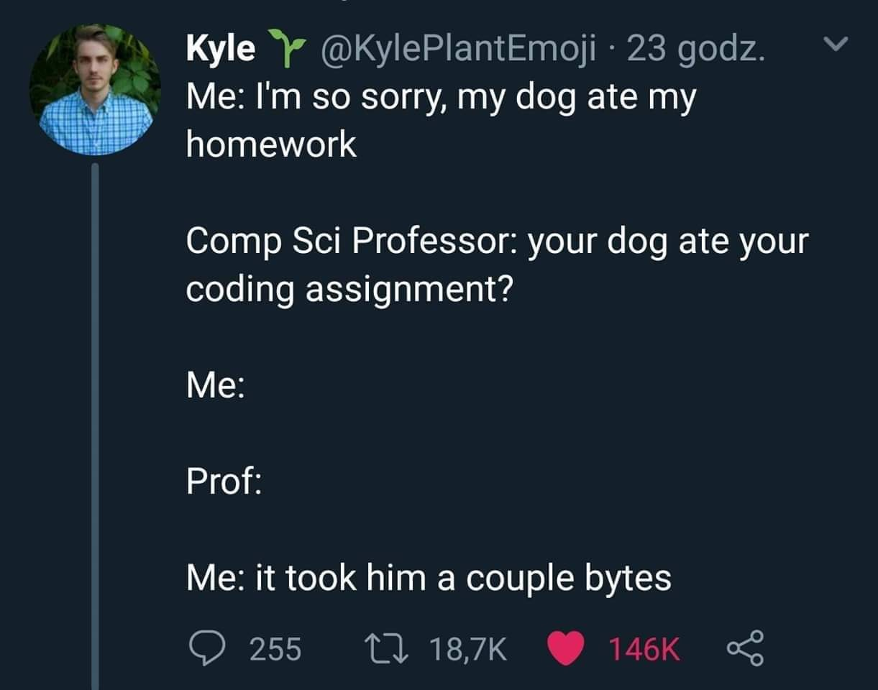

Slide 2
CS1428
Foundation of Computer Science
Lecture 9: Structs

Slide 3
Data Types in Programming:
Any value stored in memory is represented using a binary number.
The data type informs the compiler how much memory is needed, and how to represent fetched values.
But why can’t we tell the compiler to allocate more or less memory, and interpret fetched values using a different scheme?
We can actually define new data types in our program.

Slide 4
structs
By putting together primitive data types we can create new structures.
The struct keyword is used to defines these structures.
A struct contains one or more primitive variables, each of which has its own name. These are the “members” of the struct.
We can use the dot . operator to reference the individual elements of our new data type.

Slide 5
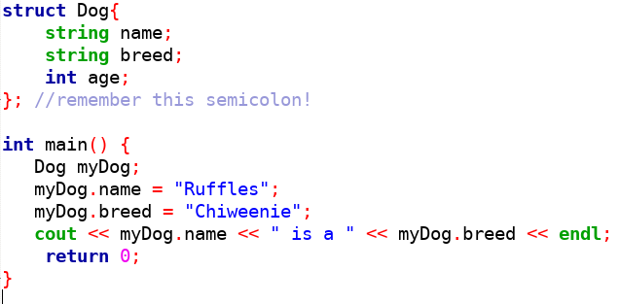
structs

Slide 6
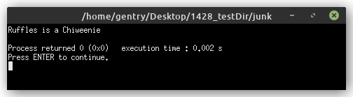
structs

Slide 7
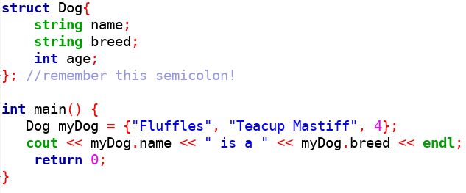
Initializing structs

Slide 8
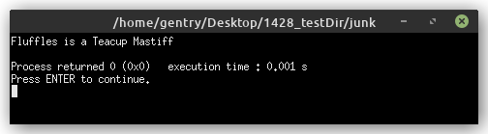
Initializing structs

Slide 9
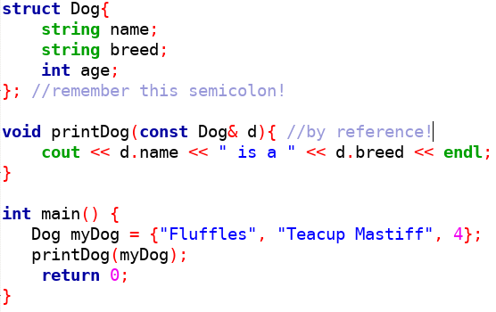
Passing structs

Slide 10
Passing structs

Slide 11
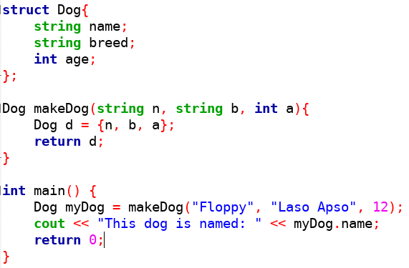
Returning structs

Slide 12
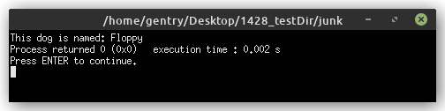
Returning structs

Slide 13
structs with functions
structs can be passed to or returned from functions.
Passing a struct to a function should be done by reference whenever possible.
Returning a struct from a function is a trick that can be used to return more than one value from a function.
Remember that struct is not a data type, it’s our tool to make new data types.

Slide 14
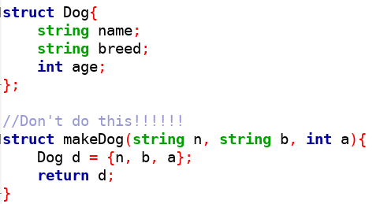
A Common Pitfall

Slide 15
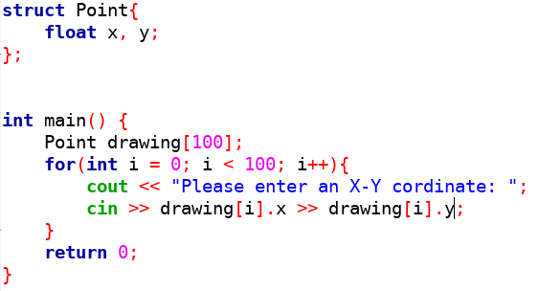
Arrays of structs

Slide 16
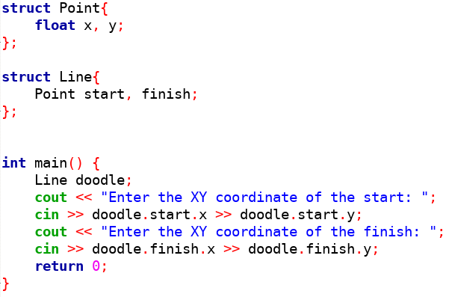
struct of structs

Slide 17
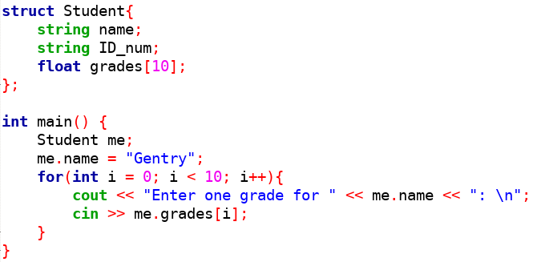
struct of Arrays

Slide 18
Constructors for structs
We can define a special function along with a struct called a constructor.
This function runs once when the struct is instantiated.
The constructor has the same name as the struct and does not have a return.

Slide 19
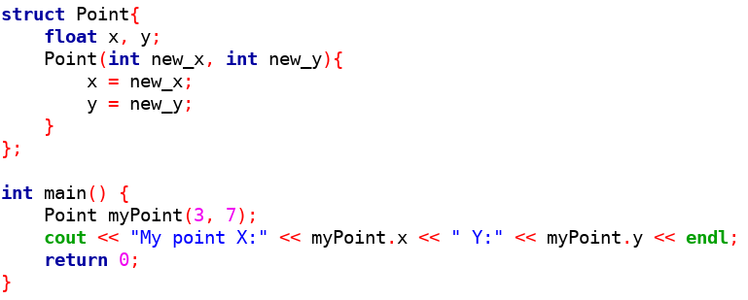
Constructor

Slide 20
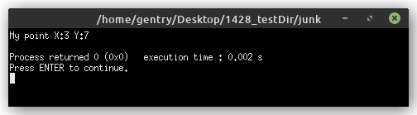
Constructor

Slide 21
Other Data Types in C++
structs were the most common way to create new data types in C, although C++ has added classes.
There are other ways to create data types in C++:
  typedef: rename a primitive data type
  enum: create named indexes
  union: a collection of variables with only one being used

Slide 22
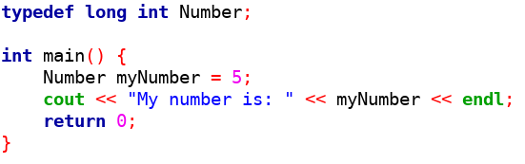
typedef

Slide 23
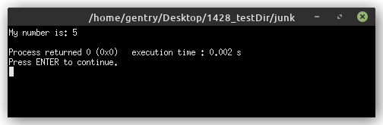
typedef

Slide 24
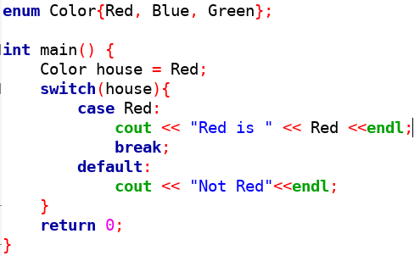
enum

Slide 25
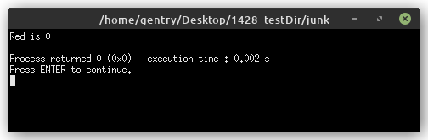
enum

Slide 26
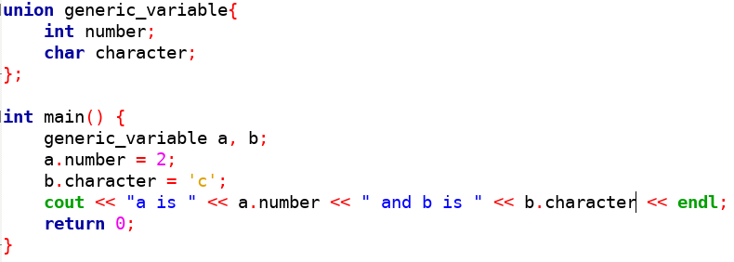
union

Slide 27
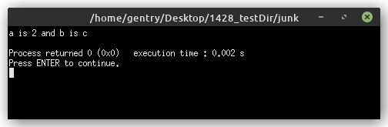
union

Slide 28
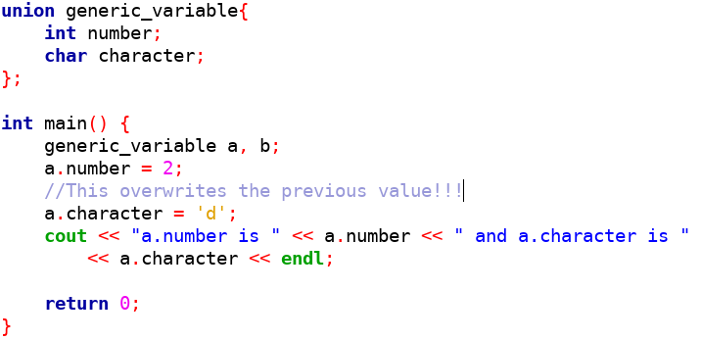
union Only Holds One Value!

Slide 29
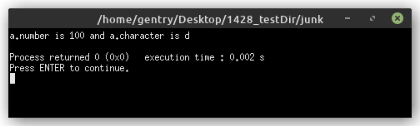
union Only Holds One Value!

Slide 30
When to Use a struct
When you want to logically encapsulate a collection of related values.
When you need to be able to return a collection of values from a function.
When you want to pass several values to a function as a single, logically related package.
When you need to remind readers of your code that groups of values are related.

