Slide 1
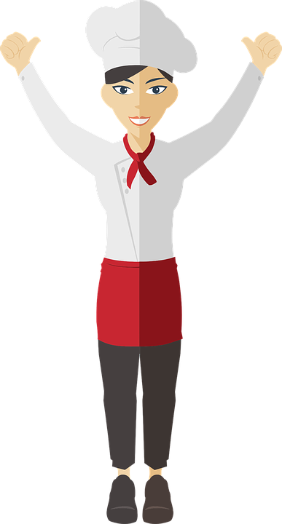
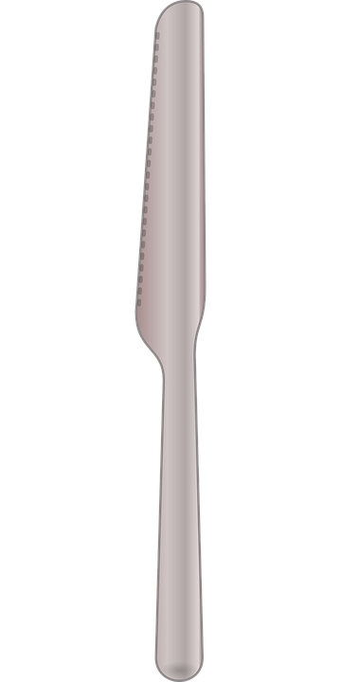


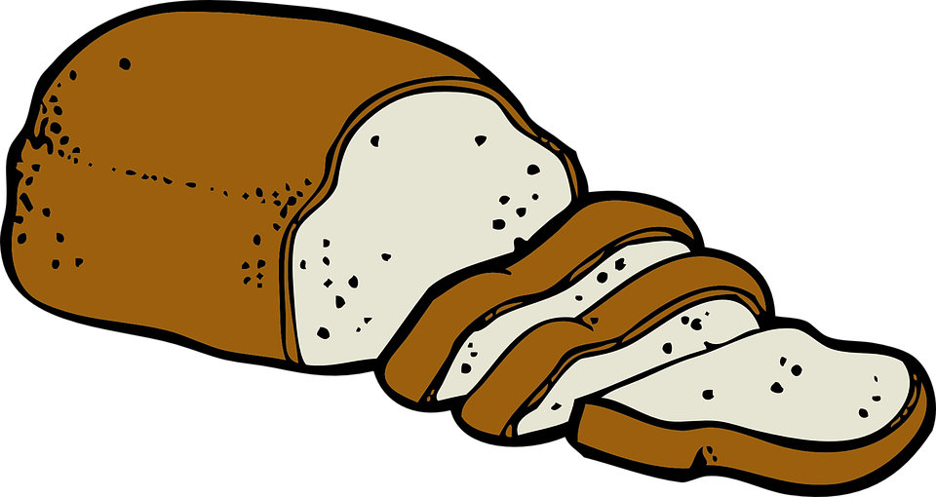
Peanut butter sandwich
Right hand
Left hand
Knife
Plate
Jar of Peanut Butter
Sliced Bread

