Slide 1
Apache Commons Net 3.5
Software Architecture Final Project
Program Overview · Architecture · Design Patterns · Implemented Changes
Matthew Gentry · Maria Alejandra Mora Pena · Maria Victoria Colmenares Czerniewicz · Koshi Yuasa · Ananjin Batdelger

Slide 2
What Is Apache Commons Net?
A Java library other programs use to communicate over the internet — without building the networking parts from scratch.
Think of it as a toolbox. Your Java program opens the toolbox and picks the right tool — the library handles all the complex networking automatically.
FTP / FTPS
SMTP / SMTPS
IMAP / IMAPS
POP3 / POP3S
NNTP
Transfer files up & down
Send email
Read email from server
Download & delete email
Browse Usenet newsgroups
Telnet
NTP / Time
Echo / Daytime
Finger
CIDR / Subnet
Remote terminal sessions
Sync clocks over network
Basic TCP/UDP tests
Look up user info
IP address & subnet math

Slide 3
Architecture Overview
Read top to bottom — your app is at the top, raw network sockets are at the bottom.
Your Application
Your code — calls the library to do any networking task
Protocol Clients
FTPClient · SMTPClient · IMAPClient · NNTPClient · TelnetClient · UDP Clients
Protocol Command Bases
Low-level classes that send and receive raw text commands over the network
SocketClient / DatagramSocketClient
Abstract base classes — handle opening a TCP or UDP socket connection
Java Sockets (javax.net)
Raw Java networking — what actually sends bytes over the wire
Supporting systems at every level: I/O Decorators · FTP Parsers · Observer Events · SSL Utilities

Slide 4
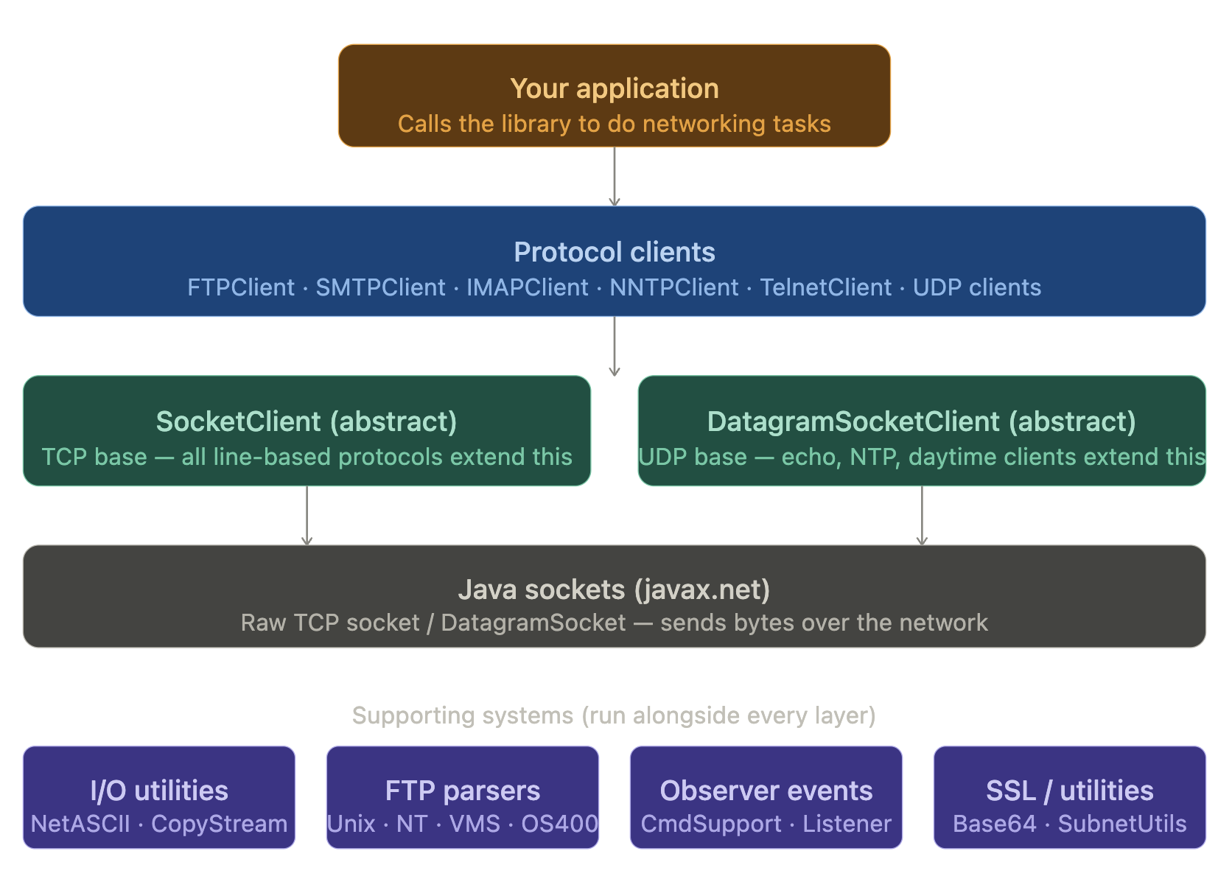
Conceptual Diagram — Full System
Insert Conceptual Diagram screenshot here
(Screenshot the Conceptual diagram from Claude and paste it onto this slide)

Slide 5
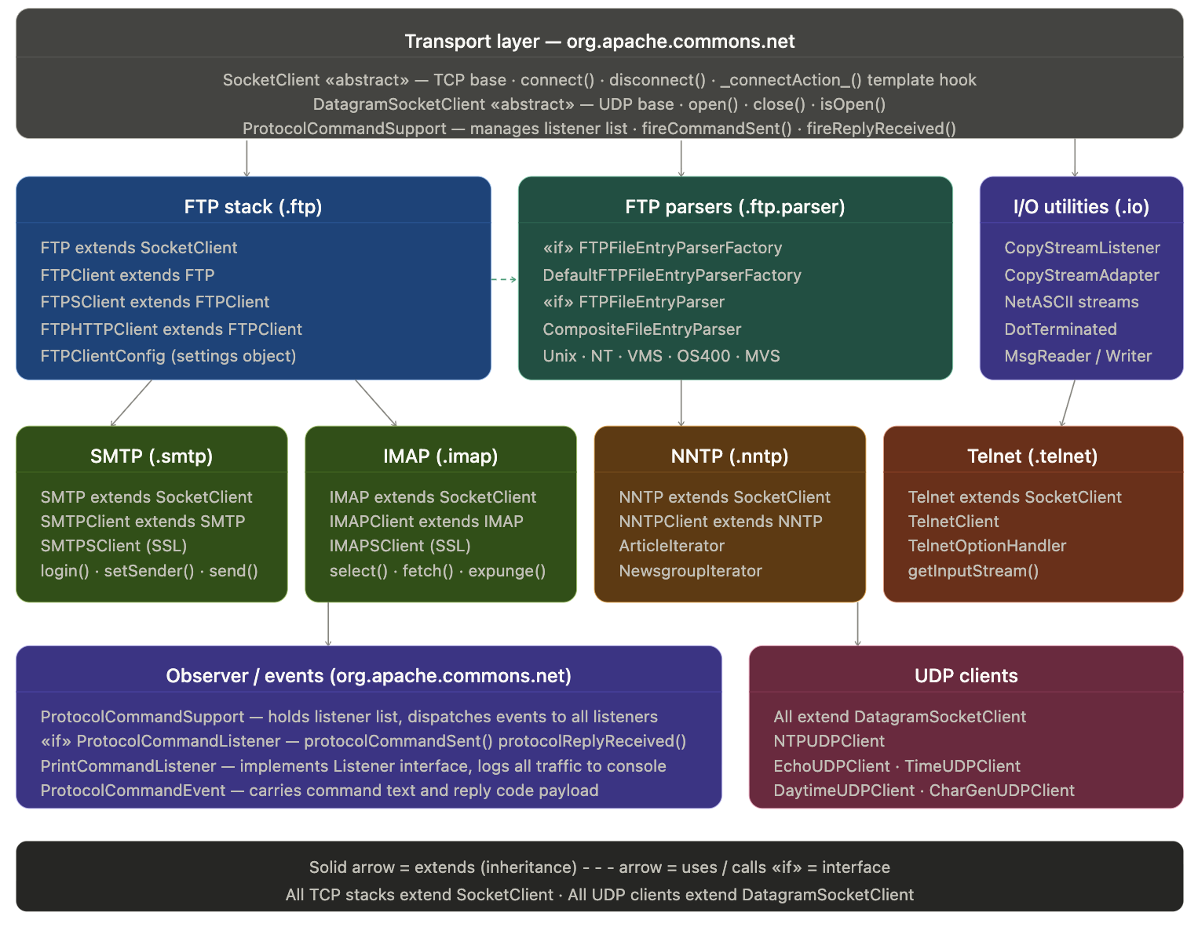
Concrete Diagram — Namespaces
Insert Concrete Namespace Diagram screenshot here
(Screenshot the Concrete diagram from Claude and paste it onto this slide)

Slide 6
Design Patterns — Overview
We found 10 classic GoF design patterns already built into the library.
Creational
Structural
Behavioral
● Factory
● Adapter
● Strategy
Picks the right FTP parser for the server type
CopyStream callers override only what they need
Swap parser per server OS
● Abstract Factory
● Facade
● Observer
Defines the interface contract for that picker
FTPClient hides messy FTP protocol behind simple calls
Listen to every command & reply without changing library
● Composite
● Template
One parser object that secretly holds many parsers
SocketClient defines steps; subclasses fill in details
● Decorator
● Iterator
Stream wrappers that each add exactly one behavior
Walk NNTP articles like a normal Java for-each loop

Slide 7
Creational Patterns — Factory & Abstract Factory
Creational patterns control how objects are created.
Factory — DefaultFTPFileEntryParserFactory
Abstract Factory — FTPFileEntryParserFactory
What it does:
What it does:
Looks at what type of FTP server you connected to and automatically picks the right file-listing parser for it.
Defines a Java interface (contract) that says: any factory must be able to create a parser. The actual implementation can be swapped.
Where in the code:
Where in the code:
DefaultFTPFileEntryParserFactory.java — createFileEntryParser() reads the server SYST response and returns the matching parser.
FTPFileEntryParserFactory.java — FTPClient holds a reference to this interface, never the concrete class, so it never depends on the specific factory.
Why it's useful:
Why it's useful:
Adding support for a new server OS only needs one new parser class. Nothing else in the library changes.
Developers who need custom parsing can write their own factory and plug it in — no library code changes required.
Simple analogy:
How they work together:
Like choosing the right plug adapter for a country — same device, different adapter depending on where you are.
Abstract Factory = the written contract. Factory = the default worker who follows that contract.

Slide 8
Structural Patterns
These patterns define how classes and objects are connected.
Adapter — CopyStreamAdapter
Facade — FTPClient
Problem: CopyStreamListener forces you to write two methods even if you only care about one.
Solution: CopyStreamAdapter gives no-op defaults — just override the one you need.
Analogy: An adapter plug that lets your device work even when the outlet doesn't match.
Problem: Real FTP involves dozens of commands, reply codes, and data channels — very complex.
Solution: FTPClient hides all of that behind login(), storeFile(), retrieveFile().
Analogy: A TV remote — you press Play and don't have to wire the electronics yourself.
Composite — CompositeFileEntryParser
Decorator — NetASCII & Stream Wrappers
Problem: Some FTP servers send mixed file formats in one directory listing.
Solution: CompositeFileEntryParser holds several parsers and tries each until one works.
Analogy: Looks like one parser to the caller, secretly contains many — caller never needs to know.
Problem: Streams need transformations like converting line endings.
Solution: Each wrapper class takes an existing stream and adds exactly one new behavior.
Analogy: Like adding toppings to a pizza — each topping is independent and stackable.

Slide 9
Behavioral Patterns
These patterns define how objects communicate and share responsibility.
Strategy — FTP FileEntryParser implementations
Observer — Protocol Command Support
Problem: Unix, Windows, VMS all format directory listings differently.
Solution: Each format has its own parser class. FTPClient calls parseFTPEntry() without knowing which one.
Analogy: Like choosing a language translator — swap the translator, not your questions.
Problem: You want to log every FTP/SMTP command without modifying the library.
Solution: Register a listener — the library calls it automatically after every command sent or reply received.
Analogy: Like a security camera — records everything without changing how the room works.
Template — SocketClient._connectAction_()
Iterator — ArticleIterator / NewsgroupIterator
Problem: Every protocol opens a socket but does something different right after connecting.
Solution: SocketClient handles the socket steps then calls _connectAction_() — a blank method subclasses override.
Analogy: A recipe template — steps are fixed, but each chef adds their own seasoning at the end.
Problem: NNTP responses are raw text lines — messy to walk through manually.
Solution: ArticleIterator and NewsgroupIterator wrap those responses for a normal Java for-each loop.
Analogy: A bookmark — it remembers where you are so you don't have to manage the position yourself.

Slide 10
Pattern Flow Diagram
Which design pattern governs each layer — read top to bottom.
Your Application
PATTERN
Your code — sits above the library
Transport Layer — SocketClient / DatagramSocketClient
Template Method
Abstract base classes that open TCP or UDP connections
Protocol Layer — FTPClient · SMTPClient · IMAPClient · NNTPClient · Telnet
Facade
User-friendly APIs your app actually calls
Event Layer — ProtocolCommandSupport → PrintCommandListener
Observer
Fires events so you can log or monitor all traffic
I/O Layer — NetASCII Stream Wrappers · CopyStreamAdapter
Decorator · Adapter
Transforms bytes: converts line endings, adapts interfaces
Iterator Layer — ArticleIterator · NewsgroupIterator · ReplyIterator
Iterator
Walk NNTP server responses like a normal Java list
FTP Parser Layer — DefaultFTPFileEntryParserFactory → Unix/NT/VMS parsers
Factory · Strategy · Composite
Picks the right parser, delegates, combines results
Left = what the layer does. Right = which pattern governs it.

Slide 11
Files Removed — Codebase Cleanup
We removed 7 things from the project. Here's what, why, and how risky each removal was.
File / Item
Risk
Reason Removed
ftp-client/ directory
None
Exact duplicate of code that already exists in the right place — zero value.
package-info.java files
Low
Only Javadoc comments — removing breaks doc generation but nothing runs differently.
examples/ directory
Low
Demo code for learning only. Not part of the library itself, no impact on functionality.
FTPCommand.java
Medium
Deprecated — fully replaced by FTPCmd.java which already existed. Dead code.
ArticlePointer.java
Medium
Deprecated — fully replaced by ArticleInfo.java which already existed.
Build config files
None
checkstyle.xml, findbugs — only affect build tools, not the actual library code.
bsd/ package
Low
rexec/rlogin/rsh — 1990s BSD commands replaced by SSH everywhere. Completely obsolete.
Notes:
"Before we get into the patterns we added, I want to show you what we cleaned out first. We removed seven things from the project. Each one was either dead code, a duplicate, or something so old it had no business being in a modern library."
ftp-client/ directory — "This was a literal duplicate. The same code existed in the right place already. Keeping it around was just confusion waiting to happen. Zero risk to remove it."
FTPCommand.java and ArticlePointer.java — "These two are the most interesting removals. Both were explicitly deprecated — the library had already replaced them with newer versions. We were just carrying dead weight. Medium risk only because something could technically still reference them, but nothing should."
bsd/ package — "rexec, rlogin, rsh — these are 1990s commands. SSH replaced them everywhere. Removing them was really just acknowledging reality."
Takeaway:
"The point here is that cleanup is part of architecture. Leaving dead code in a project costs you every time someone has to read it and figure out if it matters. We paid that debt off upfront."

Slide 12
Builder Pattern Implementation
Key Points
● FTPClientConfig is the object you want at the end — it holds all your FTP settings.
● FTPClientConfig.Builder lets you set each field one at a time using clear method names like .setServerLanguage().
● Only one field is required: serverSystemKey. All 7 others are optional and can be set in any order.
● When you call build(), the Builder assembles everything and gives you a finished, complete FTPClientConfig.
● The old way had 3 confusing constructors (1, 6, or 8 arguments) — easy to pass the wrong value in the wrong spot.
● The Builder fixes this: each value is named at the call site, so mistakes are obvious and easy to spot.
Notes:
"So the first pattern we implemented is the Builder. The problem we were solving: FTPClientConfig had eight fields and three different constructors. You could call the one-argument version, the six-argument version, or the eight-argument version — and nothing stopped you from passing the wrong value in the wrong position."
Walk through the bullet logic:
FTPClientConfig is the goal — "It's the settings object every FTP connection needs. Think of it as a configuration bundle."
Builder accumulates settings — "Instead of passing everything at once, you set each field by name, in whatever order makes sense."
Only one required field — "serverSystemKey. Everything else is optional. You don't pay for complexity you don't need."
build() finalizes it — "One call at the end gives you a complete, ready-to-use object."
Takeaway:
"The old constructors had a classic problem — they were telescoping. Three versions, each adding more arguments. The Builder replaces all of that with one clear chain of named method calls. When you read it, you know exactly what each value is."

Slide 13
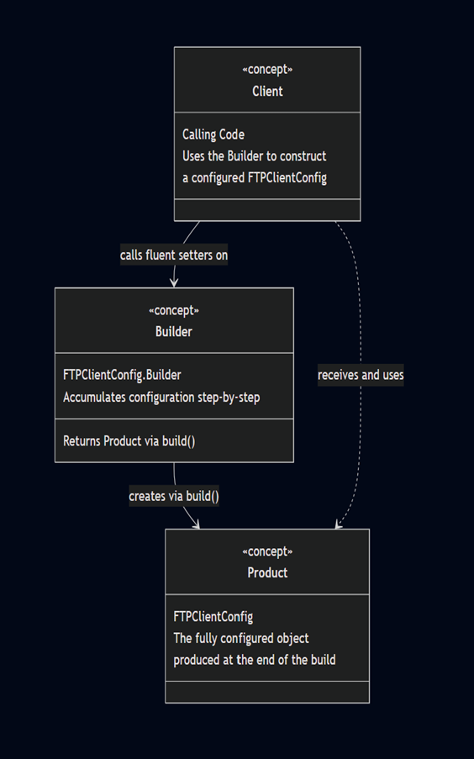
Builder Pattern Implementation
Concept for Builder Pattern
FTPClientConfig is the Product — the fully configured object produced at the end of the build
FTPClientConfig.Builder accumulates configuration step-by-step through fluent setter calls
serverSystemKey is the only required field — provided upfront to the Builder constructor
All other fields are optional and can be set in any order
build() is the terminal call that produces the final FTPClientConfig instance
Eliminates the need for long, hard-to-read constructor calls with many arguments
Notes:
"To put it in pattern terms: FTPClientConfig is the Product. It's the thing you're trying to build. FTPClientConfig.Builder is the mechanism that assembles it piece by piece."
Walk through the concept points naturally:
"serverSystemKey goes into the Builder constructor — that's intentional. It's the one field that's always required, so we make you provide it first."
"Everything else flows through fluent setters. You can chain them, or call them separately — order doesn't matter."
"build() is the contract. Once you call it, you're done. The Builder's job is over and you have your finished config object."
Takeaway:
"No more guessing which constructor to call. No more counting argument positions. Each value is labeled at the call site, which means mistakes are obvious when you read the code, not at runtime."

Slide 14
Builder Pattern Implementation
Why Builder Is the Right Choice
Why Not Other Patterns?
FTPClientConfig had 8 fields. Two problems with the old design:
Factory Method
Leads to too many combinations when 8 independent optional fields can be mixed freely.
Problem 1 — Mutable Setters
You could create a config object then keep calling setXxx() on it. The object might be half-configured when something tried to use it.
Abstract Factory
Creates families of related objects. FTPClientConfig is a single settings object, not a family.
Problem 2 — Telescoping Constructors
Three versions of the constructor with 1, 6, and 8 parameters. Pass arguments in wrong order and you get a runtime bug with no helpful error.
Prototype
Clone-then-mutate still leaves the mutable-setter problem intact.
Builder solves both: named setters at the call site, one complete object returned by build().
Facade
Hides complexity but doesn't enforce that construction is complete before use.
Singleton
The opposite of what we need — every FTP connection requires its own unique config.
Notes:
"We didn't just pick Builder because it seemed like a good pattern. We picked it because the alternatives each fail for specific, concrete reasons. Let me walk through that."
Mutable setters — "The old design let you create a config object and keep modifying it. That means someone could hand off a half-built config and something downstream could try to use it before it's ready. That's a subtle bug that's hard to trace."
Telescoping constructors — "Three constructor versions. If you called the 8-argument version and swapped two strings, you'd get a runtime bug with no error message telling you what went wrong."
"Why Not" table:
Factory Method — "Works well when you have a handful of fixed variants. But we have eight independent optional fields. The number of combinations explodes. Not the right tool."
Abstract Factory — "Creates families of related objects. We have one object. Wrong scope entirely."
Prototype — "Clone and mutate still leaves the mutable-setter problem in place. We'd solve one problem and keep the other."
Facade — "Facade hides complexity, it doesn't enforce correctness. We need to guarantee the object is complete before it's used. Facade can't do that."
Singleton — "The opposite of what we need. Every FTP connection gets its own config. One shared instance would break everything."
Takeaway:
"Builder is the only pattern that solves both problems at once — named parameters at the call site, and a complete object as the guaranteed output."

Slide 15
Builder Pattern Implementation
What We Built
● FTPClientConfig.Builder — a new public static inner class inside FTPClientConfig that accumulates all settings.
● Builder(serverSystemKey) — the only required value goes into the constructor. Everything else is optional.
● 7 fluent setters — one per optional field, e.g. .setServerLanguageCode(), .setServerTimeZoneId(). Chain them.
● build() — the final call. Passes everything to the existing FTPClientConfig constructor and returns the finished object.
Pros
Cons
Named parameters — you know exactly what each value means
Two objects created per config — Builder is thrown away after build(). Negligible overhead.
Object is always complete when build() returns — no half-configured states
Not fully immutable — old setXxx() methods still exist. Full immutability would be a bigger breaking change.
Fully backwards-compatible — all old code still works, Builder is purely additive
Slightly more code — Builder inner class repeats the field declarations. Standard tradeoff.
Adding a new optional field only needs one new Builder method
Notes:
"Here's what we actually shipped. Four pieces."
Walk through the four items:
FTPClientConfig.Builder — "A public static inner class inside FTPClientConfig. It lives right next to the thing it builds, which makes the relationship obvious."
Builder(serverSystemKey) — "The required field goes in the constructor. You can't instantiate the Builder without it. That's enforcement by design."
7 fluent setters — "One for each optional field. setServerLanguageCode(), setServerTimeZoneId(), and so on. Chain them or call them separately — your choice."
build() — "The terminal call. Passes everything collected into the existing FTPClientConfig constructor and hands you back the finished object."
Then cover the tradeoffs honestly:
Pros:
"Named parameters — code reads like documentation."
"Object is always complete when build() returns. No partial states."
"Fully backwards-compatible. Old code still works. Builder is purely additive."
Cons — and be direct about them:
"We create two objects per config — the Builder gets thrown away after build(). Negligible overhead, but it's real."
"Not fully immutable. The old setXxx() methods still exist on FTPClientConfig. To remove them would be a breaking change for existing users. We made the conscious call to not break the API."
"The Builder inner class repeats the field declarations. Standard tradeoff for the pattern — the clarity is worth the extra lines."
Takeaway:
"The thing I want to highlight is the backwards-compatibility decision. We could have forced immutability, but that would have broken every existing caller. Architecture is about tradeoffs, and we chose not to break what was already working."

Slide 16
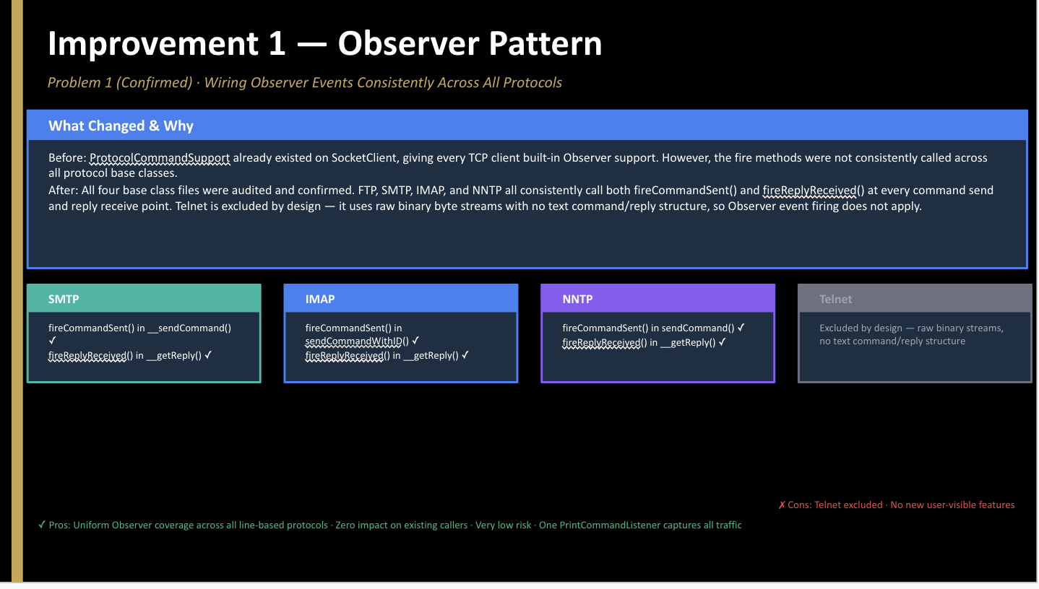
Notes:
FASADE EYE-OH

Slide 17
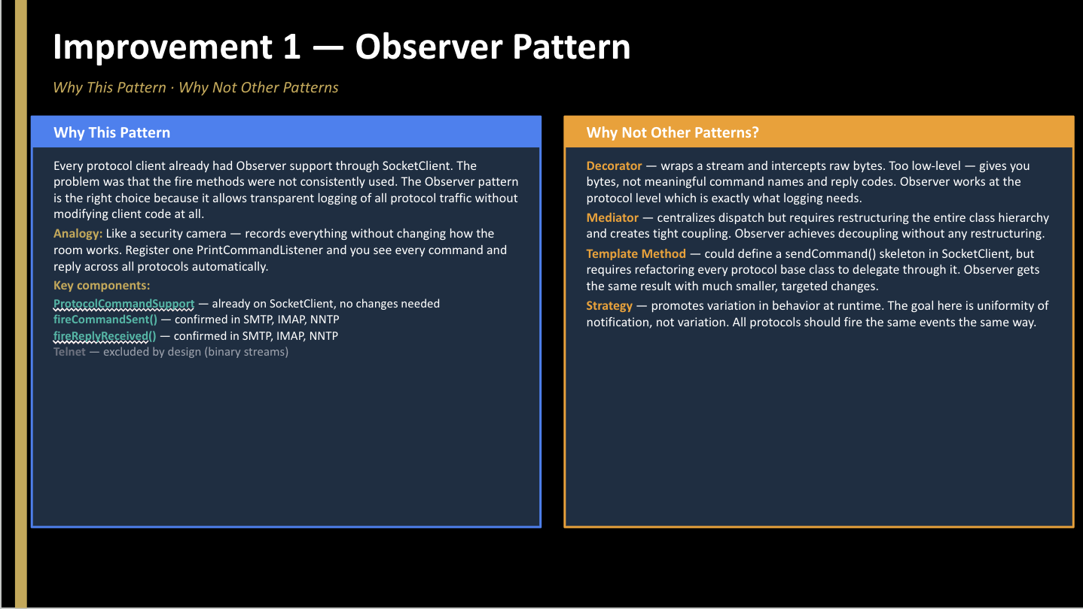
Notes:
fasad ai

Slide 18
Improvement 4 — Facade Pattern
Why This Pattern
Why Not Other Patterns?
TPClient already follows the Facade pattern cleanly:
FTP exposes raw RFC 959 commands and FTPClient hides the wire-level details. SMTPClient, IMAPClient, and NNTPClient share the same two-tier name but blur the boundary: they reach into _writer / _reader_ directly and inspect raw reply codes themselves. Reinforcing the Facade aligns all four clients with FTPClient — base = raw protocol I/O, client = high-level orchestration only.
Adapter
Assumes an interface mismatch; the two tiers already speak the same API.
Mediator
Assumes peer-to-peer routing; the relationship here is strictly hierarchical.
Decorator
Would force every existing subclass to be rewritten as composition, breaking source compatibility.
Template Method
Would invert control and assumes a shared algorithm that the three protocols do not share.
Components Needed
SMTP — new protected Writer getDataWriter() owns DotTerminatedMessageWriter construction SMTPClient — sendMessageData() now calls getDataWriter() instead of accessing _writer directly IMAP — new public boolean appendWithData(args, message) handles the full two-step APPEND continuation+literalexchange IMAPClient — append() delegates the two-step exchange to appendWithData() and no longer inspects raw reply codes NNTP — new protected BufferedReader openMessageReader() and protected Writer getDataWriter() own dot-terminated stream wrapping NNTPClient — __retrieve(), postArticle(), forwardArticle() now use the new accessors instead of touching _reader_ / _writer_ DotTerminatedMessageReader / DotTerminatedMessageWriter — unchanged; now constructed only inside the base classes

Slide 19
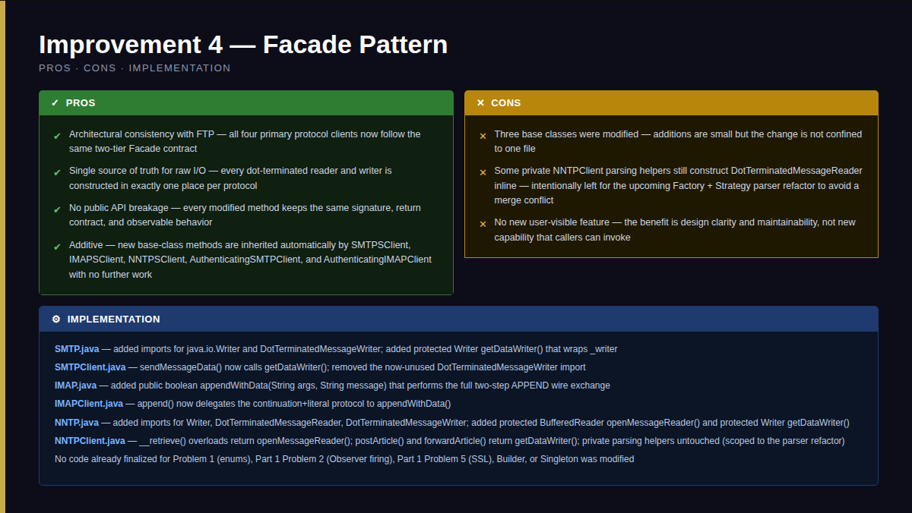

Slide 20
Pattern Summary — Before & After
What existed, what we changed, and where each pattern stands now.
Pattern
Previous Status
What We Did / Proposed
Status
Factory
Existed — FTP only
Proposed: extend to NNTP
✓
Abstract Factory
Existed — FTP only
Proposed: extend to NNTP
✓
Strategy
Existed — FTP parsers
Proposed: extend to NNTP responses
✓
Observer
Existed — partial
Event firing confirmed across all protocols
DONE
Template
Consistent
No change needed
—
Facade
Existed — FTP cleanly
Implemented as Improvement 3 — see preceding two slides. Base classes (SMTP/IMAP/NNTP) now own all raw protocol I/O; client classes are pure facades.
DONE
Composite
Consistent
No change needed
—
Decorator
Consistent
No change needed
—
Adapter
Consistent
No change needed
—
Iterator
Consistent — NNTP
No change needed
—
Builder
Did not exist
Added — FTPClientConfig.Builder
DONE
Singleton
Did not exist
Added — SocketFactoryProvider
DONE

Slide 21
Thank You
Apache Commons Net 3.5 — Software Architecture Final Project
10
3
4
7
Patterns Identified
New Patterns Added
Improvements Proposed
Files Removed
Matthew Gentry · Maria Alejandra Mora Pena · Maria Victoria Colmenares Czerniewicz · Koshi Yuasa · Ananjin Batdelger

