Slide 1
Apache Commons Net 3.5
Software Architecture Final Project
Program Overview · Diagrams · Design Patterns · Proposed Changes
Matthew Gentry, Maria Alejandra Mora Pena, Maria Victoria Colmenares Czerniewicz, Koshi Yuasa, Ananjin Batdelger

Slide 2
Program Overview
Apache Commons Net is a Java networking library — not an application. It provides client-side implementations of 10+ internet protocols so that other Java programs can communicate over a network without reimplementing low-level socket and protocol logic.
Supported Protocols
FTP / FTPS
Upload & download files from FTP servers
SMTP / SMTPS
Send email
IMAP / IMAPS
Read email from a mail server
POP3 / POP3S
Retrieve email
NNTP
Read/post Usenet newsgroup articles
Telnet
Remote terminal sessions
NTP / Time
Synchronise clocks from a time server
Echo / Daytime
Basic TCP/UDP test services
Finger
Look up user info on a remote server
CIDR / Subnet
IP address & subnet math utilities

Slide 3
Architecture Overview
Top-to-bottom = call depth from consumer to socket
Your Application
Protocol Clients (FTPClient · SMTPClient · IMAPClient · NNTPClient · TelnetClient · UDP Clients)
Protocol Command Bases (FTP · SMTP · IMAP · NNTP · Telnet)
SocketClient (abstract TCP base) | DatagramSocketClient (abstract UDP base)
Java Sockets (javax.net.SocketFactory / DatagramSocket)
Supporting systems: I/O Decorators · FTP Parsers · Observer Events · SSL Utilities

Slide 4
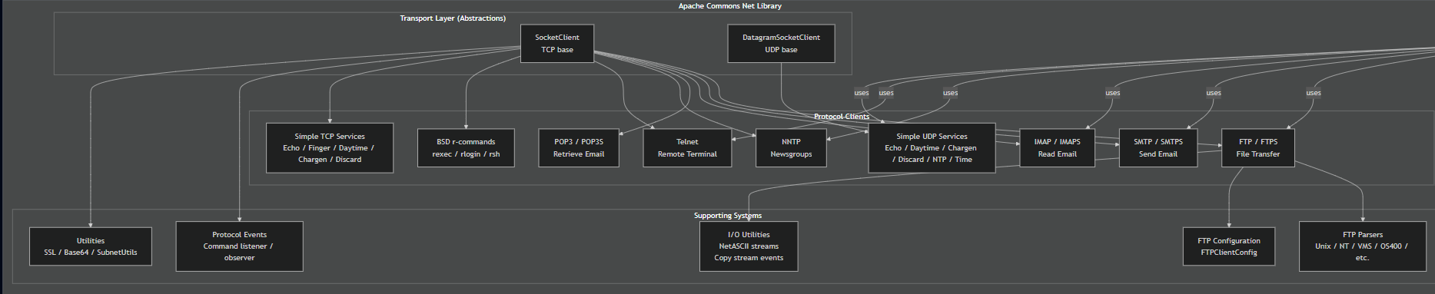
Conceptual Diagram
High-level system structure

Slide 5
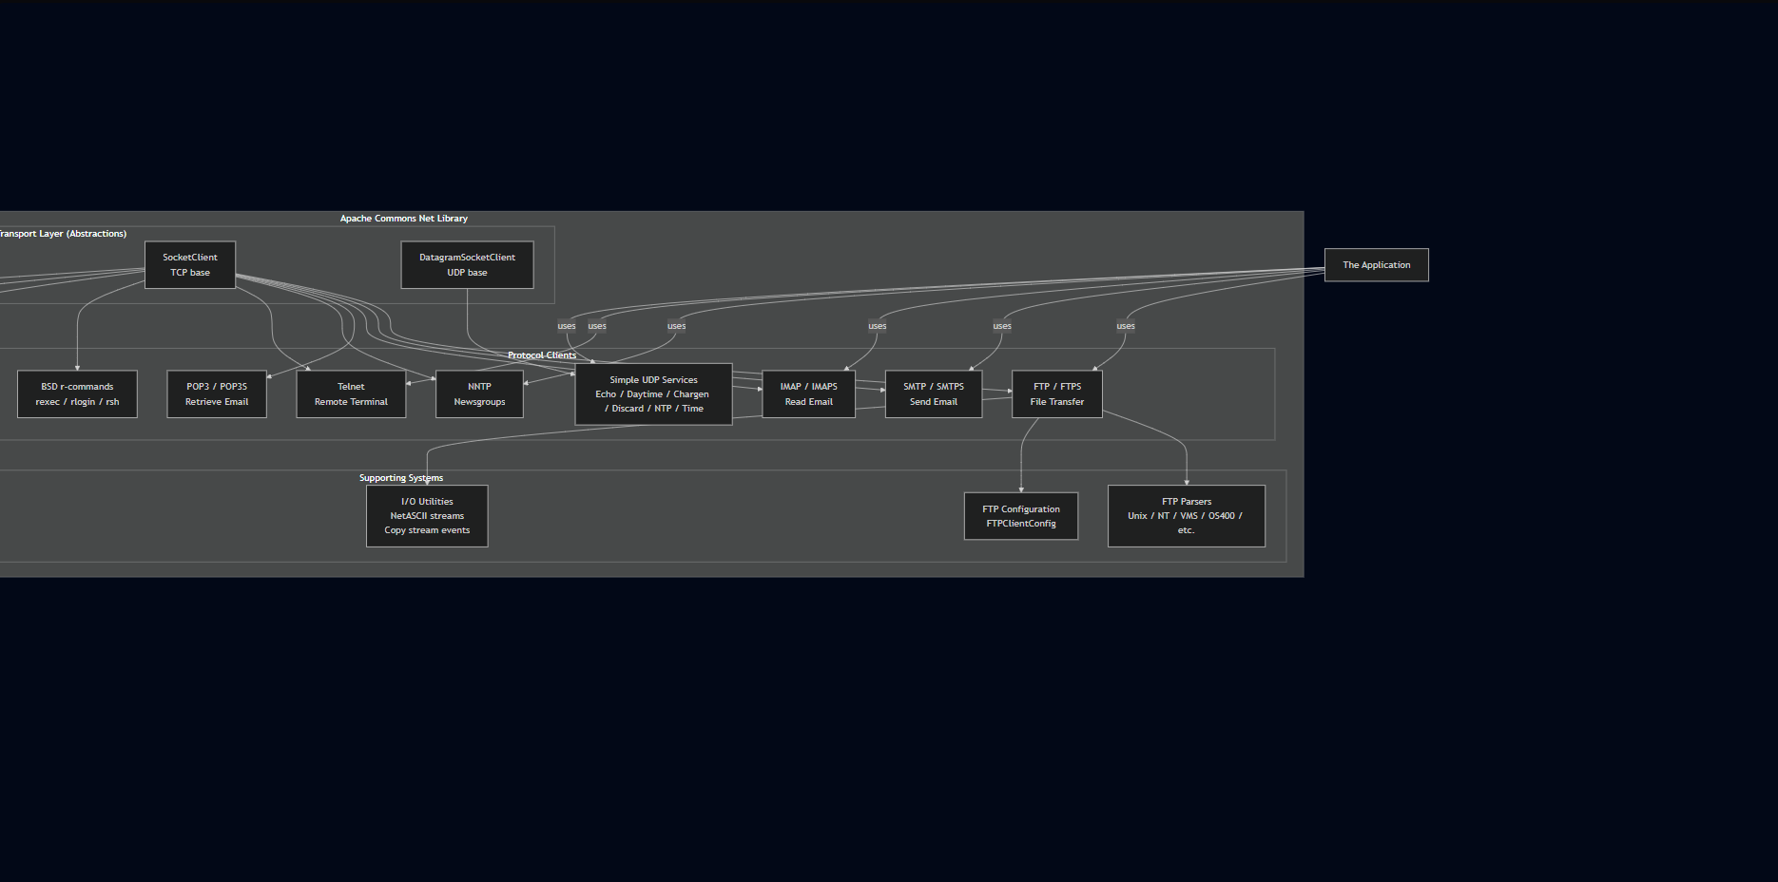
Conceptual Diagram
High-level system structure

Slide 6
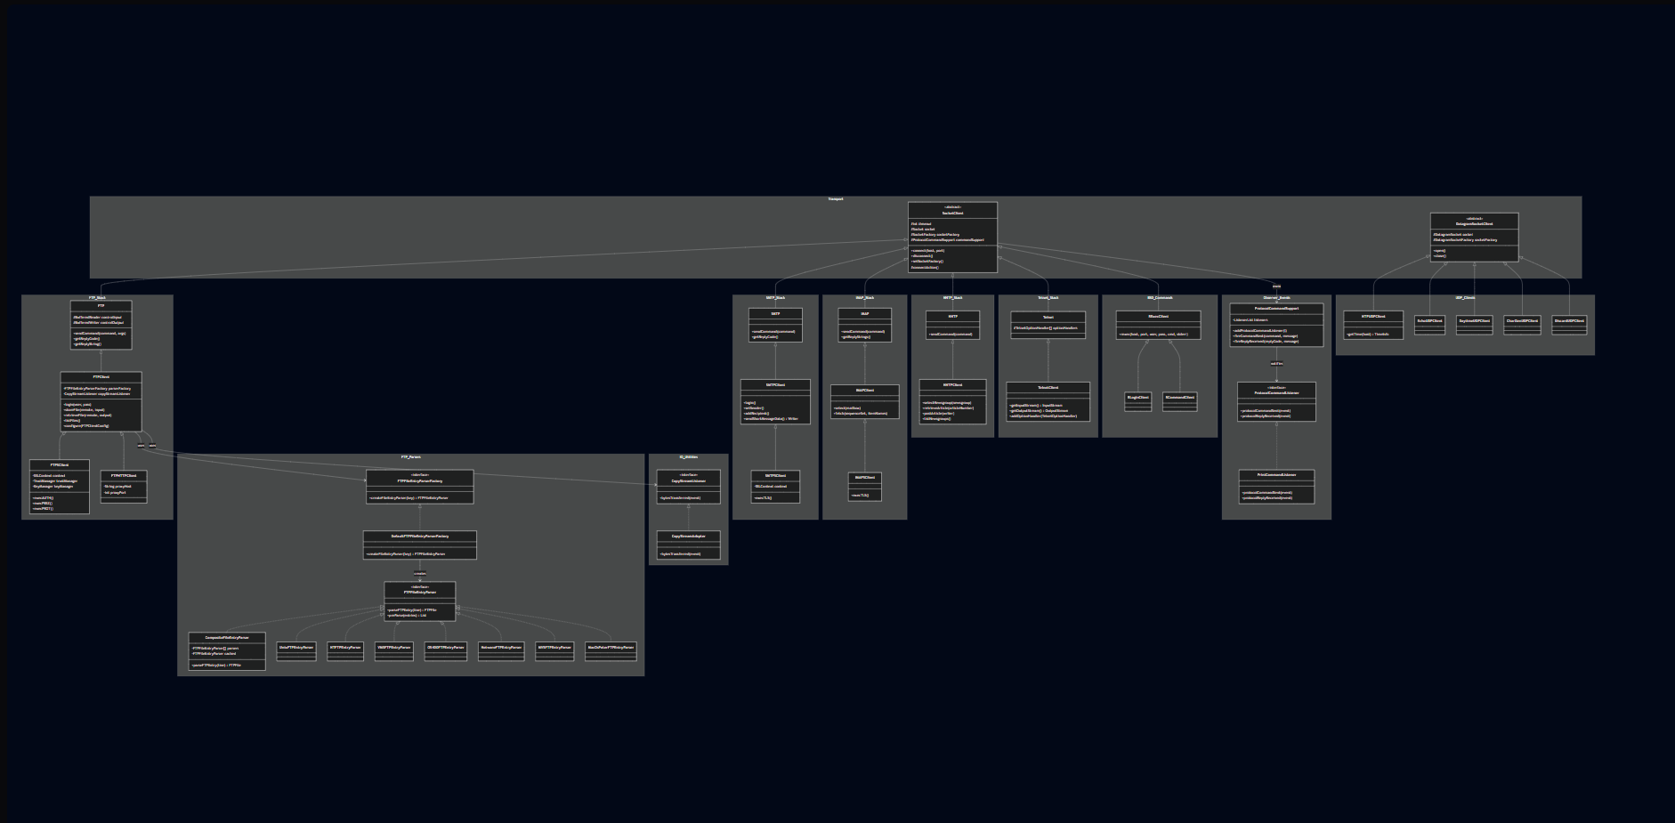
Concrete Diagram — Namespaces
Key classes per name

Slide 7
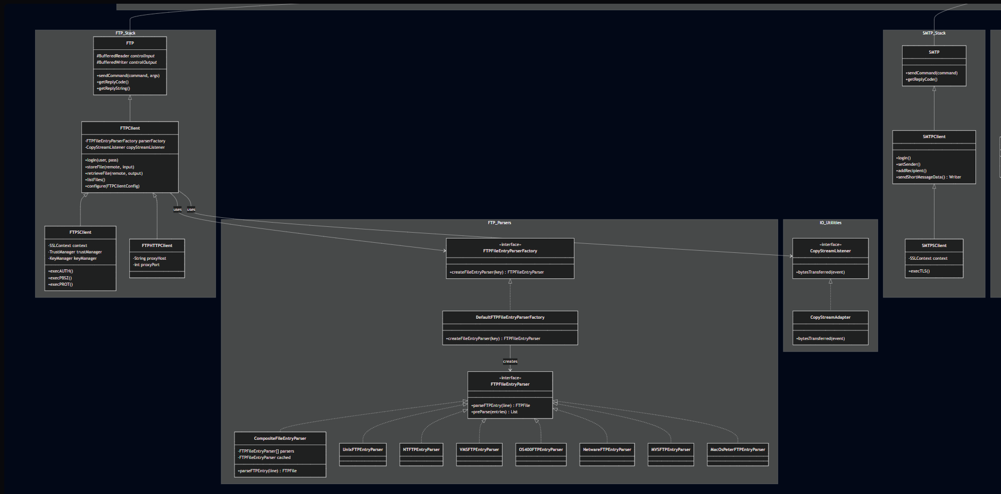
Concrete Diagram — Namespaces
Key classes per name

Slide 8
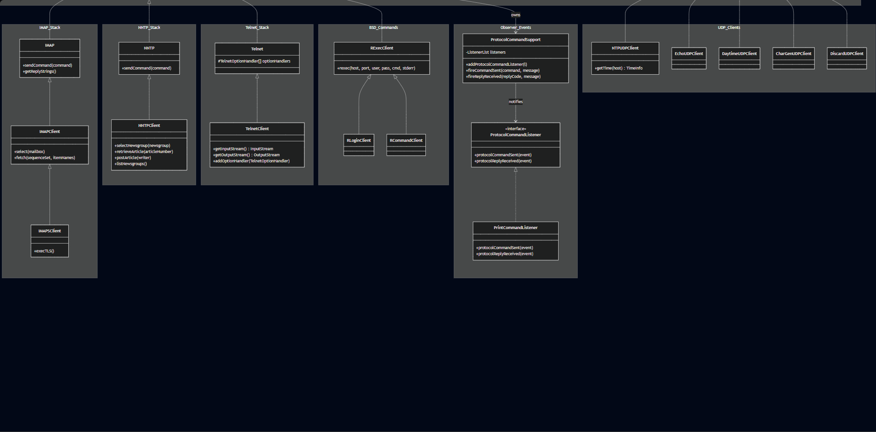
Concrete Diagram — Namespaces
Key classes per name

Slide 9
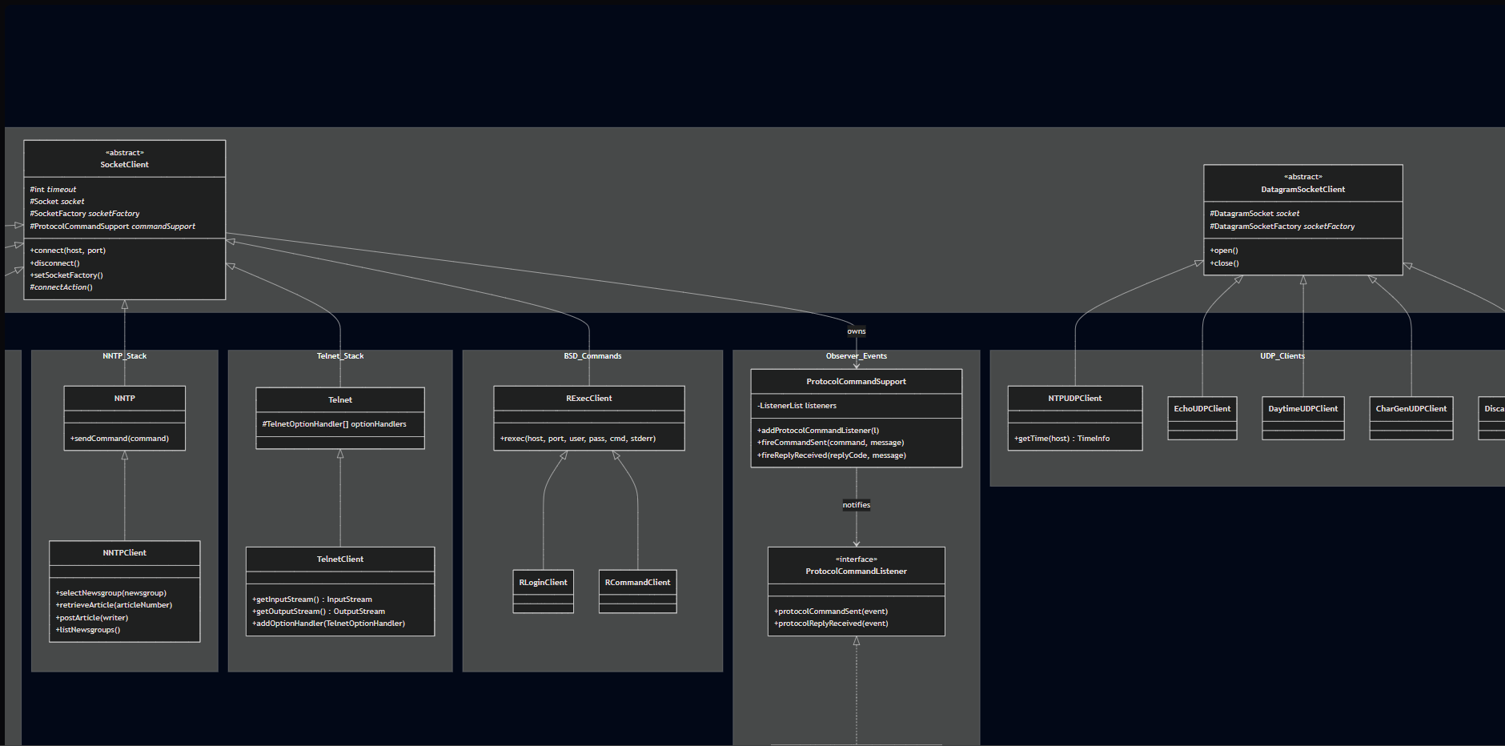
Concrete Diagram — Namespaces
Key classes per name

Slide 10
Design Patterns — Overview
Creational
• Factory — DefaultFTPFileEntryParserFactory
• Abstract Factory — FTPFileEntryParserFactory (interface)
Structural
• Adapter — CopyStreamAdapter
• Facade — FTPClient over FTP command layer
• Composite — CompositeFileEntryParser
• Decorator — NetASCII & Socket stream wrappers
Behavioral
• Strategy — FTPFileEntryParser implementations
• Observer — ProtocolCommandSupport / Listener
• Template — SocketClient._connectAction_()
• Iterator — ArticleIterator, NewsgroupIterator (NNTP)
Notes:
We found 10 patterns already being used in the code. I’ve grouped them into three buckets: Creational (how objects are made), Structural (how the code is organized), and Behavioral (how the parts talk to each other)

Slide 11
Design Patterns — Creational
Factory
Abstract Factory
FTPClient calls createFileEntryParser(key) to get the right parser for the server's OS. The factory inspects the SYST response string and instantiates the correct parser without the client knowing which one it received. Key class: DefaultFTPFileEntryParserFactory
FTPFileEntryParserFactory (interface) defines the contract for all parser factories. FTPClient depends on the interface, not the concrete implementation — so users can inject a completely custom factory. Key class: FTPFileEntryParserFactory
Both patterns work together: Abstract Factory defines the contract; Factory is the concrete implementation selected at runtime based on the server's OS type.
Notes:
The main takeaway here is the Factory pattern. Think of it as a 'Smart Selector.' When the app needs to read files from a server, it doesn't know if that server is running Windows, Unix, or VMS. The Factory looks at the server type and automatically hands the app the right 'Parser' tool so the developer doesn't have to guess."
Where to point: Point to FTPClient and FTPFileEntryParserFactory.

Slide 12
Design Patterns — Structural
Adapter
Facade
CopyStreamAdapter
FTPClient
CopyStreamListener requires two bytesTransferred overloads. CopyStreamAdapter provides no-op defaults so callers only override the method they actually need.
FTP exposes raw RFC 959 commands. FTPClient hides multi-step sequences behind login(), storeFile(), retrieveFile(), listFiles() — masking reply codes, data channel setup, and mode negotiation.
Composite
Decorator
CompositeFileEntryParser
io package — stream wrappers
Holds an array of FTPFileEntryParser implementations. Tries each in order, caches the first match. The caller holds one parser reference and never knows it's a composite.
FromNetASCIIInputStream, ToNetASCIIOutputStream, SocketInputStream, DotTerminatedMessageReader / Writer — each wraps an existing stream and adds one behaviour without changing the interface.
Notes:
it’s all about the User Experience for the developer. The Facade pattern takes a really messy, complex process—like logging into a server—and hides all that mess behind one simple button: .login().
We also use Decorators, which are like 'wrappers' that add extra features to data streams without changing the original code."
Where to point: Point to FTPClient (The Facade) and mention it makes the library much easier to use.

Slide 13
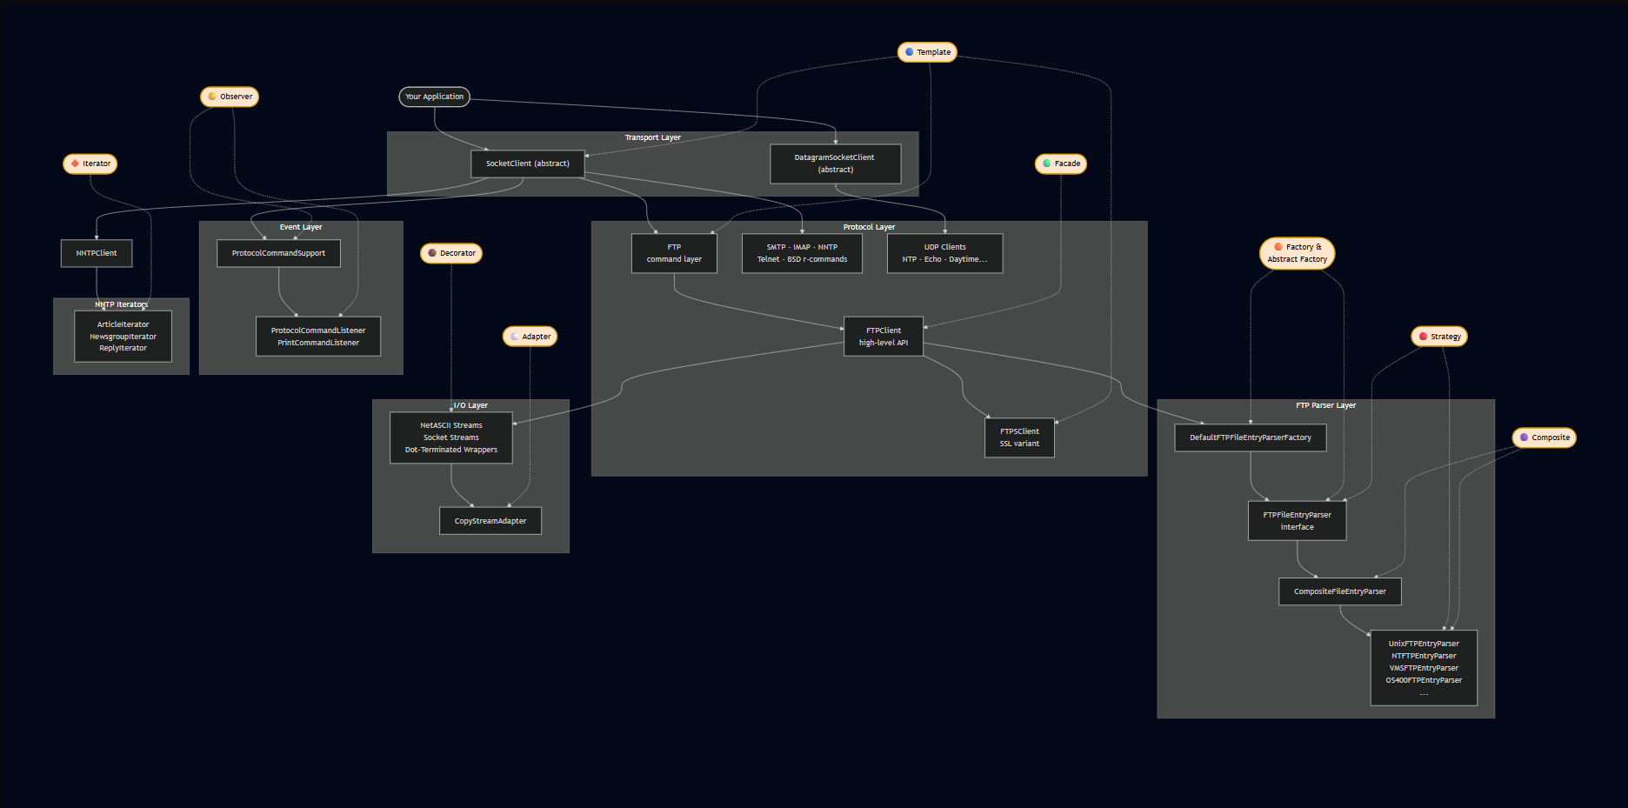
Pattern Flow Diagram
Notes:
This diagram shows exactly where these patterns live. You can see the Facade at the very top where the user interacts with the app, and the Decorators and Adapters sitting further down where the actual data is moving."
Where to point: Trace your finger from the top (Application) to the bottom (Transport) to show the flow.

Slide 14
Design Patterns — Behavioral
Strategy
Observer
FTPFileEntryParser implementations
ProtocolCommandSupport / Listener
Each OS format (Unix, NT, VMS, OS/400…) is its own parser class. The correct one is selected at runtime and injected. FTPClient never hardcodes a format.
SocketClient owns ProtocolCommandSupport. Listeners register and receive events on every command sent/reply received. Enables logging via PrintCommandListener.
Template
Iterator
SocketClient._connectAction_()
NNTP — ArticleIterator, NewsgroupIterator
connect() defines the full connection algorithm. Subclasses override _connectAction_() to insert protocol-specific init (banner read, TLS handshake, etc.).
Implements java.util.Iterator<T> to wrap raw NNTP server strings and expose typed, traversable sequences of Article and NewsgroupInfo objects.
Notes:
Finally, we have the Observer pattern. This is like a 'Notification Center.' Every time a command is sent or received, the system pings a listener. This is how we handle things like logging or tracking history without hard-coding it into every single function."
Where to point: Point to ProtocolCommandSupport.

Slide 15
Files Removed
Item
Risk
Reason
• ftp-client/ folder
None
Exact flat-package duplicate of src/main/java/.../ftp/
• package-info.java files
Low
Javadoc only — no executable code
• examples/ directory
Low
Usage demos, not part of the library
• FTPCommand.java
Medium
Deprecated; replaced by FTPCmd.java enum
• ArticlePointer.java
Medium
Deprecated; replaced by ArticleInfo.java
• Build config files
None
checkstyle.xml, findbugs files — CI tooling only
• bsd/ package
Low
rexec/rlogin/rsh — obsolete on virtually all modern systems

Slide 16
Proposed Changes — Making Patterns Consistent
Observer Firing Incomplete
ProtocolCommandSupport exists on SocketClient but only FTP fires events. Wire fireCommandSent() and fireReplyReceived() into all protocol base classes.
Facade Boundary Blurry (non-FTP)
SMTPClient, IMAPClient, NNTPClient mix raw command logic with business logic. Enforce: base class = raw commands only; client class = high-level API only.
Factory + Strategy Only in FTP
Only FTP uses the Factory + Strategy parser abstraction. Apply an NNTPResponseParser interface + factory to NNTPClient for consistency.
SSL Variants Inconsistent
FTP/SMTP/IMAP/POP3 have SSL variants; NNTP and Telnet do not. Either add NNTPSClient & TelnetSClient or explicitly document the reason for not including these.

Slide 17
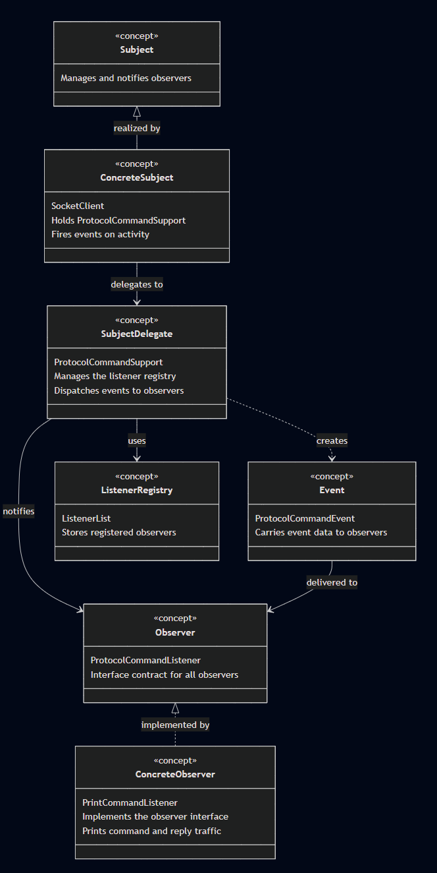
Improvement 1 — Observer Pattern
Concept for Improving the Observer Pattern
SocketClient acts as the Subject — where activity originates
Delegates observer management to ProtocolCommandSupport rather than handling it directly
ListenerList stores all registered observers
ProtocolCommandEvent packages event data and is dispatched to observers when activity occurs
ProtocolCommandListener is the interface contract all observers must implement
PrintCommandListener is the concrete observer that implements the contract and acts on notifications
Notes:
Think of this like a YouTube channel and its subscribers. The channel is SocketClient — it's where the action happens.
But instead of managing its own subscriber list, it hands that job off to an assistant called ProtocolCommandSupport,
kind of like a notification manager. That manager keeps a list (ListenerList) of everyone who signed up to be
notified. Whenever something happens — like a command being sent or a reply coming back — the manager packages that
news into a little envelope called a ProtocolCommandEvent and delivers it to every subscriber. ProtocolCommandListener
is the agreement that every subscriber has to follow — basically a promise that says "when I get notified, here's
what I'll do with it." PrintCommandListener is one real subscriber that honors that promise by printing out whatever
it receives.
Builder Pattern — Concept Diagram
Imagine ordering a custom sandwich. You don't walk up and say everything at once in one long breath — "I want
sourdough, turkey, no lettuce, extra cheese, toasted, with mustard." Instead there's a sandwich builder at the counter
and you tell them one thing at a time: bread first, then protein, then toppings. That builder is
FTPClientConfig.Builder. When you're done adding everything you want, you say "okay, make it" — that's the build()
call — and out comes your finished sandwich, which is FTPClientConfig. The client (you) never has to think about how
the sandwich is assembled internally; you just call out your preferences one step at a time.

Slide 18
Improvement 1 — Observer Pattern
Why This Pattern
Why Not Other Patterns
The Observer infrastructure (ProtocolCommandSupport, fireCommandSent, fireReplyReceived) already existed on SocketClient but was reachable only through an unreliable integer-based command API in SMTP, NNTP, and POP3. Converting to type-safe enums and adding enum-based sendCommand overloads standardizes the path through which every command reaches the Observer layer — uniformly across all protocols.
Mediator — centralizes dispatch but creates tight coupling; each protocol client loses independence Strategy — promotes variation in behavior; the goal here is uniformity of notification, not variation Template — could define a sendCommand skeleton but requires restructuring the existing class hierarchy Visitor — suited to heterogeneous object structures; Observer's event broadcast is simpler and more direct
Components Needed
SMTPCommand enum — each constant carries its RFC 821 wire string; provides a typed entry point to Observer firing NNTPCommand enum — 18 NNTP commands; getCommand() returns the constant name POP3Command enum — 14 POP3 commands; getCommand() returns the constant name sendCommand(XxxCommand, String) on SMTP, NNTP, POP3 — new overloads routing through the existing Observer-firing path Deprecated int-based overloads — retained for binary compatibility with existing external callers

Slide 19
Improvement 1 — Observer Pattern
Pros
Cons
Observer events fire through a uniform, type-safe path across FTP, SMTP, NNTP, and POP3
Compiler rejects invalid commands before they can reach the Observer layer
Consistent with FTPCmd and IMAPCommand already in the same codebase
Each constant name self-documents what the Observer will record in its event log
Breaking API change — external callers using int-based sendCommand overloads must migrate
Observer event wiring in the base class bodies (fireCommandSent / fireReplyReceived) still needs to be completed as a separate follow-up task
Enum ordinals are fragile — callers must use getCommand() for wire strings, not ordinals
Implementation
SMTPCommand.java — converted to enum; MAIL, RCPT, SEND, SOML, SAML carry their RFC 821 wire strings via getCommand() NNTPCommand.java / POP3Command.java — same enum conversion; all wire strings match constant names SMTP.java — private __sendCommand updated to accept SMTPCommand; public enum overloads added; int overloads @Deprecated NNTP.java / POP3.java — same treatment; new enum overloads added; int overloads @Deprecated IMAPCommand was already a proper enum in the original codebase — no change needed

Slide 20
Proposed Changes — Making Patterns Consistent
Observer Firing Incomplete
Only FTP fires Observer events. Wire fireCommandSent() and fireReplyReceived() into all protocol base classes.
Facade Boundary Blurry (non-FTP)
SMTPClient, IMAPClient, NNTPClient mix raw commands with business logic. Enforce: base = raw commands; client = high-level API.
Factory + Strategy Only in FTP
Only FTP has the Factory + Strategy parser abstraction. Apply NNTPResponseParser interface + factory to NNTPClient.

Slide 21
Improvement 3 — Singleton Pattern
Singleton
Default Socket Factories
Implemented a new SocketFactoryProvider singleton.
SocketClient now gets its default SocketFactory and ServerSocketFactory from SocketFactoryProvider.
DatagramSocketClient now gets its default DatagramSocketFactory from SocketFactoryProvider.
This centralizes default socket factory management and makes the lifecycle more explicit.

Slide 22
Pattern Summary — Before & After
Pattern
Previous Status
Proposed Action
Factory
Exists — FTP only
Extend to NNTP
✓
Abstract Factory
Exists — FTP only
Extend to NNTP
✓
Strategy
Exists — FTP parsers
Extend to NNTP responses
✓
Observer
Exists — partial
Command path standardized; full wiring proposed
DONE
Template
Consistent
No change needed
—
Facade
Exists — FTP cleanly
Enforce in SMTP / IMAP / NNTP
✓
Composite
Consistent
No change needed
—
Decorator
Consistent
No change needed
—
Adapter
Consistent
No change needed
—
Iterator
Consistent — NNTP
No change needed
—
Builder
Did not exist
Added — FTPClientConfig.Builder
DONE
Singleton
added
SocketFactoryProvider for default socket factories
DONE

