Slide 1
Product Launch
Launch in March
Budget approved

Slide 2
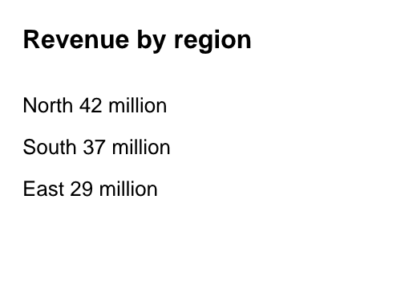
Sales
Quarter | Units
Q1 | 120
Notes:
Mention the pilot customers

