Slide 1
Using SL to calculate the surface energy of water dimers
Delano Usiukiewicz and Genwei Zhang

Slide 2
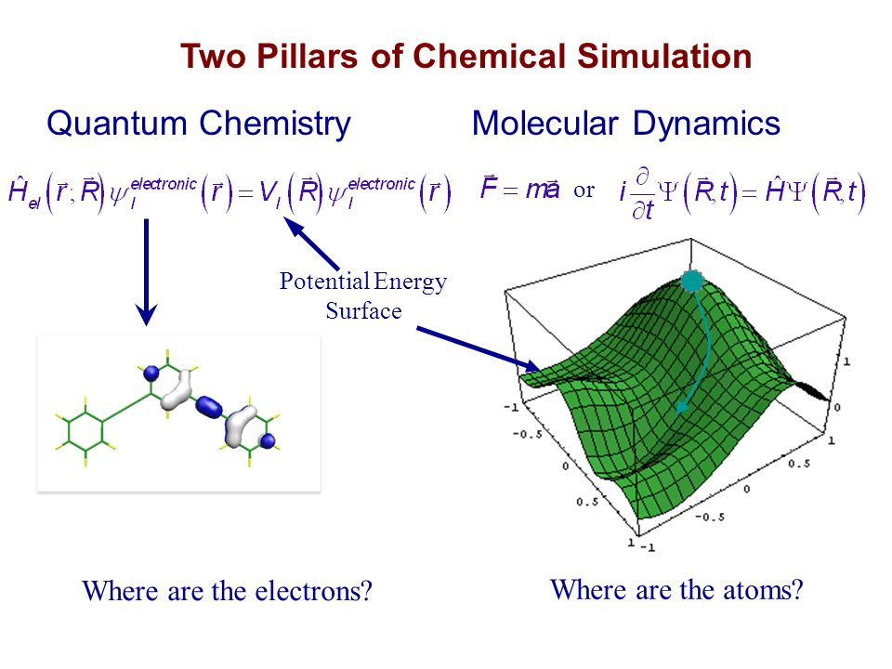
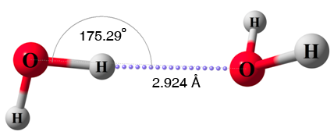
Background
Computing surface energy is fairly expensive using conventional quantum chemistry simulation methods.
Water dimer potential energy is an typical quantum chemistry simulation problem.
Accurately reproduce water-dimer potential energy using ML can advance problem-solving capabilities in the field of quantum chemistry.
QM/MM

Slide 3
Project Domain
Hypothesis: SL can create a ML model that is able to reproduce water-dimer surface energies as accurate as using conventional approaches
Goal: to re-produce water dimer surface energies to an accuracy of RMSD<=1kcal/mol

Slide 4
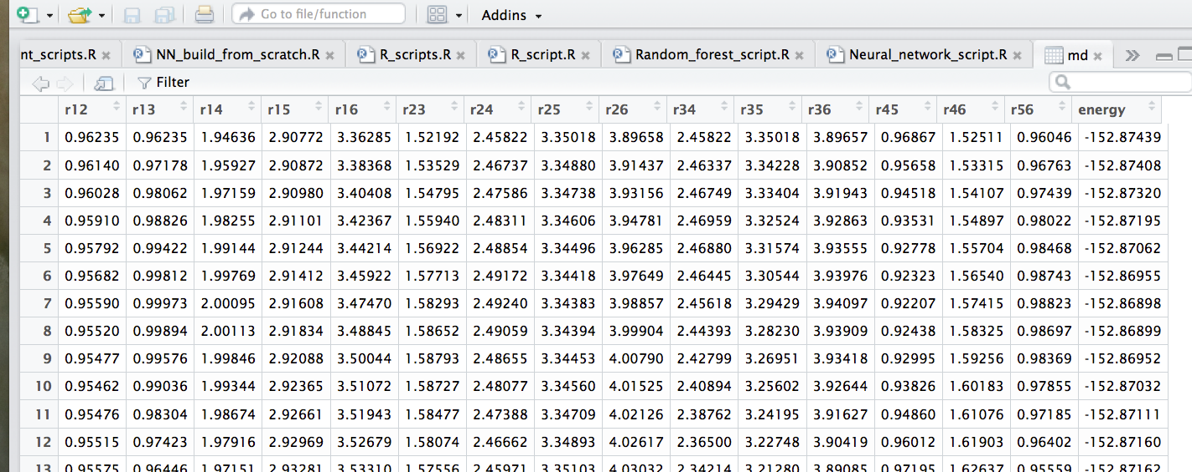
Our dataset
Dimension: 10,000×(15+1)
.
.
.
10,000 configurations: generated with QM/MM method.

Slide 5
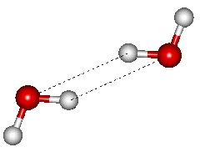
Representation
15 distances:
9 inter-molecular
6 intra-molecular
Distances were only considered as the input variables.
Potential energy is the response variable.
r34
r13
r12
r23

Slide 6
Learning methods
Random forest
R package ‘randomForest’
Parameters: mtry=5, ntree=500
Neural Net
R package ‘neuralnet’
Parameters: 1 hidden layer, 5 Neurons, threshold = 0.05, stepmax = 1e+08, rep = 1, act.fct = ‘tanh’
Custom Neural Net

Slide 7
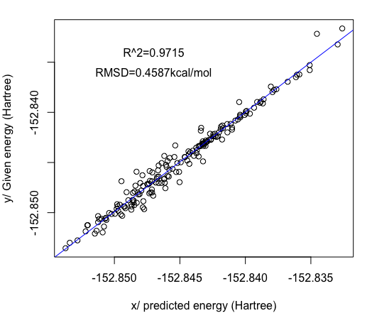
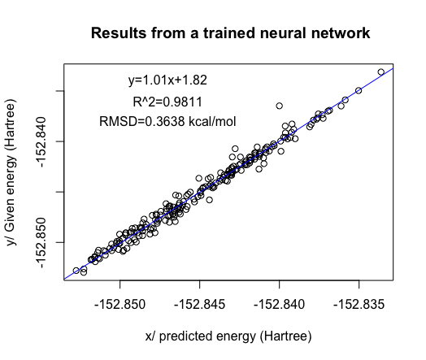
Results: RF vs. NN
Figure 1. Random forest testing results.
Figure 2. Neural network testing results

Slide 8
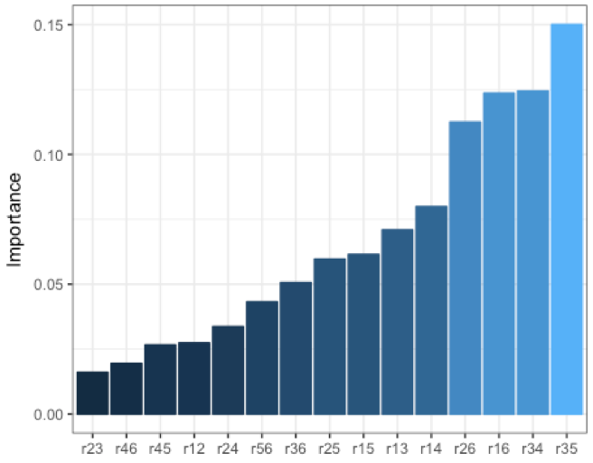
Variable importance
Inter-molecular
Intra-molecular
Choose 9 input variables instead of 15.
Figure 3. Importance plot of 15 input variables from NN.

Slide 9
Custom Neural Net Parameters
Initial weights
Random normal distribution
Initial bias
All zeros
One hidden layer with 10 or 50 neurons
Learning rate: 0.01
Regularization rate: 0.0001
Activation function
Sigmoid function
Loss function
Mean squared error + L2 regularization

Slide 10
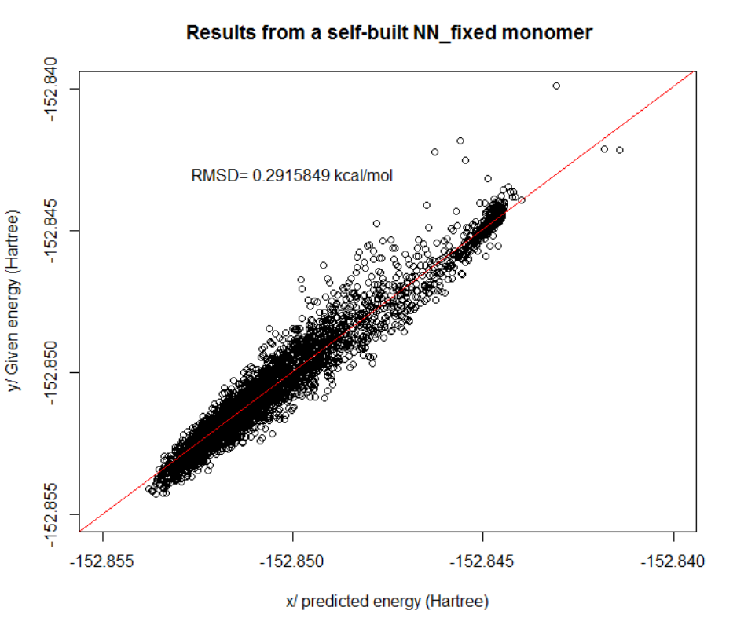
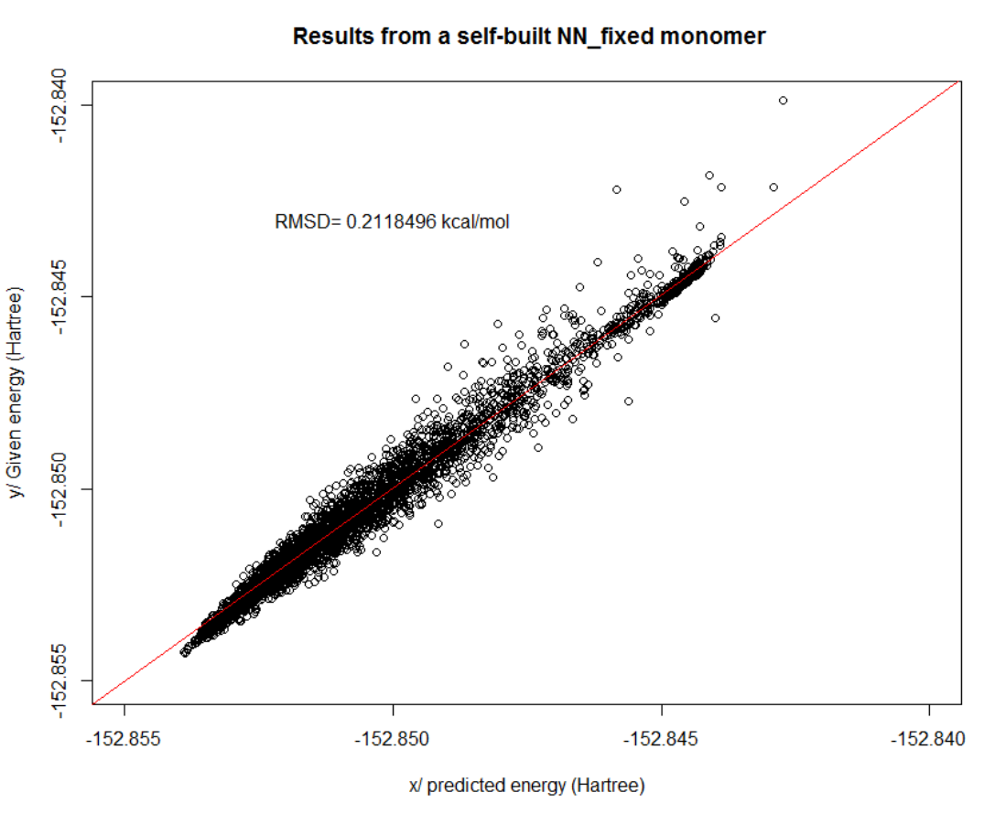
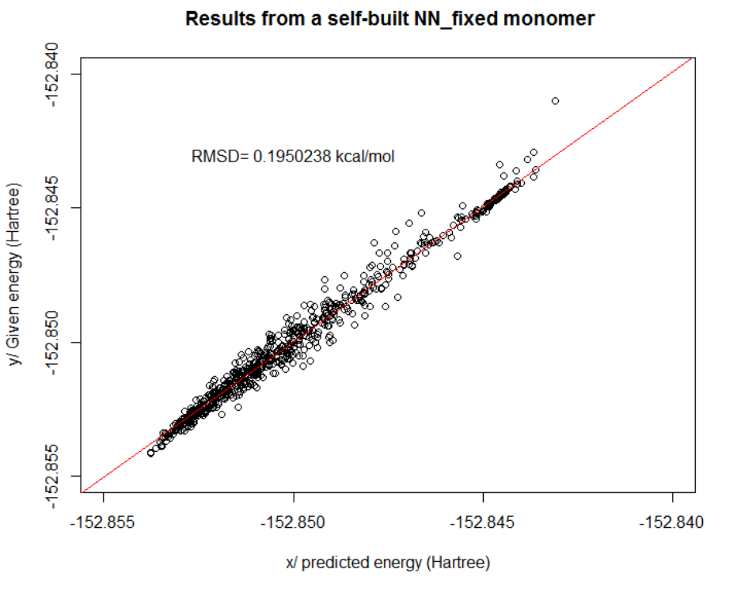
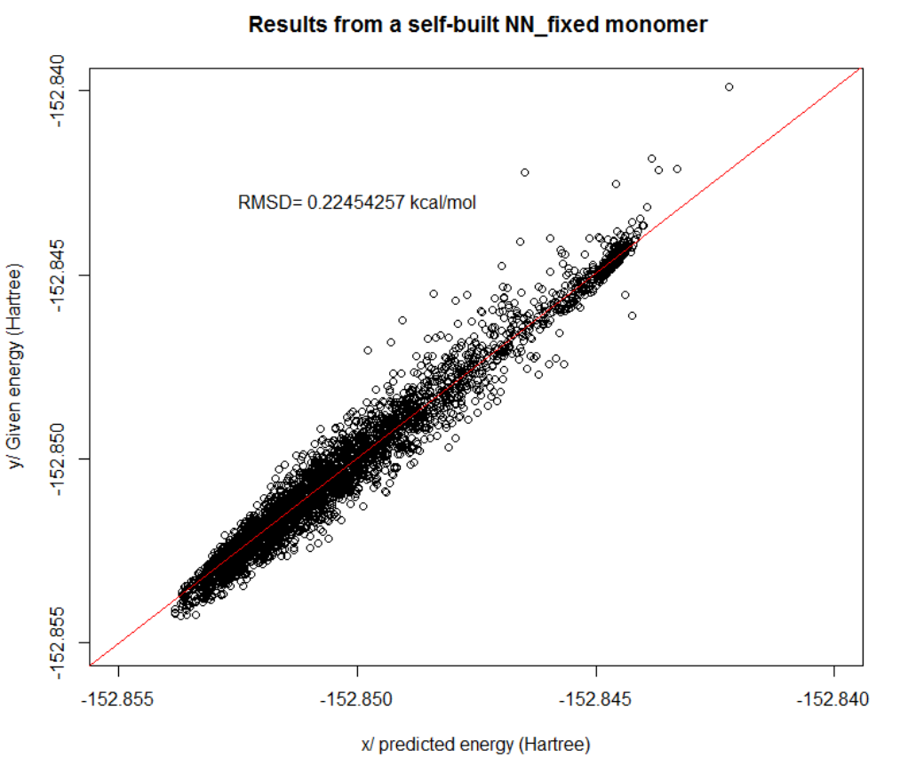
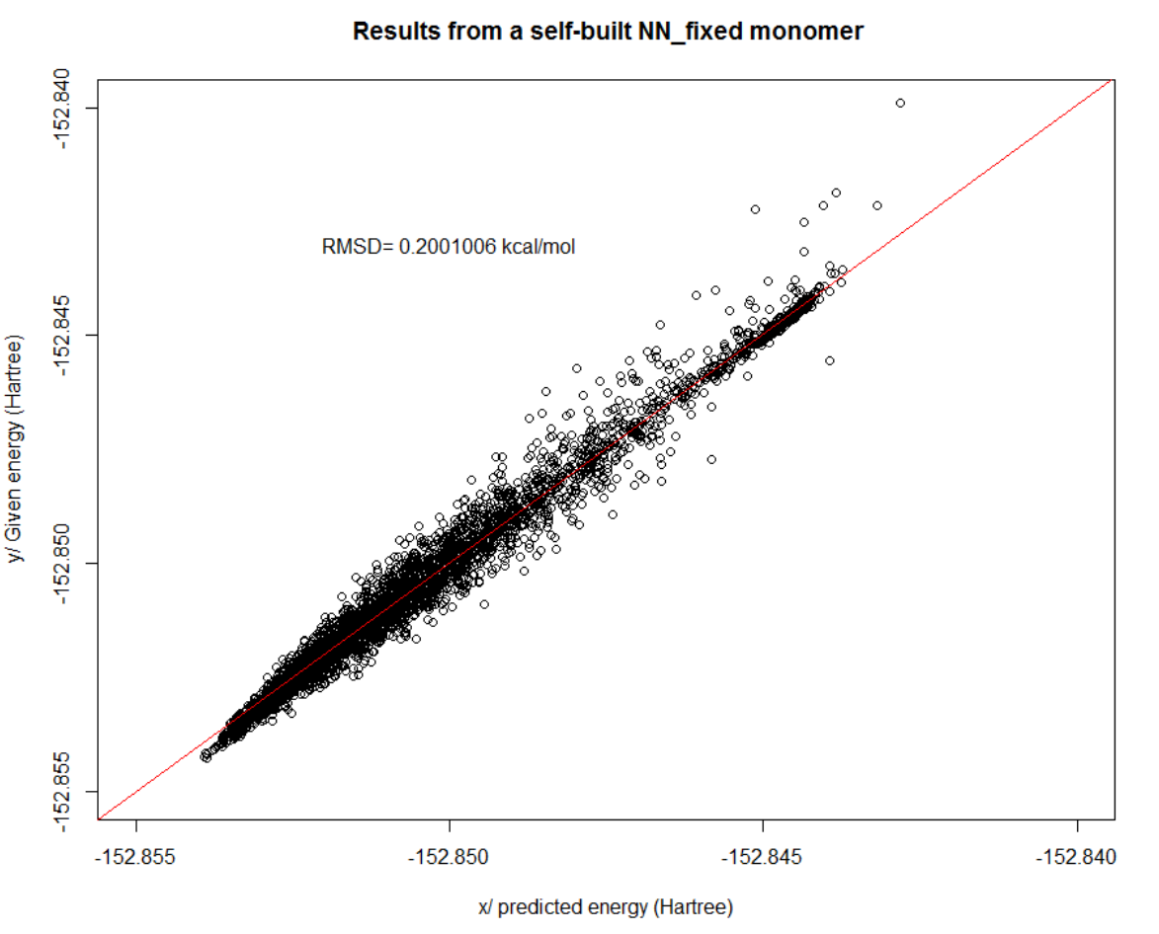
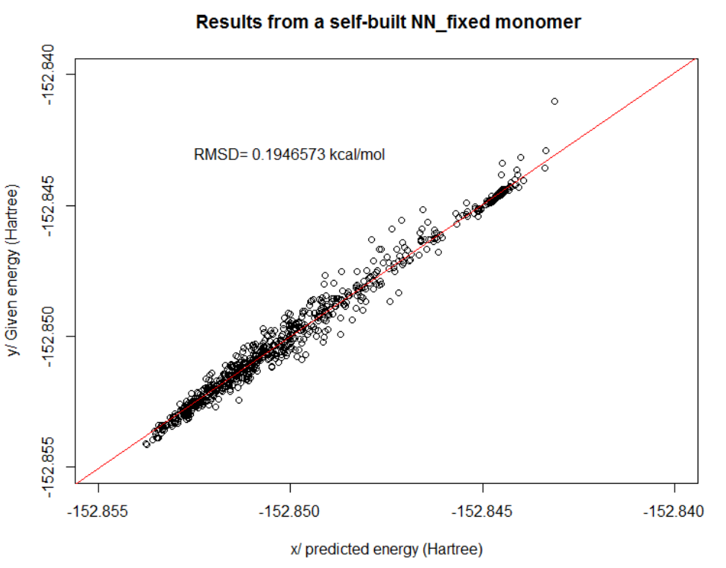
Custom Neural Net Results
RMSD=0.292kcal/mol
RMSD=0.212kcal/mol
RMSD=0.195kcal/mol
10
Hidden neurons
RMSD=0.225kcal/mol
RMSD=0.200kcal/mol
RMSD=0.194kcal/mol
50
1
5
10
Epoch (millions)

Slide 11
Data table summary
RMSD values | 1m steps | 5m steps | 10m steps
10 neurons | 0.292 kcal/mol | 0.212 kcal/mol | 0.195 kcal/mol
50 neurons | 0.225 kcal/mol | 0.200 kcal/mol | 0.194 kcal/mol

Slide 12
Conclusions
Neural networks work better than random forest on reproducing water dimer potential energy.
We developed an neural network script that can be used to train predictive models with larger amount of input data (~10k) than neuralnet package.
ML can accurately reproduce water dimer potential energy with RMSD< 1 kcal/mol.

Slide 13
Future work
Perform the bagging of all trained models to improve the prediction performance
Run even longer iterations to check and solve the over-fitting issues
Apply stacking to make the prediction more accurate through combining different types of methods (i.e. NN, regression, RF, SVM)

Slide 14
Questions?

Slide 15
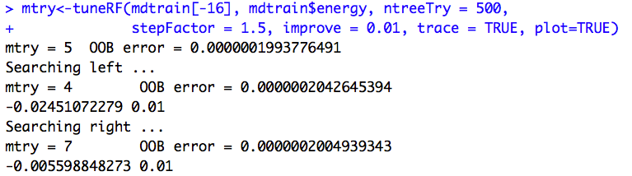
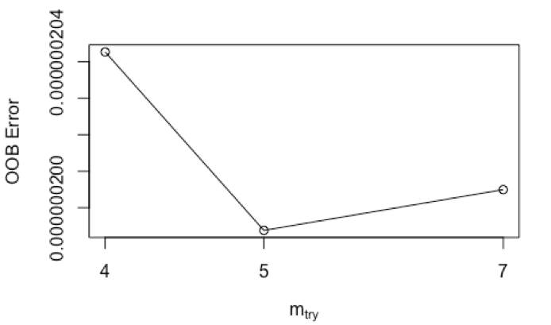
Supplemental material
mtry is the
number of variables randomly sampled as candidates at each node split.

Slide 16
Compute NN loss
# compute the loss, (mean squrared error).
diff<-score-Y;
data.loss<-(t(diff)%*%diff)/(2*batchsize)
# L2 regularization: add 1/2λW^2 for each W (where λ is the strength).
reg.loss<-0.5*reg*(sum(W1*W1)+sum(W2*W2))
loss<-data.loss+reg.loss
L2-norm loss function is also known as least squares error (LSE). It is basically minimizing
the sum of the square of the differences (S) between the target value (Y_{i}) and the estimated values (f(x_{i})

Slide 17
Backward propagation:
dscores<-2*(score-Y);
dscores<-dscores/batchsize;
dW2<-t(hidden.layer)%*%dscores;
db2<-colSums(dscores);
dhidden<-dscores%*%t(W2);
dW1 <- dhidden * (hidden.layer * (1-hidden.layer))
dW1 <- t(X) %*% dW1
db1 <- dhidden * (hidden.layer * (1-hidden.layer))
db1 <- colSums(db1)
### update weigths and bias:
dW2<-dW2+reg*W2;
dW1<-dW1+reg*W1;
W1<-W1-lr*dW1;
b1<-b1-lr*db1;
W2<-W2-lr*dW2;
b2<-b2-lr*db2;

