Slide 1
Computational and Theoretical Chemistry Research
Yihan Shao Group

Slide 2

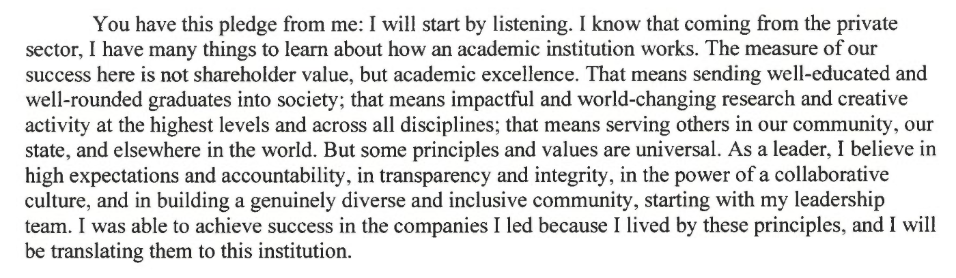
Message from President-Designate Gallogly

Slide 3
Goals for Ph.D. Students
Independent
Think independently
Manage time well
Give professional presentations
Computational and
Know how to use software
Have at least basic programming skills
Theoretical
Familiar with the basic theories
Familiar with advanced theories in your particular research area
Familiarity = know the advantage/disadvantage of each method + derive basic equations + write pseudo-code
Chemist
Know the experimental setup
Interpret experimental measurements (including errors)

Slide 4
(Research) Time Management
Expected research hours per week
10 hours for undergraduate students
Up to 30 hours for GTAs
40 hours for GRAs and Postdocs
Research activities
Read papers and books on the research topic
Derive equations
Write codes
Prepare and perform calculations
Analyze results, prepare tables/figures
Write reports and manuscripts
Discuss research projects with other group members
Attend group and external meetings

Slide 5
Time-Management Questions
Am I expected to come to the lab during normal working hours each day?
Yes, unless you’ve demonstrated that you can get work done independently and timely
Am I expected to come to the lab during the evenings and weekends?
That depends where you have the highest working efficiency

Slide 6
Weekly Meetings
Everyone
Print the latest tables/figures
Bring a list of scientific/technical issues, and if possible, potential solutions
Come with a brief plan for the immediate work
Email Yihan, when I am on travel
Ph.D. graduate students
Read N papers/chapters each week
N = 2, pre-candidacy; 1, otherwise
Upload papers (with highlights and comments) to github
Discuss the papers during the weekly meeting

Slide 7
Group Meetings
Frequency of presentations
Graduate students and postdoc
1 research talk + 1 literature talk, per semester
Undergraduate/rotation student
1 general discussion about the topic (led by Yihan, first 2 weeks)
1 research talk (20-30 minutes, last 3 weeks)
A practice talk at least 2 weeks before external talks
Feedback should be given on both the content and delivery
Email slides to Yihan
2+ days before the group meeting
Everyone is expected to ask at least N questions
N=2 for graduate students and postdocs
N=1 for undergraduate students

Slide 8
Scientific Meetings
Graduate students and postdocs
x national and y local meeting each year
Budget: z USD (full time), 2z/3 (shared) each year
Undergraduate students
One meeting for key contributions to a co-author paper
A poster or oral presentation is expected
Present work to the group 2+ weeks before the meeting
Send poster file to Yihan 7+ days before the meeting
A short presentation after the meeting
Feedback to your poster/talk
1+ interesting talks from the meeting

Slide 9
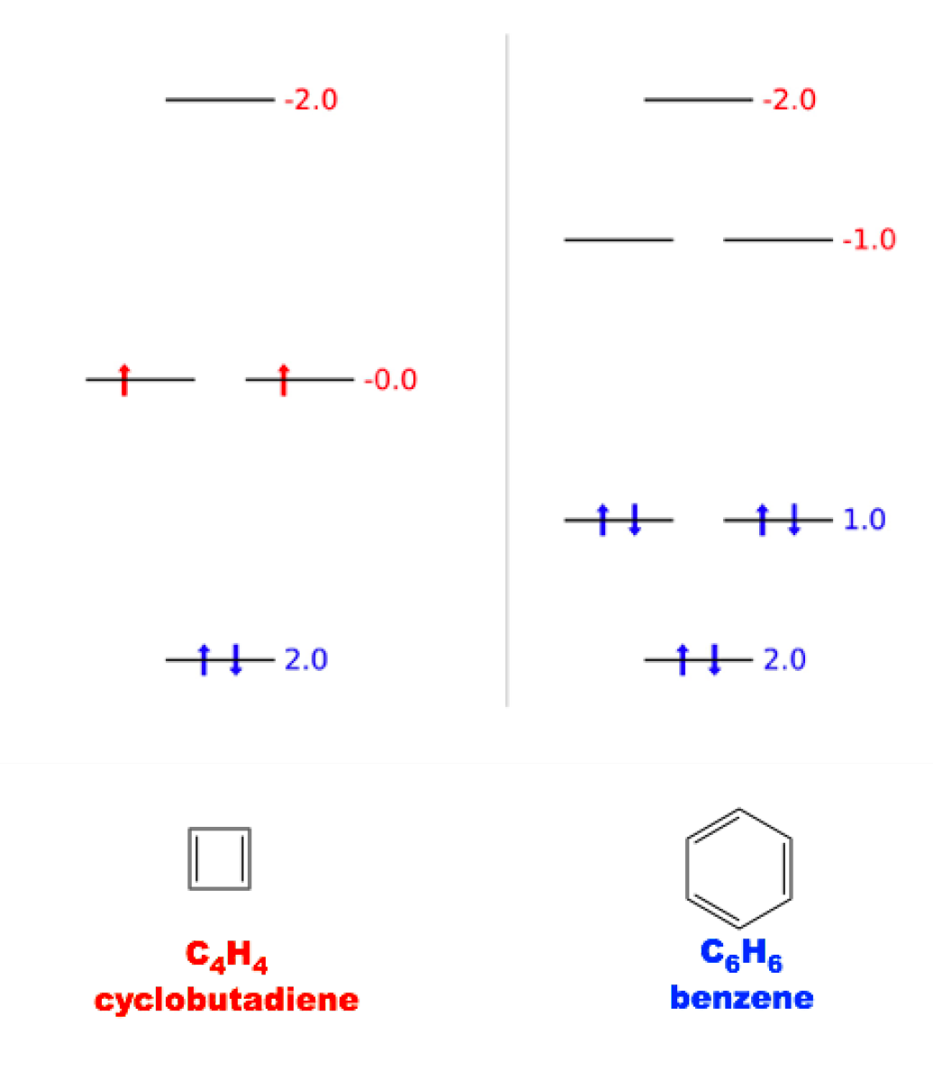
Monthly Programming Task
Show code at the last group meeting each month (graduate students)
April 2018
Compute the Hueckel spectrum of C₄H₄ and C₆H₆
Make orbital diagrams
See math_1117.pdf.

