Slide 1
Computational Studies of geminal-Diol Cleavage and Mercury Transfer

Slide 2
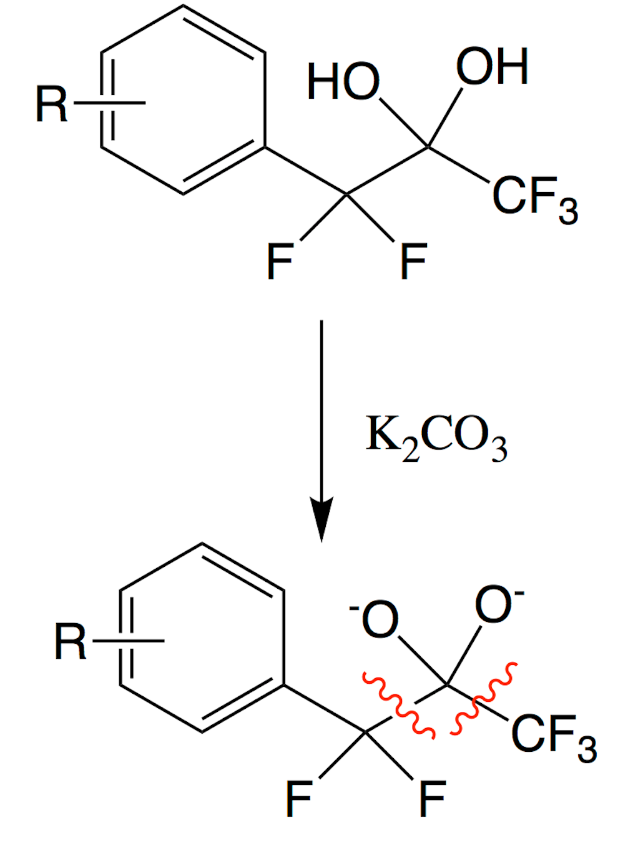
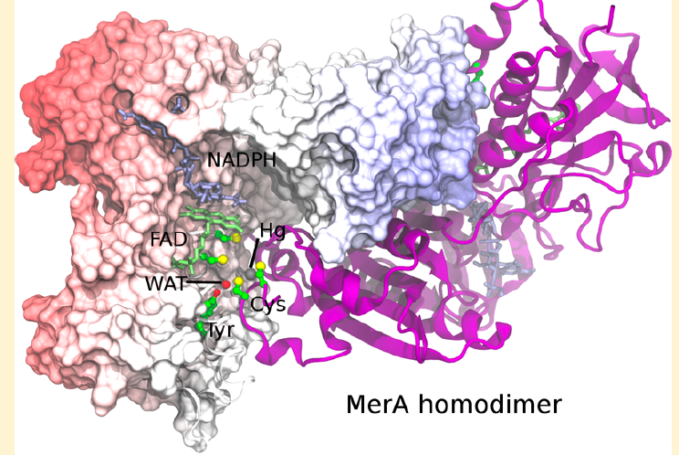


Outline
David Colby
University of Mississippi
Jerry Parks
Oakridge National Lab

Slide 3
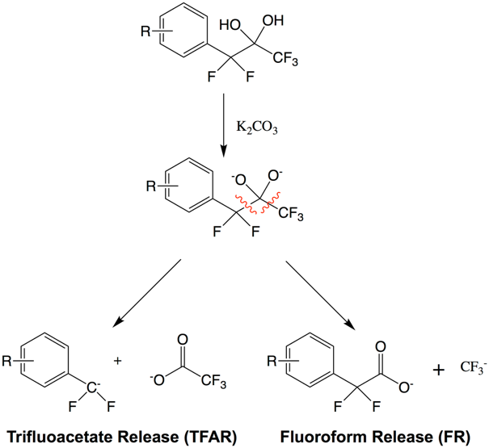
geminal-diol cleavage

Slide 4
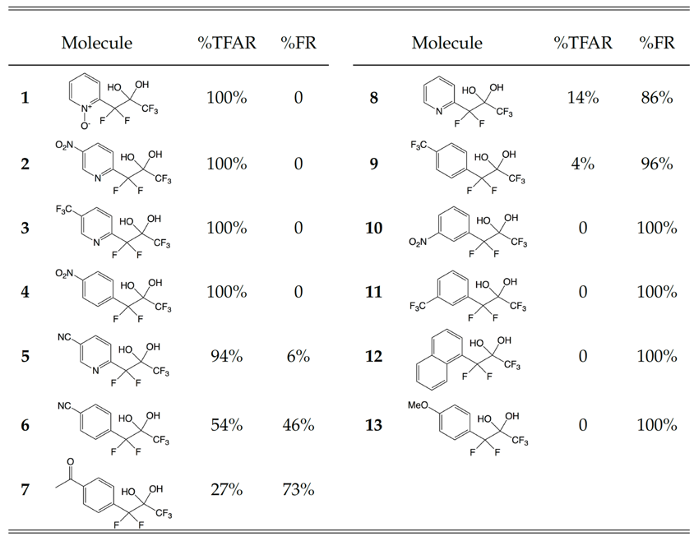
Selective Cleavage

Slide 5
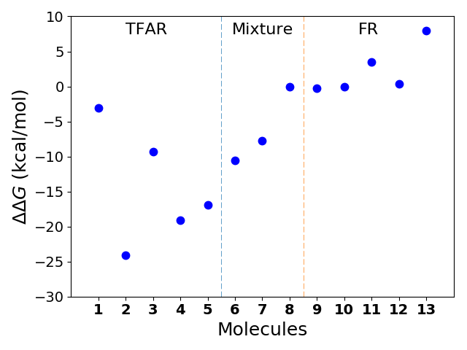
Relative free energy between TFAR and FR products

Slide 6
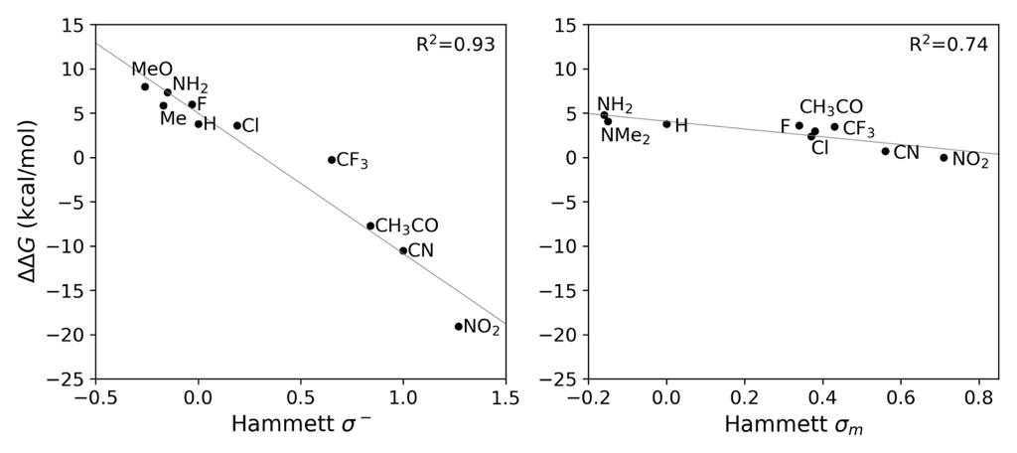
Relative free energy between TFAR and FR products

Slide 7
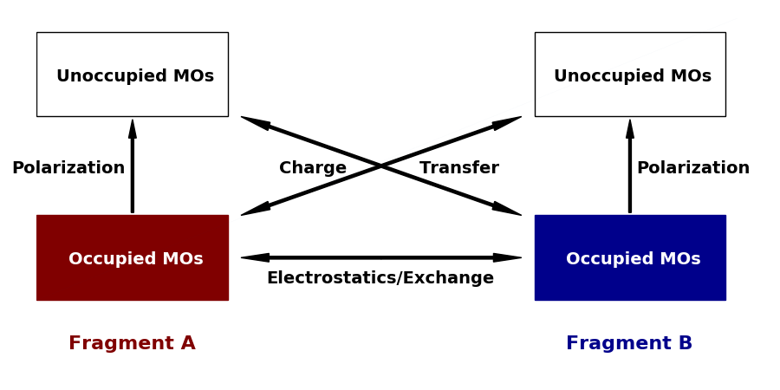
Energy Decomposition Analysis (EDA)

Slide 8
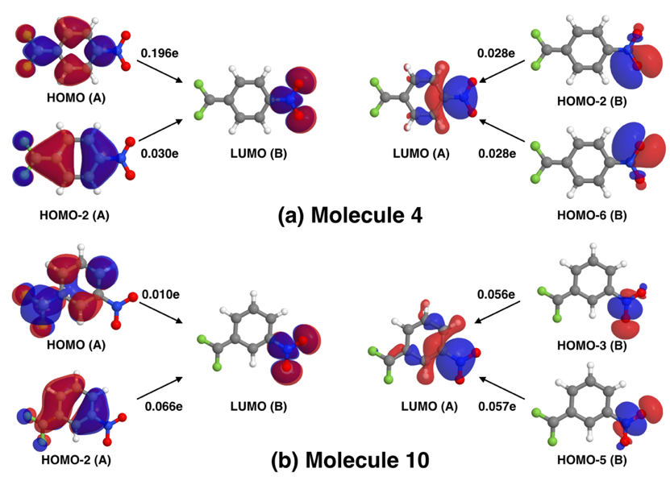
Intramolecular Charge-Transfer

Slide 9
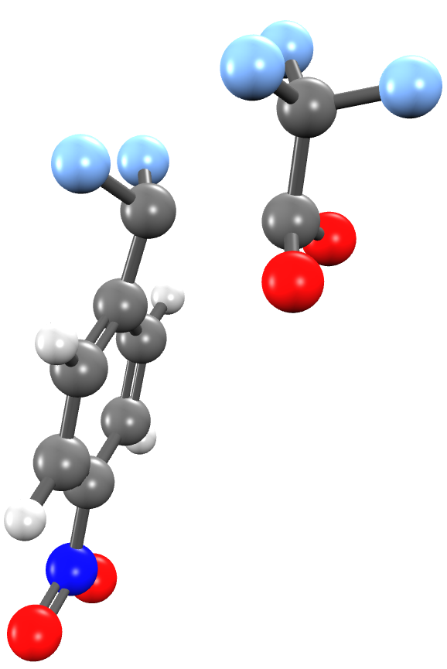
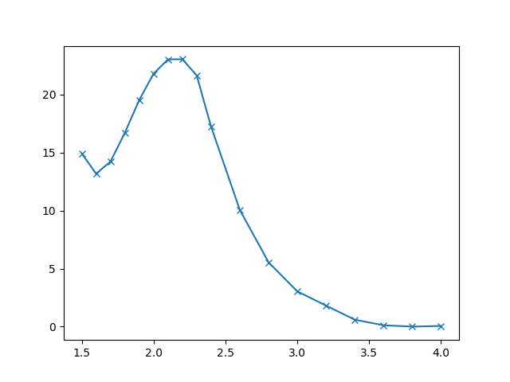
Reaction Mechanism
It has been difficult to find the transition state…

Slide 10
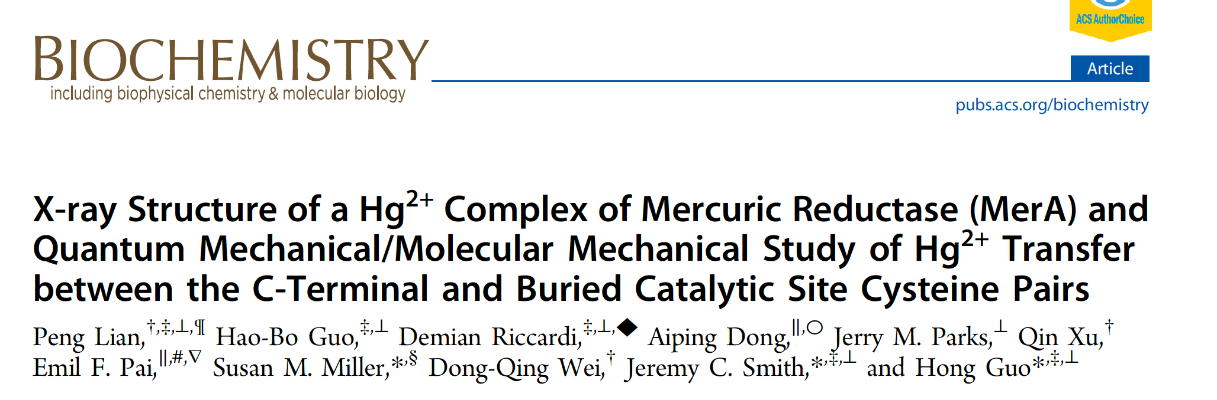
Background

Slide 11
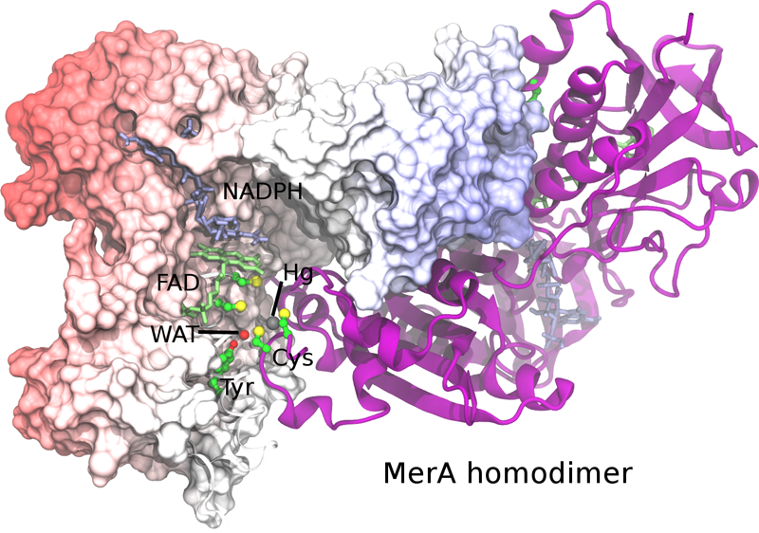
Mercuric Reductase A (MerA)

Slide 12
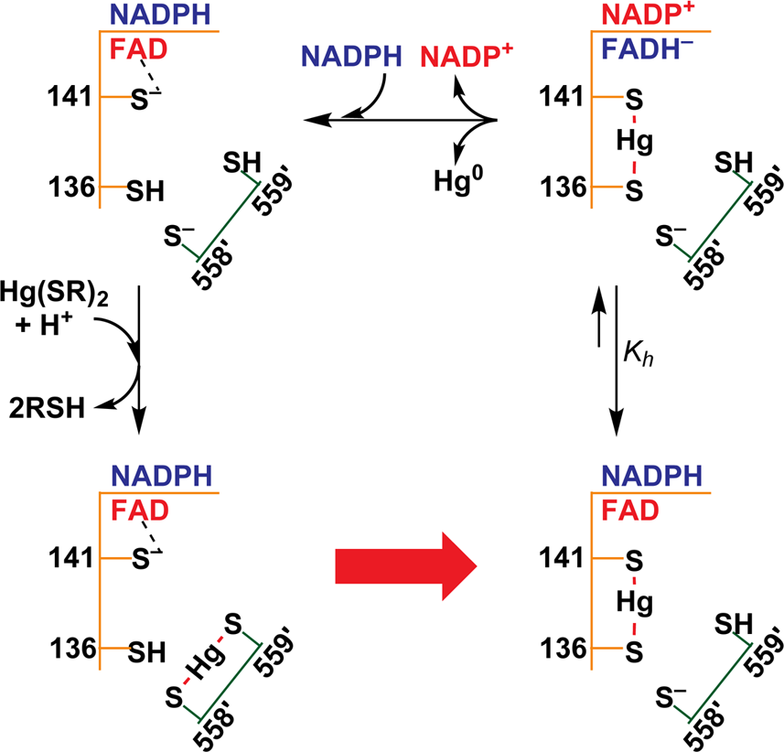
Hg²⁺ Transfer and Reduction in the MerA core

Slide 13
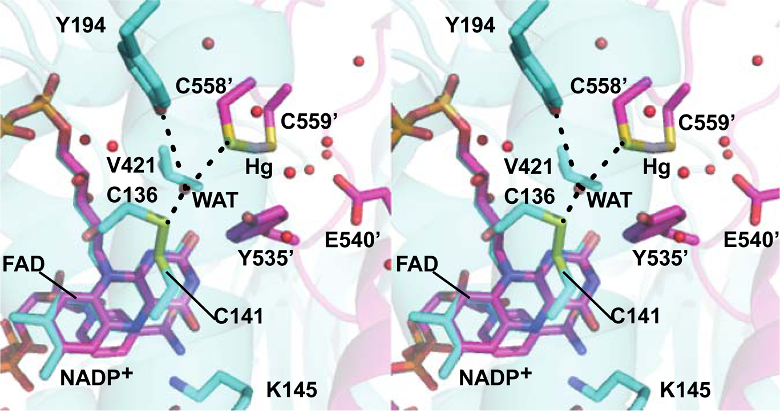
Reactant Structure

Slide 14
Minimum Energy Pathway

Slide 15
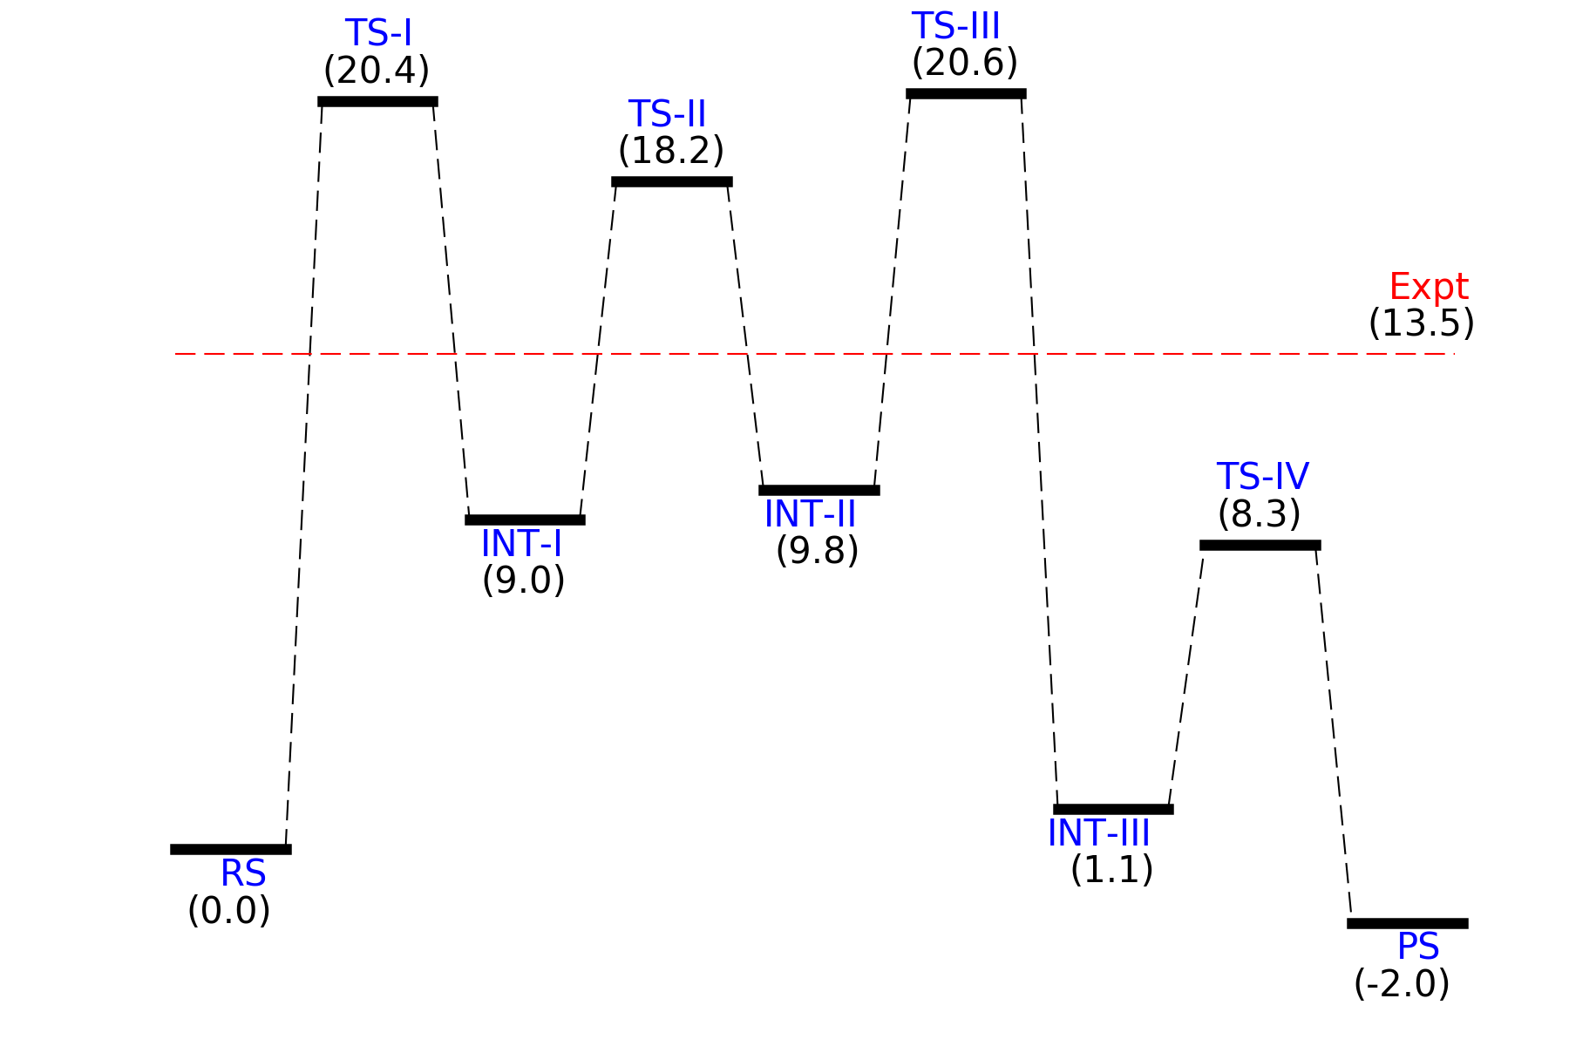
Minimum Energy Pathway

