Slide 1
Data Science in Action:
A Clinical Trial

Slide 2

#1 Give Consent
Print and sign your name agreeing to be a subject in this clinical trial
Giving consent means agreeing to be a subject in a randomized study and you are aware that you will be asked to read something and then asked to make a food choice. There are no right or wrong answers, and you can stop at anytime.

Slide 3


#2 Be Randomized
Reach into the bag and pull out a paper ticket at Random
  If Green you are in Green Group
  If Black you are in Black Group

Slide 4

#3 Intervention
Read item in Envelope that corresponds to your Group

Slide 5
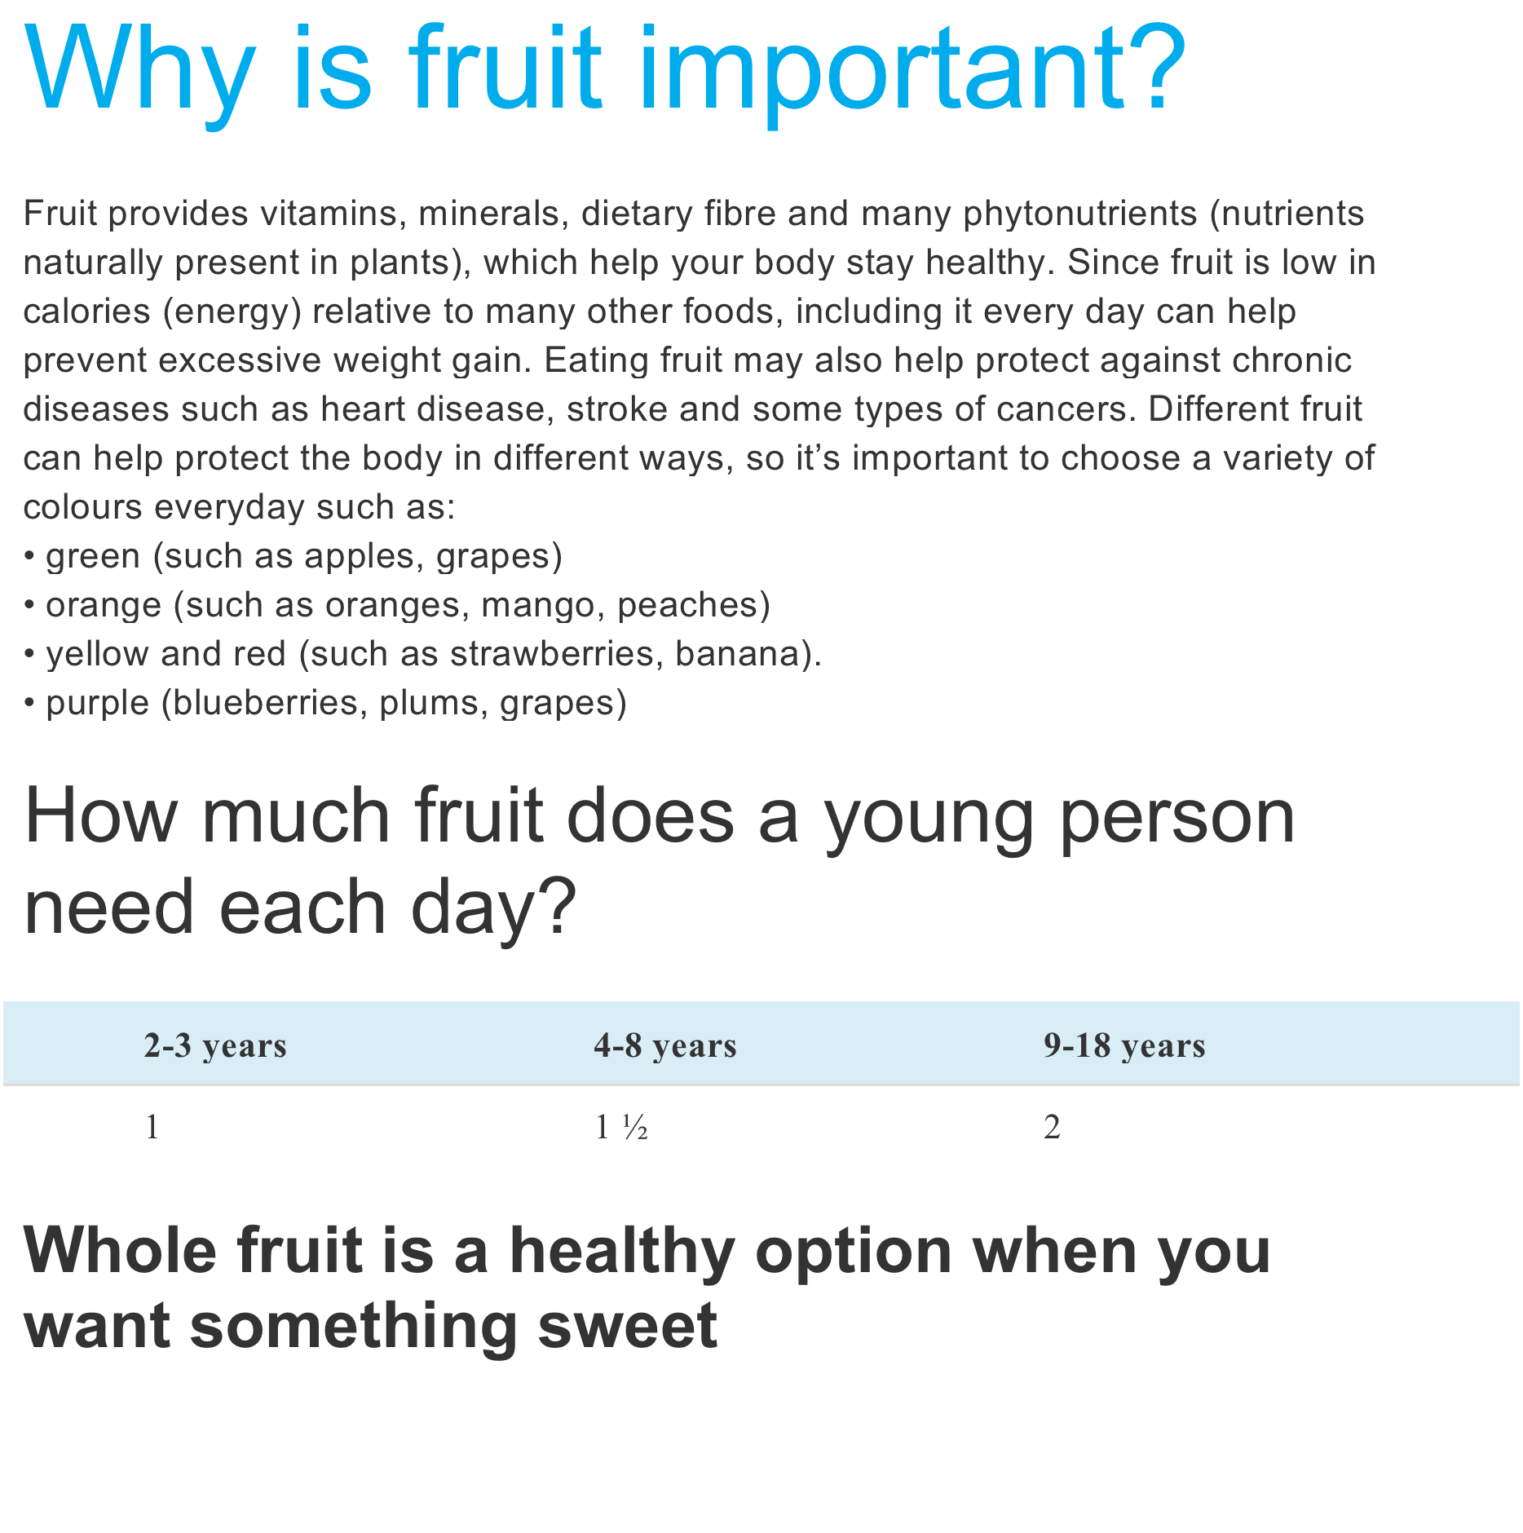
Green Intervention

Slide 6
The Candy Man
Who can take a sunrise (who can take a sunrise)
Sprinkle it with dew (sprinkle it with dew)
Cover it with choc'late and a miracle or two
The Candy Man (the Candy Man)
Oh, the Candy Man can (the Candy Man can)
The Candy Man can
'Cause he mixes it with love
And makes the world taste good (makes the world taste good)
Who can take a rainbow (who can take a rainbow)
Wrap it in a sigh (wrap it in a sigh)
Soak it in the sun and make a groovy lemon pie
The Candy Man (the Candy Man)
The Candy Man can (the Candy Man can)
The Candy Man can
'Cause he mixes it with love
And makes the world taste good (makes the world taste good)
Black Intervention

Slide 7
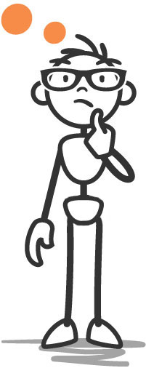
#4 Choose
Take candy or fruit
NOTE: you can only take
one or the other, not both

Slide 8
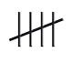

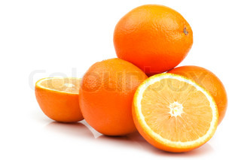
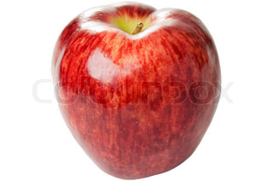
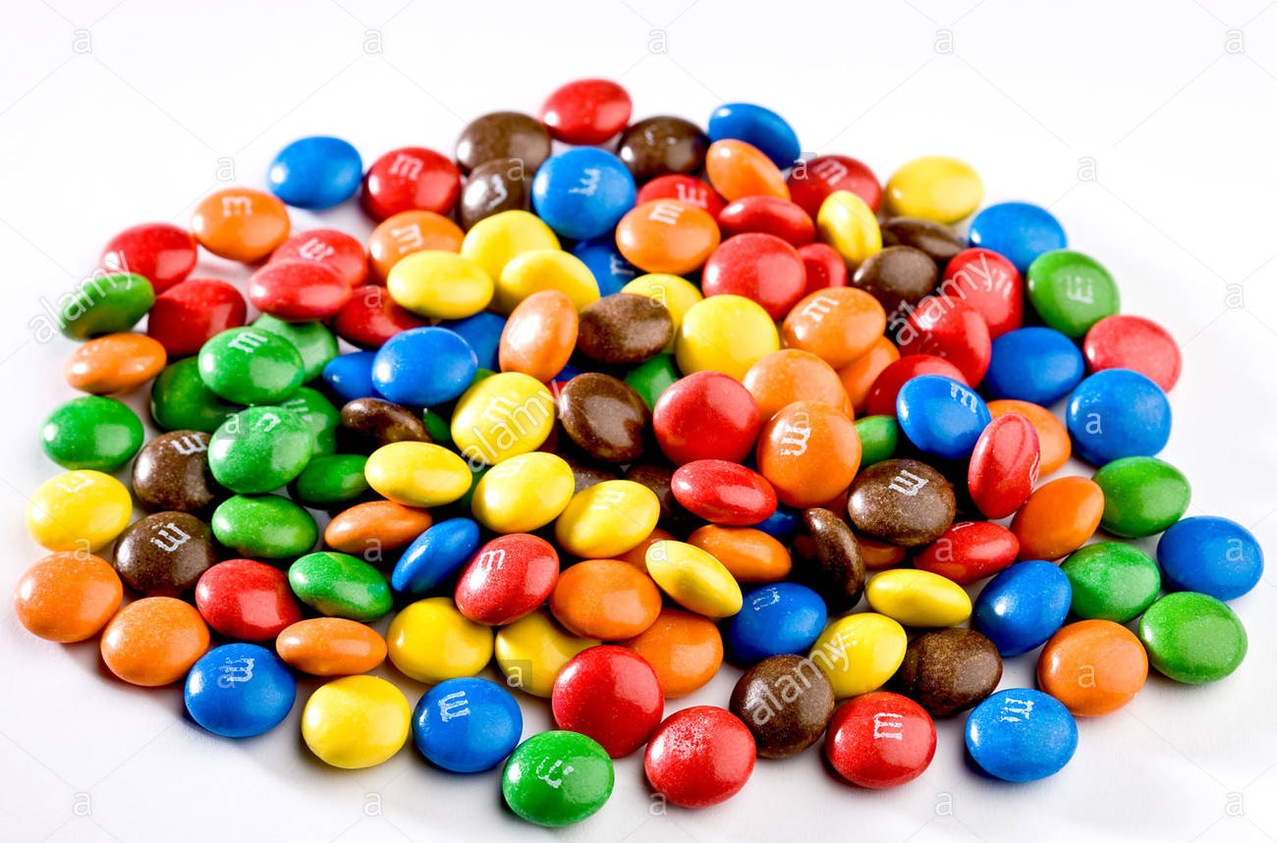
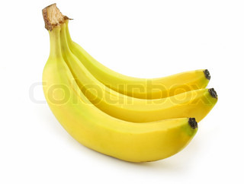
#5 Record your choice
Put a tick mark on the board under your group whether you chose candy or fruit

Slide 9
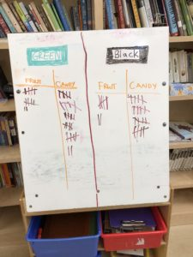
Kids in each intervention group recorded their choice throughout the day

Slide 10
What do you think the Research Question was in this Clinical Trial?
A. Do people like candy?
B. Can people read advertisements?
C. If people read an advertisement about healthy eating are they more likely to choose fruit?
Answer: C

Slide 11
Does the intervention work?
Do you think there is enough evidence based on the current data to say that people who read about healthy eating are more likely to choose fruit?
How could we use our data to answer this question?

Slide 12
Results at the End of the Day
(throughout the day, the numbers fluxuated as additional kids were enrolled)
N=63 kids participated
39 randomized to GREEN
27 randomized to BLACK
  12/39 = 30.7% of the Green group chose fruit after the intervention
  7/27 = 25.9% of the Black group chose fruit after the intervention
Difference: 4.8% higher proportion of fruit chosen in Green group but
95% Confidence interval (-20.3%, 30.0%)
p-value = 0.88
No statistically significant evidence that intervention worked
IN R:
prop.test(x = c(12, 7), n = c(39, 27))
2-sample test for equality of proportions with continuity correction
data: c(12, 7) out of c(39, 27)
X-squared = 0.022741, df = 1, p-value = 0.8801
alternative hypothesis:
two.sided95 percent confidence interval:
-0.2026907 0.2995568
sample estimates:
prop 1 prop 2
0.3076923 0.2592593

