Slide 1


Slide 2
Big Data
Imaging
Electronic Medical Records
Personal device monitoring

Slide 3
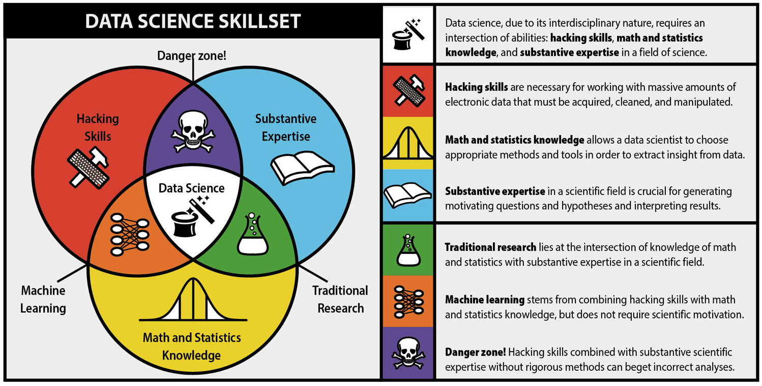
Mental Health Data Science
Providing biostatistical knowledge and innovation including new machine learning methods combined with solid data management for new discoveries in psychiatric research
http://berkeleysciencereview.com/how-to-become-a-data-scientist-before-you-graduate/

Slide 4
Machine Learning
Supervised learning
Prediction methods – Given predictors (“features”) and disease status (“labels”) for a group of people…predict what the next person disease status is based on predictors.
Unsupervised learning
Clustering methods – Given many different features on people, sort them into groups that are most similar. “Labels” are unknown on everyone before.

Slide 5
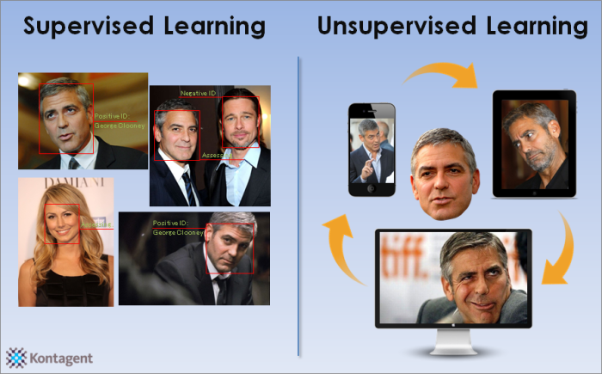

Slide 6
Today’s symposium
Brain imaging data as the features

