Slide 1
Multivariate analysis of brain imaging data in mental disorders
Melanie M Wall, PhD
Discussant
Mental Health Data Science
Department of Psychiatry
Columbia University and the New York State Psychiatric Institute
JSM 2018 Vancouver

Slide 2
Session description
Brain imaging technology has the potential of unraveling the complex mechanisms of mental disorders. The key statistical challenge in analyzing data from various imaging technologies is dealing with high-dimensional correlated multivariate data. This session will present research on new methods based functional data analysis, mixed-effects model, time-series analysis and eigenvalue estimation can be used to answer research questions on mental health disorders using brain imaging data.

Slide 3
Speakers
Adam Ciarleglio – George Washington University
  Scalar-on-Function Prediction Models with Missing Covariates: Applications in Depression Research Using EEG and Clinical Data
Shuo Chen – University of Maryland
  Association between whole brain N-Acetylaspartate concentration and blood cholesterol using high-resolution magnetic resonance spectroscopy data
Yize Zhao – Weill Cornell Medical College
  Genome-wide heritability analysis with high dimensional imaging phenotypes
Samprit Banerjee - Weill Cornell Medical College
  Discovering depression subtypes with high-dimensional eigenvalue estimation on resting-state fMRI data

Slide 4
This discussion will be an overview of neuroimaging modalities
EEG
MRI
  Structural MRI
  Functional MRI – functional connectivity
  Diffusion MRI (diffusion tensor imaging - DTI) – structural connectivity
  Magnetic Resonance Spectroscopy (MRS) – metabolites

Slide 5
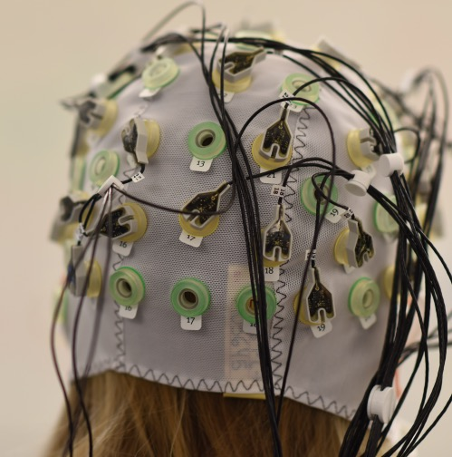
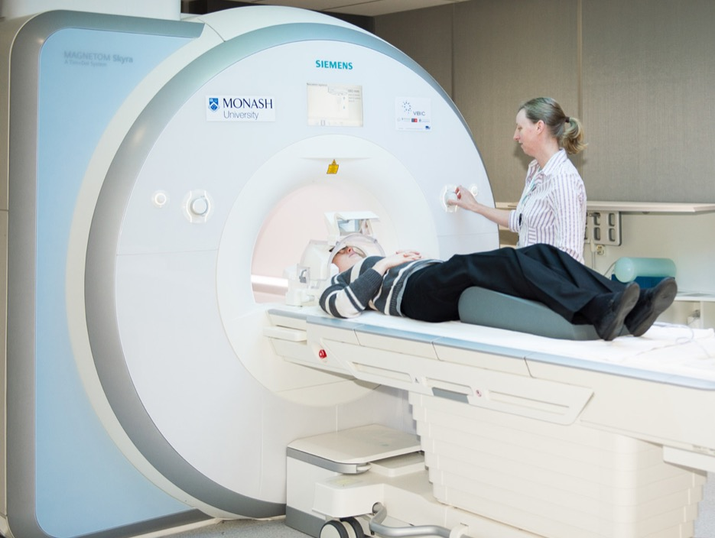
EEG - electroencephalography
MRI - Magnetic Resonance Imaging

Slide 6
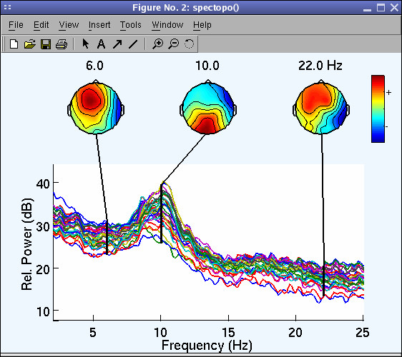
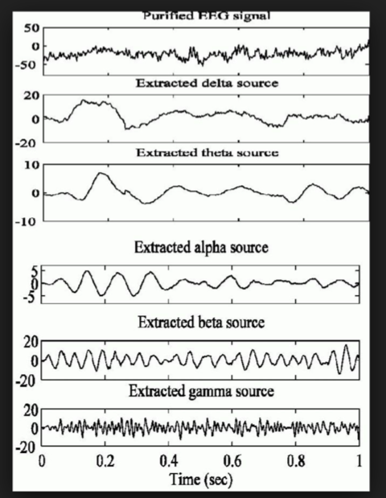
EEG – measures electrical signals in the brain
The brain is an electrical system – all of our thoughts (conscious or otherwise) are generated through a network of neurons, that send signals to each other with the help of electrical currents.
Low spatial resolution – electrode locations
The billions of neurons in the human brain have highly complex firing patterns, mixing in a rather complicated fashion. The neural oscillations that can be measured with EEG are a mixture of several underlying base frequencies, which are considered to reflect certain cognitive, affective or attentional states: frequency bands: Delta band (1 – 4 Hz), theta band (4 – 8 Hz), alpha band (8 – 12 Hz), beta band (13 – 25 Hz) and gamma band (> 25 Hz).
Very high resolution across Time
https://imotions.com/blog/eeg-vs-mri-vs-fmri-differences/

Slide 7
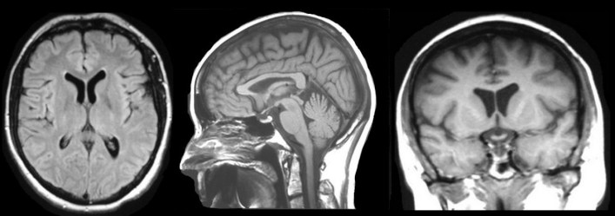
Structural MRI – measure size, shape of all the different brain regions
MRI provides exquisite detail of brain, spinal cord and vascular anatomy, and has the advantage of being able to visualize anatomy in all three planes: axial, sagittal and coronal. T1 weighted images is the most common way to get the structure, T2 weighted images and Flare are also done to map the structure
From http://casemed.case.edu/clerkships/neurology/Web%20Neurorad/MRI%20Basics.htm

Slide 8
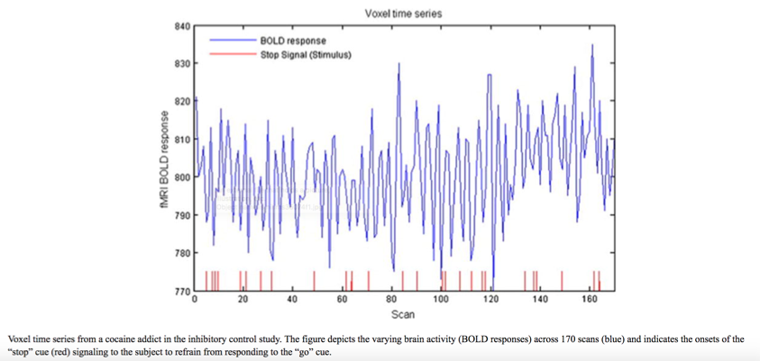
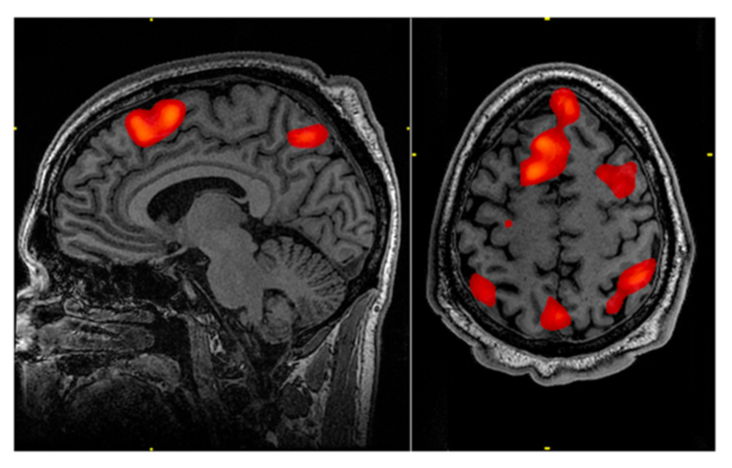
Functional MRI - fMRI – measures times series of blood flow in all the different brain regions (at voxels)
If there is more oxygenated blood in one part of the brain compared to others, then chances are that this brain area is more active. This is known as the Blood-Oxygenation Level Dependent response (otherwise known as BOLD).
Two common research objectives with fMRI:
TASK BASED fMRI - detecting brain regions that reveal task-related alterations in measured brain activity (activations)
RESTING STATE fMRI - identifying highly correlated brain regions that exhibit similar patterns of activity over time (functional connectivity).
Bowman FD, Guo Y, Derado G. Statistical approaches to functional neuroimaging data Neuroimaging Clin N Am. 2007 Nov;17(4):441-58, viii.
https://imotions.com/blog/eeg-vs-mri-vs-fmri-differences/

Slide 9
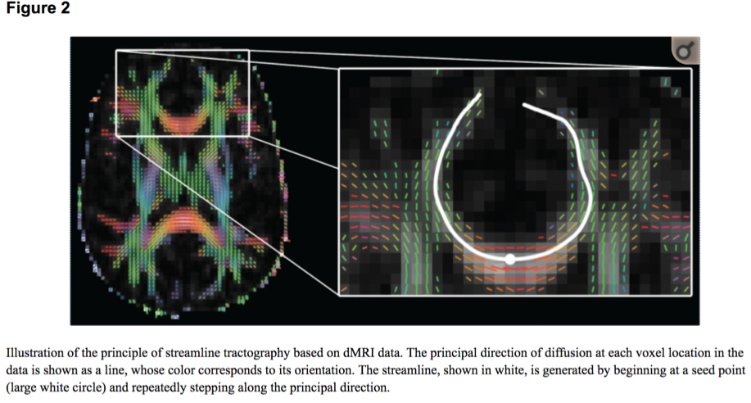
Diffusion MRI – dMRI – “Diffusion tensor imaging” – DTI measures motion of water molecules in neural tissue of white matter tracts where the axon budles are
Measures structural connectivity of White Matter
Example measures: Mean diffusivity (MD), fractional anisotropy (FA), mean tract length, and number of streamlines all derived from DTI data
These structural connectivity measures can be obtained at different locations delineated using deterministic tractography, within each resting state network (RSN)
“Although MRI is capable of producing highly detailed structural images of the human brain, the spatial resolution of clinical MRI is typically on the order of a millimeter. Neuronal axons, by contrast, are rarely more than a few microns in diameter; and it is therefore not possible to directly image axon bundles in the living brain using current technology. Nevertheless, entire white matter tracts, which can be several millimeters across, often have a coherent orientation in any particular part of the brain, and this is exploited by diffusion MRI (dMRI).” Clayden 2013.
Funct Neurol. 2013 Jul-Sep; 28(3): 197 – 203 . Imaging connectivity: MRI and the structural networks of the brain
Jonathan D. Clayden, PhD
https://www.ncbi.nlm.nih.gov/pmc/articles/PMC3812744/
White Matter Structural Connectivity Is Not Correlated to Cortical Resting-State Functional Connectivity over the Healthy Adult Lifespan Front. Aging Neurosci., 18 May 2017
https://www.frontiersin.org/articles/10.3389/fnagi.2017.00144/full

Slide 10
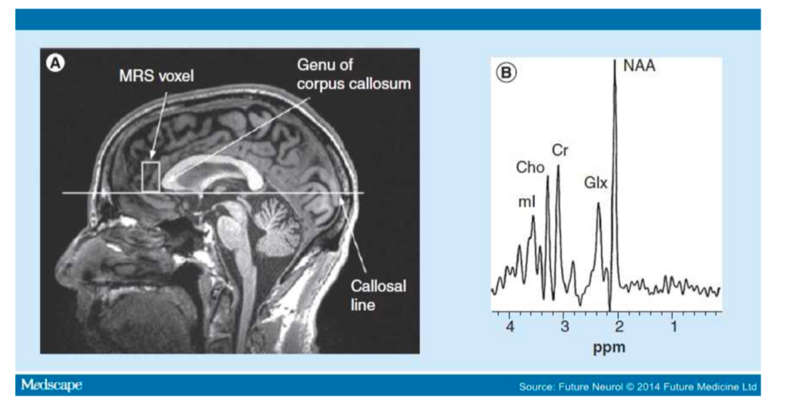
Magnetic resonance spectroscopy – MRS – measures metabolites in the brain
Each biochemical, or metabolite, has a different peak in the spectrum which appears at a known frequency. The peaks corresponding to each indicate how much metabolite is present at that location in the brain at a fixed time.
Choline, creatine, N-acetyl aspartate (NAA), Glx (glutamate, glutamine), inositol, gamma amino butyric acid (GABA) and phosphocreatine (PCr)

Slide 11
BIG BRAIN DATA
Each modality produces ENORMOUS sized data structure
Highly multivariate: (TIME)*(LOCATION)*(MULTIPLE MEASURES)
Great opportunities for statistical contributions in the area of multimodal imaging for understanding, preventing, and treating psychiatric disorders.

Slide 12

Get involved directly with substantive researchers!

Slide 13
Open Questions for the Speakers????

Slide 14
References
Liu, Sidong, Weidong Cai, Siqi Liu, Fan Zhang, Michael Fulham, Dagan Feng, Sonia Pujol, and Ron Kikinis. "Multimodal neuroimaging computing: a review of the applications in neuropsychiatric disorders." Brain informatics2, no. 3 (2015): 167-180.
Bowman FD, Guo Y, Derado G. Statistical approaches to functional neuroimaging data Neuroimaging Clin N Am. 2007 Nov;17(4):441-58, viii.

