Slide 1

PROJECT SCHEDULING AND RESOURCE PLANNING
Discussants:
Florence Buri
Rechele Espinosa
Brixlemar Noval
Marvin Rosas
Bevian Villantes

Slide 2
OBJECTIVES:
Understand the importance of project scheduling and resource planning in project success.
Define the key aspects of project scheduling and resource planning.
Describe how resources are planned, allocated, and managed in a project.
Realize the impact of good scheduling and resource planning on timely delivery, budget control, quality, and stakeholder satisfaction.

Slide 3

Why we study Project Scheduling and Resource Planning?
Project scheduling and resource planning are critical components of project management, ensuring projects are completed on time, within budget, and to the required quality. Effective scheduling and resource allocation enable project managers to optimize resource utilization, minimize delays, and manage project risks.

Slide 4

Project Scheduling
Project scheduling involves creating a detailed plan that outlines the sequence of activities, their start and end dates, the resources required, and the critical path. The goal is to establish a realistic timeline for project completion.

Slide 5
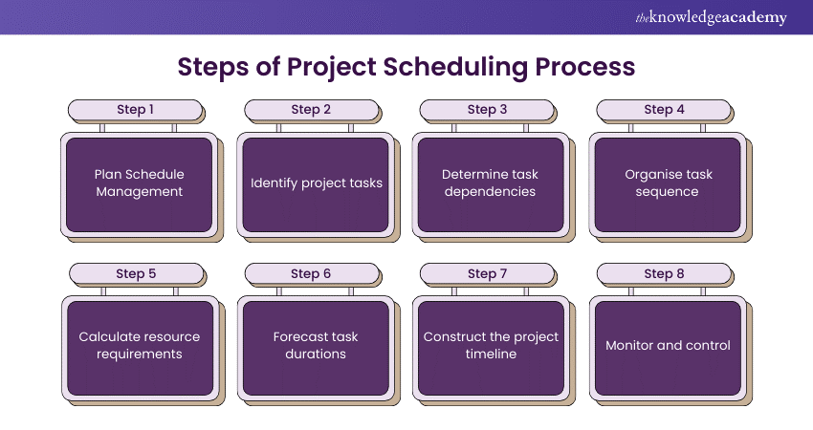

Slide 6
Key Aspects of Project Scheduling
Project Scheduling
Work breakdown Structure
Schedule development
Resource Allocation
Activity Sequencing

Slide 7
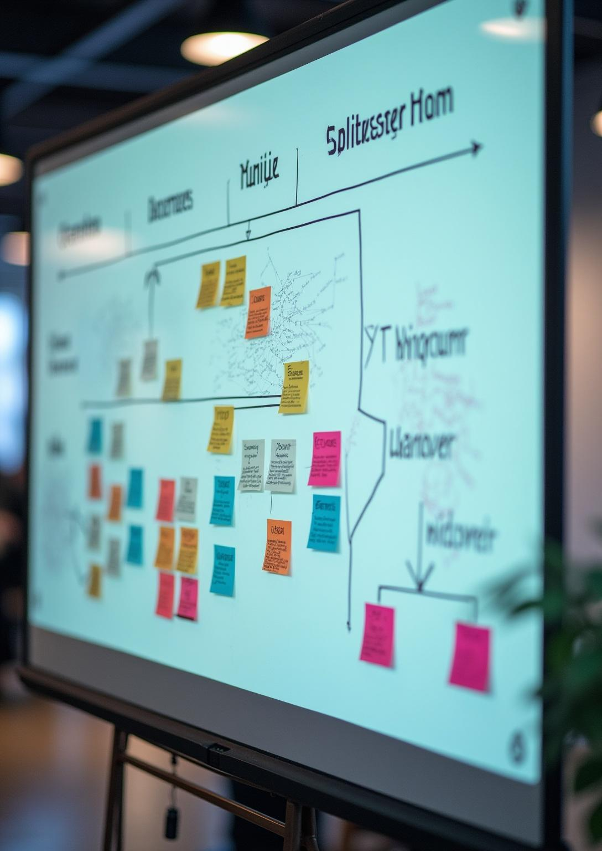
Work Breakdown Structure (WBS)
A hierarchical decomposition of the total scope of work to be carried out by the project team to accomplish the project objectives and create the required deliverables.
Purpose: Provides a clear and manageable structure for breaking down complex tasks into smaller, more manageable component.
Example: For a construction project, the WBS might include phases like "Planning," "Foundation," "Structure," "Finishing," and "Handover," each further divided into specific tasks.

Slide 8
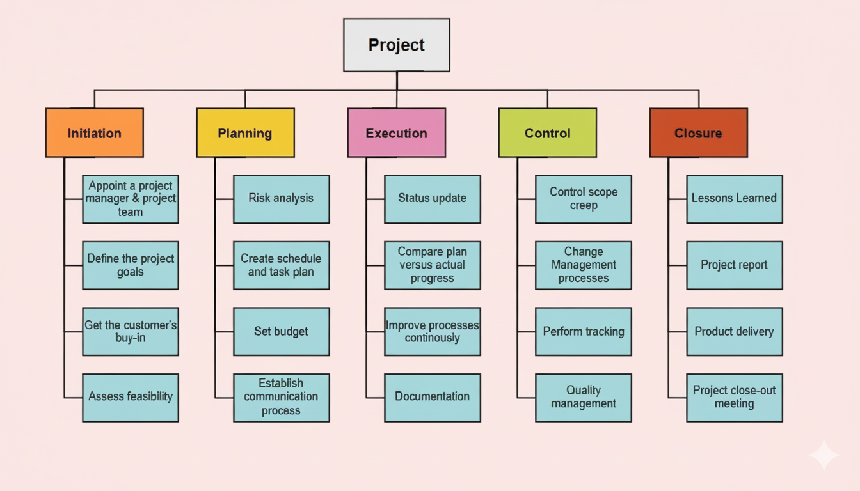

Slide 9
Activity Sequencing
Identifying and documenting the relationships among the project activities.
Methods:
Dependency Determination: Determining the dependencies between activities (e.g., Finish-to-Start, Start-to-Start, Finish-to-Finish, Start-to-Finish).
Network Diagrams: Visual representations of activity sequences and dependencies, such as precedence diagrams or activity-on-node (AON) diagrams

Slide 10

Resource Allocation
-Identifying the resources (e.g., people, equipment, materials) required for each activity and assigning them accordingly.
Considerations: Resource availability, skills, costs, and constraints.
Tools: Resource calendars, resource histograms, and resource leveling techniques.

Slide 11
Schedule Development:
Creating the project schedule by analyzing activity sequences, durations, resource requirements, and constraints.
Techniques:
Critical Path Method (CPM) | Program Evaluation and Review Technique (PERT): | Gantt Charts
is a project management technique that identifies the longest sequence of dependent tasks, determining the shortest time to complete a project and highlighting which tasks cannot be delayed. | is a project management tool that estimates project duration using optimistic, pessimistic, and most likely time estimates. | is a project management tool that displays tasks on a timeline, showing their start and end dates, duration, and progress.

Slide 12
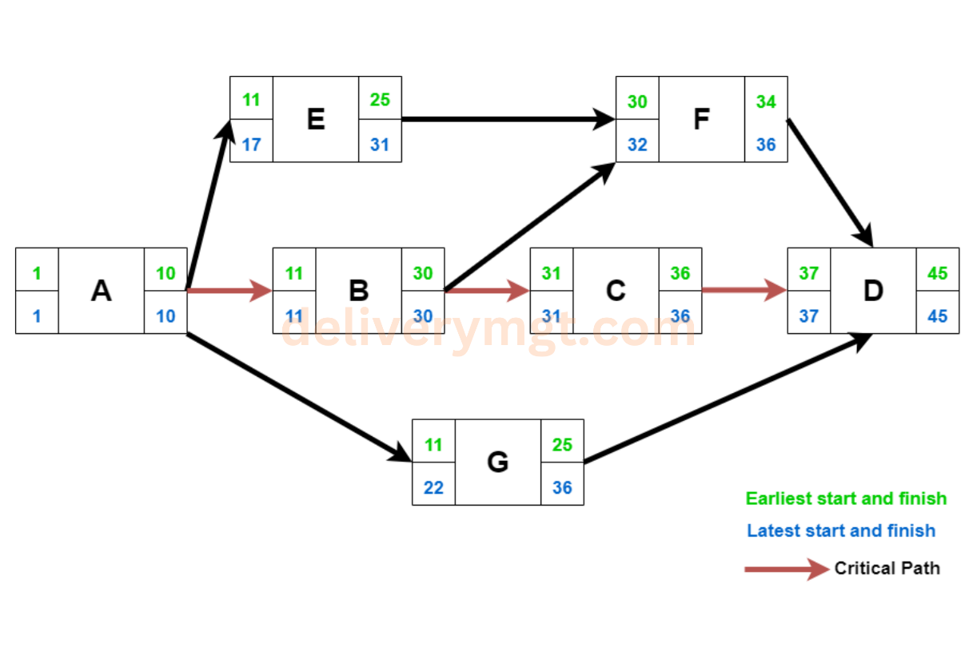
Critical Path Method
The purpose of the Critical Path Method (CPM) is to determine the longest sequence of dependent tasks, identify critical activities that cannot be delayed, and ensure efficient scheduling to complete the project in the shortest possible time.

Slide 13
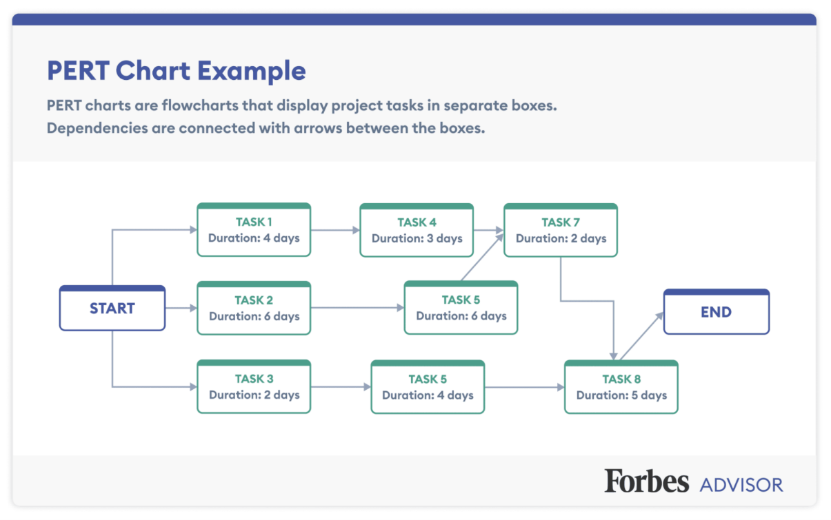
Program Evaluation and Review Technique (PERT):
The purpose of Program Evaluation and Review Technique (PERT) is to help plan, schedule, and control complex projects by estimating time, identifying the critical path, and minimizing risks to ensure timely completion.

Slide 14
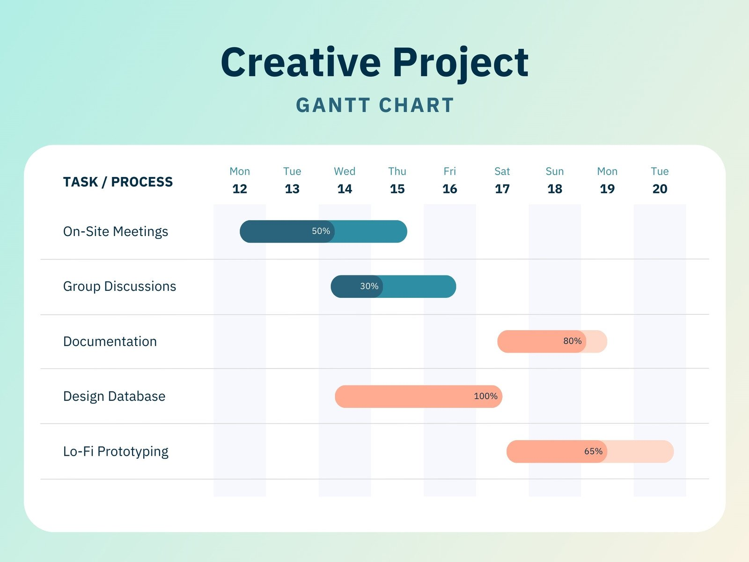
Gantt Charts
The purpose of Gantt charts is to visually organize project tasks, showing their timelines, sequence, and progress. They help track deadlines, identify task dependencies, and ensure efficient project management.

Slide 15

Resource Planning
Resource planning involves identifying, acquiring, and managing the resources needed to complete project activities. Effective resource planning ensures that resources are available when and where they are needed.

Slide 16
Key Aspects of Resource Planning
Resource Planning
Resource Identification
Resource Monitoring and Control
Resource Allocation and Leveling
Resource Acquisition

Slide 17
Resource Identification
-Determining the types and quantities of resources required for each activity.
Categories:
Human resources (project team members, consultants)
Equipment
Materials
Facilities, and;
Funding.

Slide 18
Resource Acquisition
Obtaining the necessary resources, either from internal sources or external vendors.
Strategies:
Internal Acquisition
External Acquisition

Slide 19
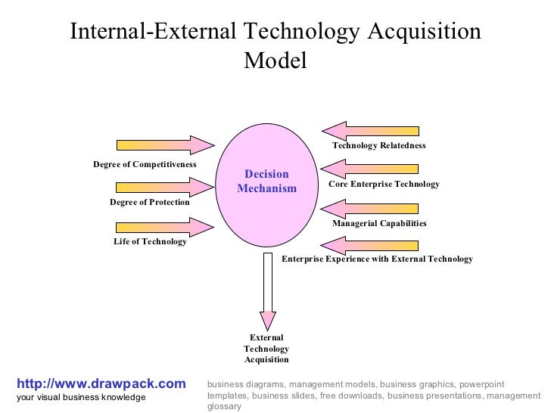
Internal Acquisition
Assigning existing staff, procuring equipment from internal departments, and allocating budget from internal funds.
External Acquisition
Hiring contractors, leasing equipment, purchasing materials from suppliers, and securing external funding.

Slide 20
Resource Allocation and Leveling
-Assigning resources to specific activities and adjusting the schedule to balance resource utilization.
Techniques:
Resource Leveling: Adjusting activity start and end dates to resolve resource overallocation.
Resource Smoothing: Adjusting activities within their float to optimize resource utilization without affecting the project's critical path.

Slide 21
Resource Monitoring and Control
-Tracking resource utilization, identifying variances, and taking corrective actions to ensure resources are used efficiently.
Tools:
Resource Tracking Systems
Performance Reports
Variance Analysis

Slide 22

Tools and Techniques
1. Project Management Software:
Examples:
Microsoft Project
Asana
Trello
Jira
Features:
Scheduling,
Resource Allocation,
Task Management,
Collaboration, And
Reporting.

Slide 23
Tools and Techniques
2. Spreadsheet:
Uses:
Creating Simple Schedules
Tracking Resources and
Performing Basic Analysis.
Software:
Microsoft Excel
Google Sheets.

Slide 24
Tools and Techniques
Spreadsheet:
Examples:
Email
Instant Messaging
Video Conferencing
Purpose:
Facilitating communication and collaboration among project team members and stakeholders.

Slide 25
Best Practices:
Start Early:
Begin scheduling and resource planning as early as possible in the project lifecycle.
Involve Stakeholders:
Engage project team members, stakeholders, and resource managers in the planning process.
Be Realistic:
Develop schedules and resource plans that are achievable and based on realistic estimates.
Document Assumptions:
Clearly document all assumptions and constraints related to scheduling and resource planning.
Monitor and Control:
Continuously monitor progress, track resource utilization, and take corrective actions as needed.
Use Project Management Software:
Leverage project management software to streamline scheduling, resource allocation, and tracking.
Communicate Regularly:
Maintain open communication channels to keep all stakeholders informed of project status and resource availability.

Slide 26
Impact on Project Success
Effective project scheduling and resource planning are essential for:
On-Time Delivery:
Ensures the project is completed within the agreed-upon timeframe.
Budget Control:
Helps manage costs by optimizing resource utilization and minimizing waste.
Quality Assurance:
Facilitates the allocation of skilled resources to ensure high-quality deliverables.
Risk Management:
Enables proactive identification and mitigation of potential delays and resource shortages.
Stakeholder Satisfaction:
Keeps stakeholders informed and satisfied by delivering project results as planned.

Slide 27

Thank You!

