Slide 1

PQM & CC
Irene Banculo, Mark John Quezon
Cindy Lorene Macatiag, Medilyn Raca , Marilyn Dela Cruz

Slide 2

Contents
Part 1
Project Quality
Part 2
Change Control

Slide 3
Project Quality Management
INTRODUCTION
•Project quality management is a crucial aspect of project management that ensures the project meets its objectives, is completed on time, and satisfies stakeholder expectations.
•PQM includes all the activities of all overall management that determine the quality policy, objectives, and responsibilities and implement them within the quality system.

Slide 4



A
OBJECTIVES
B
QUALITY PLANNING
C
QUALITY ASSURANCE
D
QUALITY CONTROL

Slide 5
DEFINITION
QP
QA
QC
Identify quality standards, procedures, and specifications for the project.
Ensure that the project is executed in accordance with the quality plan, and that quality standards are met.
Monitor and control the project's quality, identifying and addressing any deviations from the quality plan.

Slide 6
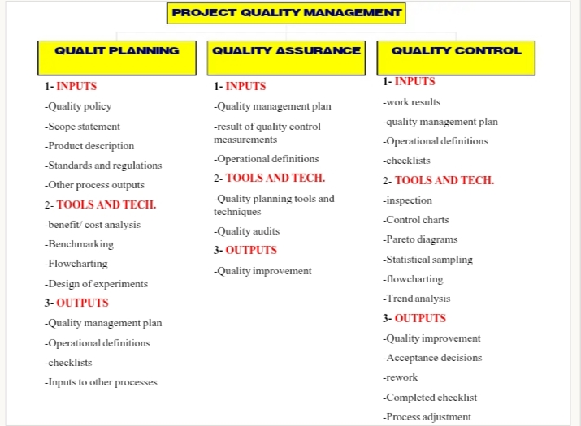

Slide 7
PQM Approach compatibility
•Compatible with ISO 9000 and 1000 series of standard guidelines
•Proprietary Approaches to quality as recommended by Deming, Juran , and Crosby, and others
•Nonproprietary approaches such as TQM, continuous improvement approaches and others

Slide 8

Nature of PQM
1. Customer Focus: Meeting customer requirements and expectations.
2. Continuous Improvement: Identifying areas for improvement and implementing changes.
3. Process Approach: Focusing on processes to achieve quality objectives.
4. Evidence-Based Decision Making: Using data and analysis to make informed decisions.
5. Risk Management: Identifying and mitigating risks that could impact quality.

Slide 9
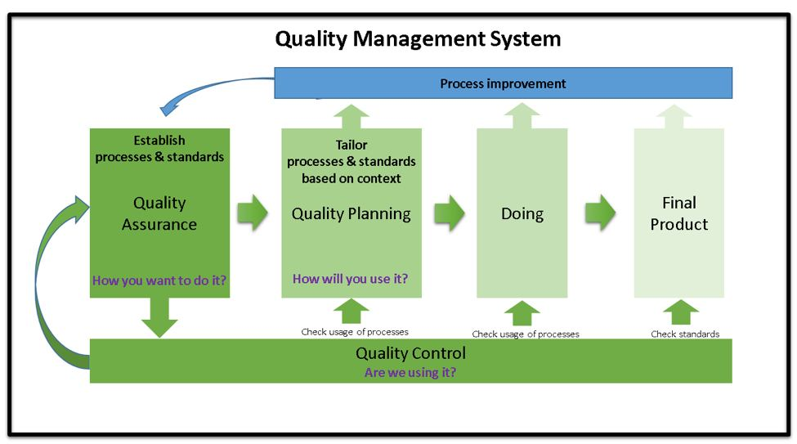

Slide 10
Common understanding
Quality management should complement modern project management as they both recognize the importance of :
1- Customer satisfaction
2- Prevention over inspection
3- Management responsibility
4- Processes within phases
(plan-do-check - act cycle)

Slide 11
Quality planning
•Quality Planning involves identifying with quality standards
•It is a key facilitating process during the Project planning Process
•In modern quality management quality is planned in and not inspected in
•Prior to the development of ISO 9000 series, quality planning concepts were widely discussed as part of quality assurance.

Slide 12
QUALITY PLANNING FLOWCHART
1. Quality Policy
2.Scope Statement
3.Product description
4. Standards and Regulations
5.Other process outputs
1. Benefits/cost analysis
2.Benchmarking
3.Flowcharting
4.Design of experiments
1.Quality Management plan
2.Operational definition
3.Checklists
4.Inputs to other processes
INPUTS
TOOLS & TECHNIQUES
OUTPUTS

Slide 13
QUALITY PLANNING INPUTS
QUALITY POLICY
•the over all intentions and direction of an organization with regard to quality, as formally expressed by the top management
•In the case of a joint venture, a quality policy for the individual project should be developed LJ
•The management team is responsible for dissipating the quality policy to all project stakeholders through appropriate information distribution channels

Slide 14
SCOPE STATEMENT
•The scope statement is a key input to quality planning because it documents major project deliverables as well as project objectives which serve to define important stakeholder requirements
PRODUCT DESCRIPTION
•Although the elements of the product description may be embodied in the scope statement, the product description often contains details of technical issues and other concerns that may affect quality planning

Slide 15
STANDARDS AND REGULATIONS
•The project management team any application-area-specific standards or regulations that may affect the project
OTHER PROCESS OUTPUTS
•In addition to the scope statement and product description, processes in other knowledge areas may produce outputs that should be considered as part of the quality planning

Slide 16
TOOLS AND TECHNIQUES
BENEFITS/COST ANALYSIS
•The planning process must consider benefit/cost tradeoffs
•The Primary Benefit: Is less work, higher productivity, lower costs, and increased stakeholder satisfaction
•The Primary Cost: Is the expanses associated with PQM activities

Slide 17
BENCHMARKING
Benchmarking involves comparing actual or planned project practices to those of other projects to generate ideas to:
1- Generate ideas for improvement
2- provide a standard for measurement of performance
FLOW CHARTING
The flowcharting techniques in quality management generally include:
cause and effect diagram
System or process flow charts

Slide 18
DESIGN OF EXPERIMENTS
•This is an analytical technique which aims to define variables that have most influence on the overall outcome
•This technique is commonly applicable to the product of the project issues.

Slide 19
QUALITY PLANNING OUTPUTS
QUALITY MANAGEMENT PLAN
•The quality management plan should describe how a project management team will implement its quality policy
•Also called Quality System, (in ISO terminology), the plan should define:
-The organizational structure
-Roles and responsibilities
-Resources needed for implementation of quality management

Slide 20
QUALITY MANAGEMENT PLAN (CONTINUED)
The Quality Plan should address:
-Quality Control of the project
-Quality Assurance
-Quality Improvement of the project
OPERATIONAL DEFINITIONS
An operational definition describes what something is and how it is measured by the quality control process.

Slide 21
CHECKLISTS
•A checklist is a structured tool used to verify that a set of required steps or requirements have been performed.
•Many organizations have standard checklists to ensure consistency of frequently performed activities
INPUTS TO OTHER PROCESSS
The quality planning process may identify need for further activity in another area

Slide 22
QUALITY ASSURANCE
•Quality Assurance (QA) is a proactive process that ensures products, services, or processes meet specified requirements and standards.
•Quality assurance is provided by a Quality Assurance dept.
•Quality assurance can be INERNAL (from the project management team to the performing organization)
•Quality assurance can be EXTERNAL (provided to the customer and other parties actively involved in the work of the project

Slide 23
QUALITY ASSURANCE FLOWCHART
1.Quality management plan
2.Results of quality control measurements
3.Operational definition
1.Quality planing tools and techniques
2.Quality audits
1.Quality improvement
INPUTS
TOOLS & TECHNIQUES
OUTPUTS

Slide 24
QUALITY ASSURANCE INPUTS
•Quality management plan as previously described
•Results of quality control measurements which are records of quality control testing and measurement in a format of comparison or analysis
•Operational definitions as previously described in the output of the Quality Planning

Slide 25
TOOLS AND TECHNIQUES
•Quality Planning tools and techniques, which can be used for quality assurance as well
•Quality Audits which are a structured review of other quality management activities:
-they may be timely or carried out randomly
-They may be carried out by properly trained Internal- auditors or by third parties such as quality systems registration agencies

Slide 26
QUALITY ASSURANCE OUTPUTS
•Quality improvement includes taking action to increase the effectiveness and efficiency of the project to be provide added benefits to the stakeholders of that project.
•In many cases the implementation of quality improvements will require preparation of change requests or taking corrective actions and will be handled according to procedure for overall change control

Slide 27
QUALITY CONTROL
•Quality Control (QC) is a process that ensures products or services meet specified requirements and standards.
•QC is often used in various industries, including manufacturing, construction, and software development.
•Project results mentioned include both PRODUCT results such as deliverables and MANAGEMENT results such as cost and schedule performance

Slide 28
The project management should be aware of the following among other subjects
•Prevention
•Inspection
•Attribute sampling
•Varialble Sampling
•Special Cause
•RandomCause
•Tolerances
•Control limits

Slide 29
QUALITY CONTROL FLOWCHART
1.Work results
2.Quality management plan
3.Operational definition
4.Checklists
1.Inspection
2.Control chart
3.Pareto diagram
4.Statistical sampling
5.Flowcharting
6.Trend analysis
1.Qaulity improvement
2.Acceptance decision
3.Rework
4.Process adjustment
INPUTS
TOOLS & TECHNIQUES
OUTPUTS

Slide 30

Tools and Techniques for Quality Control
Inspection:
•Inspection includes activities such as measuring, examining and testing undertaken to determine whether results conform to requirements
•Inspection can be carried out on the level of a single activity or a final product
•Inspections can be called reviews, product reviews, audits, and walk-throughs

Slide 31
Control Chart
•A control chart is a graph used to monitor a process over time to see if it is stable and in control
•These charts are graphical representations that display the result of a process over time and are used to determine if the process is "in control"
•When in control the process should not be adjusted, however it may be changed in order to provide improvements Control charts may be used ot monitor any type of output variable
•Control charts are most often used to monitor repetitive activity in production but can also be used to monitor cost and schedule variances

Slide 32
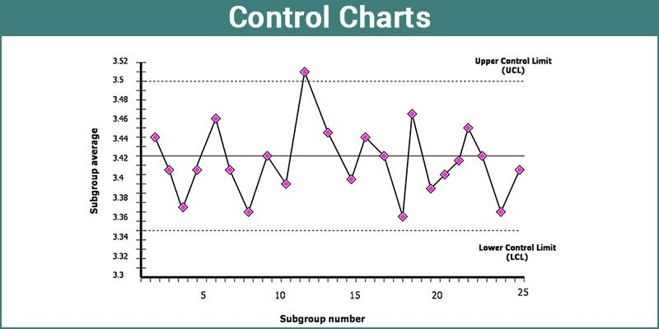

Slide 33
PARETO DIAGRAM
A Pareto chart is a type of chart that contains both bars and a line graph, where individual values are represented in descending order by bars, and the cumulative total is represented by the line
A Pareto diagram is a histogram ordered by frequency of. occurrence which shows how many results were generated by what category or identified cause
The project management team should take action to fix the problems that are causing the greatest number of defects first
Typically the Pareto diagram reflects that a relatively small number of causes are responsible for the majority of the problems or defects.

Slide 34
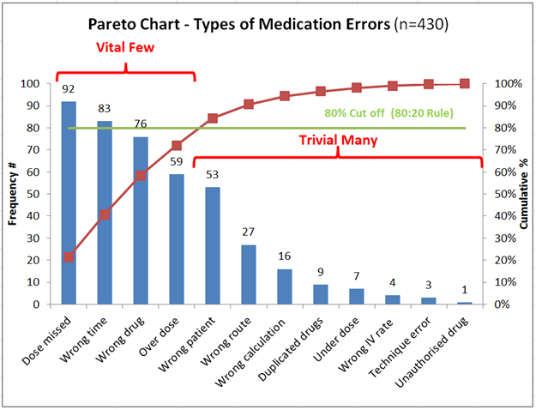

Slide 35
STATISTICAL SAMPLING
In statistics, quality assurance, and survey methodology, sampling is the selection of a subset or a statistical sample of individuals from within a statistical population to estimate characteristics of the whole population.
Statistical sampling involves choosing a part of a population of interest for inspection
Appropriate sampling can effectively reduce the cost of quality control
There is a vast body of knowledge related to statistical sampling and therefore the management must be aware of the various sampling techniques

Slide 36
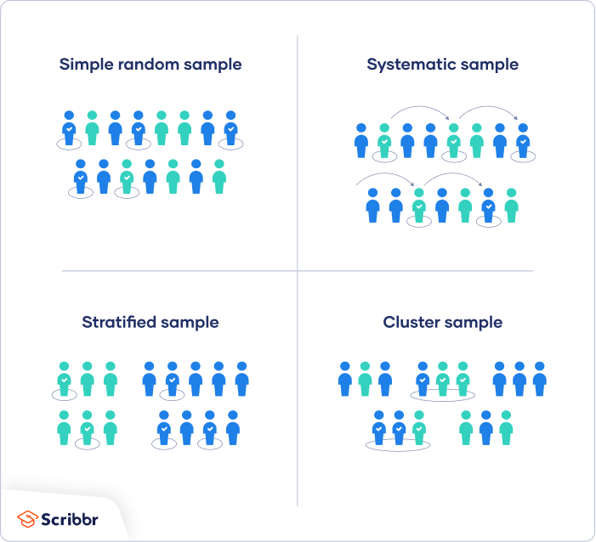
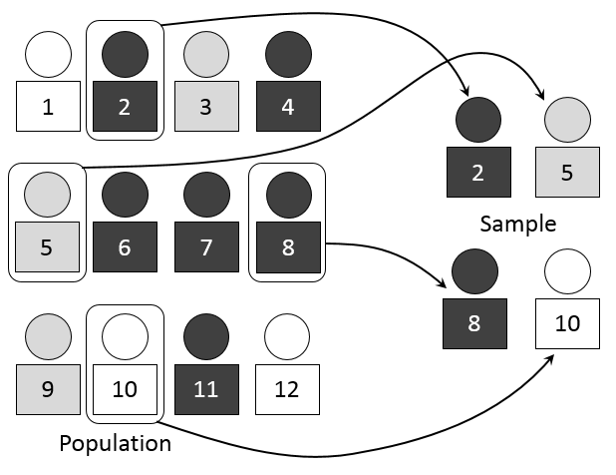

Slide 37
FLOWCHARTING
Flowcharting is the process of creating a diagram that visually represents a workflow or algorithm using standardized symbols, shapes, and connecting arrows to show the sequence of steps

Slide 38
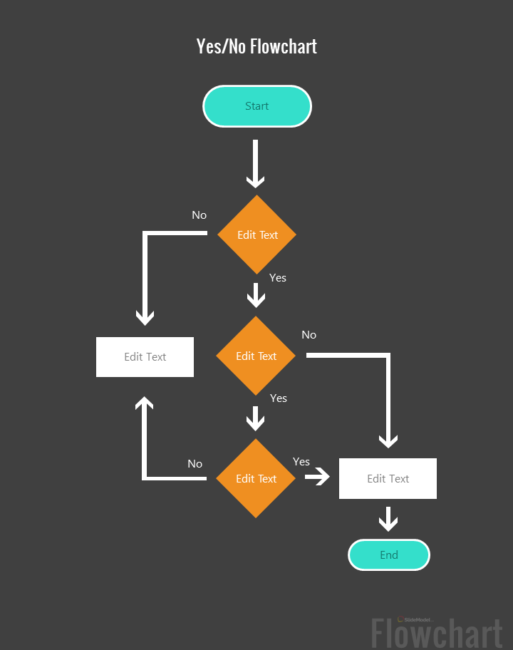
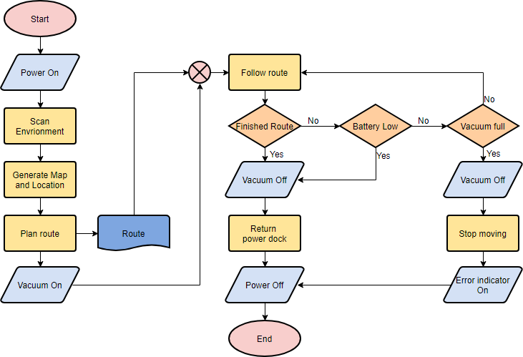

Slide 39
TREND ANALYSIS
Trend analysis is the process of collecting and examining historical data to identify patterns and predict future outcomes
The trend analysis involves the use of mathematical techniques to forecast future outcomes based on historical results it is often used to monitor:
Technical performance - how many defects have been identified and how many remain uncorrected
Cost and schedule performance - how many activities in a certain period were completed with significant variances

Slide 40
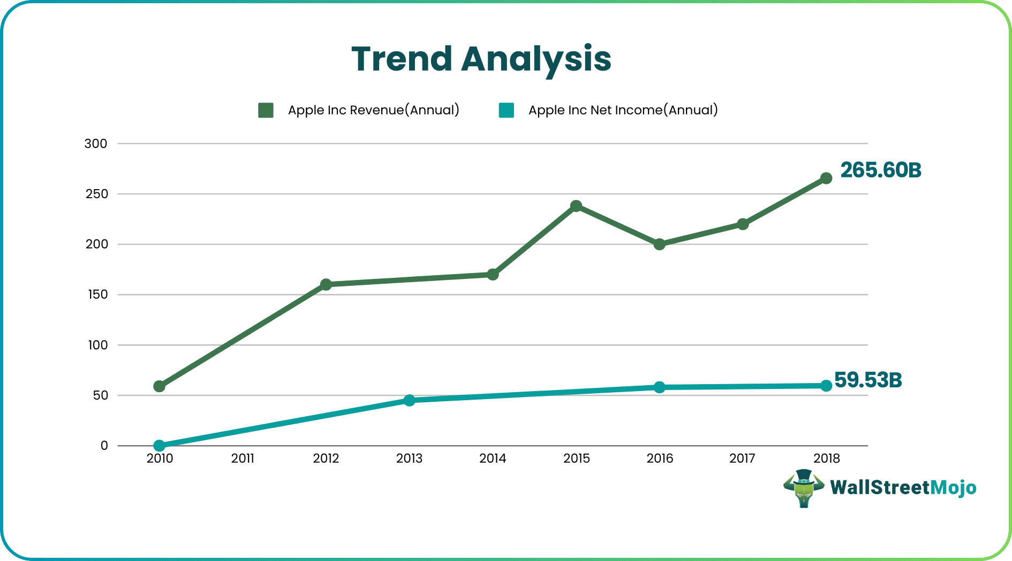

Slide 41
QUALITY CONTROL OUTPUTS
•Quality improvement (previously described)
•Acceptance decisions, where the inspected items will either be accepted or rejected and those rejected may be reworked
•Rework, which is an action taken to bring defects or nonconforming items into compliance with requirements and specifications. Rework is a frequent cause of project over-runs and the project management team must make an effort to minimize it.
•Completed Checklists, which become a part of a project record when they are used
•Process Adjustments, which involves immediate corrective or preventive action as a result of quality control measurements. In some cases the adjustment may need to be handled according to procedures for overall change control.

Slide 42
Conclusion
In conclusion we find that in order to achieve PQM or Project Quality Management, one has to integrate the concepts of Project management with the processes of quality management at the project scale and throughout its different phases.
for effective PQM it is essential that the project management team be aware of the concepts of quality management to be able to make use of the described processes and implement them to achieve the required end product

Slide 43
CHANGE CONTROL
is a systematic process for managing changes to a project, system, or product to ensure they are properly reviewed, documented, and approved
Key components of change control
Change request submission: A formal request is submitted to document the proposed change
Impact assessment: The potential impact of the change on project constraints like scope, time, and cost is evaluated.

Slide 44
Review and approval: A change control board or stakeholders review the request and its impact, then either approve, reject, or defer it
Documentation:All changes, decisions, and their impacts are documented.
Implementation: Approved changes are implemented in a controlled manner, often with rollback plans in place.
Monitoring: The effectiveness of the implemented change is monitored and confirmed.
Change Control Board (CCB):A group responsible for reviewing and approving or rejecting change requests.

Slide 45
Why is change control important?
Minimizes risk: It prevents negative impacts by evaluating every proposed change before implementation.
Prevents unauthorized changes: It ensures that only approved modifications are made to a project or system.
Ensures accountability: It provides a traceable record of all changes and decisions made.
Maintains stability: It helps maintain the stability of a system or project during necessary adjustments.
Ensures compliance: It is critical for maintaining regulatory compliance in industries like pharmaceuticals and medical devices.

Slide 46
Where change control is used?
Change control is used in various sectors, especially in those with complex systems and changing requirements:
Information Technology (IT)
Software Development
Pharmaceutical
Medical Device Manufacturing
Engineering and Manufacturing

Slide 47
Steps in the Change control
Identification
Documentation
Impact Analysis
Evaluation
Approval/Rejecton
Implementtion
Documentation update
Closure

Slide 48
Benefits of change control
Reduced Risks
Improved Project Outcomes
Better Communication
Enhanced Traceability
Cost Control

Slide 49
Tools for change control
Change Management Software: Tools like ServiceNow, Jira, and Asana help automate and manage the change control process.
Document Management Systems:Ensure all change-related documents are stored and managed effectively.
Collaboration Platforms:Facilitate communication and collaboration among stakeholders.

Slide 50
Best Practices for Change Control
Establish a Clear Process:Define a formal change control process.
Use a Standardized Form:Use a standard change request form.
Involve Stakeholder:Engage relevant stakeholders in the process.
Document Everything:Keep detailed records of all changes.
Regularly Review:Periodically review the effectiveness of the change control process.

Slide 51
THANK YOU

