Slide 1
suicides in Greece
Georgios Chalkiopoulos

Slide 2
INTRODUCTION
The scope of the project is to study whether there is an increasing trend, regarding the suicide rate, for Greece and whether the behavior of Greece is different than the rest of the Europe.
The data used was downloaded from Eurostat.
All plots were generated using R. The relevant code will be included in the zip file.

Slide 3
Current Status
Comparison between countries (2019)*
*2019 was used as the latest date with data available

Slide 4
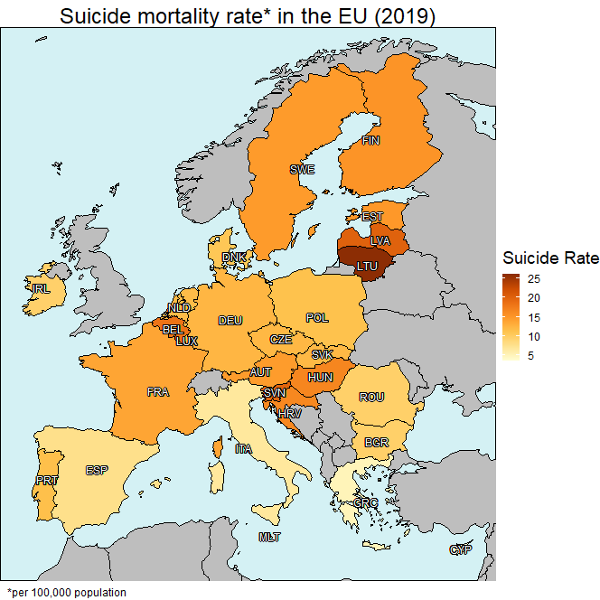
Current Status: Overview
Greece has one of the lowest suicide rates amongst EU countries
Southern countries have a lower suicide rate compared to Northern ones

Slide 5
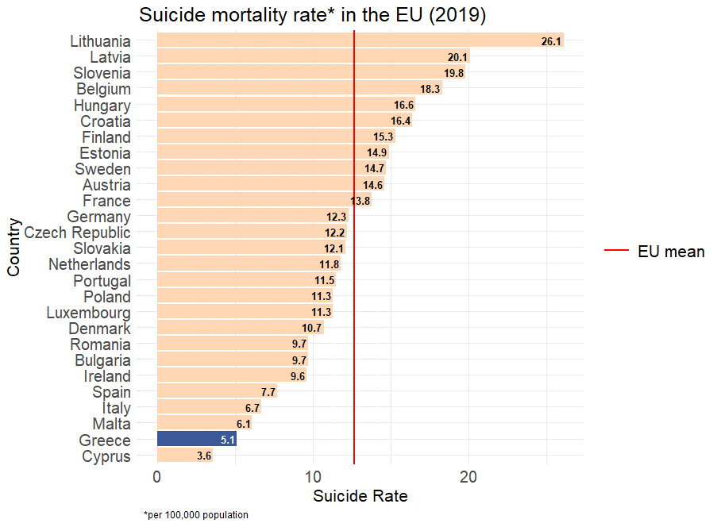
Current Status: Suicide rate in EU countries (2019)
Greece has the 2nd lowest suicide rate, after Cyprus
The suicide rate is more than twice lower than the mean

Slide 6
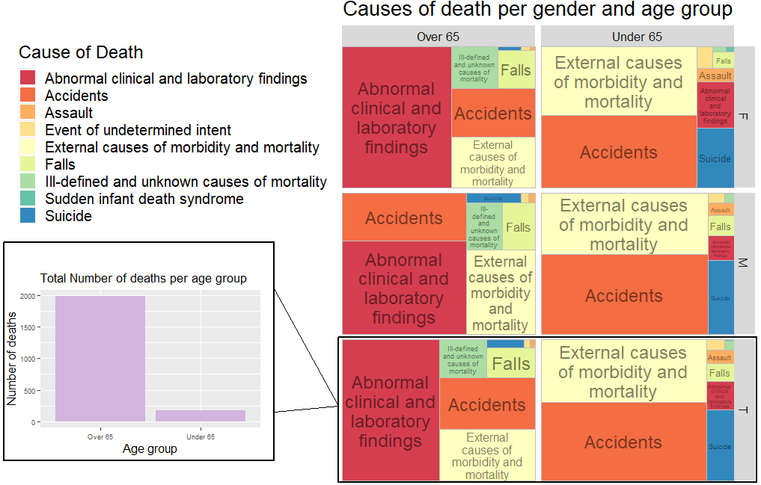
Current Status: Causes of death
Looking at the causes of death, we observe that suicide is the 3rd most common cause of death amongst people less than 65 years old, while it is not that common for people above 65
The absolute number of deaths in people over 65 is much larger compared to the “Under 65” group
People over 65 suffer more from medical issues, compared to younger people

Slide 7
Historical data
Evolution of suicide death rate over the years*
*2000-2019 period

Slide 8
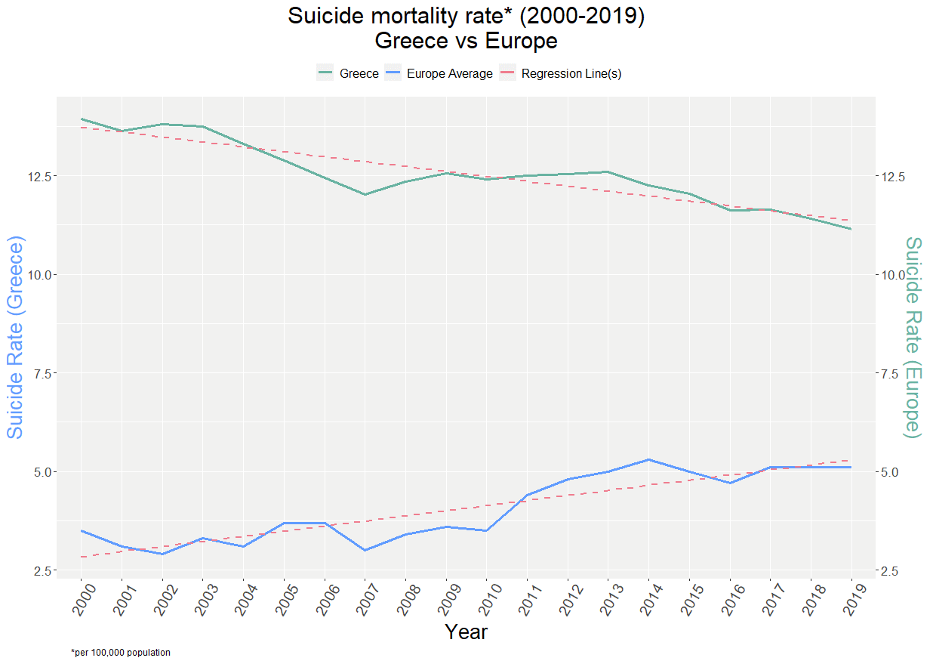
Historical data: Greece vs Europe (2000-2019)
While Europe presents a downwards trend, regarding the number of suicides, Greece has an upward trend over the last years
Before 2010 the rate was relatively constant, but stating 2010 the average rate has doubled

Slide 9
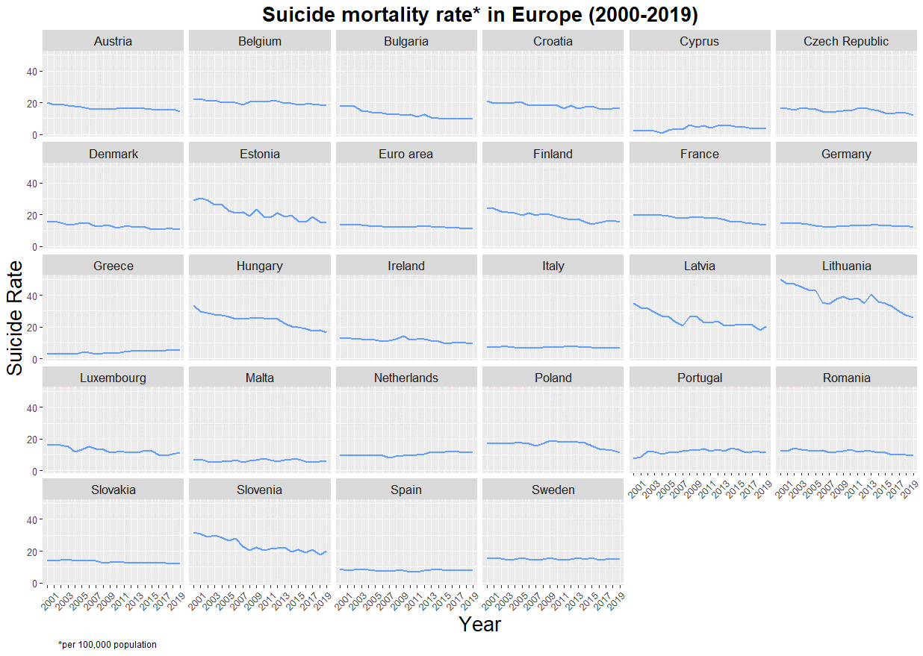
Historical data: Mortality rate per country per year
Greece is the only country is Europe to have a clear increase in suicide rate over the last decade

Slide 10
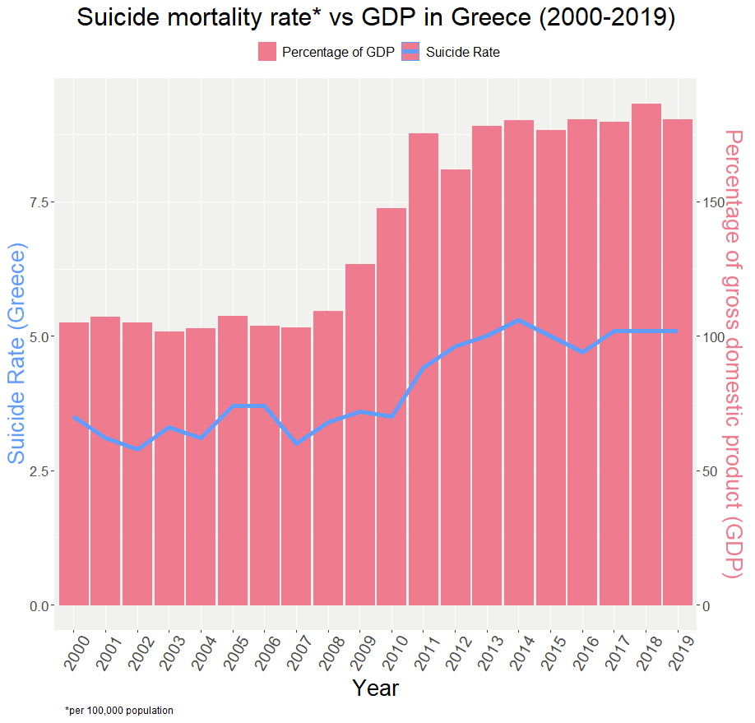
Historical data: Mortality rate vs GDP in Greece
It looks like the situation in Greece after 2010 has an impact on the suicide rate
Since 2010, that the GDP increased and Greece went through a crisis, the suicide rate drastically increased

Slide 11
Gender and age
Differences between age and gender groups*
*2011-2019 period

Slide 12
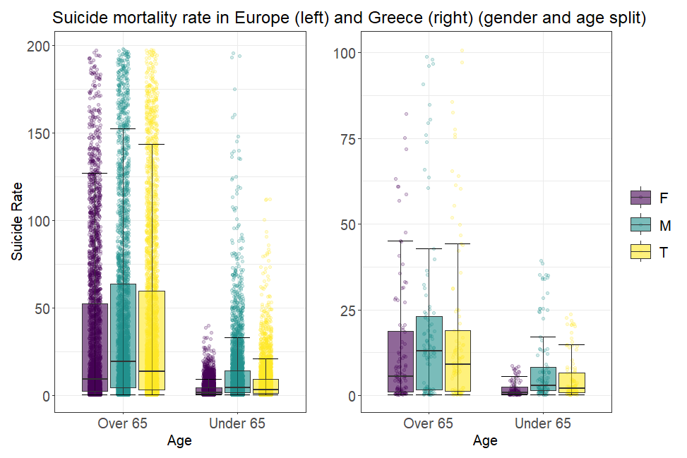
Gender and age: Suicide Rate Europe and Greece
Greece follows the same pattern as the rest of Europe:
More people commit suicide in the “Over 65” age group and
Male suicide rate is higher compared to Female

Slide 13
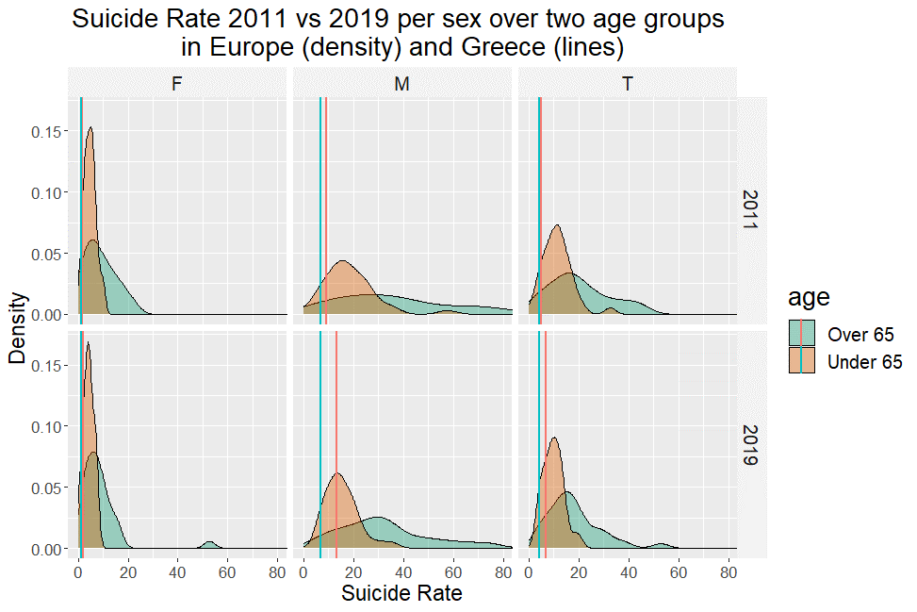
Gender and age: Suicide Rate in Greece 2011 vs 2019
All countries in Europe have decreased the suicide rate from 2011 to 2019
Greece has seen a significant increase in Males over 65
5% quantiles have been excluded for the graph

Slide 14
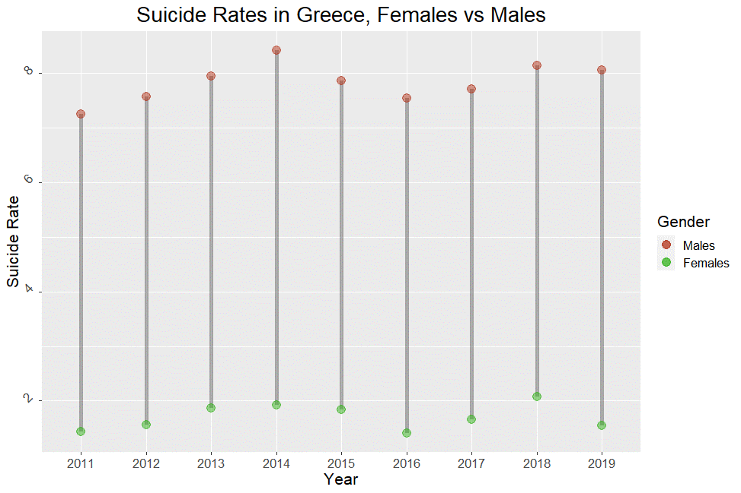
Gender and age: Greece Males vs Females 2011-2019
Both Males and females follow the same pattern per year
The difference is constant over the years

Slide 15
GDP & suicide RATE
Correlation between GDP & suicide RATE*
*2000-2019 period

Slide 16
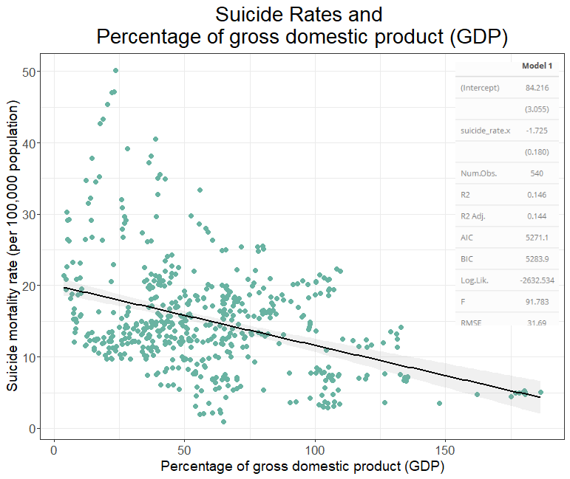
GDP & Suicide Rate: Country wealth and Suicides
It seems that the wealthier countries have a higher suicide rate compared to less wealthy
The two variables seem to be correlated

Slide 17
SUMMARY
While suicides have been on the decrease in Europe, Greece has seen an increase, which started after 2010.
The biggest increase was observed amongst men above 65, while, even in the lower age groups, men have a higher suicide rate than women.
Nevertheless, Greece has still one of the lowest suicide rates in Europe but should take measures to stop the increasing rate.

Slide 18
Don’t underestimate your value in the world. You owe it to yourself — and to your family — to look at every possible alternative.​
Jordan Peterson

Slide 19
THANK YOU
Georgios Chalkiopoulos
gchalkiopoulos@aueb.gr

