Slide 1
Weekly Update
May 6th 2020

Slide 2
Last week Activities:
Run the cross validation and tested the deposit and non-deposits from the NA database for 6 tectonic variables reconstructed with the AREPS and Clennett model.
No further ML steps were analysed as the output files from Data_Wrangling are different for the AREPS workflow and the Clennett workflow.
USYD workshops for HDR students.
CANVAS mandatory modules

Slide 3
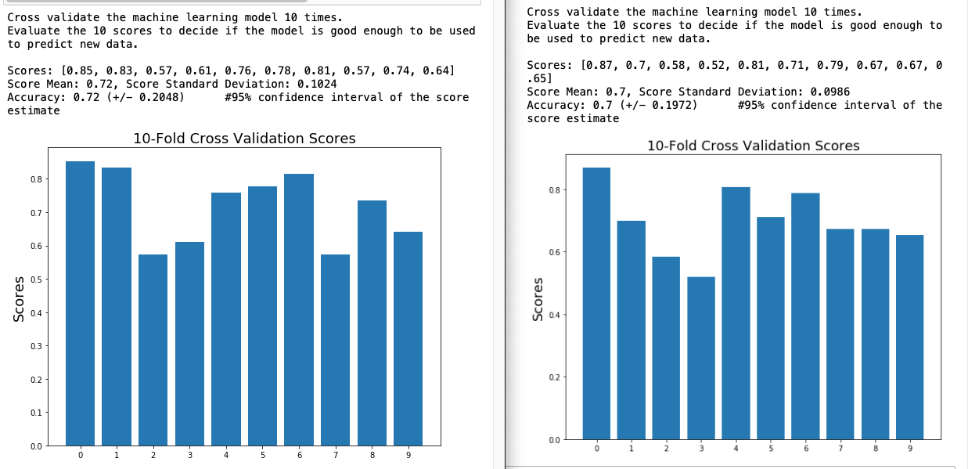
Cross-Validation: AREPS and Clennett models
Clennett Model AREPS model

Slide 4
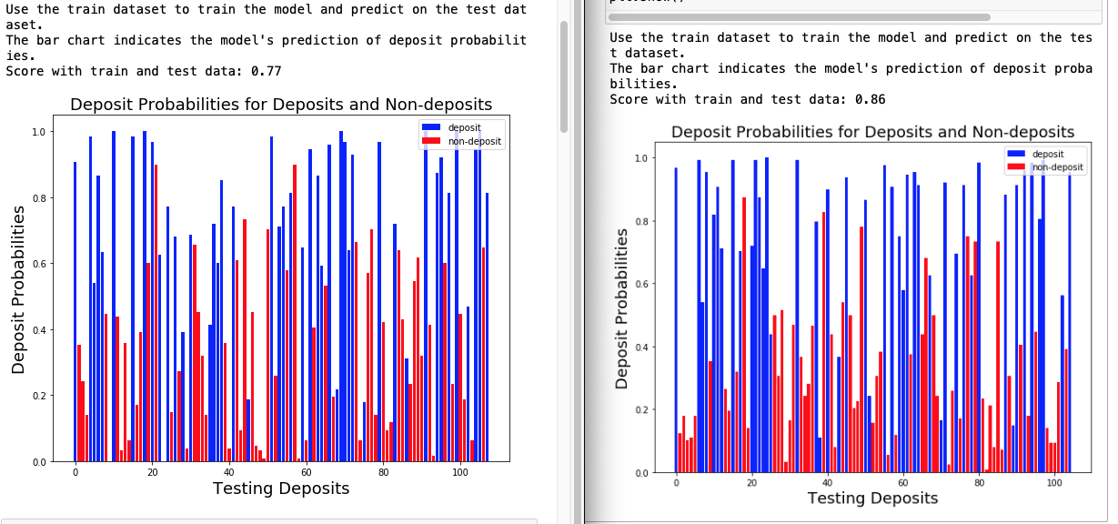
Testing the Dataset.
Clennett Model AREPS model

Slide 5
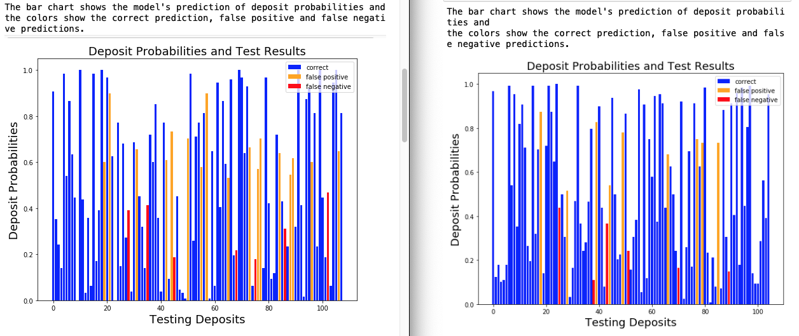
Testing the Dataset.
Clennett Model AREPS model

Slide 6
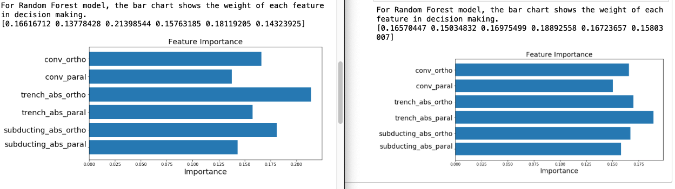
Weights of Features
Feature | Clennett | AREPS
convergence velocity orthogonal (in cm/yr) | 17% | 16%
convergence velocity parallel (in cm/yr) | 14% | 15%
trench plate absolute velocity orthogonal (in cm/yr) | 21% | 17%
trench plate absolute velocity parallel (in cm/yr) | 16% | 19%
subducting plate absolute velocity orthogonal | 18% | 17%
subducting plate absolute velocity parallel | 14% | 16%

Slide 7
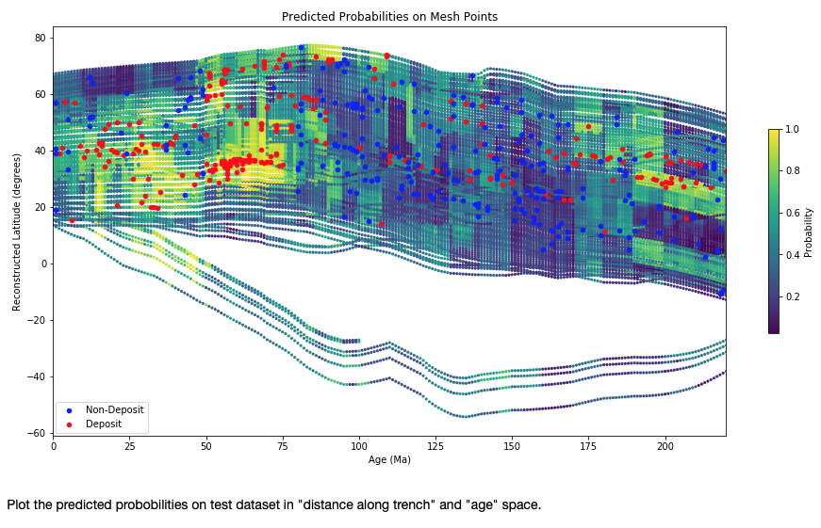
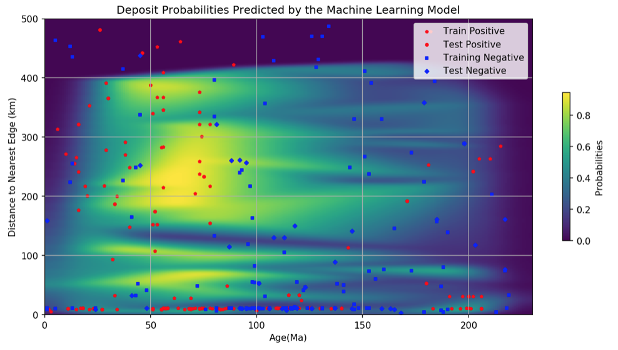
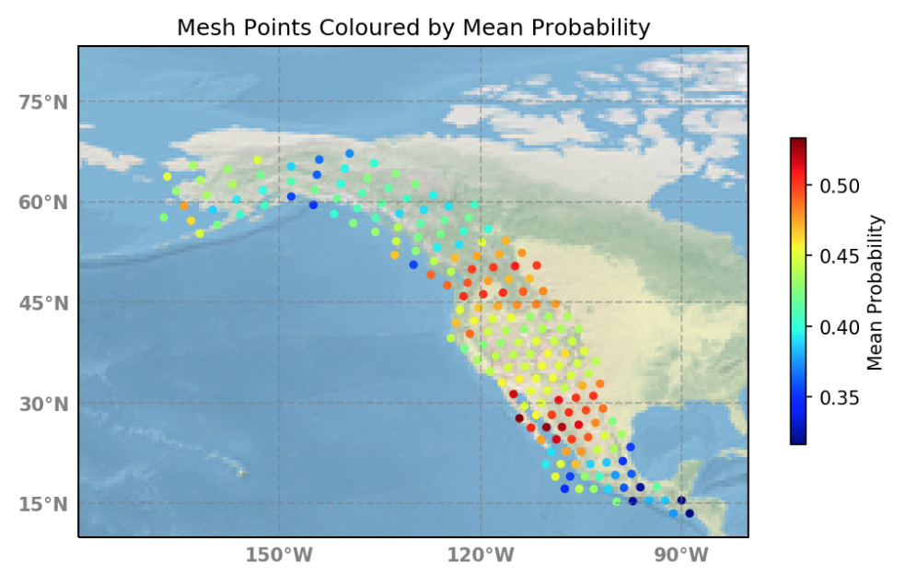
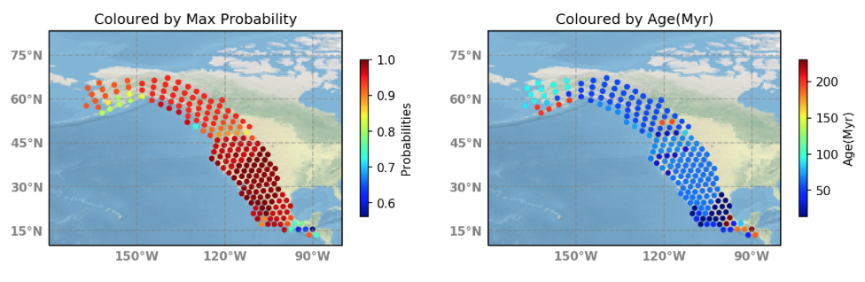
ML Notebook – Clennett Model Workflow

Slide 8
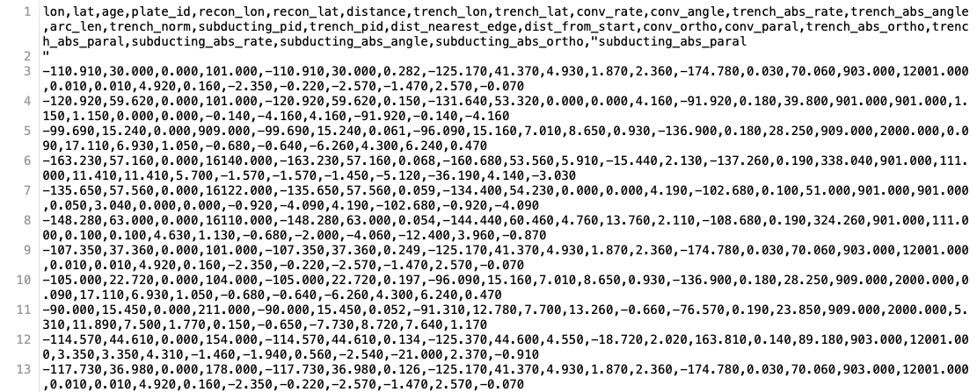
ML input files: Clennett Workflow

Slide 9
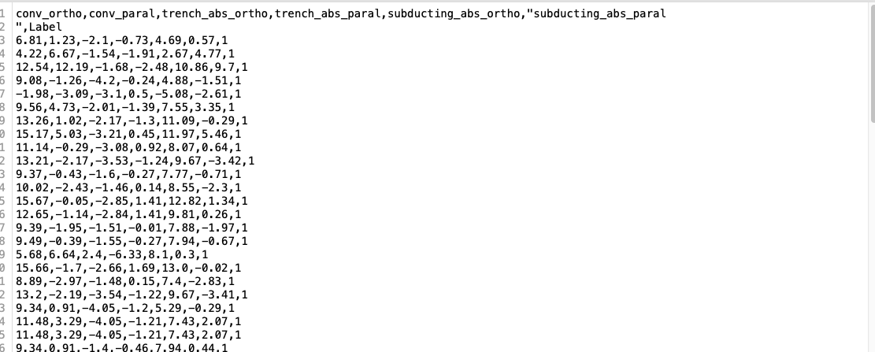
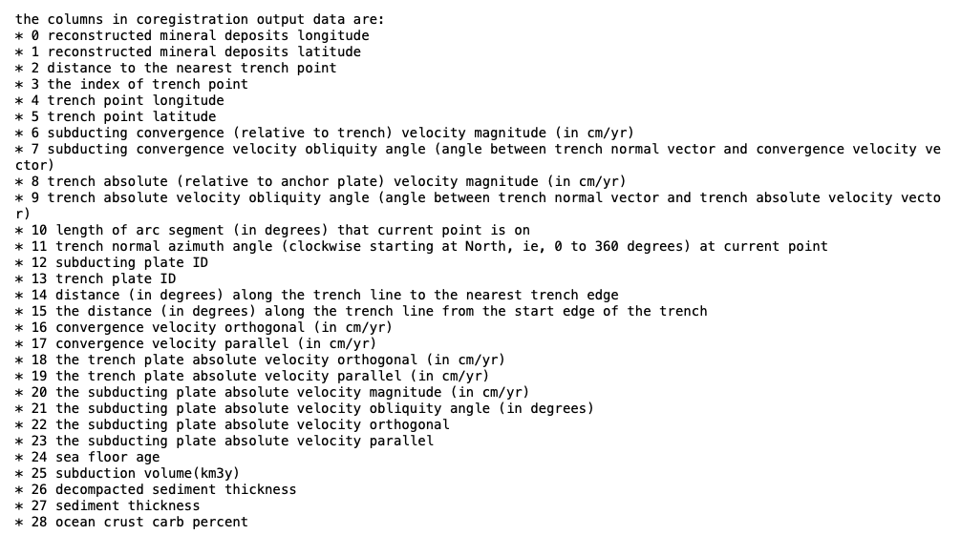
ML input files: AREPS Workflow

Slide 10
USYD HDR Workshops
Literature review
Clearer Writing
Critical thinking
Writing in Academic Style
Introduction to EndNote
CANVAS Mandatory Modules

Slide 11
Next Activities
Finish the analysis of differences between Clennett and AREPS model.
Start writing End-of-Year report.
Workshops
Analytical Writing
Advanced Module of EndNote
CANVAS modules

