Slide 2
File for coresgistration has to be a comma separated spreadsheet, not a comma separated value.
If you have your own data base, not need to run part two.
The index on the ready-to-coregister file has to be the number of samples the DB has.
Replace tmp = np.c_[np.arange(62) for: tmp = np.c_[np.arange(len(proba)).

Slide 3
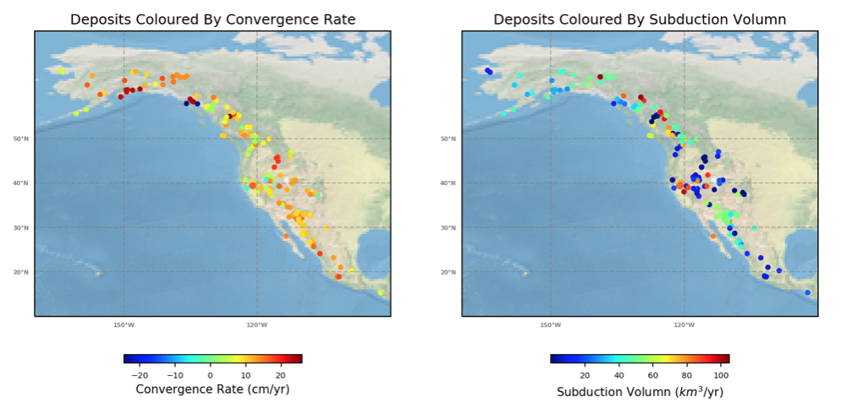

Slide 4
After evaluating the scores, how to decide in the the model is good enough?

