Slide 1
Faster Scala Collections with
Compile-Time Reflection
Master Thesis
Georgios Kollias
Supervisor: Yannis Smaragdakis
2012-13

Slide 2
Where It All Started
2011: Yammer's notorious leaked email
  A list of all issues that made running Scala in production hard
  They returned to Java :)
2011: Cliff Click's “The Problem”
  The main technical reason for Yammer's complaints

Slide 3
Cliff Click's “The Problem”
// The function in the inner loop
long add1(long a) {return a + 1;}
// The iterator function
void map(long[] dst, long[] src) {
for(int i=0; i < dst.len; i++)
dst[i] = add1(src[i]);
}
So, it applies a bunch of optimizations:
  Range-check elimination
  Loop unrolling
  Prefetching
Usually, we'd like to use map with more functions (add2 etc)
It's easy for JVM to inline add1

Slide 4
Cliff Click's “The Problem”
void map(CallableOneArg fcn1arg, long[] dst, long[] src) {
for(int i=0; i < dst.len; i++)
dst[i] = fcn1arg.call(src[i]);
}
+1 virtual call
JVM cannot apply the optimizations we saw before
  Major perf degradation
It's a major pain for modern high-level JVM languages
Now map is generic
But we cannot inline fcn1arg.call :(
  “The Problem”

Slide 5
Our Approach to “The Problem”: ft-declosurify
It defines two methods: macroMap & macroForeach
They can be used from all Scala Collections
Drop-in replacements (almost) of the default map & foreach methods
Only faster!
  Because they suffer less from “The Problem”
Scala's new compile-time reflection was our tool

Slide 6
Two Steps Back:
Scala Collections
scala.collection.mutable vs scala.collection.immutable
mutable can be mutated in place
immutable cannot be changed
  They have “mutating” methods but they return new collections

Slide 7
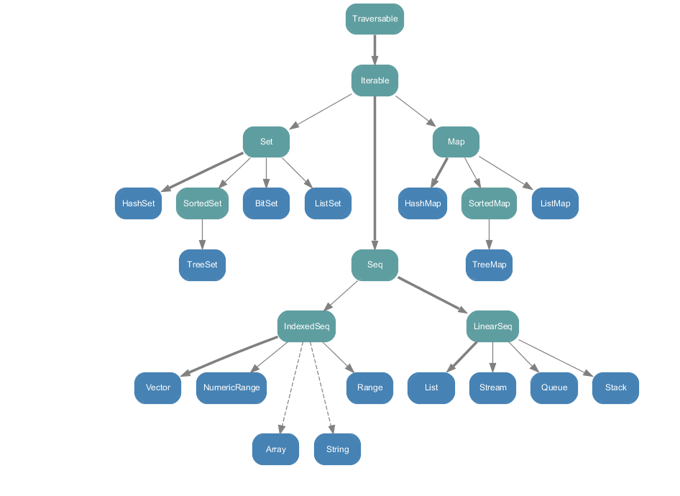
Two Steps Back:
Immutable Scala Collections

Slide 8
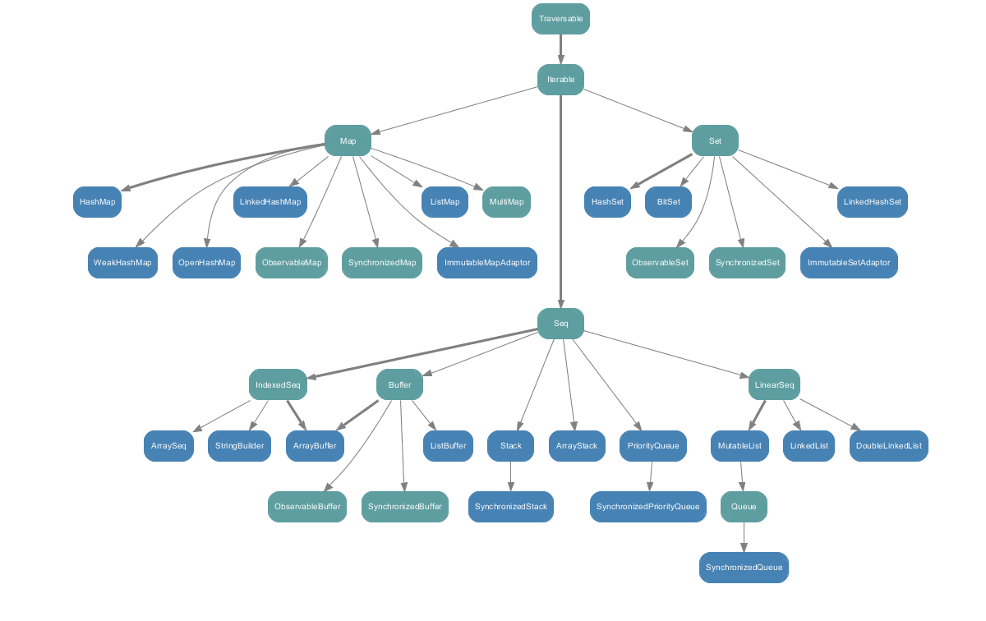
Two Steps Back:
Mutable Scala Collections

Slide 9
One Step Back:
Scala Compile-Time Reflection (CTR)
Since Scala 2.10 (January 2013)
APIs that allow us to create/manipulate ASTs directly in the Scala compiler (scalac)
These ASTs are typechecked (type-safe) and they can be hygienic too
CTR is available to programmers only through the new Scala Macros system
  Supports syntactic macros, like Lisp's macros but with types

Slide 10
One Step Back:
Scala Compile-Time Reflection
AST for expression “x < 10”
  Apply(Select(Ident(newTermName("x")), newTermName("$less"), List(Literal(Constant(10)))))
  scary and un-hygienic
reify comes to the rescue
  It's a macro itself!
  reify(x < 10) returns the AST above, typechecked and hygienic

Slide 11
ft-declosurify Overview
Scala's default map:
def map[B, That](f: A => B)(implicit bf: CanBuildFrom[Repr, B, That]): That = {
def builder = {
val b = bf(repr); b.sizeHint(this)
b
}
val b = builder
for (x <- this) b += f.apply(x)
b.result
}
List(1,2,3).map(x=>x+1)
x => x + 1:
{
class $anonfun extends
AbstractFunction1[Int,Int] with ... {
def <init>(): ... = ...
def apply(x$1: Int):Int = x$1.+(1)
};
new $anonfun()
}
megamorphic virtual call

Slide 12
ft-declosurify Overview
List(1,2,3).macroMap(x=>x+1) expands to:
{ private def local1(x$1: Int): Int = x$1.+(1);
private def builder1: Builder[Int,List[Int]] = {
val b: mutable.Builder[Int,List[Int]] = List.canBuildFrom[Int].apply();
b.sizeHint(List.apply[Int](1, 2, 3));
b
};
val buf = builder1();
var these = List.apply[Int](1, 2, 3);
while(!these.isEmpty){
buf.+=(local1(these.head));
these = these.tail
};
buf.result
}
expands == replaced at call-site
local1 doesn't suffer from “The Problem”
But still we don't solve “The Problem” at its core here
  We just move it

Slide 13
ft-declosurify Overview
List(1,2,3).macroMap(myf) where myf is an arbitrary Int=>Int function
Only the local1's body changes to:
{ private def local1(x$1: Int): Int = myf.apply(x$1);
...
}
myf's runtime type will be the same during the macroMap's loop
So, JVM's type profiler has enough info to inline the call!
Some wins against “The Problem”
Back to “The Problem”?

Slide 14
ft-declosurify Implementation: Overview
macroMap's signature is exactly the same with map's one
  “drop-in” replacement
  def macroMap[B, That](f: A => B)(implicit bf: CanBuildFrom[Repr, B, That]): That
macroMap is declared in the same trait as map inside Scala's standard library (TraversableLike)

Slide 15
ft-declosurify Implementation: Overview
macroMap is implemented directly into the scalac
  We cannot use compile-time reflection (and, of course, macros) in the standard library
Whenever scalac finds a macroMap's Symbol, it calls our implementation (expansion phase)
scalac knows which implementation to call through its FastTrack mechanism (≈ registry)
  Hence the ft prefix!

Slide 16
ft-declosurify Transformations
Currently, there are 3 transformations for:
  Array & mutable IndexedSeq(uences)
  LinearSeq(uences)
    Both mutable & immutable
  The rest (Traversable)
Multiple transformations for performance and API reasons
The chosen transformation depends, primarily, on the static type of the source collection (prefix)

Slide 17
ft-declosurify Transformations: Array & mutable IndexedSeq
Array(1,2,3).macroMap(x =>x+1) expands to:
{ def local1(x$1: Int): Int = x$1.+(1);
val xs: Array[Int] = Array[Int](1, 2, 3);
var buf: Array[Int] = new Array[Int](xs.length());
var i: Int = 0;
while(i.<(xs.length())){
// buf(i) = (local1(r(i)));
buf.update(i, local1(xs.apply(i)));
i = i.+(1)
};
buf
}
Only this category collections accept a length in constructor
.length = O(1)
xs.apply(i) = O(1)
buf.update = supported & O(1)

Slide 18
ft-declosurify Transformations: (im)mutable LinearSeq
List(1,2,3).macroMap(x =>x+1) expands to:
{ private def local1(x$1: Int): Int = x$1.+(1);
private def builder1: mutable.Builder[Int,List[Int]] = {
val b: mutable.Builder[Int,List[Int]] = List.canBuildFrom[Int].apply();
b.sizeHint(List.apply[Int](1, 2, 3));
b
};
val buf = builder1();
var these = List.apply[Int](1, 2, 3);
while(!these.isEmpty){
buf.+=(local1(these.head));
these = these.tail
};
buf.result
}
.isEmpty = O(1)
.head = O(1)
.tail = O(1)

Slide 19
ft-declosurify Transformations: Traversable (all the rest)
List(1,2,3).macroMap(x =>x+1) expands to:
{ private def local1(x$1: Int): Int = x$1.+(1);
private def builder1: mutable.Builder[Int,immutable.Set[Int]] = {
val b: mutable.Builder[Int,immutable.Set[Int]] = Set.canBuildFrom[Int].apply();
b.sizeHint(r);
b
};
val buf = builder1();
val it = r.toIterator;
while(it.hasNext){
buf.+=(local1(it.next));
};
buf.result
}
This transformation should use methods available to all collections:
  .toIterator
    .hasNext
    .next

Slide 20
ft-declosurify Benchmarks:
Array & mutable IndexedSeq

Slide 21
ft-declosurify Benchmarks:
Array & mutable IndexedSeq

