Slide 1
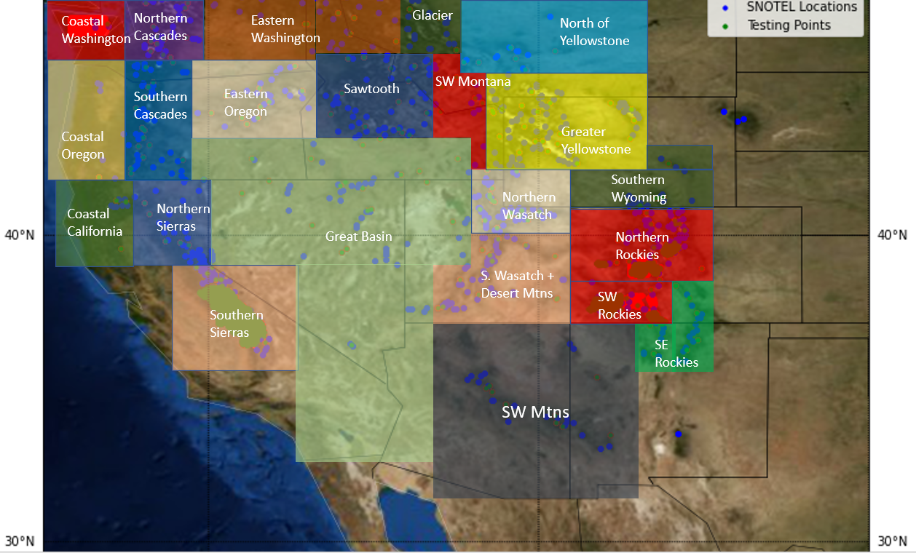
The distributed ML model architecture trains region specific ML models to address the differences in snow processes.

