Slide 1
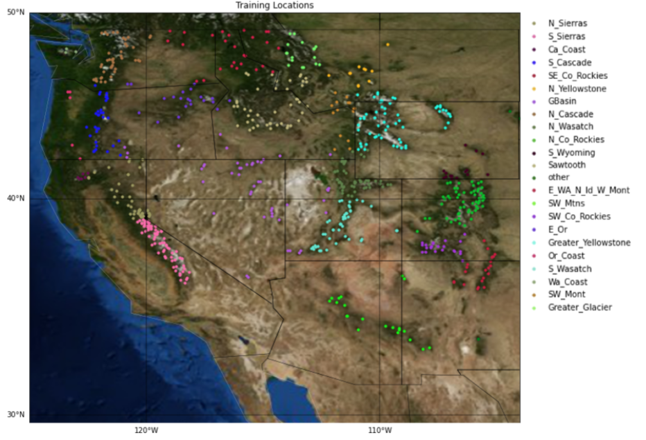
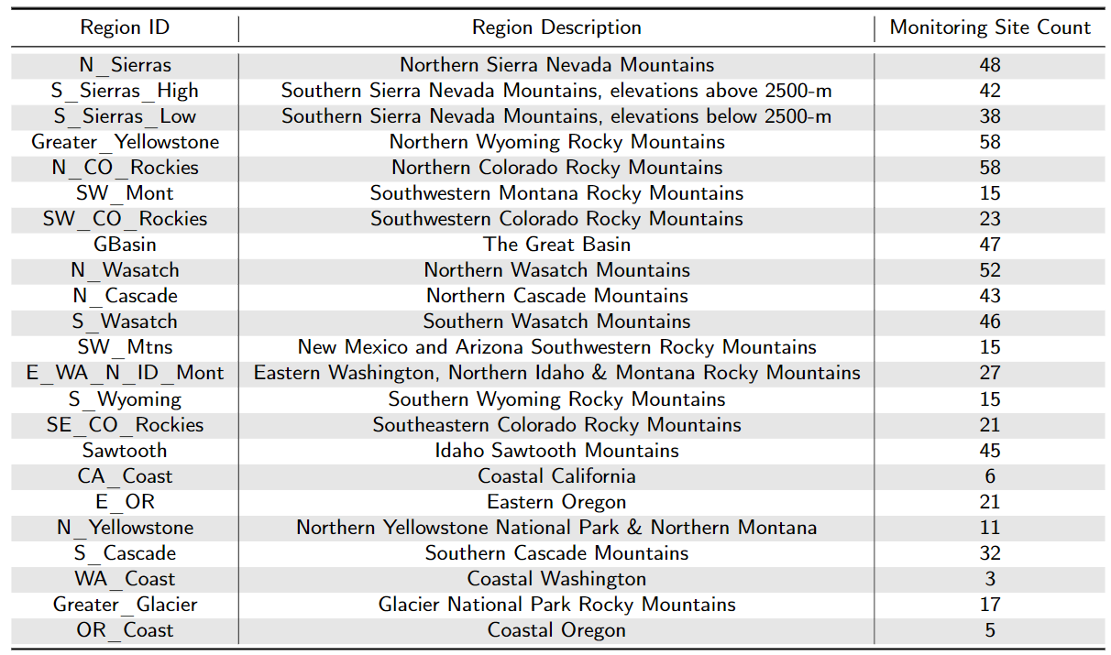
Each region of the distributed ML model architecture contains numerous SNOTEL or CDEC SWE observations.

