Slide 1
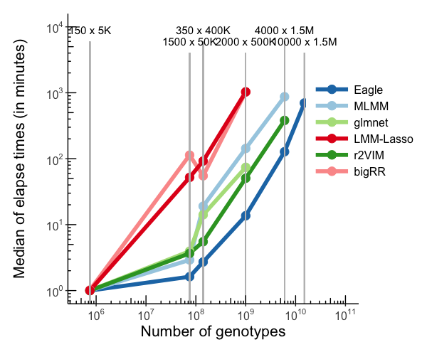
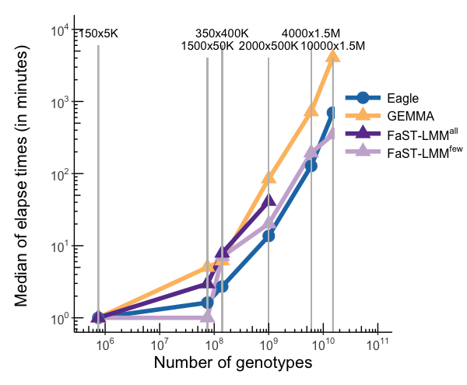
Method | Name | 150x5K | 1500x50K | 350x400K | 2000x500K | 4000x1.5M | 10000x1.5M
Multiple | Eagle | 0.08 | 1.62 | 2.71 | 13.65 | 127.63 | 699.55
 | MLMM | 0.15 | 2.91 | 19.04 | 143.01 | 870.84
 | glmnet | 0.11 | 3.95 | 14.06 | 74.03
 | r2VIM | 0.09 | 3.66 | 5.51 | 50.59 | 380.52
 | bigRR | 1.01 | 113.35 | 54.99 | 1030.61
 | LMM-Lasso | 0.57 | 52.08 | 92.20 | 1031.85
Single | GEMMA | 0.02 | 5.02 | 6.17 | 84.83 | 723.33 | 4071.60
 | FaST-LMM | 0.01 | 0.80 | 7.07 | 20.16 | 193.90 | 346.19
 | FaST-LMM | 0.03 | 2.96 | 7.90 | 41.27

Slide 2
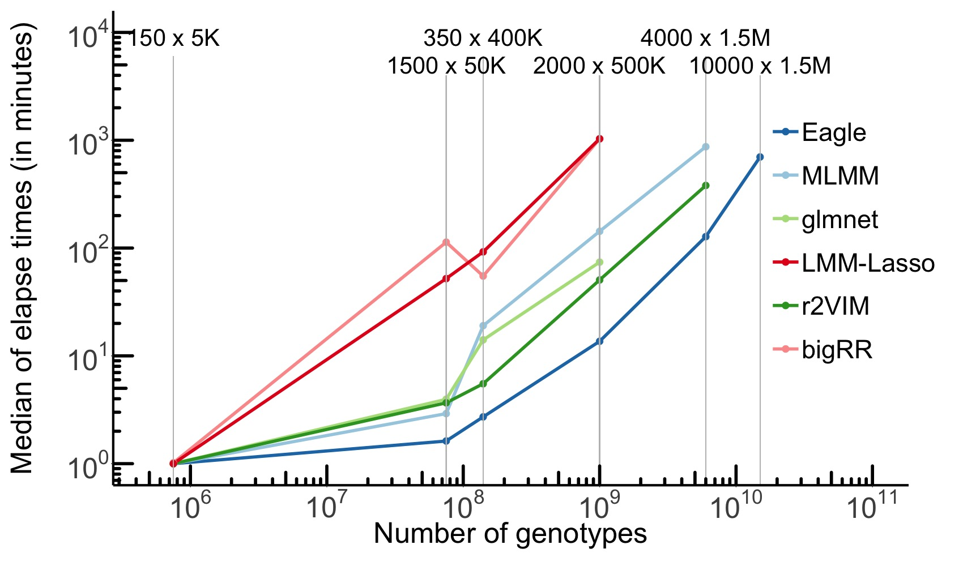
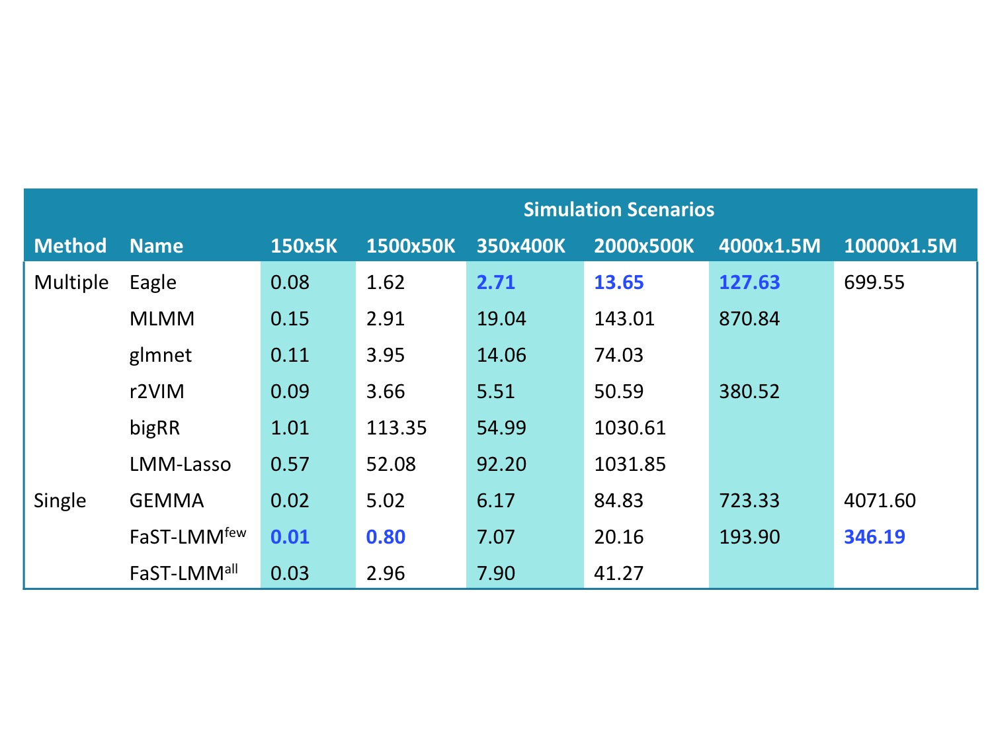
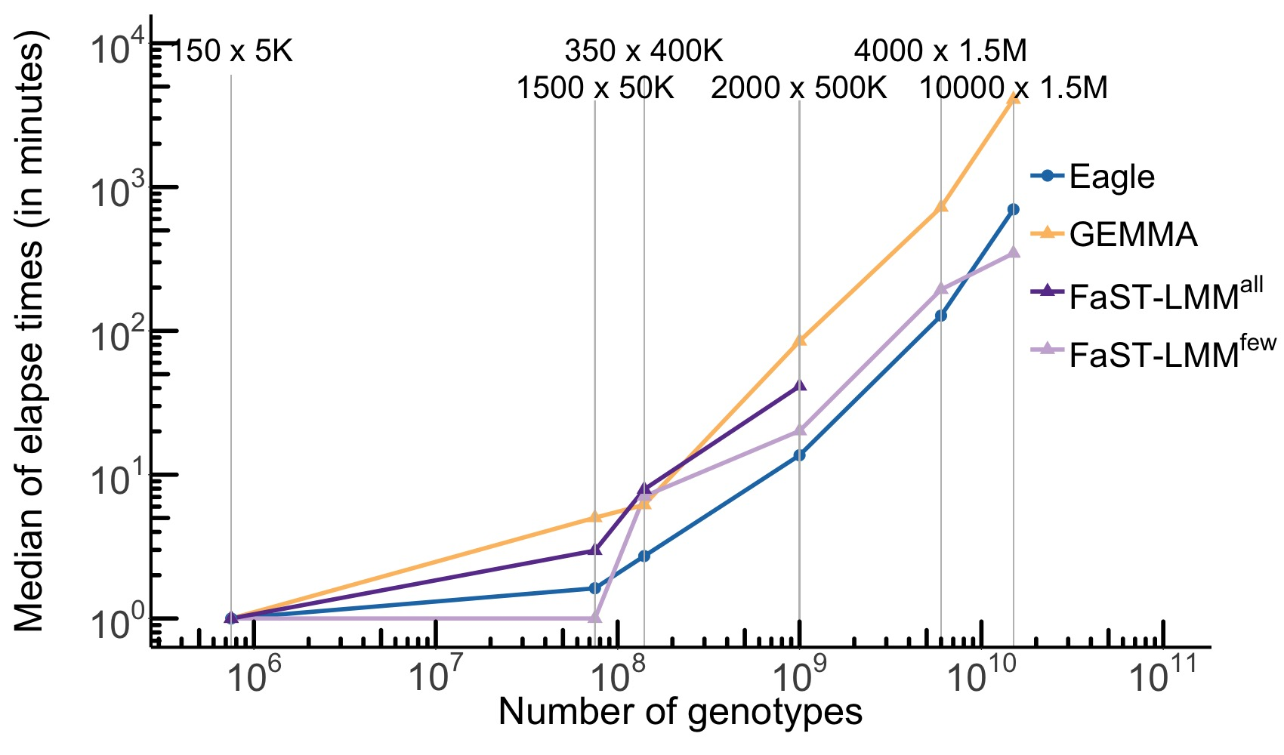
A
C
B

Slide 3
 |  | Simulation Scenarios
Method | Name | 150x5K | 1500x50K | 350x400K | 2000x500K | 4000x1.5M | 10000x1.5M
Multiple | Eagle | 0.08 | 1.62 | 2.71 | 13.65 | 127.63 | 699.55
 | MLMM | 0.15 | 2.91 | 19.04 | 143.01 | 870.84
 | glmnet | 0.11 | 3.95 | 14.06 | 74.03
 | r2VIM | 0.09 | 3.66 | 5.51 | 50.59 | 380.52
 | bigRR | 1.01 | 113.35 | 54.99 | 1030.61
 | LMM-Lasso | 0.57 | 52.08 | 92.20 | 1031.85
Single | GEMMA | 0.02 | 5.02 | 6.17 | 84.83 | 723.33 | 4071.60
 | FaST-LMM^{few} | 0.01 | 0.80 | 7.07 | 20.16 | 193.90 | 346.19
 | FaST-LMM^{all} | 0.03 | 2.96 | 7.90 | 41.27

