Slide 1

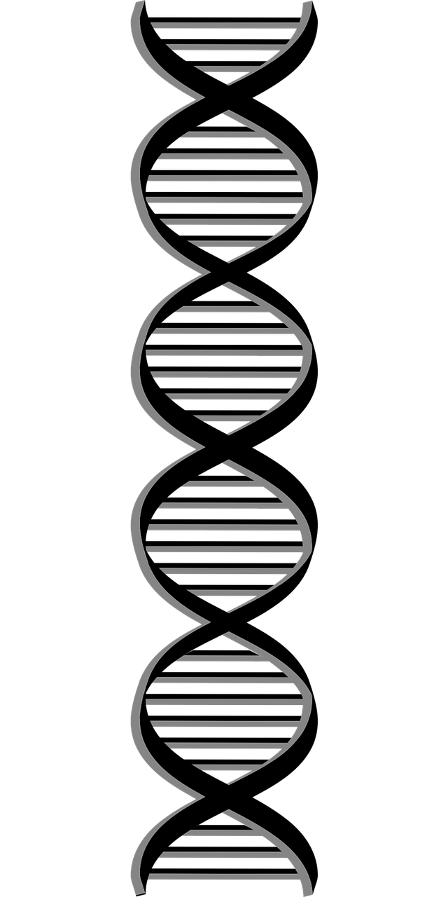
Eagle
Multiple-locus Genome-wide Association Mapping
Analysis Workflow
Read Genotypes
Read Phenotypes
Read Map
Formats: PLINK ped or plain text
Formats: text file, space or
comma separated
Formats: text file, space
separated
Example plain text file
Example
Genotypes can be
coded as any
alphanumeric value
Example
Column names
Space
separated
Column names
3 traits and 4 fixed effects
SNP | Chrm | Pos
rs3454 | 1 | 0.3
rs2344 | 1 | 2.5
rs05344 | 1 | 11.4
rs9847 | 1 | 24.5
rs6342 | 1 | 25.7
rs62636 | 1 | 31.6
SNPs
y1 | y2 | pc1 | pc2 | age | sex
0.1 | 100 | 0.11 | 1.4 | 10 | M
3.4 | 110 | 0.36 | 2.3 | 25 | M
-2.1 | 90 | 0.27 | 1.7 | 34 | F
-0.3 | 44 | 0.18 | 2.1 | 24 | F
1.2 | 206 | 0.21 | 1.9 | 18 | M
-1.8 | 23 | 0.42 | 2.5 | 41 | F
0 | 0 | 1 | 1 | 0 | 1 | 1 | 1
0 | 0 | 1 | 1 | 0 | 1 | 1 | 1
0 | 0 | 1 | 0 | 0 | 1 | 1 | 0
0 | 2 | 1 | 1 | 0 | 1 | 1 | 1
1 | 2 | 1 | 0 | 0 | 1 | 0 | 0
2 | 2 | 1 | 1 | 1 | 1 | 0 | 1
0 | 2 | 1 | 2 | 0 | 1 | 2 | 1
2 | 2 | 1 | 1 | 0 | 2 | 0 | 1
1 | 2 | 0 | 0 | 0 | 0 | 0 | 0
1 | 2 | 1 | 1 | 0 | 0 | 1 | 2
SNP
Individuals
Individuals
Findings
Analysis
”Best” set of snp and their
map location
Distributed
computation
SNP | Chrm | Pos
rs00454 | 5 | 123.2
rs112844 | 1 | 73.1
rs833208 | 12 | 15.3
Amount of phenotypic
variance explained by
SNP, cumulatively
Effect size, and significance
Multiple-locus
genome-wide
analysis
SNP | Proportion of Variance Explained
rs00454 | 0.05
+ rs112844 | 0.12
+ rs833208 | 0.16
SNP | Effect size | P-value
rs00454 | 1.2 | 1e-8
rs112844 | 0.9 | 1e-7
rs833208 | -0.8 | 1e-6
Linear mixed model
framework

