Slide 1
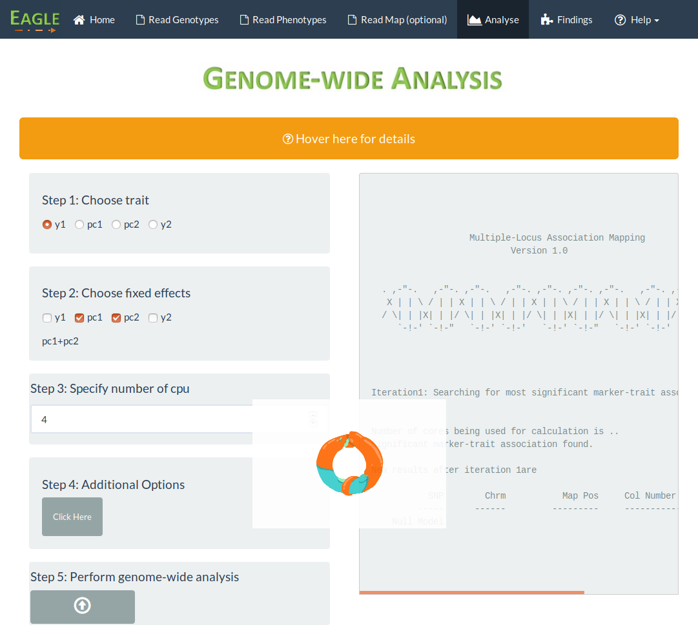
Selected “y1” to be the trait
Output from analysis
appears here
Fixed effects are “pc1 + pc2”
Number of cpu set to four
Processing animation
No change to default settings

