Slide 1
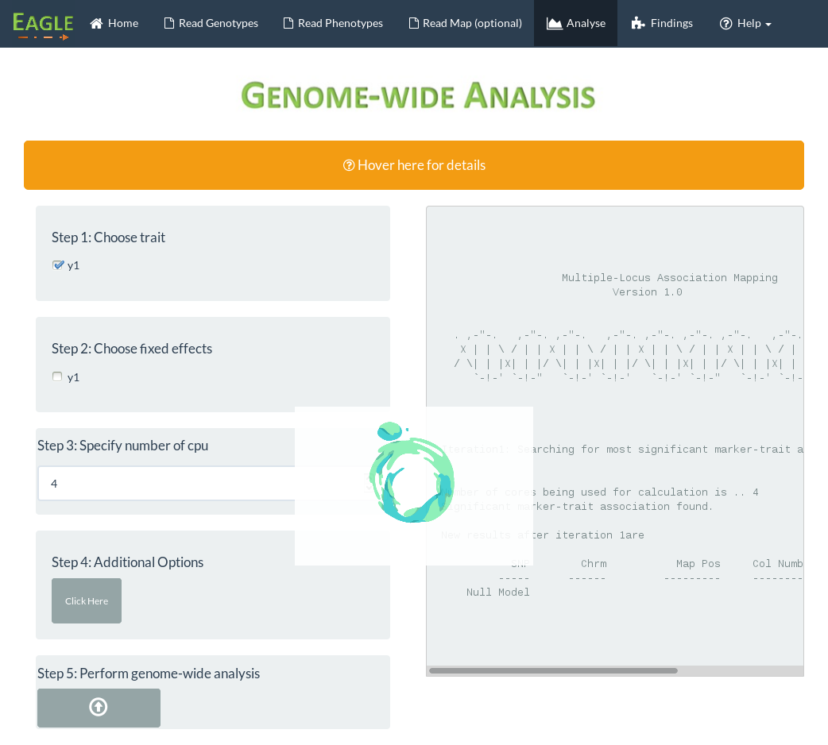
Click on findings
once analysis is
complete
Output from analysis appears here
Selected “y1” to
be the trait
Nothing selected
as model has no
fixed effects
Processing
animation
Set number of
cpu to 4
Click button to
start analysis

